Slide 1


Name of Project
🌍 Natural Disaster Prediction & Early Warning System

Slide 2

Learning Objectives
- To analyze earthquake dataset (NEIC, Kaggle)
- To apply Machine Learning models for earthquake magnitude prediction
- To evaluate models using regression metrics (MSE, MAE, RMSE, R²)
- To build an Early Warning prediction pipeline
- To demonstrate deployment using Streamlit
GOAL
To develop an AI/ML-based system that predicts earthquake magnitudes using historical seismic data and provides insights for disaster preparedness.
GOAL
Source :
www.freepik.com/

Slide 3
Tools and Technology used
Programming Language: Python
Libraries:
Pandas (data cleaning & preprocessing)
NumPy (numerical computations)
Matplotlib & Seaborn (data visualization)
Scikit-learn (ML models – Linear Regression, Random Forest, Gradient Boosting, model evaluation, GridSearchCV/RandomizedSearchCV for tuning)
Dataset Source: Kaggle (Earthquake dataset)
Environment: Jupyter Notebook / Google Colab
(For major project extension): Streamlit (interactive dashboard deployment)

Slide 4
Methodology
1. Data Collection from Kaggle (Earthquake dataset ≥ 5.5 magnitude)
2. Data Preprocessing (handling missing values with imputation)
3. Feature Selection (location, depth, magnitude, source)
4. Model Selection (Linear Regression, Random Forest, Gradient Boosting)
5. Model Training & Evaluation using MSE, MAE, RMSE, R²
6. Deployment of best model using Streamlit

Slide 5
Problem Statement:
Earthquakes are unpredictable natural disasters that cause severe destruction. There is a need for a data-driven system that can analyze historical seismic data and predict earthquake magnitude for early preparedness.

Slide 6
Solution:
The system uses Machine Learning algorithms (Linear Regression, Random Forest, Gradient Boosting) to predict earthquake magnitudes. The Streamlit app allows users to upload datasets, view model performance, and select the best predictive model.
GitHub Repositry Link :
https://github.com/LM1264/Natural_Disaster_Prediction_And_Early_Warning_System.git

Slide 7
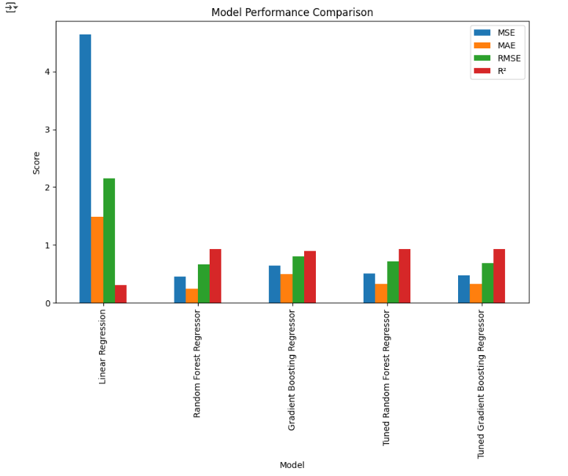
Screenshot of Output:
Screenshots include dataset preview, model performance comparison table, and Streamlit dashboard with R² chart.

Slide 8
Conclusion:
The project successfully demonstrates the application of AI/ML in climate risk and disaster management. Among the Linear Regression model, ensemble methods like Random Forest Regressor and Gradient Boosting Regressor showed better predictive performance. The deployment using Streamlit enables an interactive way for real-time earthquake prediction and early warning system.

