Slide 1
DEPLOYMENT WALKTHROUGH
LMCache on CXL Memory
How the KV cache is placed in CXL memory, grown while serving, and shared between two servers. Shown step by step.
The basics
Deployment, step by step
Measured on this rig
Operating it
Upstream
LMCache multiprocess mode · dev branch · October 2026

Slide 2
AGENDA
Today
The basics
Deployment, step by step
Measured on this rig
Why KV reuse matters. CXL memory, Device-DAX, MP mode, and the L1 and L2 tiers.
One server, the Device-DAX L1, hot-plug, the DAX L2, then two servers on one shared L1.
TTFT by cache setup, CXL against the local SSD, bandwidth over time.
Operating it
Upstream
No typing today
Failure handling, NUMA placement, /status and /metrics, common errors.
What has been merged, what is open, where the numbers come from.
Every step is shown as an animation. Scripts and raw results are in the materials folder for later.
Builds are advanced with the arrow key. Each deployment slide adds one element at a time.
LMCache on CXL · Deployment walkthrough
2

Slide 3
CHAPTER 1
The basics
Memory on a link, the Linux door, and the two processes that use it.
LMCache on CXL · Deployment walkthrough
3

Slide 4
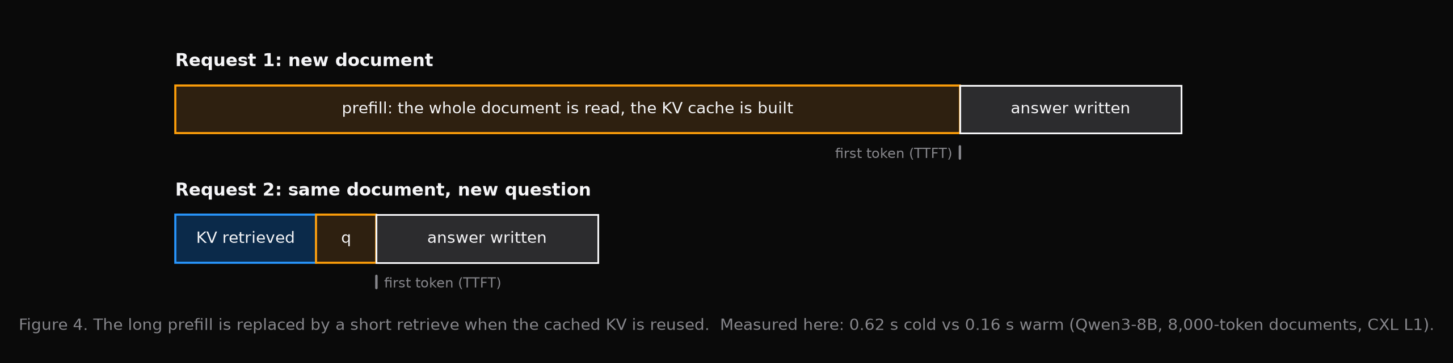
THE BASICS
One document, two questions
KV cache: what is kept in memory by the model about text it has read
TTFT: time to first token. For long text, mostly prefill time.
Today’s question: is time saved when the cached KV is retrieved instead of prefilled again?
LMCache on CXL · Deployment walkthrough
4

Slide 5
THE BASICS
Why the cache is outgrown
bytes/token = 2 × layers × kv_heads × head_dim × dtype_bytes
Bigger model, longer text, more users: more bytes.
GPU
the busy work
DRAM
recent text
disk or network
everything older
With CXL, more memory is added than the DRAM slots allow. It is used like memory, not like a disk. It can be shared by two servers.
Today: a Device-DAX L1, then a DAX L2, then a shared L1, built step by step.
LMCache on CXL · Deployment walkthrough
5

Slide 6
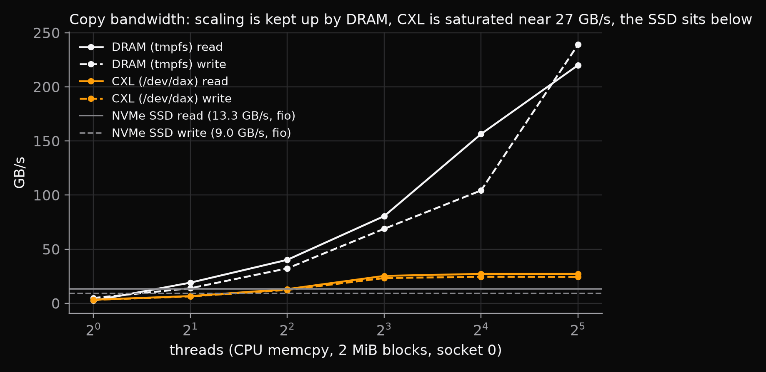
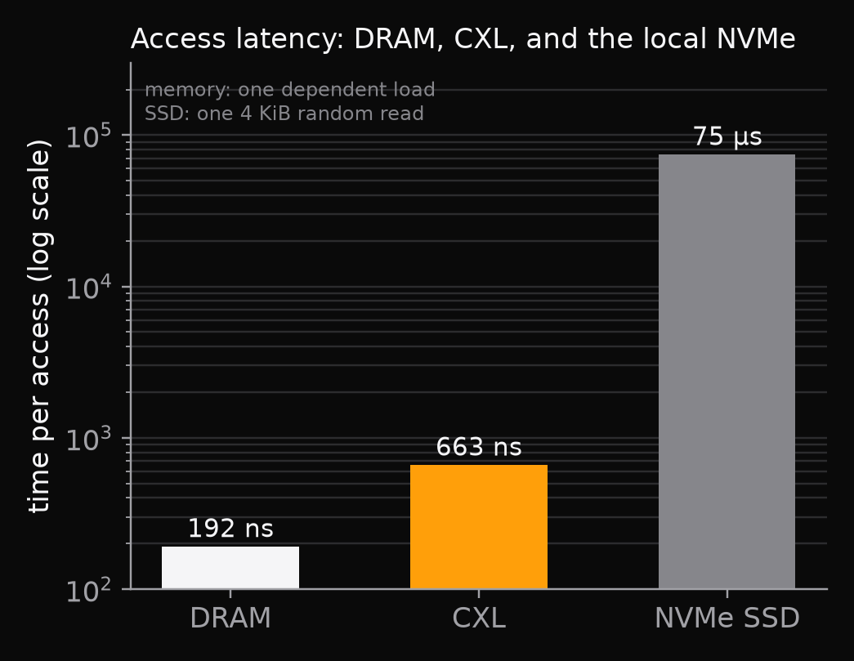
THE BASICS
DRAM, CXL and the local SSD
LMCache on CXL · Deployment walkthrough
6

Slide 7
THE BASICS
Four things
Word | What is meant here
CXL(protocol) memory | Extra memory that is connected over a CXL link instead of a DRAM slot.
Device-DAX, devdax | A Linux device file. That memory can be taken by one process and used directly.
MP mode | LMCache is run as its own process, next to the inference engine. Even on one server.
L1 and L2 | LMCache’s tiers. The GPU is served by an L1 tier. An L2 adapter is the bigger store behind it.
Next: the link, the Linux door, the two processes, then the tiers.
LMCache on CXL · Deployment walkthrough
7

Slide 8
THE BASICS
Memory on a link
Server A
DRAM
Fixed at boot. Belongs to this socket.
Server B
1 TiB on this socket
same switch
The same memory is seen.
CPU
CXL port
CXL switch
CXL memory device
socket 0
where the link begins
shared by servers
5 TiB of DRAM
Reads and writes are sent to both.
Same reads and writes, over the link.
One device. Many servers.
Big. Used like memory. Slower than DRAM.
By the CPU it is seen as just more memory. The question is by whom it may be used.
LMCache on CXL · Deployment walkthrough
8

Slide 9
THE BASICS
Two ways in CXL memory.
Door 1 · system-ram
system-ram
NUMA node 2
taken in by Linux
memory for everyone
This memory is handed out by Linux like any other. The exact bytes cannot be picked.
CXL memory device
one block of memory
Door 2 is taken by LMCache.
Door 2 · devdax
devdax
mmap
/dev/dax0.0
mapped by LMCache
The memory is given only to the program that opens the device. It is connected by Linux, which then steps aside.
LMCache on CXL · Deployment walkthrough
9

Slide 10
THE BASICS
Why devdax was chosen
system-ram
devdax
By whom the bytes are picked
By whom the bytes are picked
By Linux. The memory node can be picked, not the bytes.
By the LMCache server. This device, this offset.
By whom else it can be used
By whom else it can be used
By everyone. That is what system-ram is for.
Only by the process that opens the device.
Page size and lifetime
Page size and lifetime
Small pages, unless they are merged by Linux. With pinned pages the node is locked in.
Big pages, pinned once. Memory can be added or removed while running.
Two servers, one switch
Two servers, one switch
The same memory is believed free by two Linux kernels. Data is corrupted.
The same offset is the same bytes on both servers.
LMCache on CXL · Deployment walkthrough
10

Slide 11
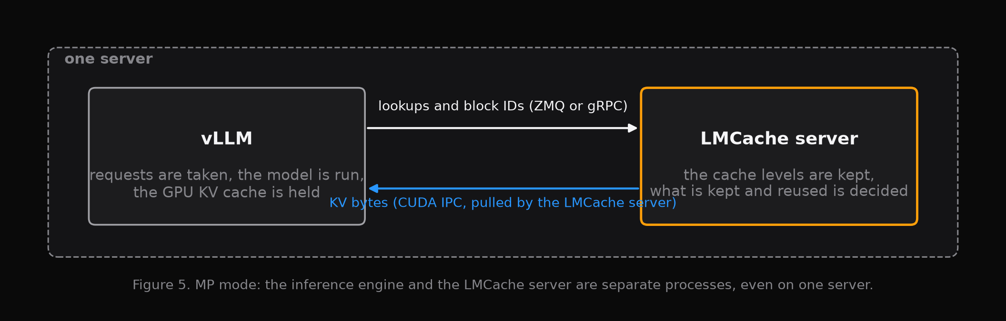
THE BASICS
MP mode: two processes
✓
The inference engine is kept simple
✓
The cache is kept alive if the engine is restarted
A second server? Not until step 7
LMCache on CXL · Deployment walkthrough
11

Slide 12
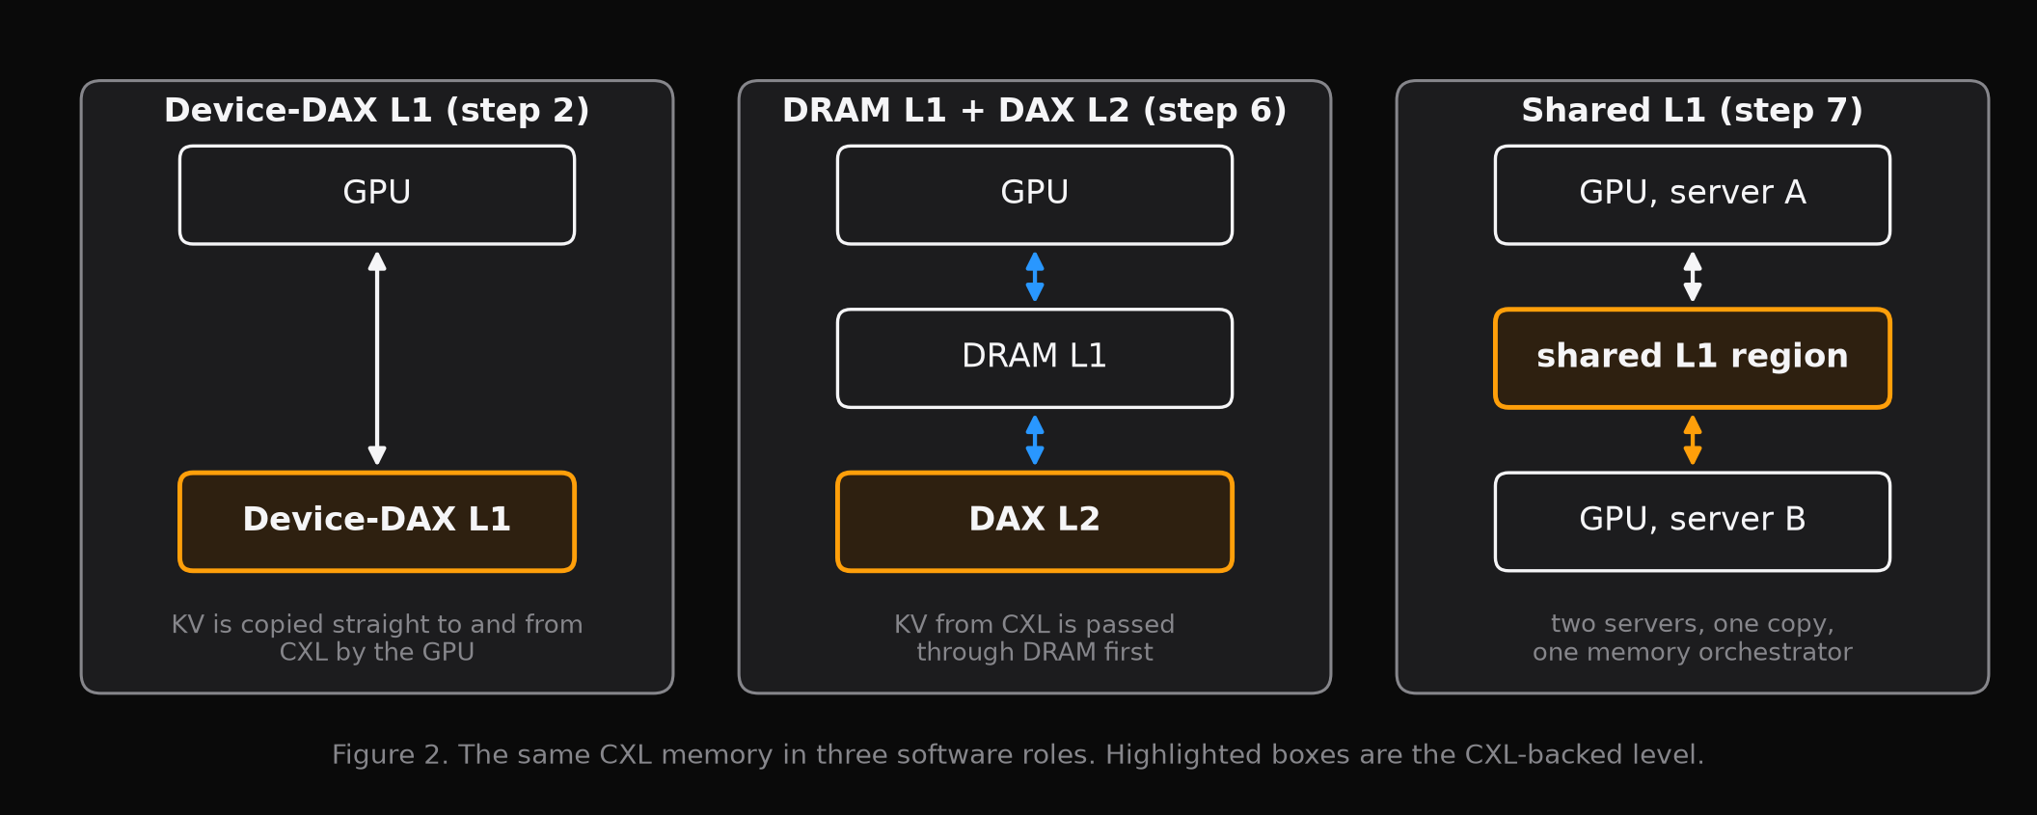
THE BASICS
Same hardware, three jobs
These three are built in the deployment chapter, in that order: steps 2, 6 and 7. The flags are shown on the next slide.
LMCache on CXL · Deployment walkthrough
12

Slide 13
THE BASICS
Three ways it can be set up
 | Device-DAX L1 | DRAM L1 + DAX L2 | Shared L1 (Upstream soon)
Flags | --l1-manager, type DEVDAX | --l2-adapter, type dax | a shared region, plus lmcache memory
Data path | Copied to CXL by the GPU directly | Copied into fixed slots by the CPU | Copied by the GPU, with visibility fences
Scope | One server | One server | Many servers
While running | Added, drained | Added, resized, removed | Fixed. Reset when stopped.
LMCache on CXL · Deployment walkthrough
13

Slide 14
THE BASICS
Where CXL is plugged in
Coordinator
who is in the group, what is cached, how full
lmcache server
vLLM
L1
DRAM
DEVDAX · CXL
GDS
KV is sent to the cache
L2
dax · CXL
fs
nixl
s3 …
Memory orchestrator
the shared L1 region is owned here
CXL is found three times: as an L1, as an L2, and as the shared L1 region.
LMCache on CXL · Deployment walkthrough
14

Slide 15
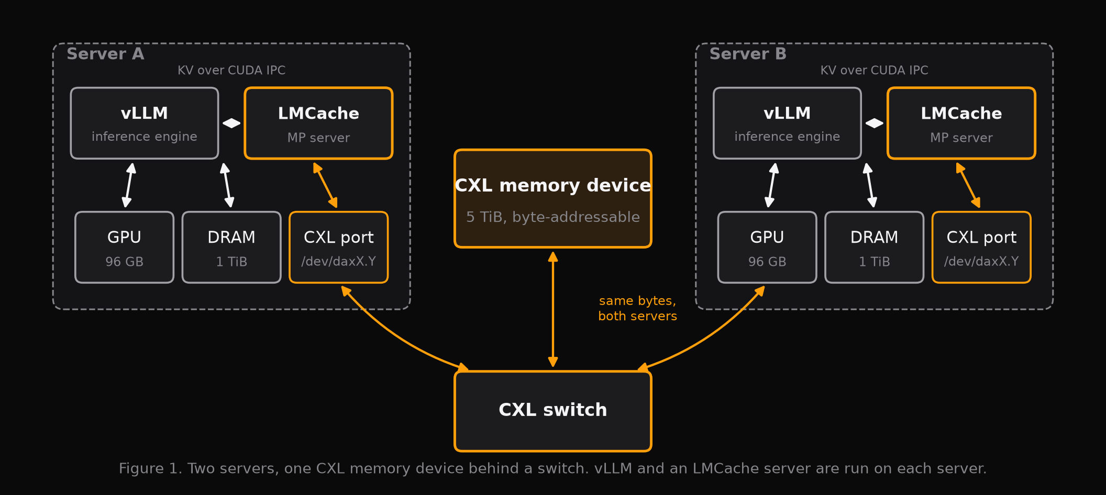
THE BASICS
The machines
2 sockets · 8 GPUs with 96 GB · 2 TiB DRAM per server
2 × 5 TiB CXL memory, one device per socket, seen by both servers
LMCache on CXL · Deployment walkthrough
15

Slide 16
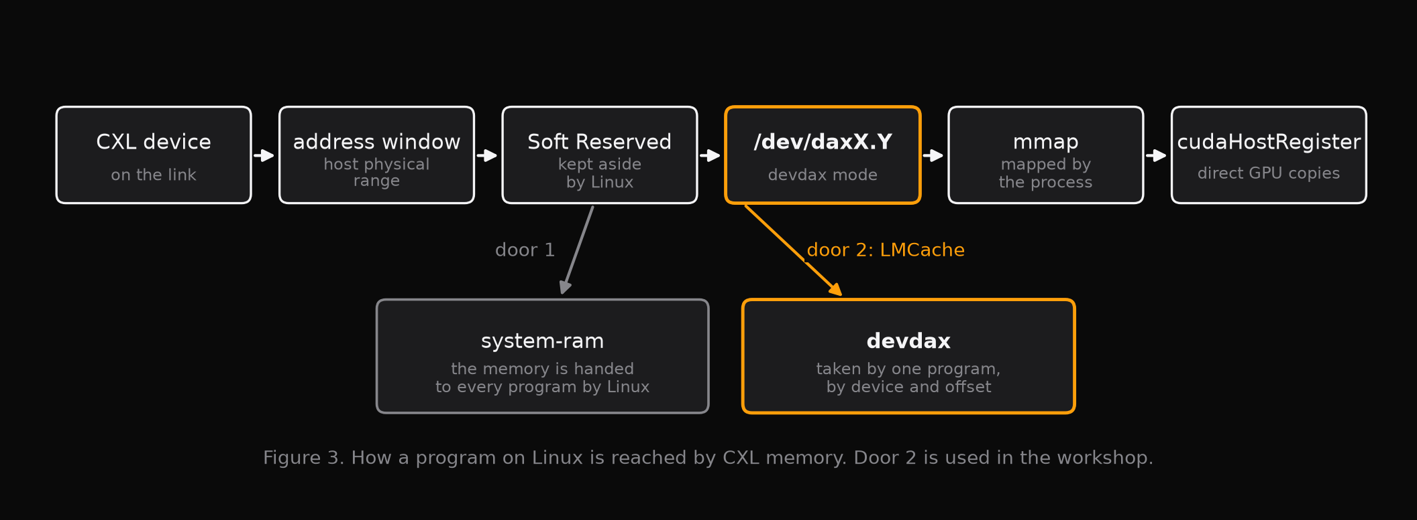
THE BASICS
From the device to /dev/dax
Mapped at the device’s alignment: 2 MiB on this machine
Data is kept after the server exits. No index, nothing after power loss.
This memory is kept out of Linux’s general pool by devdax
!
LMCache on CXL · Deployment walkthrough
16

Slide 17
THE BASICS
Five steps from device to GPU
Opened
Mapped
Page tables
CUDA is told
Copied
/dev/dax0.0
mapped into the process
pointed at the device
cudaHostRegister, once
GPU to CXL, directly
Size, alignment and socket are in sysfs.
The offset is picked by the LMCache server. The same offset can be picked on server B.
No extra copies are kept by Linux, and it is never swapped out.
Pinned once. It is never moved while the program runs.
One copy per chunk. CPU copies are used only for the DAX L2 slots.
Through system-ram
Through devdax
Memory chosen by Linux is given. Small pages unless they are merged by Linux. It can be moved, or lent to others.
A fixed block at a known spot on a known socket is given, pinned once. The same bytes can be named by two servers.
LMCache on CXL · Deployment walkthrough
17

Slide 18
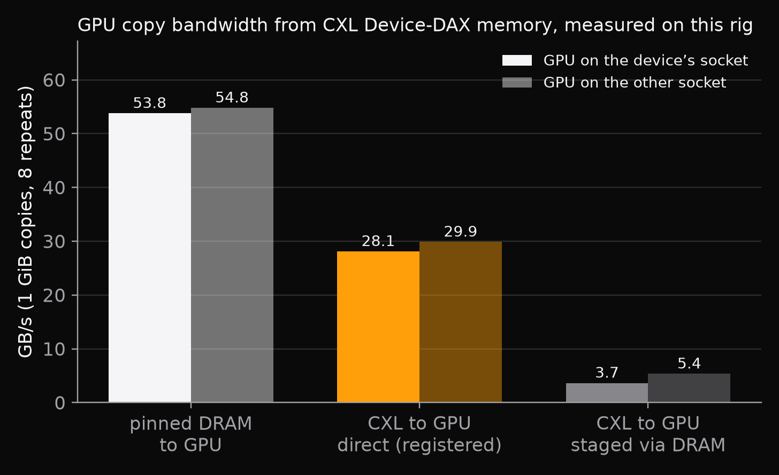
THE BASICS
Is it seen by the GPU?
✓
The mapping is registered once with cudaHostRegister
Then the GPU copies to and from the device directly
Direct is 8× faster than the two-copy fallback here
Measured with the workshop probe: eight 1 GiB copies. The Device-DAX L1 does this registration at startup.
LMCache on CXL · Deployment walkthrough
18

Slide 19
CHAPTER 2
Deployment, step by step
One server. The Device-DAX L1. Hot-plug. The DAX L2. Then two servers on one shared L1.
LMCache on CXL · Deployment walkthrough
19

Slide 20
DEPLOYMENT, STEP BY STEP
One server, two processes
Server A
vLLM
lookups, block IDs
LMCache server
inference engine
MP mode: its own process
GPU
the KV cache of running requests
KV bytes over CUDA IPC
The engine is kept simple. The cache is run as its own process, and it survives an engine restart.
LMCache on CXL · Deployment walkthrough
20

Slide 21
DEPLOYMENT, STEP BY STEP
The Device-DAX L1
Server A
vLLM
lookups, block IDs
LMCache server
CXL device
inference engine
MP mode: its own process
/dev/dax0.0 · mapped, registered with CUDA
L1 manager · DEVDAX
GPU
the KV cache of running requests
KV bytes over CUDA IPC
direct copies between the GPU and the device · 22 GB/s measured here
The L1 is placed in CXL memory. Registered once with CUDA, the device is copied to and from by the GPU directly.
LMCache on CXL · Deployment walkthrough
21

Slide 22
DEPLOYMENT, STEP BY STEP
The first request
Request 1 · a long document and a question
Server A
vLLM
lookups, block IDs
LMCache server
CXL device
inference engine
MP mode: its own process
/dev/dax0.0 · mapped, registered with CUDA
L1 manager · DEVDAX
GPU
the KV cache of running requests
256-token chunks
prefill · 8,000 tokens
KV bytes over CUDA IPC
The document is prefilled on the GPU. Its KV is stored into the L1 in the background, chunk by chunk.
LMCache on CXL · Deployment walkthrough
22

Slide 23
DEPLOYMENT, STEP BY STEP
The second request
Request 2 · the same document, a new question
TTFT 0.62 s → 0.16 s, measured on this rig
Server A
vLLM
lookup · hit, 15 chunks
LMCache server
CXL device
inference engine
MP mode: its own process
/dev/dax0.0 · mapped, registered with CUDA
L1 manager · DEVDAX
GPU
the KV cache of running requests
KV bytes over CUDA IPC
retrieve · direct copies into the GPU
Only the question is prefilled. The document’s KV is retrieved from CXL.
LMCache on CXL · Deployment walkthrough
23

Slide 24
DEPLOYMENT, STEP BY STEP
Hot-plug
Server A
vLLM
lookups, block IDs
LMCache server
MP mode: its own process
CXL device
inference engine
/dev/dax0.0
L1 manager · DEVDAX
A second device
GPU
the KV cache of running requests
/dev/dax0.1 · added
KV bytes over CUDA IPC
active
draining
removed
Capacity is added and drained while serving. Reads are still served while a device drains. No restart.
LMCache on CXL · Deployment walkthrough
24

Slide 25
DEPLOYMENT, STEP BY STEP
DRAM in front, CXL behind
Server A
vLLM
lookups, block IDs
LMCache server
CXL device
inference engine
MP mode: its own process
DAX L2 · fixed slots of 36 MiB
L1 manager · DRAM
store
GPU
L2 adapter · dax
the KV cache of running requests
KV bytes over CUDA IPC
load
Hot data stays in the DRAM L1. CXL becomes the bigger L2 behind it: stores are CPU copies into slots, loads are prefetched back.
LMCache on CXL · Deployment walkthrough
25

Slide 26
DEPLOYMENT, STEP BY STEP
Two jobs: ownership and visibility
Ownership: the memory orchestrator
Visibility: the fences
Where is a chunk kept? By whom may it be written? When may it be read by the other server? These are answered by one process, with small messages.
An old copy of the same memory may still be held by server B in its CPU cache. The new data is made visible by a publish fence on A and an acquire fence on B.
A chunk is written by A. It is held in A’s CPU cache.
A read is made by B. The old data is still held in its own cache: stale.
A publish fence on A: CLFLUSHOPT, then SFENCE. The memory is reached by the data.
An acquire fence on B, then a read: fresh data.
Ownership is covered on the next two slides. The exact fence steps come after.
LMCache on CXL · Deployment walkthrough
26

Slide 27
DEPLOYMENT, STEP BY STEP
A second server
memory orchestrator
Server A
Server B
vLLM
LMCache server
vLLM
LMCache server
inference engine
inference engine
shared L1 · DEVDAX
shared L1 · DEVDAX
DRAM L1 · spill
DRAM L1 · spill
GPU
GPU
Shared L1 region
the same bytes on both servers: /dev/dax0.0 on A, /dev/dax4.0 on B
One region is mapped by both servers. One orchestrator keeps the bookkeeping. The KV bytes never pass through it.
LMCache on CXL · Deployment walkthrough
27

Slide 28
DEPLOYMENT, STEP BY STEP
Stored on A, retrieved on B
1 · space for a chunk is asked for
memory orchestrator
5 · lookup: is the chunk held?
2 · an offset and a write token come back
6 · an offset and a read lease come back
Server A
Server B
vLLM
LMCache server
vLLM
LMCache server
inference engine
inference engine
shared L1 · DEVDAX
shared L1 · DEVDAX
DRAM L1 · spill
DRAM L1 · spill
GPU
GPU
3 · D2H copy, then publish fence
7 · acquire fence, then H2D copy
Shared L1 region
4 · committed
the same bytes on both servers: /dev/dax0.0 on A, /dev/dax4.0 on B
8 · lease released
Eight small messages. The bytes are moved only once, through the shared region.
LMCache on CXL · Deployment walkthrough
28

Slide 29
DEPLOYMENT, STEP BY STEP
Why every copy is fenced
The two servers’ CPU caches are not kept in sync by the CXL switch in this workshop, so it is done by software fences (software_fenced). With newer CXL (3.0) it can be done in hardware: the setup at hand should be checked before this design is copied.
Writer
GPU copy done
publish fence: CLFLUSHOPT, SFENCE
marked ready
Reader
a read is asked for
acquire fence on the range
copied to the GPU
!
coherent mode: only for one server, or hardware by which caches are kept in sync
✓
Chunks are 2 MiB aligned, so a cache line is never shared by two writers
LMCache on CXL · Deployment walkthrough
29

