Slide 1

Workshop
Lahiru Madushan

Slide 2

About Me
01

Slide 3

Prerequisites
VS Code
Node.js
Python
Windows Subsystem for Linux (WSL)
Code file
https://github.com/LMJayasundara/Workshop
AWS account (Optional)
02

Slide 4
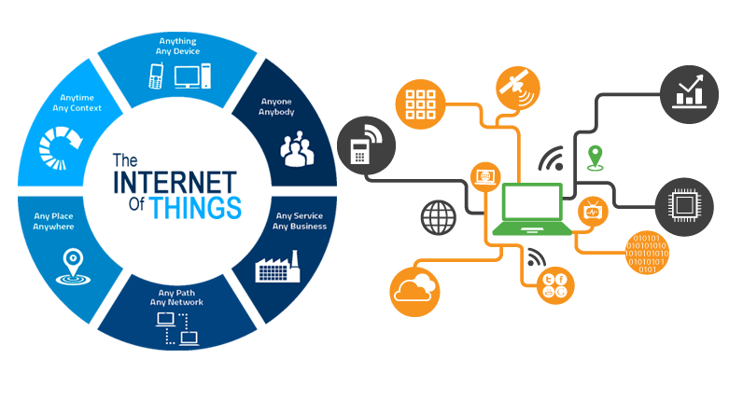
Introduction to IoT
03

Slide 5

What is IoT?
Internet of Things is a system of physical objects connected over the Internet. It collects and transfers data to get the necessary work done without manual touch.
04

Slide 6
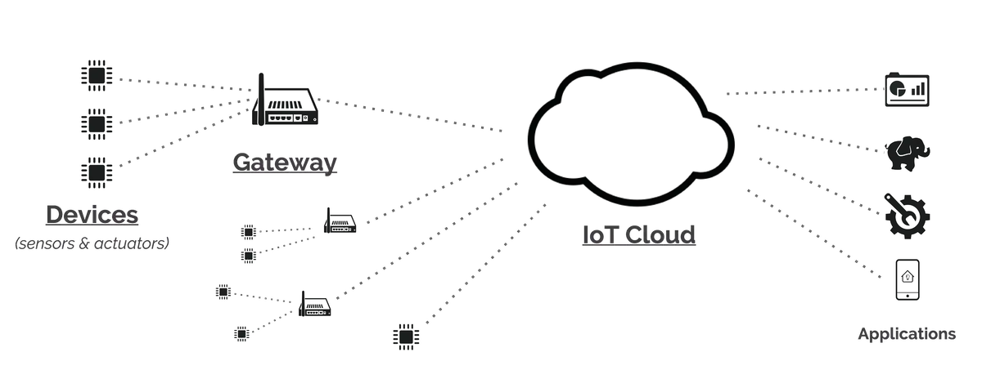
How IoT works?
05
Notes:
Sensors/Devices: Sensors or devices are a key component that helps you to collect live data from the surrounding environment.
Connectivity: All the collected data is sent to a cloud infrastructure. The sensors should be connected to the cloud using various mediums of communications. These communication mediums include mobile or satellite networks, Bluetooth, WI-FI, WAN, etc.
Data Processing: Once that data is collected, and it gets to the cloud, the software performs processing on the gathered data.
User Interface: The information needs to be available to the end-user in some way which can be achieved by triggering alarms on their phones or sending them notification through email or text message. The user sometimes might need an interface which actively checks their IoT system.

Slide 7
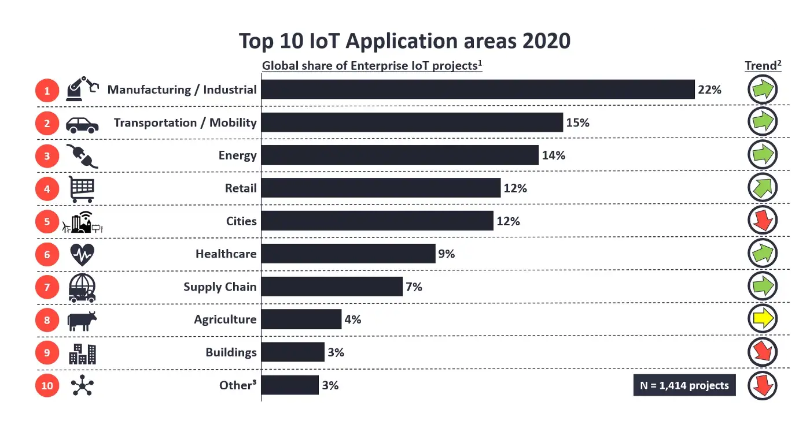
IoT Applications
06

Slide 8
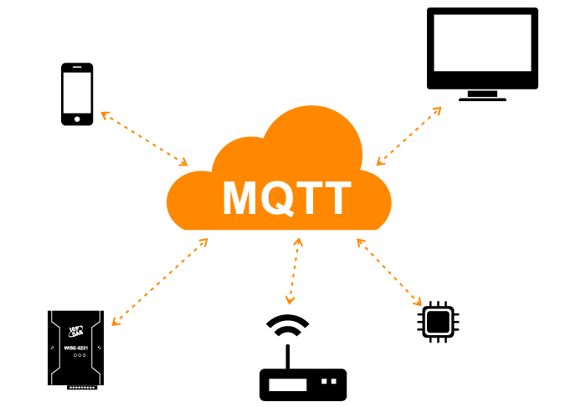
Introduction to MQTT
07

Slide 9

What is MQTT?
MQTT (Message Queuing Telemetry Transport) is a publish/subscribe messaging protocol that works on top of the TCP/IP protocol.
MQTT uses your existing Internet home network to send messages to your IoT devices and respond to those messages.
08

Slide 10
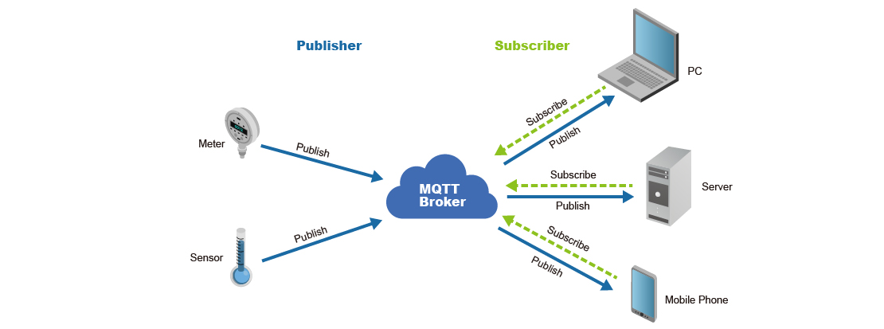
How MQTT works?
MQTT is a publish/subscribe messaging protocol. Clients will connect to the network, which can subscribe or publish to a topic. When a client publishes to a topic, the data is sent to the broker, which then is distributed to all the clients that are subscribed to that topic.
09
Notes:
Broker - The broker is the server that distributes the information to the interested clients connected to the server.
Client - The device that connects to broker to send or receive information.
Topic - The name that the message is about. Clients publish, subscribe, or do both to a topic.
Publish - Clients that send information to the broker to distribute to interested clients based on the topic name.
Subscribe - Clients tell the broker which topic(s) they’re interested in. When a client subscribes to a topic, any message published to the broker is distributed to the subscribers of that topic. Clients can also unsubscribe to stop receiving messages from the broker about that topic.
QoS - Quality of Service. Each connection can specify a quality of service to the broker with an integer value ranging from 0-2. The QoS does not affect the handling of the TCP data transmissions, only between the MQTT clients. Note: In the examples later on, we’ll only be using QoS 0.
0 specifies at most once, or once and only once without requiring an acknowledgment of delivery. This is often referred to as fire and forget.
1 specifies at least once. The message is sent multiple times until an acknowledgment is received, known otherwise as acknowledged delivery.
2 specifies exactly once. The sender and receiver clients use a two level handshake to ensure only one copy of the message is received, known as assured delivery.

Slide 11

Example Project – Windows environment
Setup MQTT broker in Windows and test with the command line interface.
10

Slide 12
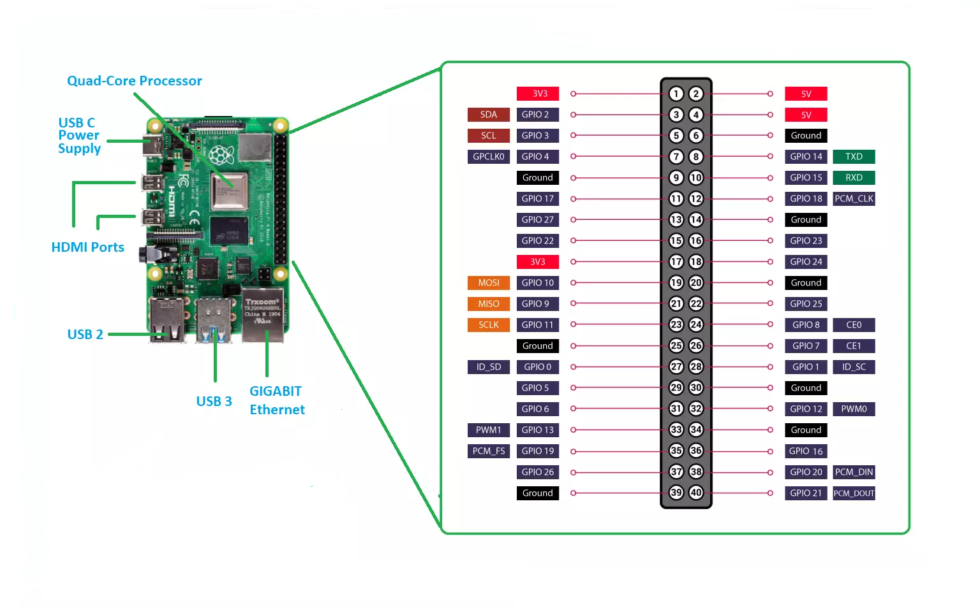

Introduction to the Raspberry Pi & WSL
11
Notes:
Raspberry Pi is a original credit-card sized computer.
Versions Introduce about Raspberry Pi versions
WSL Windows Subsystem for Linux

Slide 13
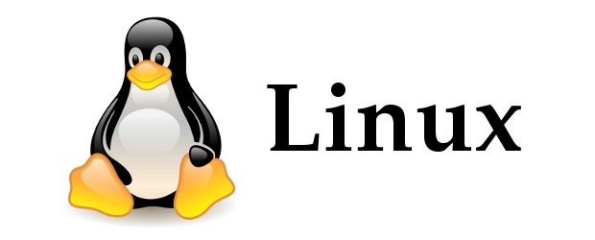
Introduction to the Linux Environment
LINUX is an operating system or a kernel distributed under an open-source license.
Being open-source, anyone with programming knowledge can modify it.
Once you have Linux installed you no longer need an antivirus! Linux is a highly secure system.
It is easy to learn.
12

Slide 14
Example Project – Linux environment
Setup MQTT broker in Linux and test with the terminal commands.
13

Slide 15

Introduction about programming languages
14

Slide 16
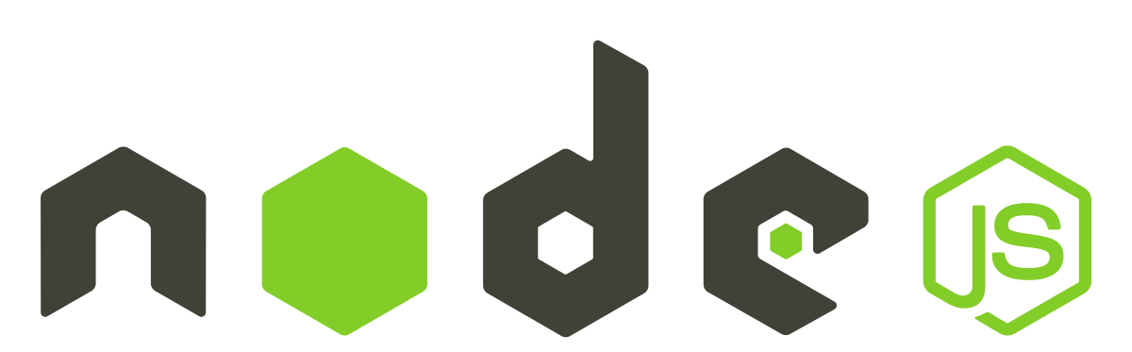
Node.js
Node.js is an open source server environment.
Node.js runs on various platforms (Windows, Linux, Unix, Mac etc.).
Node.js uses JavaScript on the server.
Node.js uses asynchronous programming!
Node.js eliminates the waiting, and simply continues with the next request.
Node.js runs single-threaded, non-blocking, asynchronous programming, which is very memory efficient.
15

Slide 17

Python
Python is a popular programming language
Python works on different platforms (Windows, Mac, Linux, etc).
Python has a simple syntax similar to the English language.
Python can be used to handle big data and perform complex mathematics.
Python relies on indentation, using whitespace, to define scope; such as the scope of loops, functions and classes. Other programming languages often use curly-brackets for this purpose.
16

Slide 18
Example Project – Node.js, Python with Windows and Linux environment
Setup MQTT broker in Windows/Linux and test with the programming languages.
17

Slide 19
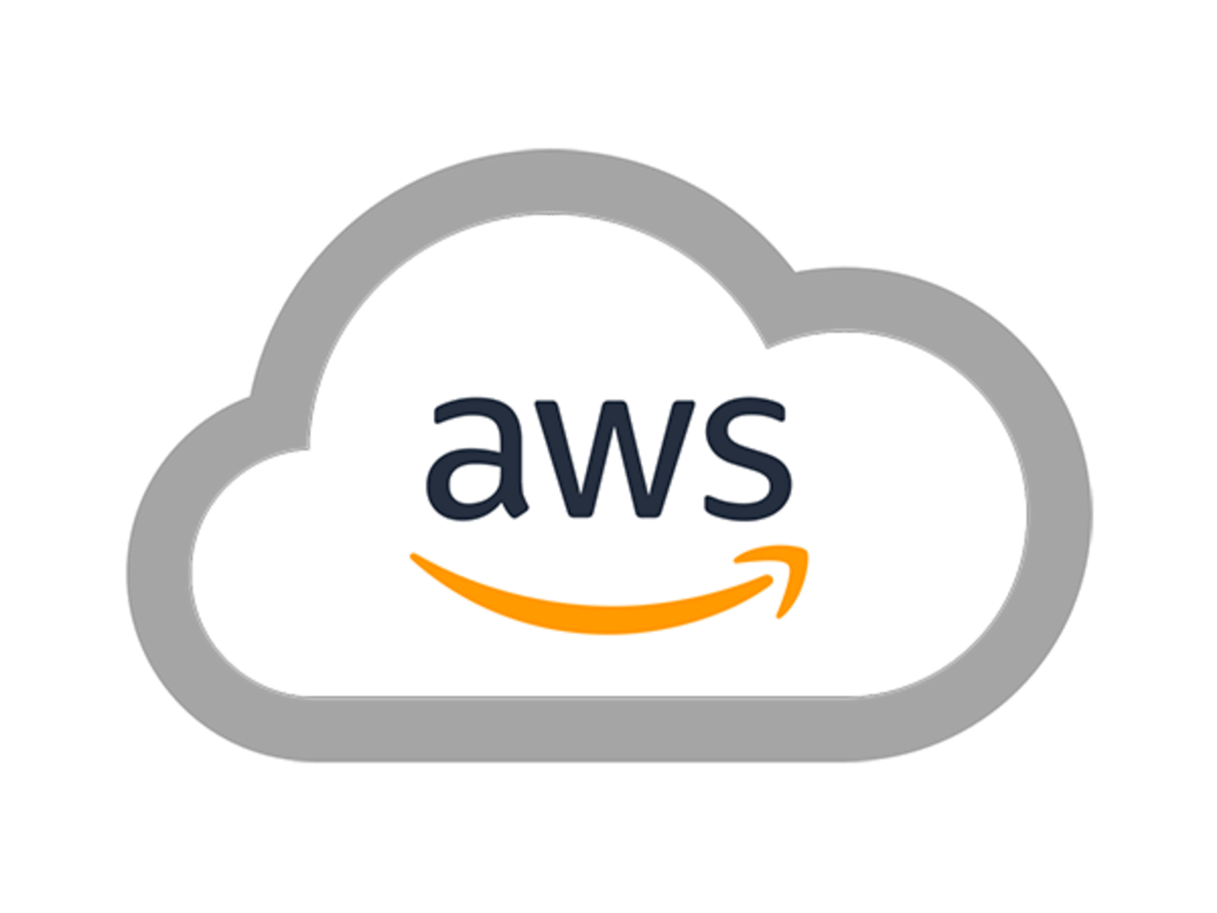
Introduction to AWS
18

Slide 20

AWS (The Amazon Web Services)
Amazon web service is an online platform that provides scalable and cost-effective cloud computing solutions.
AWS is a broadly adopted cloud platform that offers several on-demand operations like compute power, database storage, content delivery, etc., to help corporates scale and grow.
19

Slide 21
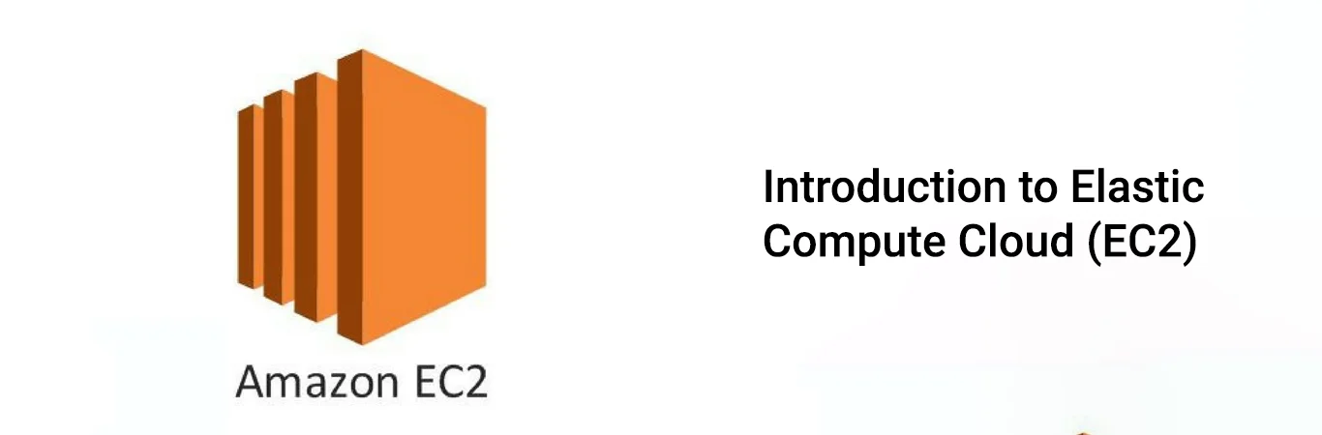
Amazon EC2
Virtual computing environments, known as instances.
02
20

Slide 22

Let’s Combine All
21

Slide 23

22

Slide 24

Feel free to contact me!
Lahiru Madushan
jmlahirujayasundara@gmail.com
https://www.linkedin.com/in/lahirujayasundara
070 448 66 77
23

