Slide 1
Transformer encoder architecture
--- BERT ---

Slide 2
Keywords
NLP: Natural Language Processing
Embedding: word to numerical structure
Word2vec = fixed embedding; same word = same embedding
BERT = contextualized meaning, embedding for whole sentence

Slide 3
BiderectionalEncoderRepresentationsfromTransformers
Tensorflow hub: https://www.tensorflow.org/hub; repository of trained machine learning models
Training: next sentence prediction, mased language model (Lückentext)
https://jalammar.github.io/illustrated-bert/, https://www.youtube.com/watch?v=7kLi8u2dJz0

Slide 4
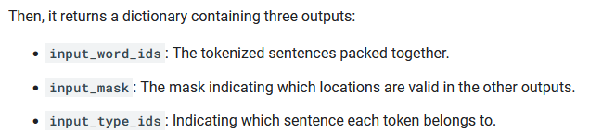
BERT Preprocessor
Size(input_mask) = 128. Ist größer als längster Satz (aufpassen)!!!

Slide 5
Multiple Inputs
Hausbild + hard facts → Price prediction

Slide 6
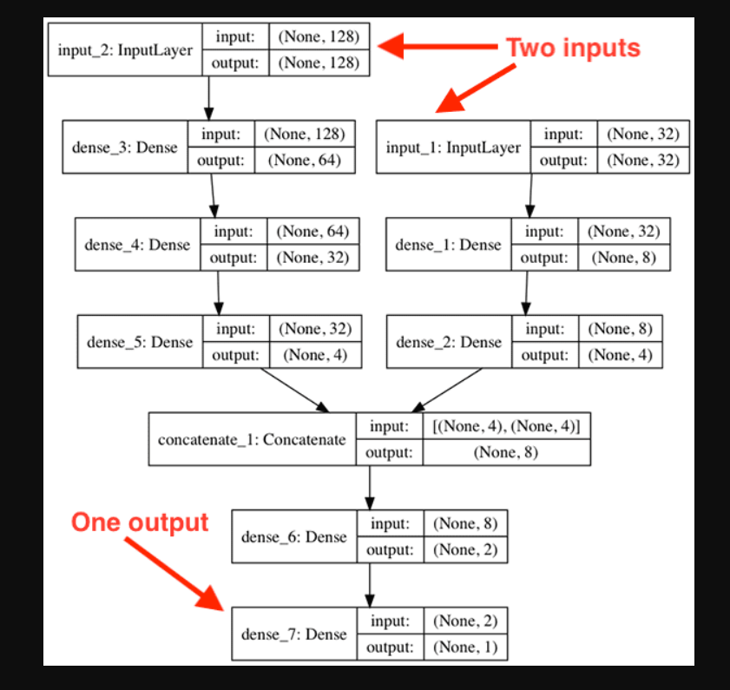
Methods

Slide 7
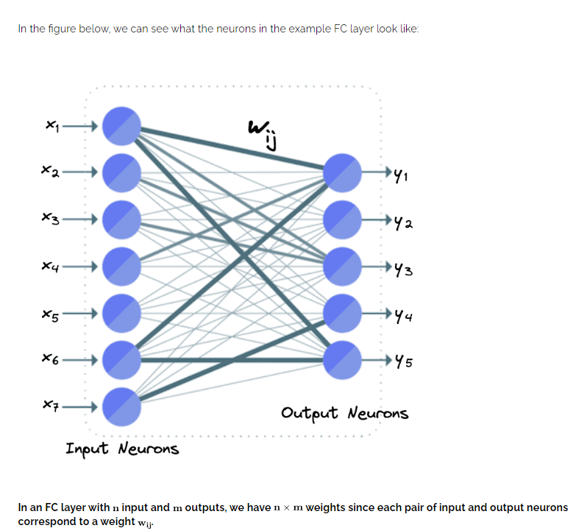
FC layer

Slide 8
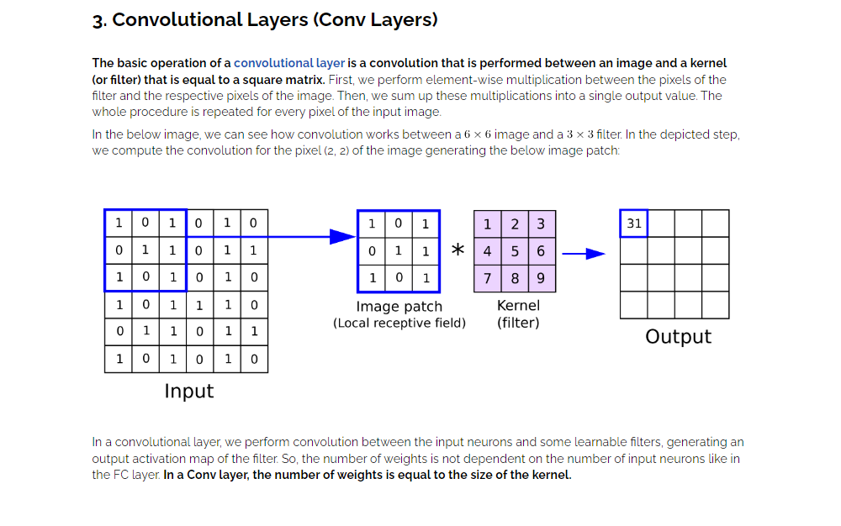
Convolutional layer (only neigboring neurons connected)

