Slide 1
Machine learning
Session 1

Slide 2
Outcomes
By the end of this session you will know:
  A basic understanding of machine learning, how to develop a machine learning model to learn.
    Setting up training/test data sets
  How to use linear regression to make predictions on continuous data (i.e. predict housing prices)
  How to use gradient descent as a broad method for fitting models.
  How to use logistic regression to conduct binary classification (i.e., predict malignant from benign tumours).
  Use Nearest Neighbour Classification for classification (i.e., predict malignant from benign tumours).
  Building ML models using python:
    including how to read and write data, if statements, for loops, functions, ‘objects’.

Slide 3
Before we begin
We will be using python and jupyter notebooks to write code for building machine learning models
Easiest way to install python is through Anaconda – a “package manager”.
Link: https://www.anaconda.com/distribution/
Simply google “anaconda python”, download the appropriate version for your computer
Can use miniconda if you want, doesn’t include pre-installed python packages and therefore less memory, otherwise is exactly the same.
Jupyter notebook comes preinstalled with anaconda, is a browser based tool to write and run code in python.

Slide 4
What is machine learning?
Machine learning boils down to a set of methods for developing a complex function which is able to describe a set of data and make new predictions based on the patterns it learned.
Machine learning models will perform better given more data.
A Model = a function; a graph which can describe a set of data.

Slide 5
Types of Machine learning
Supervised learning
Unsupervised learning
Semi-Supervised learning
Use a set of known examples (labelled data) to teach a model how to make predictions.
Examples: Linear Regression, logistic regression, support vector machines, neural networks, etc…
A set of tools to group or cluster data based upon the similarity of their features.
Examples: K-means clustering, Heirarchical clustering, principal component analysis, T-SNE
Somewhere between unsupervised and supervised learning, a small set of labelled data is used to inform on the structure of the data to facilitate learned predictions.

Slide 6
Types of Data
Machine learning models fit data to learn patterns and make predictions. What types of data can we use?
Structured data:
  Continuous variables: Real numbers where the data exists along a continuum. There is a relativistic magnitude between datapoints.
    E.g., housing prices, basketball scores, gene expression values
  Categorical variables: Data which can are separated into distinct categories. There is no relative quantitative relationship between the categories.
    E.g., weather (raining, sunshine, cloudy). Can also take the form of binary variables (e.g., a sports team won or loss the game).
  Ordinal variables: Data which is separated by distinct categories, however, there is a relative quantitative relationship between the categories.
    E.g., level of education
Unstructured data:
  Data which are not easily numerically defined.
    E.g., images, voice recordings, text

Slide 7
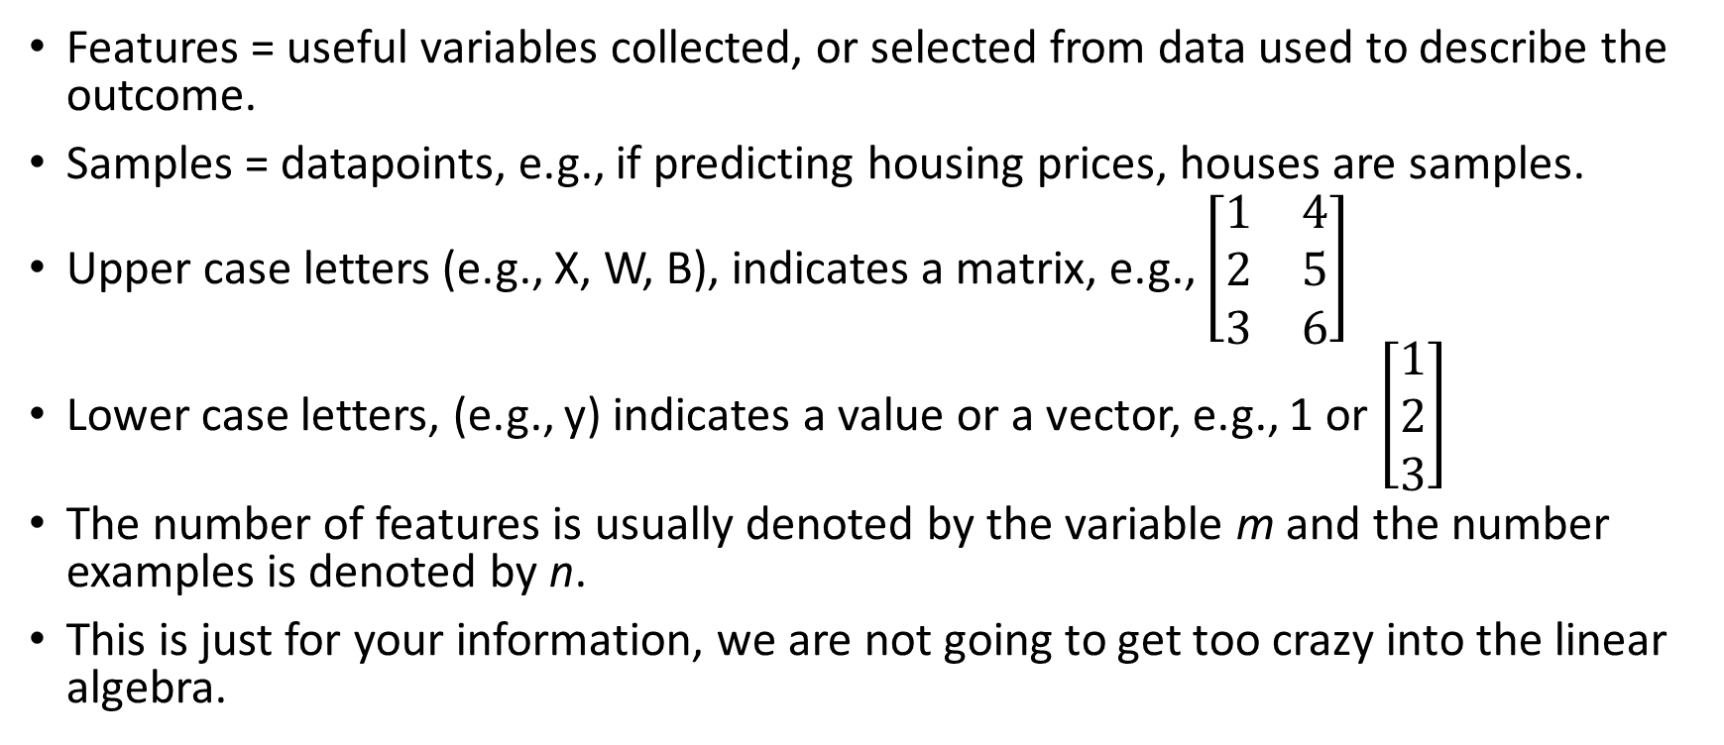
Nomenclature: Features and samples
Features = useful variables collected, or selected from data used to describe the outcome.
Samples = datapoints, e.g., if predicting housing prices, houses are samples.
Upper case letters (e.g., X, W, B), indicates a matrix, e.g., $\left[\begin{matrix}1 & 4 \\ 2 & 5 \\ 3 & 6\end{matrix}\right]$
Lower case letters, (e.g., y) indicates a value or a vector, e.g., 1 or $\left[\begin{matrix}1 \\ 2 \\ 3\end{matrix}\right]$
The number of features is usually denoted by the variable m and the number examples is denoted by n.
This is just for your information, we are not going to get too crazy into the linear algebra.

Slide 8
Two types of supervised learning: Regression, classification
Regression: Fitting a model to predict a continuous variable outcome. (e.g., housing prices, score of the basketball game)
Classification: Fitting a model to assign a sample to a group, or categorical outcome variable. (e.g., healthy vs. benign vs. malignant tumours, which team will win a game)

Slide 9
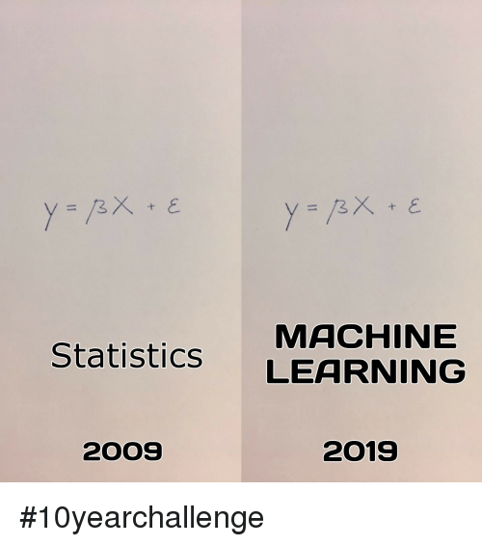
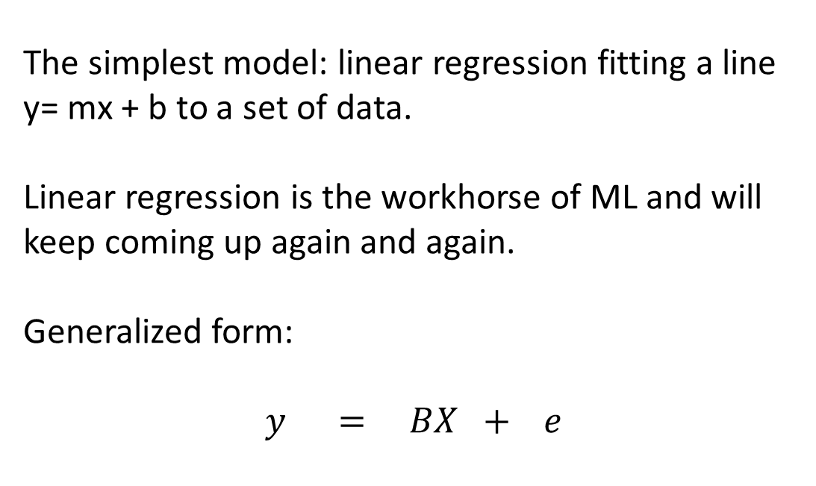
Hello Machine Learning World: Linear Regression
The simplest model: linear regression fitting a line y= mx + b to a set of data.
Linear regression is the workhorse of ML and will keep coming up again and again.
Generalized form:
$$y = BX + e$$
Feature Weights
Features
Bias term/
intercept
Outcome vector/value

Slide 10
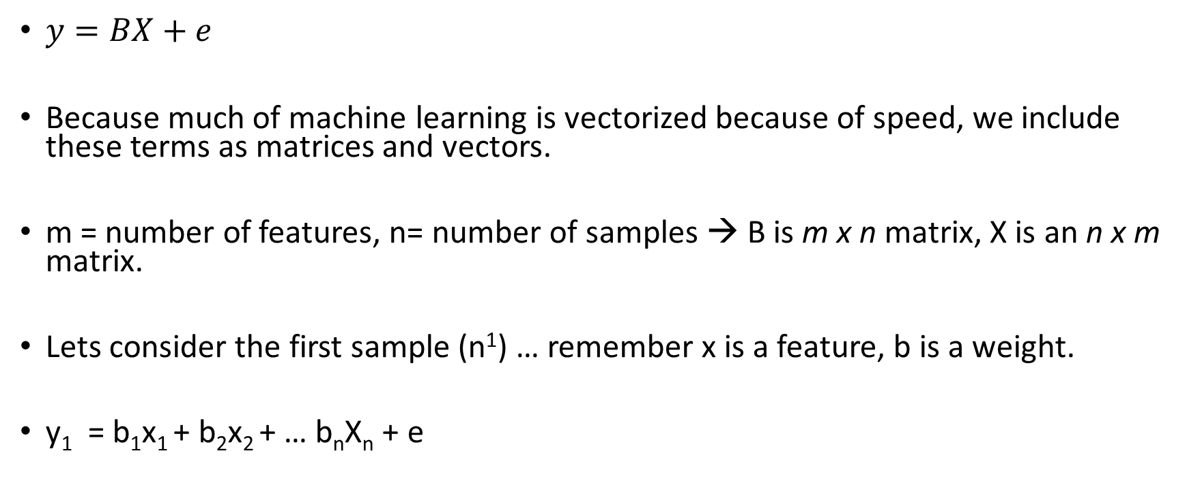
Linear Regression cont…
$y=BX+e$
Because much of machine learning is vectorized because of speed, we include these terms as matrices and vectors.
m = number of features, n= number of samples → B is m x n matrix, X is an n x m matrix.
Lets consider the first sample (n¹) … remember x is a feature, b is a weight.
y₁ = b₁x₁ + b₂x₂ + … b_{n}X_{n} + e

Slide 11

Example: housing prices
Size of house in sqr ft (x₁) | Importance of house size (weight b₁) | Number of bedrooms (x₂) | Importance of number of bedrooms (weight b₂) | Inherent value of land (bias constant) | Equation: Y = b1x1 + b2x2 + b0 | Housing price (y)
6,000 | 100 | 3 | 50,000 | 25,000 | =(6000*100)+(3*50000) + 50000 | $775,000
5,000 | 100 | 3 | 50,000 | 25,000 | =(5000*100)+(3*50000) + 50000 | $675,000
6,000 | 100 | 2 | 50,000 | 25,000 | =(6000*100)+(2*50000) + 50000 | $725,000
n samples
m
n
n
n
$$\left[\begin{matrix}100 & 100 & 100 \\ 50,000 & 50,000 & 50,000\end{matrix}\right]∗\left[\begin{matrix}6,000 & 3 \\ 5,000 & 3 \\ 6,000 & 2\end{matrix}\right] + \left[\begin{matrix}25,000 \\ 25,000 \\ 25,000\end{matrix}\right] = \left[\begin{matrix}775,000 \\ 675,000 \\ 725,000\end{matrix}\right]$$
m features
$$y=BX+e$$
B (aka B^{T} or θ^{T} )
X
e
y

Slide 12
So in this example, what do you think we need to learn?
Size of house in sqr ft (x₁) | Importance of house size (weight b₁) | Number of bedrooms (x₂) | Importance of number of bedrooms (weight b₂) | Inherent value of land (bias constant) | Equation: Y = b1x1 + b2x2 + b0 | Housing price (y)
6,000 | 100 | 3 | 50,000 | 25,000 | =(6000*100)+(3*50000) + 50000 | $775,000
5,000 | 100 | 3 | 50,000 | 25,000 | =(5000*100)+(3*50000) + 50000 | $675,000
6,000 | 100 | 2 | 50,000 | 25,000 | =(6000*100)+(2*50000) + 50000 | $725,000

Slide 13
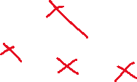
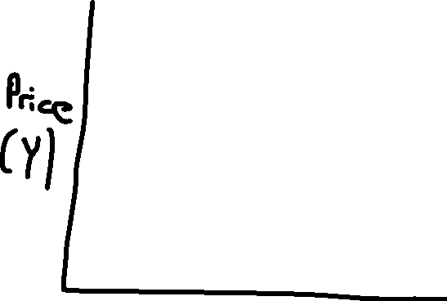





How do we learn these weights? – fitting the model
Not so good of a fit
Good fit
Please note: for visualization purposes I am only plotting 1-feature vs the output. In reality this is done using n-dimensional features

Slide 14
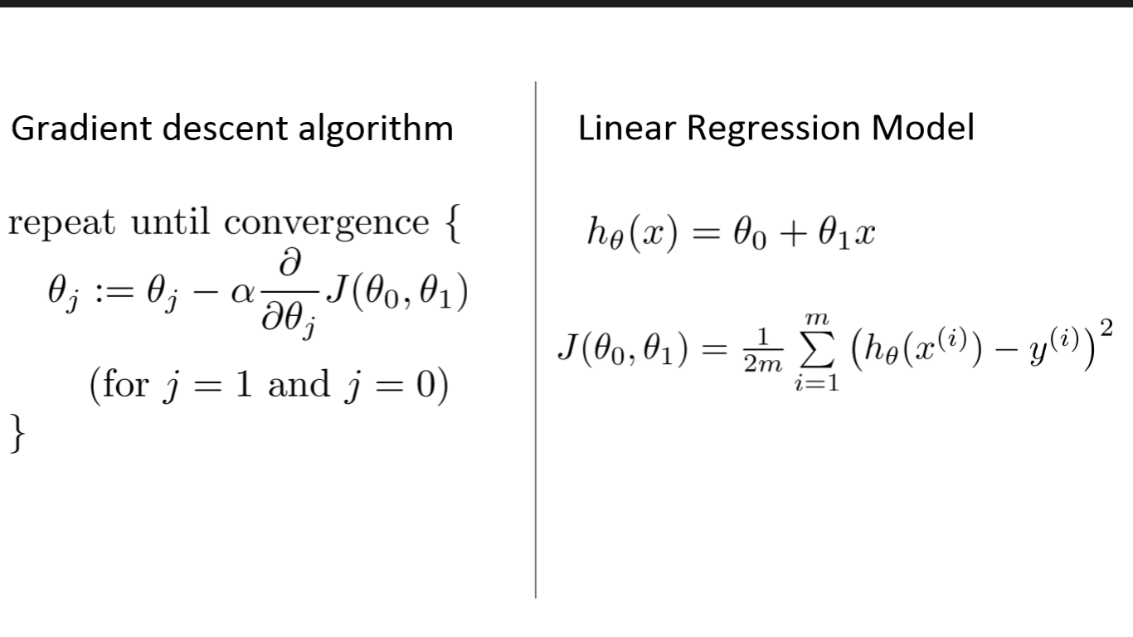


Cost functions and loss functions
Cost function: the penalty associated with 1 sample.
Loss junction [J(θ)] is the sum of cost functions over all samples.
For linear regression, the cost function is the mean squared error:

Slide 15



Sum of squared error graphically
Not so good of a fit
Good fit

Slide 16





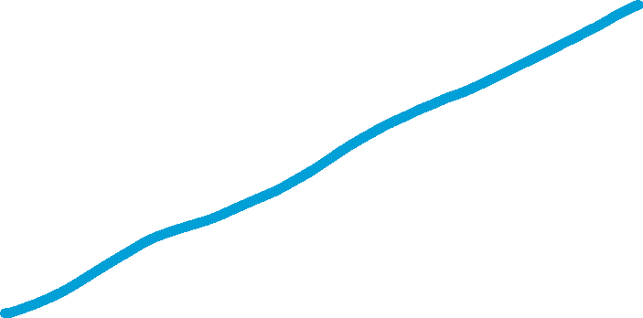
Making predictions using linear regression
Trained samples
New samples

Slide 17
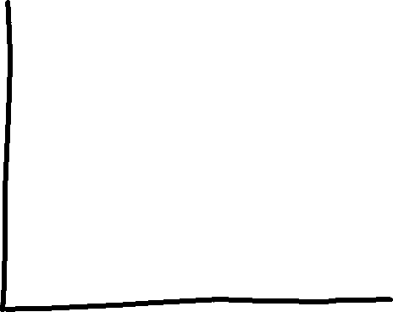
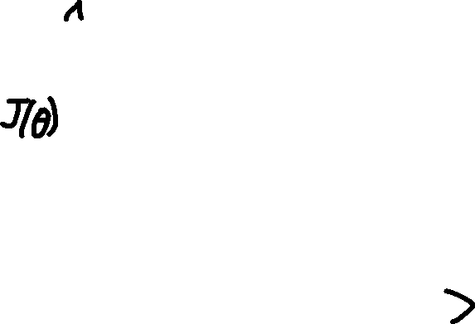
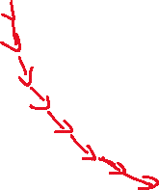





Formalizing gradient descent
Need the cost at some set of inputs (i.e., J(X)).
Need the direction of the cost (i.e., d/dx J(X)).
Need a learning rate (α), which defines how fast gradient descent is accomplished.
(loss with respect to weights)
(weights)

Slide 18
Equations for gradient descent

Slide 19




Gradient descent
(loss with respect to weights)
(weights)

Slide 20
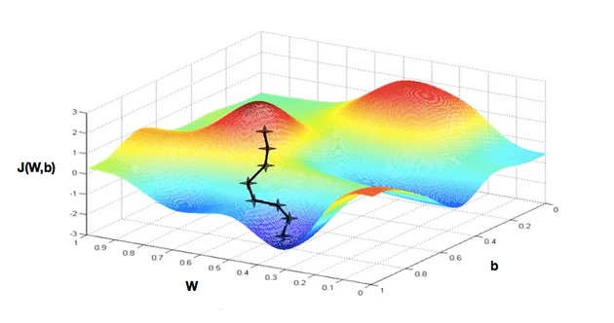
>1 dimensional gradient descent

Slide 21


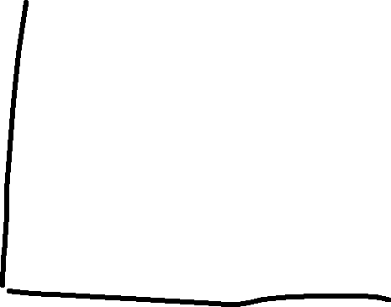







Learning rates and gradient descent
Too large:
Too small:
Can even diverge if too large

Slide 22
Scaling your data and gradient descent…
Size of house in sqr ft (x₁) | Importance of house size (weight b₁) | Number of bedrooms (x₂) | Importance of number of bedrooms (weight b₂) | Inherent value of land (bias constant) | equation | Housing price (y)
6,000 | 100 | 3 | 50,000 | 25,000 | =(6000*100)+(3*50000) + 50000 | $775,000
5,000 | 100 | 3 | 50,000 | 25,000 | =(5000*100)+(3*50000) + 50000 | $675,000
6,000 | 100 | 2 | 50,000 | 25,000 | =(6000*100)+(2*50000) + 50000 | $725,000
Y = 100(house_area) + 3(number_of_bedrooms) + 25,000
- 100 and 3 are ~ 2 orders of magnitude apart. Difficult to choose a learning rate that would work for both weights, will slow down gradient descent.
- Also difficult to assess relative importance of each feature to the overall equation.

Slide 23
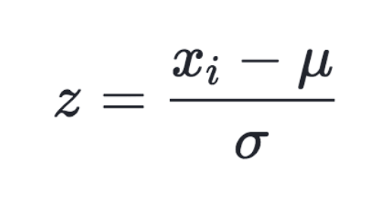

Scaling your data – generally always scale your data.
Standard Scalar (I always use this one): Centers your data, fits it into a normal distribution (z-scores), resultant distribution has a mean = 0 and StdDev = 1
MinMax Scalar: fits your data into a range between 0 and 1.
Others…
Drawbacks for regression: weights and outputs are not directly interpretable.. Can reverse transform your datapoints however (i.e. multiply by StdDev and add the mean).

Slide 24
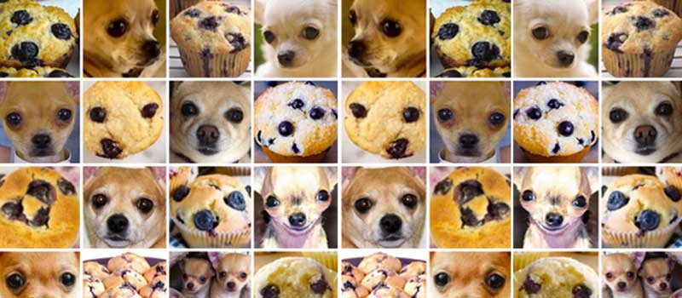
Classification analysis:
Used to predict categorical variables (e.g., cat or dog, winning or losing, tumour or not tumour).

Slide 25


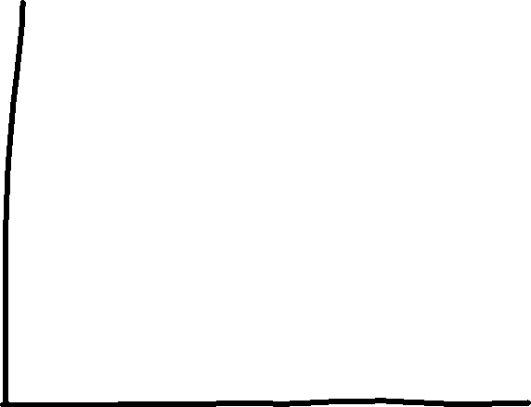




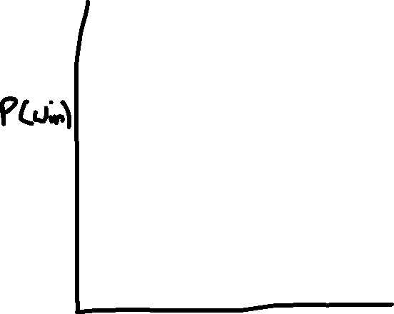
Classifying data – logistic regression.
What is the Probability of winning?
Low chance
medium chance
high chance
# points scored by the raptors

Slide 26
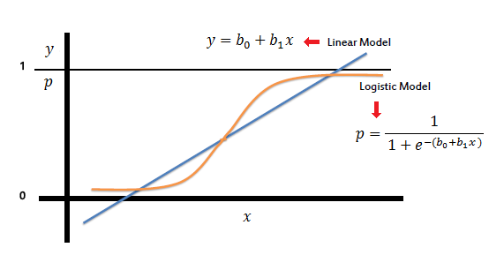

Logistic regression – transforming linear regression for classification analysis
$$g(x)=\frac{1}{1+e^{−f(x)}}$$
Where f(x) = linear model
Think about this equation, what happens when f(x) gets really large? Really small?
I want you to remember this Idea about transforming a function Using a function… this is the basis for neural networks (also generalized linear models).

Slide 27
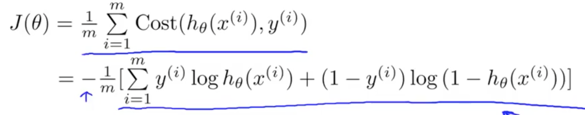









How do we fit a logistic regression? – gradient descent
(loss with respect to weights)
(weights)

Slide 28
Last thoughts on gradient descent
Gradient descent can be used to optimize any function when given an appropriate cost/loss function.
In ML moving forward we will use gradient descent for everything, and only the cost function will change.

Slide 29

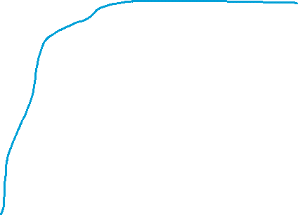
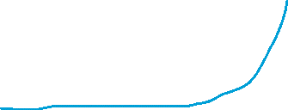
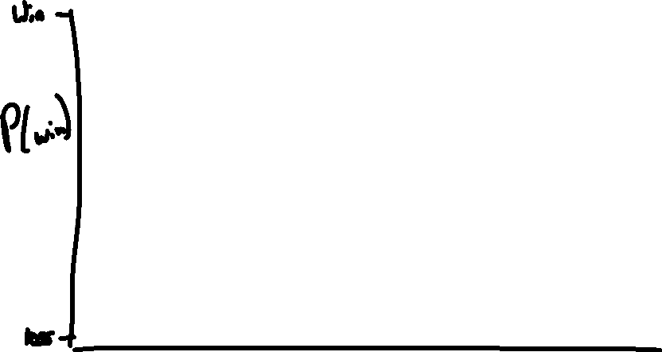
Okay lets use logistic regression
Trained sample
New sample

Slide 30
Summarizing thoughts on machine learning thus far…
While linear regression and logistic regression seem very preliminary and basic models, these principles are the basis for all of ML.
In fact, in any project you do going forward, you should always test your performance against linear and or logistic regression.
So what is machine learning? What are machines in fact learning?

Slide 31
ML is fitting a model and testing it. How can we evaluate our ML models?
Basic Approach:
Randomly split our data in training and test datasets.
  Training = 70% of data,
  Test = 30% of data.
Fit a model with the training data,
Assess a score on the test data
It is very important the test data is completely independent of the training data (no information leakage).
If, for example, a sample is duplicated in the training and test data, because the model is built to fit the training data it will see the same sample and know the answer already. This gives you a false accuracy rate.

Slide 32
Scoring - classification
There are a number of different scoring metrics, how you score the fit is up to you.
Commonly: accuracy (percentage of correct responses in the test data)
Could be: # of false positives, others,

Slide 33
Lets build models now… python and programming.
Python is a dynamic, soft typed language (similar to R).
Dynamic = does not require compiling to run, can run interactively line by line.
Python is famous for its philosophy for simplicity
  there should only be one or a small number of methods to complete a given task.
  Code should be readable, and easy to interpret
While traditionally python has been considered a ‘slower’ language due to being dynamic. Since the implementation of Cython (a python code wrapper for the C programming language) python can run very fast, especially for numeric computing.
Currently python is the industry standard for machine learning code, and in the following session we will learn to code using the very same tools used by industry professionals.

