Slide 1
Neural networks: a generalized method to build very complex models

Slide 2
Last lecture, we covered the entire machine learning workflow
Collect Data
Clean Data
Generate/Choose Features
Scale Data
Questions?
Choose Model
Choose Hyperparameters
Fit Model
Evaluate Accuracy
Make Predictions

Slide 3
Motivating example, the importance of interactions
Previously we have been treating variables as independent of each other
E.g.,
Prob_dimentia = w1(age) + w2(weight) + w3(blood pressure)
However, in reality, these variables likely do not only exist independently to predict a probability of dementia.
E.g., The risk of your blood pressure is likely magnifed by your age.
the additional risk associated with blood pressure, is low when you are young, and high when you are old.
We can rewrite as:
Prob_dimentia = w1(age) + w2(weight) + w3(blood_pressure) + w4(blood_pressure * weight).
Remember: weights (i.e., w1, w2, w3, w4) are simply how important each feature is towards predicting the final answer.

Slide 4
But wait, there’s more.
Every feature in our variable has the potential to interact with every other variable, and add additional predictive information.
Prob_dimentia = w1(age) + w2(weight) + w3(blood_pressure) + w4(age * blood_pressure) + w5(age * weight) + …. + Wn(age*weight*blood_pressure)
Therefore, we can potentially model incredible complex interactions between our features, most of which are useless.
How can we assess these interactions in a more analytical and comprehensive way?

Slide 5
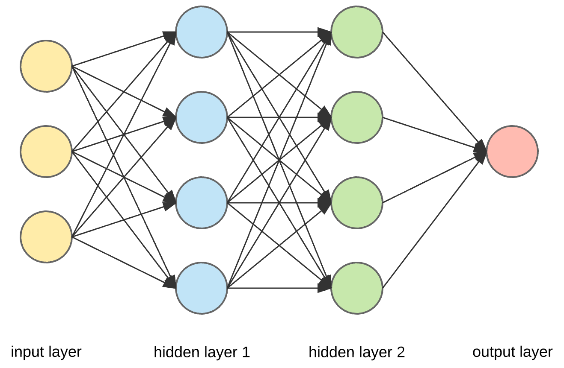
Neural Networks: a not so black box, black box way to build very complex models.
Hidden layers > 3 = ‘deep learning’
Can create very complex functions, requires fine tuning, lots of data
= weight*feature
Features
= integrate
weight*features
So what’s really happening here?
Compute an output (i.e. a prediction)
Combines
features into new ‘interaction’ features
Combines
features into new ‘interaction’ features
Original features

Slide 6
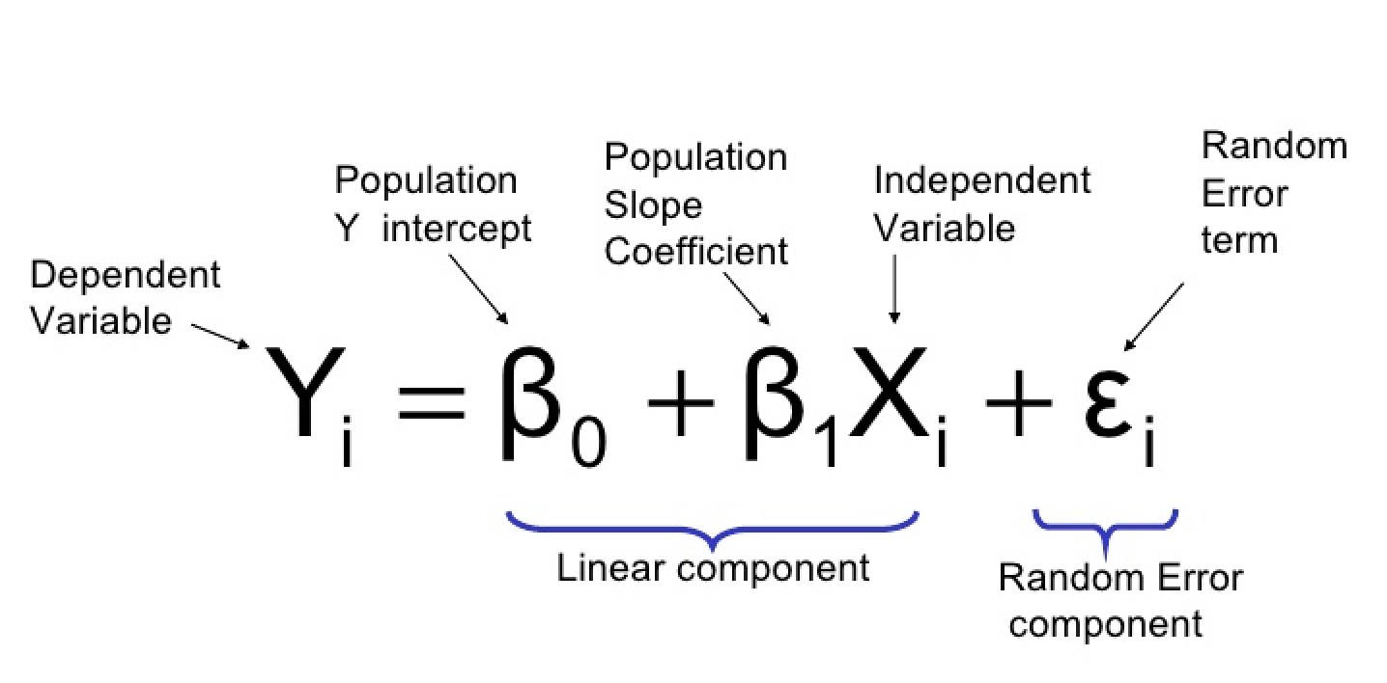
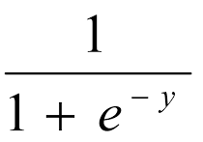
Revisiting logistic regression
g(x) = a(f(x)); where a(x) is the log. Reg. func
Where f(x) =
Where a(x) =
Linear regression / linear model

Slide 7
We can describe logistic regression graphically
Transform Y with an activation
Bias
Linear model
(Linear Regression)
w4
Activation
Function
X1
w1
Logistic_function(Y)
Y = w1X1 + w2X2 + w3X3+ (w4)(bias)
output
X2
w2
w3
X3

Slide 8
A single neural generalized
Bias
Linear model
(Linear Regression)
w4
Activation
Function
(adds non-linearity)
X1
w1
Y = w1X1 + w2X2 + w3X3+ (w4)(bias)
output
X2
w2
w3
X3

Slide 9
More simplified diagram
Inputs/features
Linear model
Activation function
New output
Note: in practice,
A node represents
Both the linear model
And the activation
function
Remember, arrows
Indicate (info * a weight)

Slide 10
Deeper layers represent new combinations of previous features
Bias
Bias
Y3 = w9X4 + W10X5 + w11BIAS
Y1=w1x1+w2x2+w3x3+w4bias
A(Y3)
A(Y1)
X4
X1
X5
X2
X6
A(Y2)
X7
X3
Y2=w5x1+w6x2+w7x3+w8bias
NOTE: every arrow has it’s own weight

Slide 11
More layers results in more complex ‘interactions’ which results in more complex decision functions

Slide 12
A single neural generalized
Bias
Linear model
(Linear Regression)
w4
Activation
Function
X1
w1
Y = w1X1 + w2X2 + w3X3+ (w4)(bias)
output
X2
w2
w5 [no weight if output layer]
w3
X3

Slide 13
Most common activation function (use this as default): Rectified Linear Unit (ReLU)
Y (new output)
X>0, y=y;
X<=0, y=0
X (i.e. linear combination of features)

Slide 14
Intuition why this works… maybe… (how I think about it)
Some linear combinations are not informative; neuron_output = w*(A(x))
neuron_output = 0 when either (w ~= 0, or A(x) ~= 0)

Slide 15
Other activation functions
Sigmoid activation (logistic regression)
TanH activation (logistic regression)
1
1
-1
0
TanH >> sigmoid, expect as an output layer activation,
The reason is very technical… just take it as it is…

Slide 16
Output layers, integrating the network information into a decision

Slide 17
Output Layer
Linear model
(Linear Regression)
Layer N-1
Activation
Function
w1
Y = w1X1 + w2X2 + w3X3
output
w2
w3
Sigmoid activation for binary outputs
ReLU or Linear for regressions

Slide 18
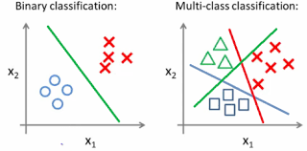
Multiclass classification

Slide 19
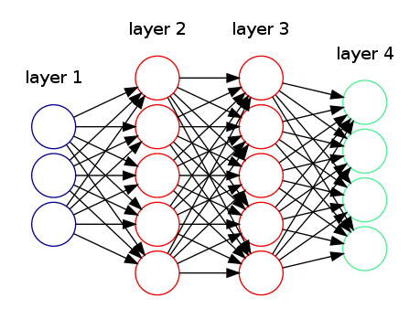
Multi-class classification in neural networks
Softmax activation:
normalized sigmoid function,
Computes a probability for each class

Slide 20
Any questions on what the neural network is doing

Slide 21
What is the machine learning in machine learning?
The weights.. How to best fit a model to most accurately predict the right answer.

Slide 22



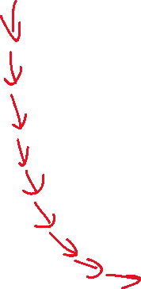



Training neural networks… gradient descent!
Price
Loss
(J(Theta)
House Square Footage
Weights (Theta)

Slide 23
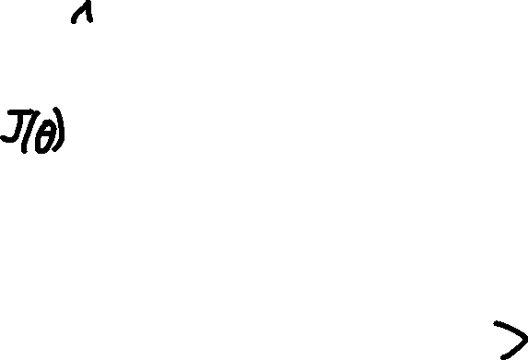
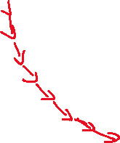




Formalizing gradient descent
Need the cost at some set of inputs (i.e., J(X)).
Need the direction of the cost (i.e., d/dx J(X)).
Need a learning rate (α), which defines how fast gradient descent is accomplished.
(loss with respect to weights)
(weights)

Slide 24
Like any gradient descent problem, we need to compute the loss, change in loss
Loss = J(ϴ) = forward propogation
Change in loss = d/dϴ (J(ϴ)) = backwards propagation
Forward propagation
Vs. right answer = loss
Compute how the loss changes with respect to each weight in the network using the chain rule in calculus
Backward propagation

Slide 25
Optimize weights to best fit the model
Note: regularization is still needed,
A common choice is L2 regularization
(same is linear regression)
(loss with respect to weights)
(weights)

Slide 26
Building a network architecture is an art not a science
N_hidden_layers should
be proportional to your data
Some ideas
N_nodes in first layer <= n_features
Use ReLU activation
functions
Make your own grid searches,
Record the results, and refine
Your architecture
Reduce # nodes in subsequent layers

Slide 27
Why neural networks are so powerful
By developing a systematic way to interrogate interactions between features, neural networks in a way can interpret raw data which do not have features, and create their own derived features.
In this way, neural networks can be used to:
interpret images using raw pixel data
Interpret language/words/characters
Interpret sequential number series (i.e. real-time changes in stock prices)
Reinforcement learning: learn to change decisions in real time based on feedback.
Many more.

Slide 28
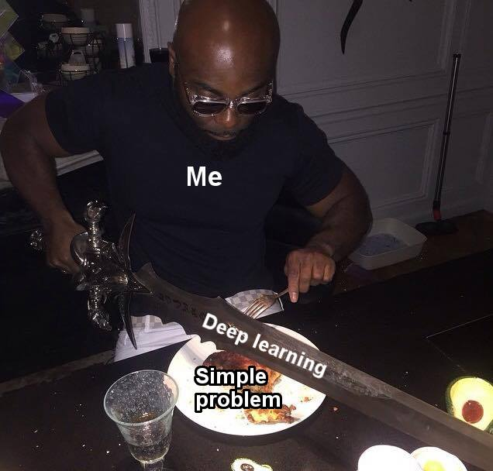
Use an appropriate model for an appropriate job…

Slide 29
What can you do with the information you have learned in the course so far?
Collect Data
So far we have learned how to use machine learning to conduct regression and classification analysis. For your analysis, classification seems to be the most natural analysis…
Projects you should be able to accomplish:
Use gene expression data to predict cancers from non-cancers (or different celltypes, etc..).
Identify the most predictive genes.
2) Use cellular morphology features to morphologically distinguish cell states (this is what I do).
3) Develop models to predict prognosis, disease onset, identify biomarkers.
Clean Data
Generate/Choose Features
Scale Data
Choose Model
Choose Hyperparameters
Fit Model
Evaluate Accuracy
Make Predictions

Slide 30
Next class: convolutional neural networks – making classification using image data
At this time, I had thought about doing a joint collaborative process to use the knowledge we have learned.
If anyone has interest/ideas and some access to data we can think about starting a project.
We can potentially get free datasets from GEO and allen brain atlas.

Slide 31
Building neural networks in python
Use the keras library → is a front-end wrapper of tensorflow, the most common python NN library in python and developed by google.
Important! Tensorflow runs much faster on an NVIDIA GPU with cuda. It’s an involved process so we wont do that and will use the CPU version.
To not lose track of these various installations we should first create a new environment in anaconda.
Environments are basically contained locations which you can easily delete when you no longer need it.

Slide 32
Environments in anacoda
Anaconda-base
Numpy, sklearn, matplotlib, pandas
New_env
Tensorflow-cpu
Reduces the risk of random conflicts… stuff like that.

Slide 33
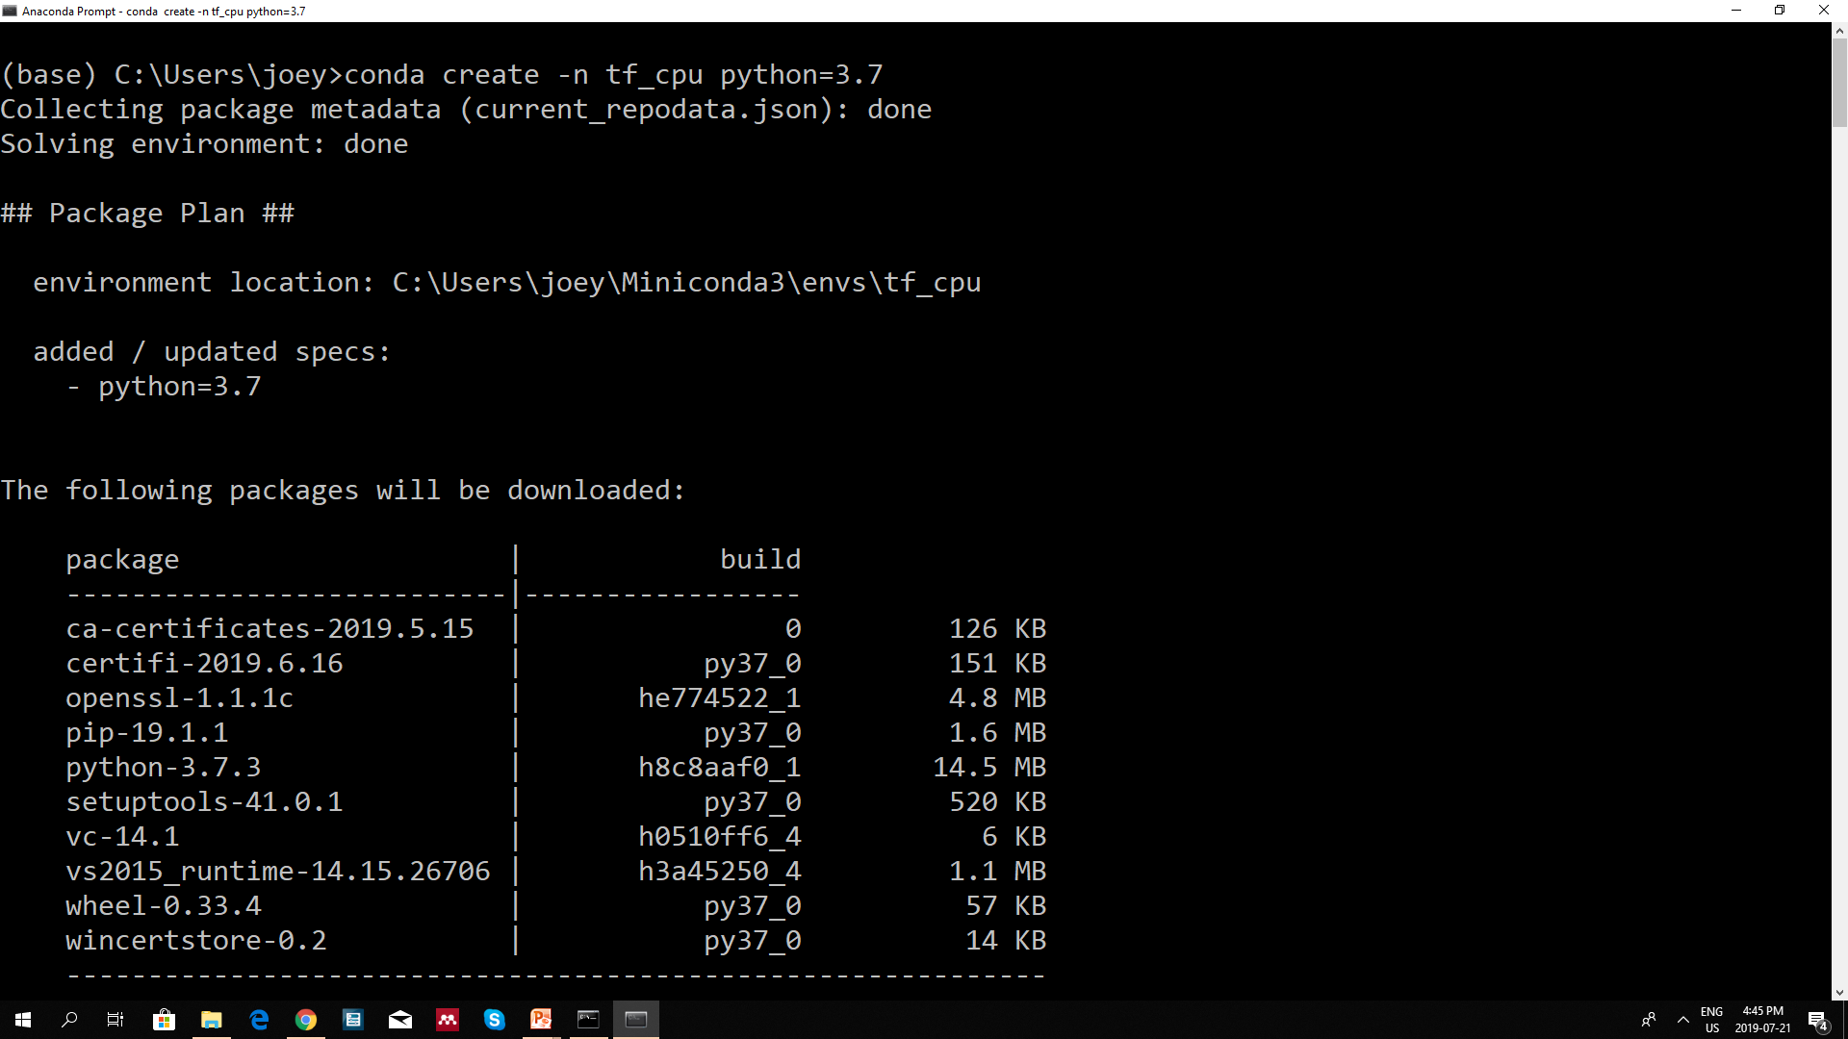
Create a new environment
Name, choose whatever you want

Slide 34
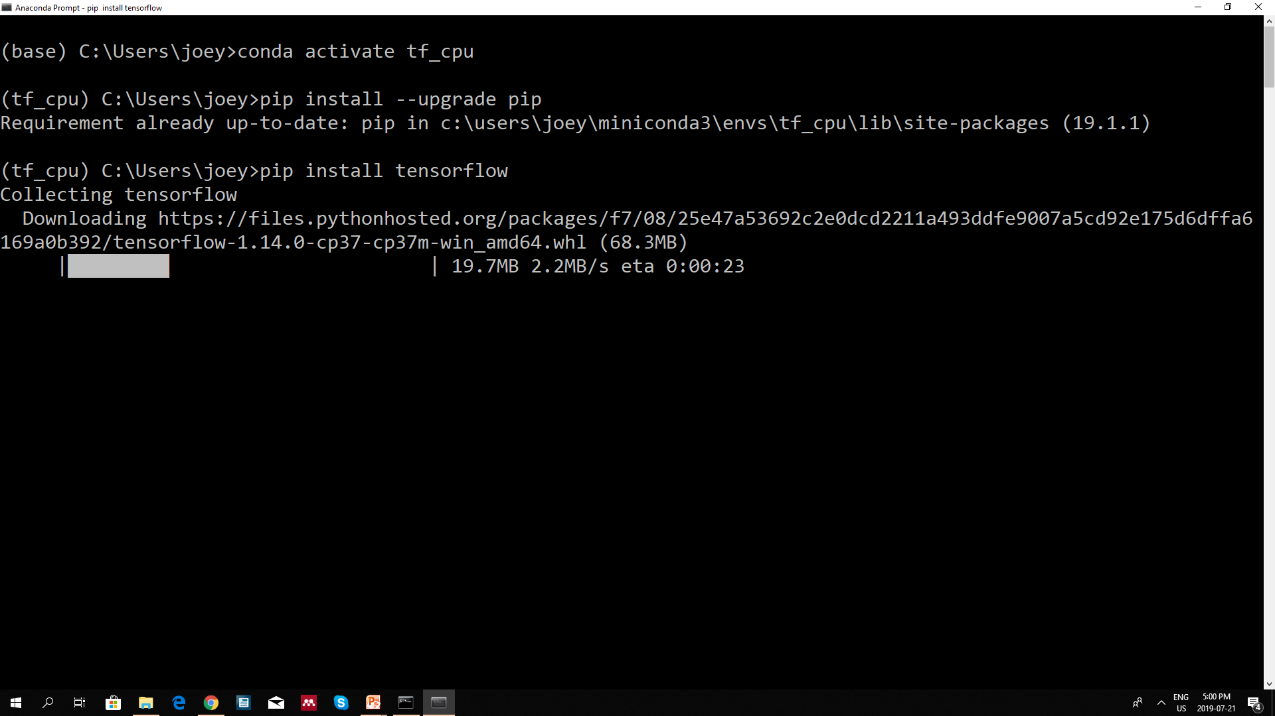
Pip install tensorflow into the environment

Slide 35
Installing new packages in python
Pip install package_name
(just google pip install your_package_name)

Slide 36
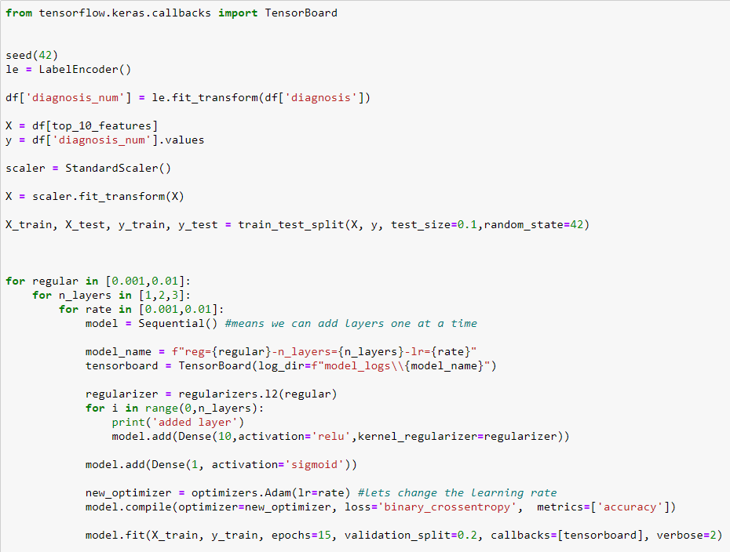
Tensorboard – a built in way to visualize your neural networks
This is our grid search
For each grid, save unique model name

Slide 37
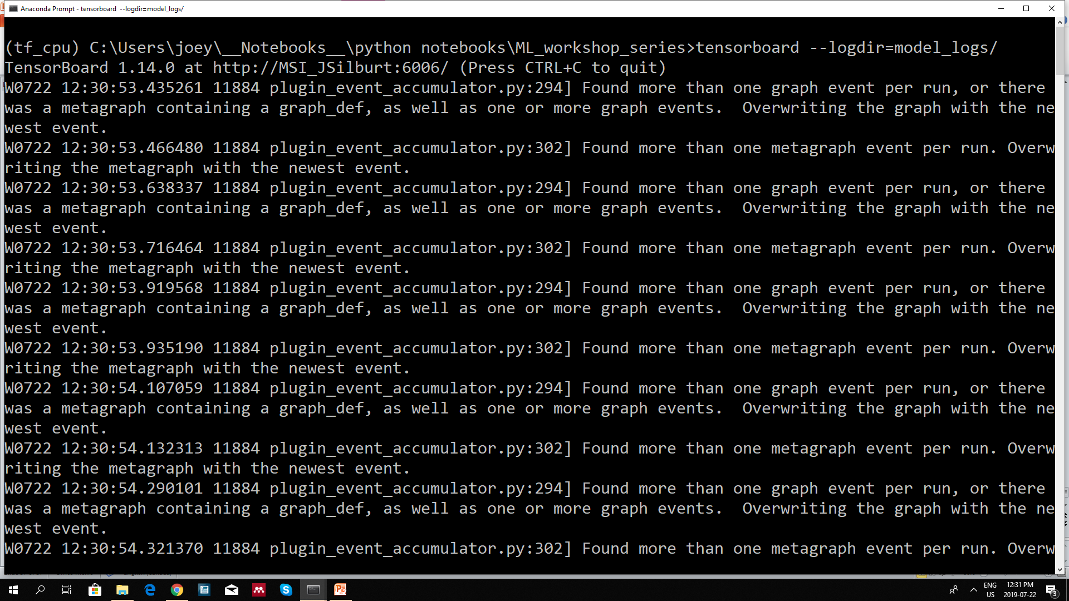
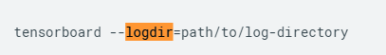
At the command prompt, in the location of your notebook type in:
Put that in your browser

