Slide 1
ML workshop Week 2: Support vector machines and fine-tuning machine learning models
Joey Silburt
July 8, 2019

Slide 2
The machine learning workflow
Collect Data
Clean Data
Generate/Choose Features
Scale Data
Covered in Lecture 1
Choose Model
Choose Hyperparameters
Fit Model
Evaluate Accuracy
Make Predictions

Slide 3
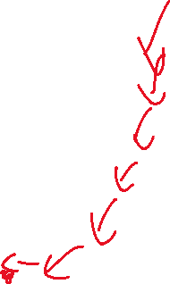
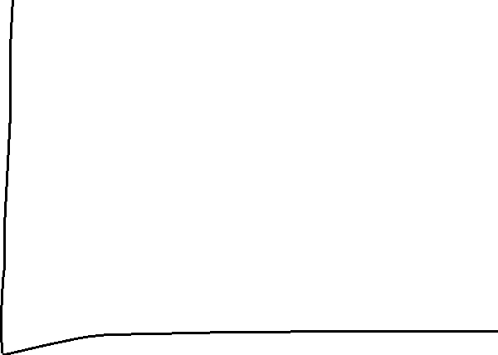
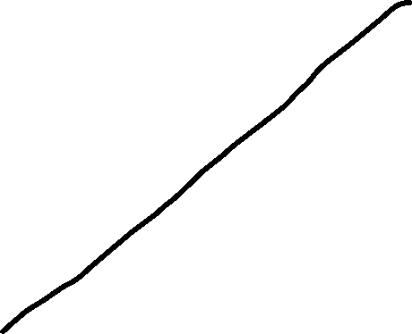
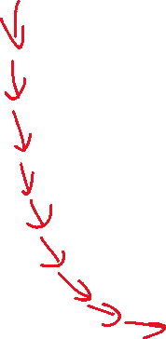


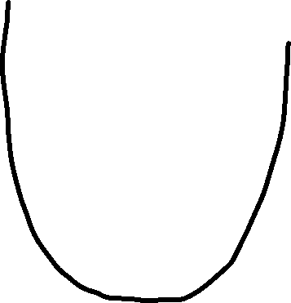
Revisiting Linear Regression and gradient descent
Price
Loss
(J(Theta)
House Square Footage
Weights (Theta)

Slide 4
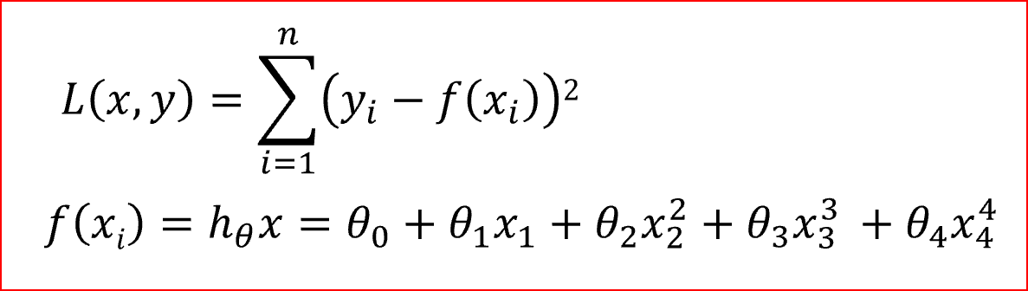
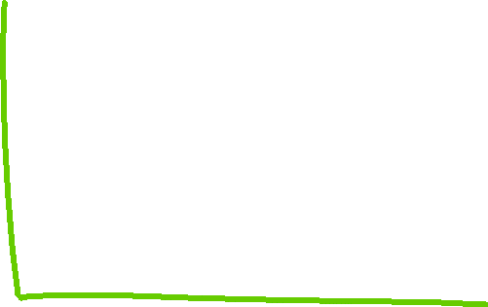

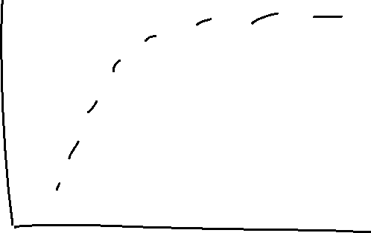
To make better decisions we need to fit more complex non-linear functions
good fit
Over fit
Under-fit
New examples
New examples
Note: X is the same feature

Slide 5


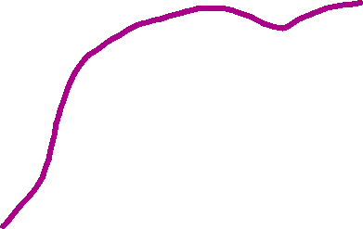


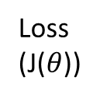
Gradient descent and the problem of overfitting and regularization
Loss
(J($θ$))
Over fit
New examples
With regularization
Weights ($θ$)
Penalize large Weights
$$J\left((θ)\right)=\frac{\sum{Loss}}{\# Training Samples}$$
$$J\left((θ)\right)=\frac{\sum{Loss}}{\# Training Samples}+ \frac{(λ)}{2}{\left\|(θ)\right\|}^{2}$$

Slide 6
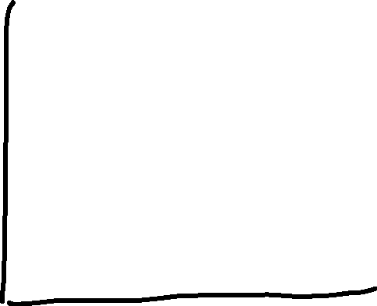

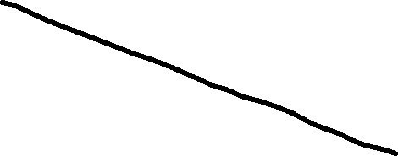
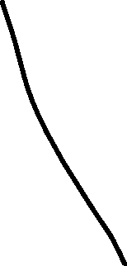

Support vector machines, an algorithm for fitting complex models.
Can be used for regression (termed support vector regressor) or classification (termed support vector classifier).
Often called ‘large-margin classifiers’.
Support vector machines fits a function which maximally separates two or more classes of data. (class = group)
In this way, it creates as large a margin as possible to distinguish between classes of data.
This current model is called a linear SVM
Malignant
Benign
Gene 2
Gene 1

Slide 7


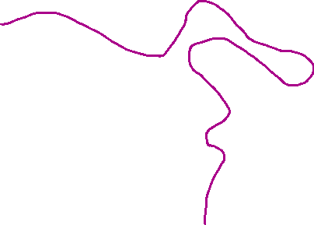
What if the distribution is not so clean?
The C parameter regulates the number of incorrect selections allowed to occur when drawing the decision boundary, with higher values of C indicating less errors are allowed and is therefore more complex.
The C parameter is a regularization term and trades off complexity with fit accuracy.
C=High
C=low

Slide 8
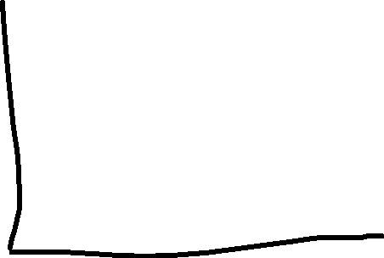


Support vector machines are called ‘kernel’ methods. This is because, you can input a kernel to change how the SVM fits a model.
Polynomial kernel
malignant
Benign
Not linear separable
gene1²
gene1
gene1

Slide 9
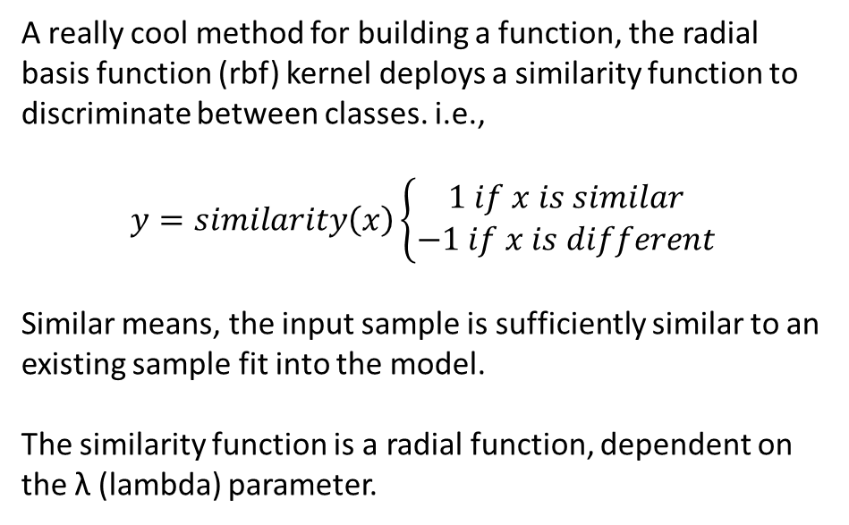

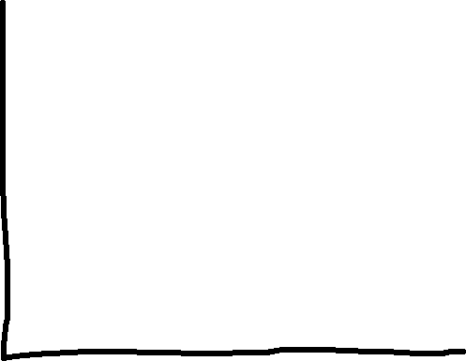
The Radial Basis Function Kernel – A method to build complex functions
Decision Boundary
A really cool method for building a function, the radial basis function (rbf) kernel deploys a similarity function to discriminate between classes. i.e.,
$$y=similarity\left(x\right)\left\{\begin{aligned}1 if x is similar \\ −1 if x is different\end{aligned}\right.$$
Similar means, the input sample is sufficiently similar to an existing sample fit into the model.
The similarity function is a radial function, dependent on the λ (lambda) parameter.
Class 1 (benign)
Class 2 (malig)
∝ λ
New samples

Slide 10
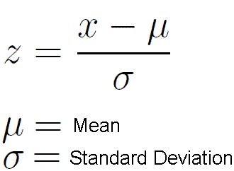
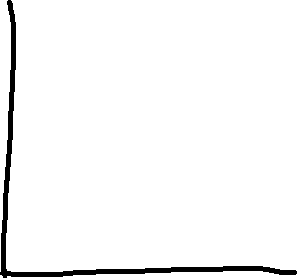

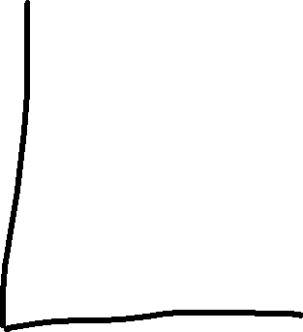
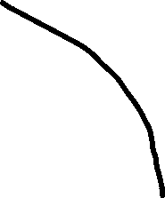
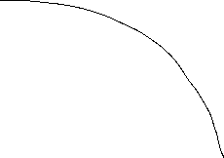
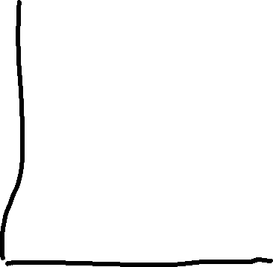

Note for SVC:
It is essential for SVCs to scale your features..
5
100
100
Feature 3
Feature 3
Feature 1
0
0
-5
Feature 2
Feature 4
Feature 4

Slide 11
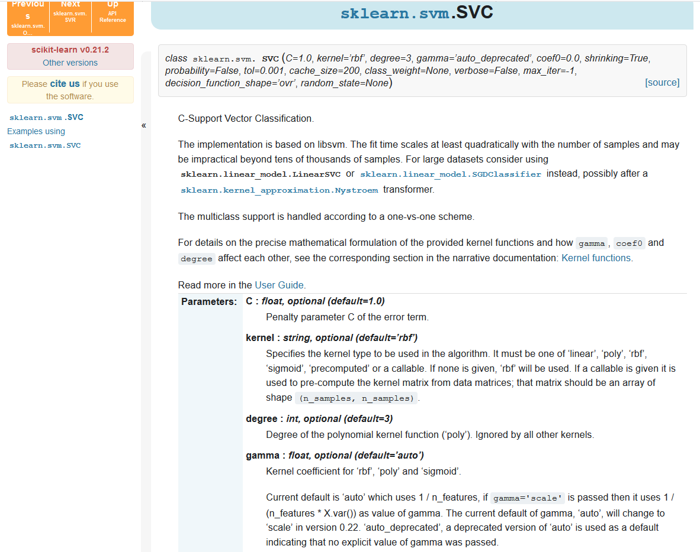
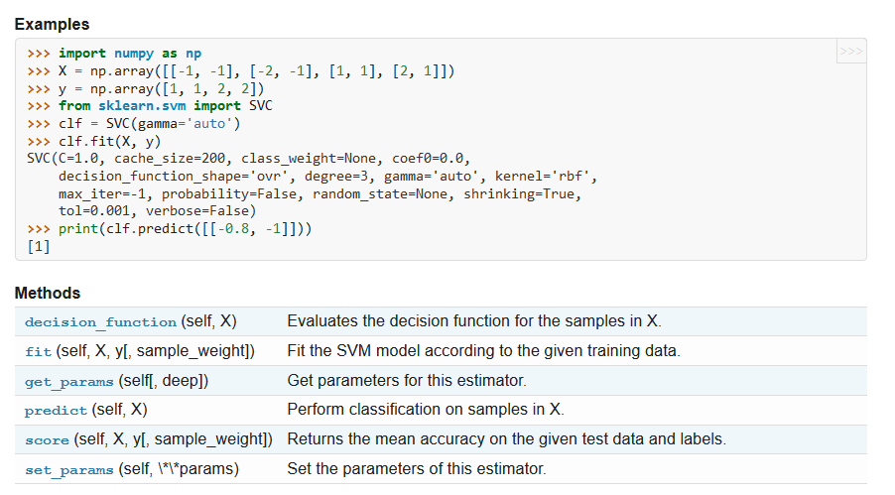
Using a support vector machine classifier in python
All Sklearn ML models have the functions:
model.fit(X,y) → where X is the features, y is target
- this function runs gradient descent to fit the model
Model.predict(X) → outputs predicted y

Slide 12
The machine learning workflow
Collect Data
Clean Data
Generate/Choose Features
Scale Data
Choose Model
Choose Hyperparameters
Fit Model
Evaluate Accuracy
Make Predictions

Slide 13
How to choose the best hyperparameters?
In making a support vector machine, we need to choose values for the hyperparameters C and lambda, so how can we choose these parameters?
Answer: choose the parameters which has the best score.
To do so, we will conduct a grid search – basically a series of for loops to iterate through a range of hyperparameters and select the best result.

Slide 14
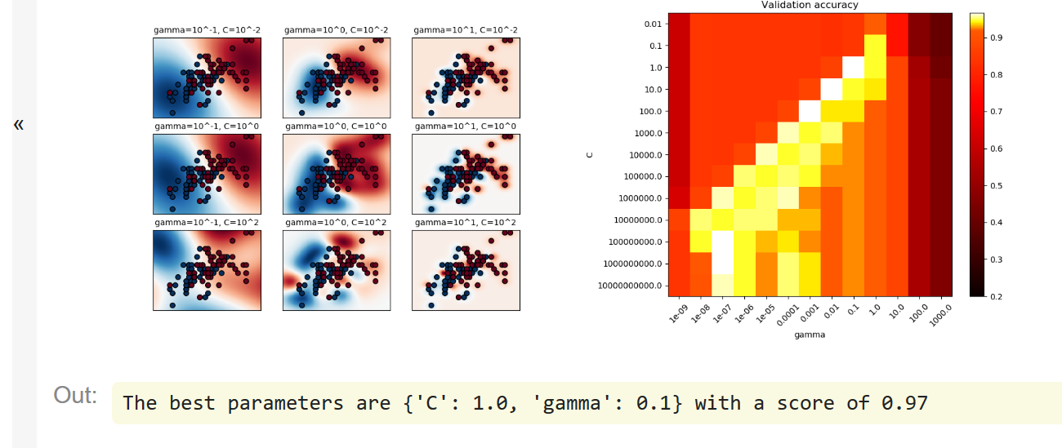
Grid Search of SVC

Slide 15
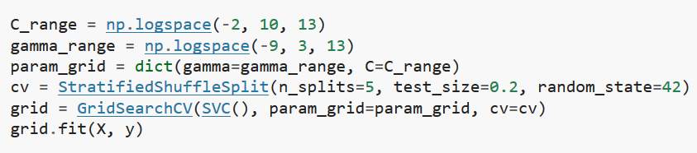
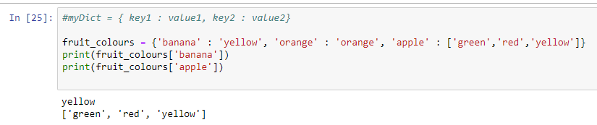
Code for implementing a grid search
SVM parameters
A list [10^-2,…,10^10] # list is 13 elements long
A list [10^-9,…,10^3] # list is 13 elements long
ignore
for now
Model
Replace with any sklearn model you want
Parameters to iterate over
Dictionaries! Very useful data structure in python:
Syntax:

Slide 16
Cross Validation – a method to get a more accurate prediction of your model
Train (~70%)
Test (~30%)
Your Data
Problems:
1. even though we are randomly sampling 30%, maybe we get a particularly bad distribution.
2. Maybe we have too sparse data that there is not enough to train if 30% is tested.
SOLUTION: CROSS VALIDATION
K-fold cross validation:
Partition the data randomly into k equal portions
Leave one portion out to serve as the test.
Train on the remaining folds
Test on left out fold
Repeat for all combinations of K-partitions
Average over all folds to get accuracy
4-fold cross validation

Slide 17
Grid search with cross-validation
For value of C:
For value of gamma:
Output average accuracy
Choose best parameters:
Model accuracy is average K-fold accuracy with the best parameters

Slide 18
Revisiting how to train a model
There is a conundrum – Ideally, your final evaluation should use data the model has never seen before, and grid search implicitly semi-stores that information by determining the best hyper-parameters for your ‘never before seen data’.
Introduce a cross-validation dataset for tuning
To be super conservative (which I like to be) and to get the best, unbiased estimate of accuracy you should implement a cross-validation set to optimize parameters.
Often you might see no use of a cross validation set, and basically K-fold cross validation over the whole data… the accuracy being the best performing model.. Useful if not a lot of data, is used a lot… I don’t know how to feel
Train (~80%)
Cross Validation Set (for tuning) ~20%
Test Set
(~20%)
Unbiased estimate
of performance
Use k-fold cross validation on this chunk of data
Cross Validation on whole dataset (i.e. previous slide)

Slide 19
The machine learning workflow
Collect Data
Clean Data
Generate/Choose Features
Scale Data
Choose Model
Choose Hyperparameters
Fit Model
Evaluate Accuracy
Make Predictions

Slide 20
Choosing features is an essential component to building a model
We will learn about recursive feature elimination (RFE) and Principal Component Analysis.
But why choose features? Why not include all features?

Slide 21


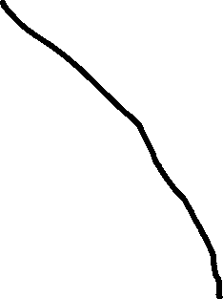
Including too many features may be a version of overfitting.
How much discriminatory information are we actually adding in?
4
6
Feature 2
3
5
Feature 1

Slide 22
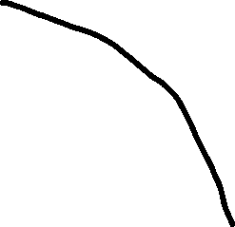

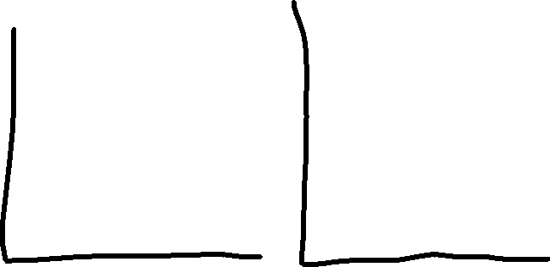
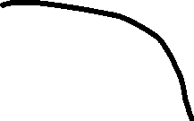
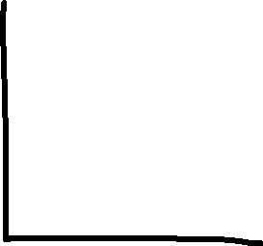
The real problem however occurs with respect to # of features to # of samples.
Data is randomly distributed
Not a terrible decision boundary
Pretty bad
5
3
1
2
4
6
Predict Red if: low(1) and low(2) and low(3) and high (4) and low(5) and low(6)
Highly specific prediction formula, with a very low understanding of the distribution.. So the more precision
We add into the algorithm (i.e. with features) the more room for overfitting and errors.
A very useless rule of thumb… 20 samples per feature

Slide 23
Better answer… let your model accuracy tell you how many features!
Recursive feature elimination algorithm:
Need to specify how many features you want at the end,
How many features to eliminate per round.
Caveat: does not inherently grid search best hyperparameters for the # of features…
As you remove features your hyperparameters should be changed
so you should test a couple different hyperparameter combinations.
Train/Test Model
Evaluate Accuracy
Remove n # of features
Outputs K best features with best accuracy

Slide 24
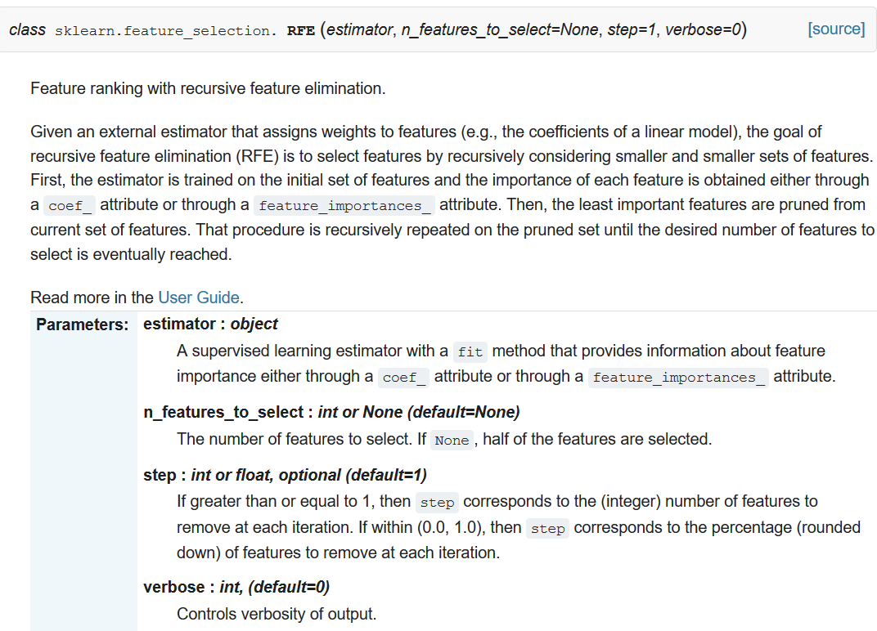
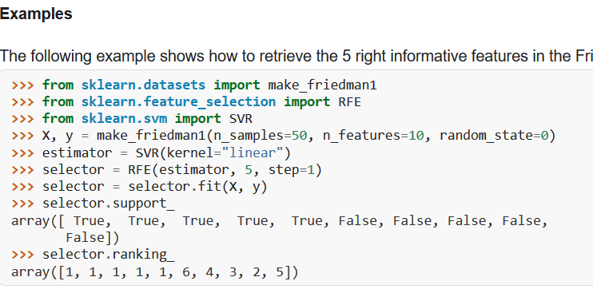
Using RFE in python
Generating a dataset… use your own dataset
X = features dataset,
y = target variable

Slide 25

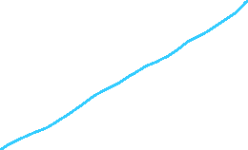
Principle Component Analysis: a way to reduce your number of variables without losing much information
New feature 1 = principal component 1 (most variance)
New feature 2 = principal component 2 (second most variance)
Axes are arbitrary!
Variance of
feature 1
Variance of
New feature 1
Feature 2
New axis
Variance of
Feature 2
New Feature 1
Variance of
New feature 2
New feature 2
Feature 1
The variance of new feature 2 is now very small, and the variance of new feature 1 is in fact larger.. In a way, we ‘repackaged’ the variance into two new variables. We did not in fact change the data in any way, all the information is still there.

Slide 26


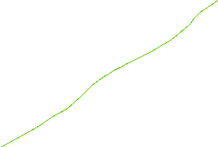


Using PCA to reduce variables
Note: PCA is not linear regression… it’s a completely different algorithm, even if it looks similar.
PCA transform
Lets only use PC1
PC2
Feature 2
PC1
PC1
Feature 1
Given that PCA consolidates variance into new variables, you may no longer need 2 variables to establish a strong decision boundary.
As a rule of thumb, use enough PCs to retain 99% of your original variance.
It is a good idea to scale your data before applying PCA.

Slide 27
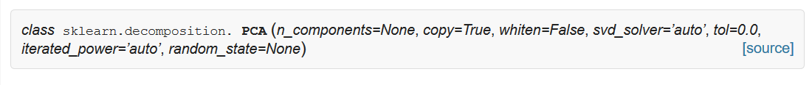
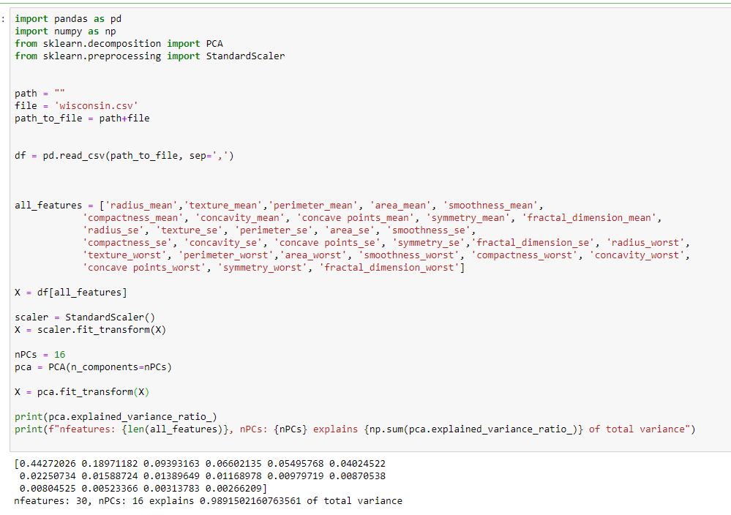
PCA in Sklearn

Slide 28
Diagnosing your model fit
Performance is relative to human performance.
It may not be possible to solve all problems with 99% accuracy. A good example of this is sports betting.
A sports gambler who can successfully predict sports outcomes at >55% is amazing. This is because some outcomes are truly stochastic.. Maybe we don’t have the right information, maybe it’s just not possible to solve.
Generally, more data and more features can improve accuracy… but not always, and you might simply be wasting your time.
To better diagnose our model’s potential, we can use a learning curve.

Slide 29
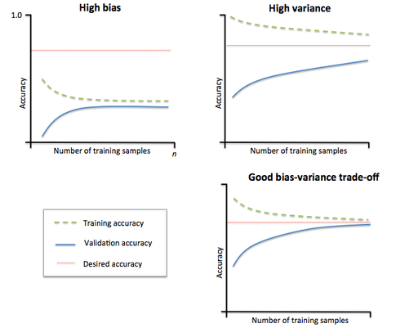
Learning curve – incrementally resample more data in your dataset and test accuracy
overfit your model.. It’s too complex, need less features, or more samples
Underfit your model.. It’s too simplistic, need more features
Correct trade off of model complexity given the number of samples

Slide 30
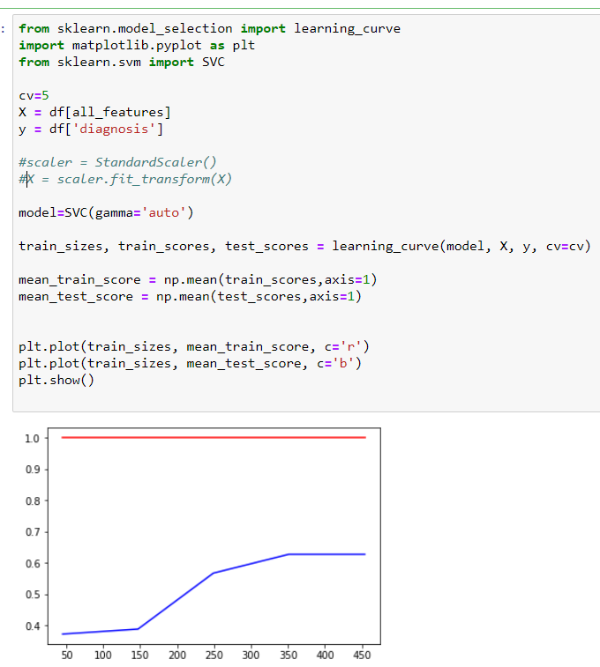
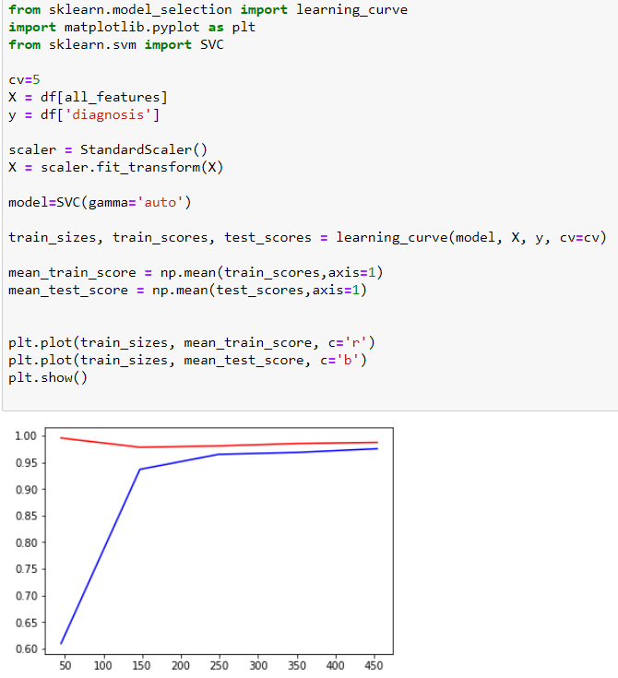
Learning curve coding in python

