Slide 1
Visualisation and assessment of ChIP-seq quality
BioC 2014
Thomas Carroll
Head of Bioinformatics,
MRC Clinical Sciences Centre,
Imperial College London

Slide 2
ChIP-seq is noisy
ChIP-seq/ChiP-exo/DNA-seq/MNase-seq is noisy.
Experimental biases:
    Fragmentation/digestion.
    IP strength/efficiency and specificity.
    PCR Bias (Overamplification from low starting material)
Highly variable patterns of enrichment between ChIPs.
    Transcription factors may show sharp/narrow peaks.
    Polymerase II will show mix of sharp/narrow and dispersed/broad peaks

Slide 3
Duplication Rate

Slide 4
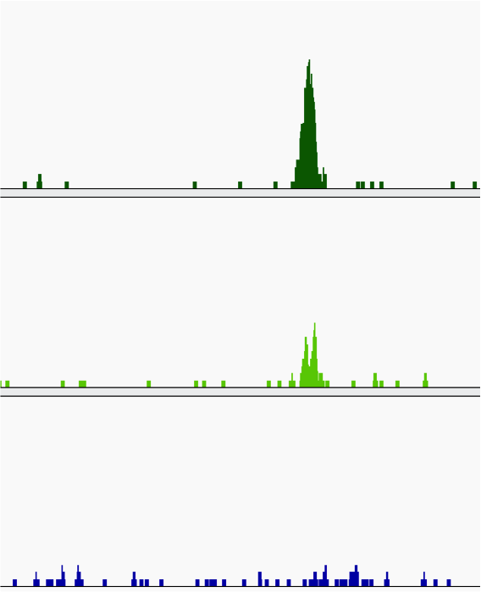
Always visualise your data
Coverage graphs.
    Wigs (Okay)
    bedGraphs (Okay)
    BigWigs (Great)
Allows for quick assessment of data...
..but dependent on user's interpretation/experience.

Slide 5
High-thoughput ChIP-seq quality control with ChIPQC
Need methods to quantify informative characteristics about your ChIP-seq data.
ChIPQC – Tom Carroll and Rory Stark (Diffbind).
ChIPQC provides workflow to generate metrics per sample/experiment.

Slide 6
ChIPQC package
A workflow package providing common metrics and visualisations useful for ChIP-seq data.
Available on all platforms.
Simple interface.
(Reasonably) low CPU and memory demands.
Integration with DiffBind and rtracktables packages allows us to move to analysis and reporting.

Slide 7
ChIPQC
Example of different profiles

Slide 8
Standards for ChIP-seq
(Experimental and practical)
Large-scale mapping and increased throughout from multiplexing has brought about some standards.
  Encode Consortium
    ChIP-seq guidelines and practices of the ENCODE and modENCODE consortia. Landt SG et al (Genome Research. 2012)
    Large-scale quality analysis of published ChIP-seq data. Marinov GK et al (G3. 2014)
  And many other labs/facilities.
    Systematic evaluation of factors influencing ChIP-seq fidelity. Chen Y et al (Nat Methods. 2012)
    Practical guidelines for the comprehensive analysis of ChIP-seq data. Bailey T et al (PLoS Comput Biol. 2013)
    Impact of artifact removal on ChIP quality metrics in ChIP-seq and ChIP-exo data Carroll TS et al (Frontiers Genet. 2014)

Slide 9
Distribution of Signal

Slide 10
ChIP-seq metrics
Distribution of Signal
Clustering of Watson/Crick reads.
Duplication Rate.

Slide 11
Distribution of Signal
  Within enriched regions
  Within/across expected annotation
  Across the genome
  Within known artefact regions

Slide 12
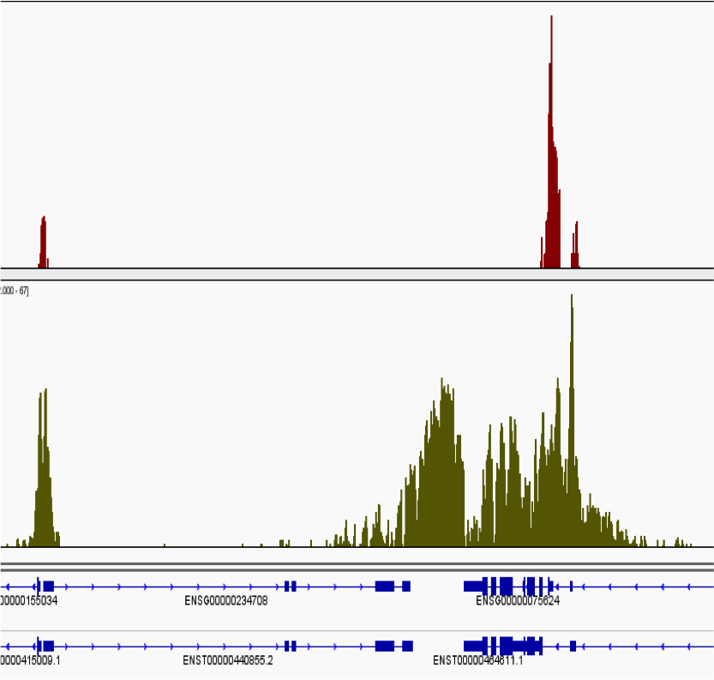
Distributions Of Signal
Narrow/Punctuate enrichment (Transcription Factors).
Broad/Dispersed enrichment (Histone Marks).
Mixed Enrichment (Transcriptional Machinery).
Background control (No IP fragmented DNA).
Different epigentic marks can have dramatically differing signal pile-up profiles.
Evaluation of distribution of signal pile-ups can help:-
  Characterize enrichment profile.
  Allow for comparison between ChIP's efficiencies.
  Identify the presence of artefact signal.

Slide 13
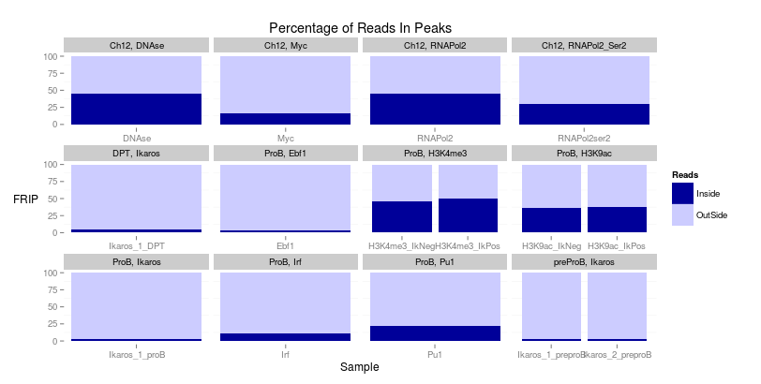
Signal in Peaks (FRIP)
The simplest assessment of enrichment.
  Call enriched regions over input
  Measure fraction of reads in peaks (FRIP)
  Good quality TF > 5%
  Good quality Pol-II > 30%

Slide 14
Signal in Peaks (FRIP)
The simplest assessment of enrichment.
  Call enriched regions over input
  Measure fraction of reads in peaks (FRIP)
  Good quality TF > 5%
  Good quality Pol-II > 30%

Slide 15
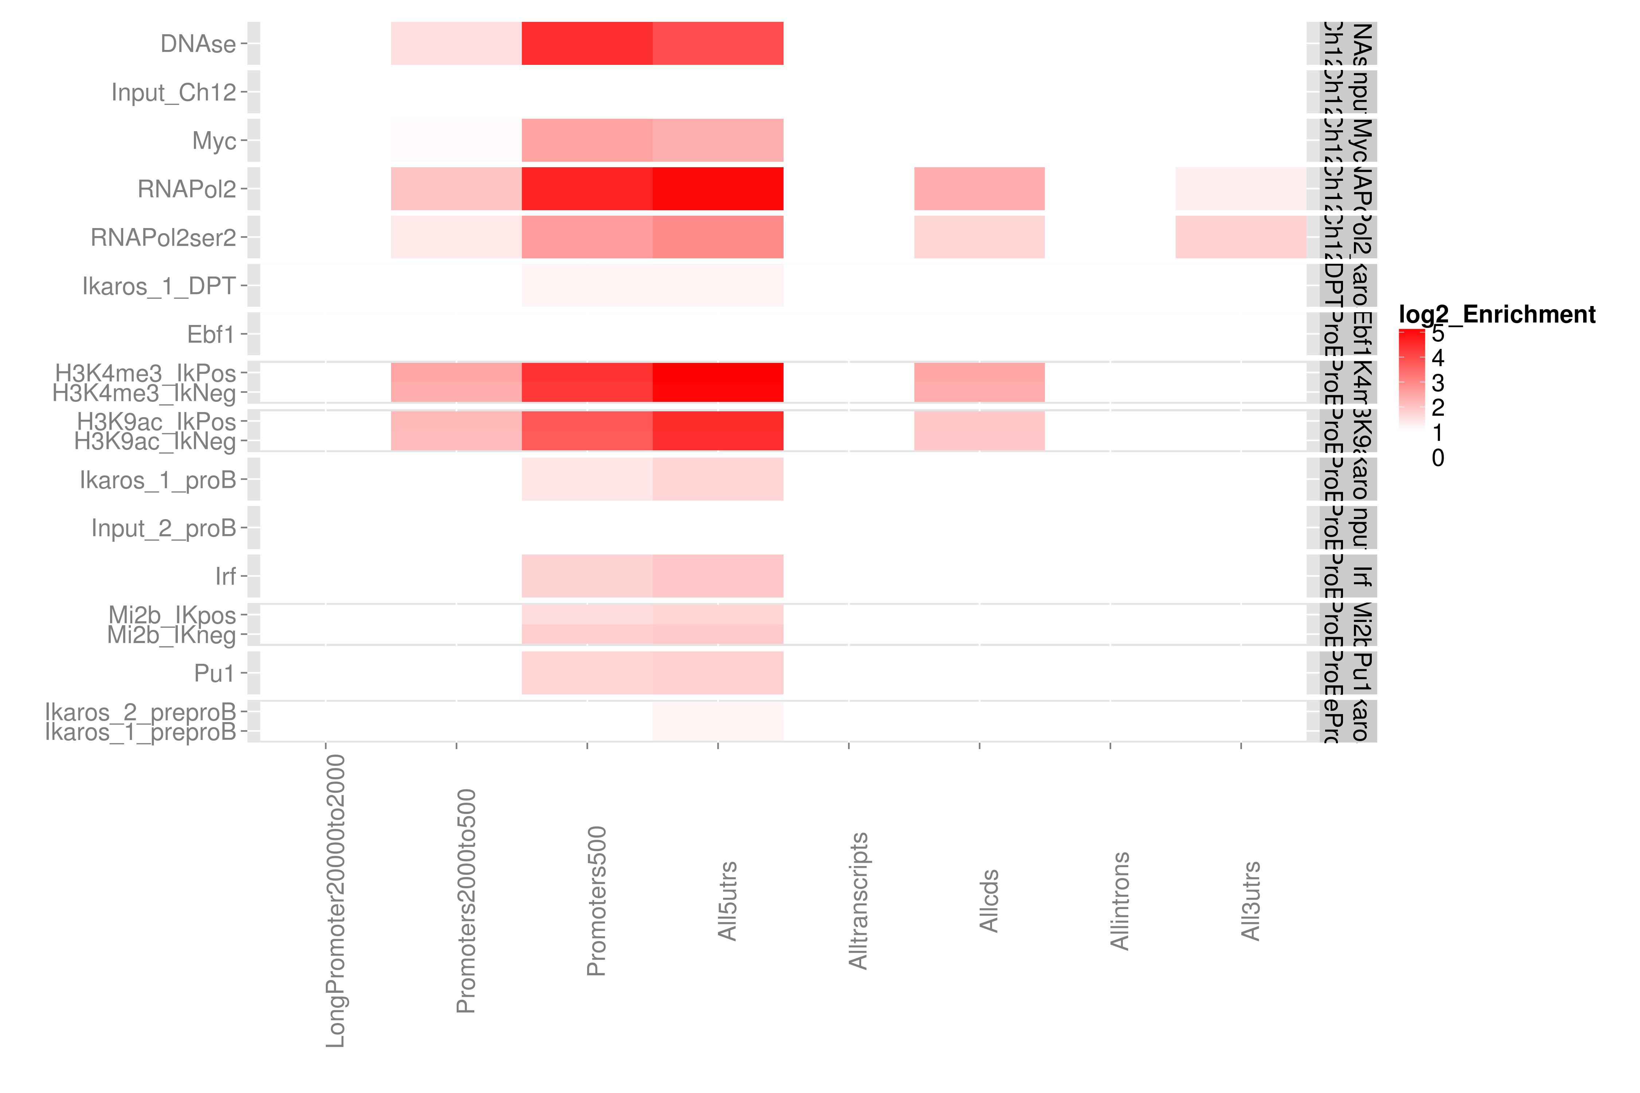
Relative Enrichment in Genomic Intervals (REGI).
Expected enrichment in genomic regions
Plot relative enrichment of reads in annotated regions.

Slide 16
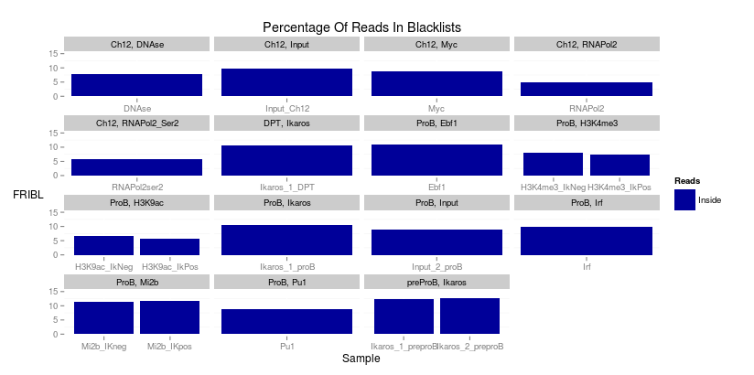
Signal in Blacklists (FRIBL)
Work from Encode (Kudaje A) has produced curated list of conserved high signal artefact regions.
Available for many species including human, mouse and drosophila genomes.
Represent around 0.5% of genome.
Can account for high proportion of total signal (> 10%).

Slide 17
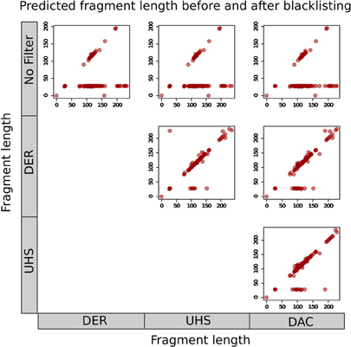
Why worry about blacklists?
Carroll et al 2014
Can affect -
  Normalisation between samples.
  Fragment length estimation.
  Quality metrics for ChIP-seq.

Slide 18
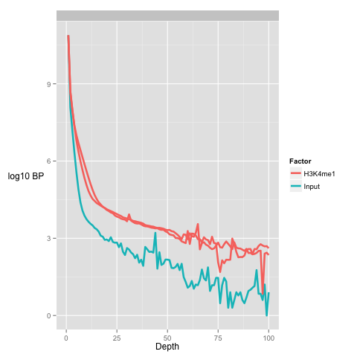
Global signal profile
A simple method to review global distribution is as histograms.
More enriched samples show higher number of bases at greater depths
Input samples show higher number of bases at low depths

Slide 19
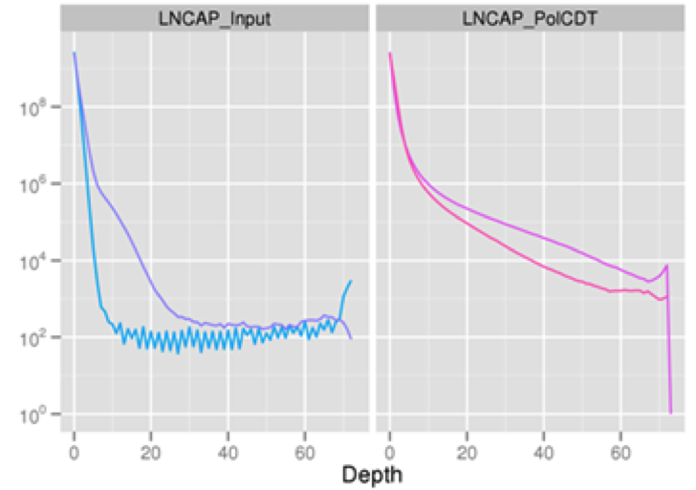
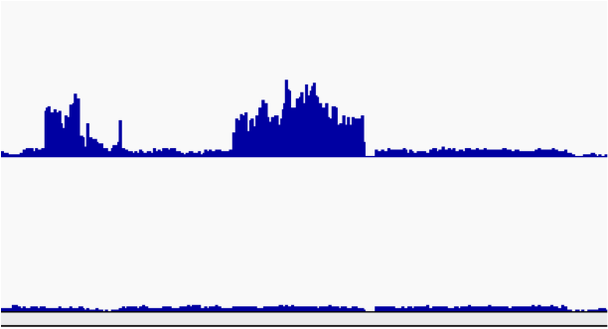
Global Signal Profile
Presence of stretch of high signal depth
Identify anomalous signal region as candidate for blacklisting.

Slide 20
Metric of Global Signal Profile -
SSD
SSD developed in htseqtools package.
Normalised standard deviation of coverage.
Provides measure of pile-up across genome
    Sample with regions of high signal (High SSD score)
    Sample with low signal across genome (Low SSD score)
Provides no measure of signal structure.

Slide 21
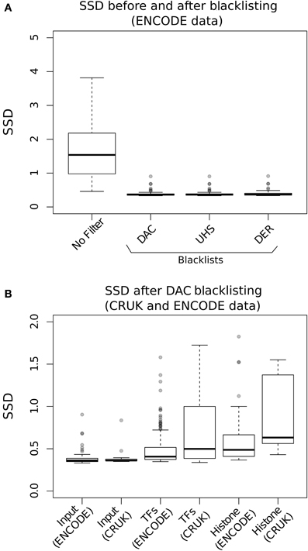
SSD and Blacklists
Carroll et al 2014
SSD is very sensitive high signal artefact regions.
Input SSD scores reduced after Blacklisting
Sample SSD scores remain higher.

Slide 22
Clustering of Watson/Crick reads.

Slide 23
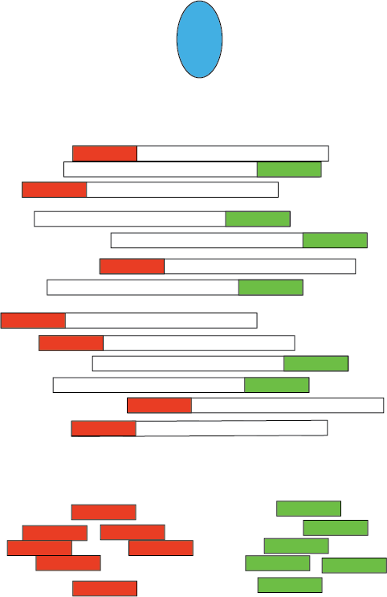
Watson and Crick reads cluster around epigenetic marks
ChIP-seq is typically single ended.
ChIP-seq watson and crick reads cluster around binding events.
For transcription factors the extent of this clustering related to ChIP-seq quality.

Slide 24
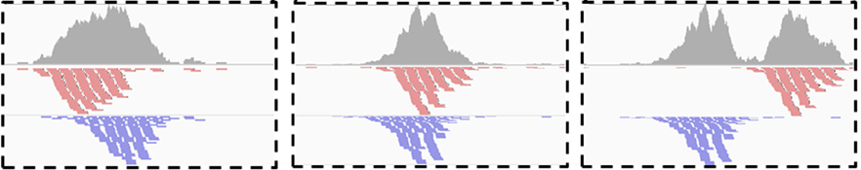
Assessing W/C read clustering
Slide Watson reads along binding site (5' to 3').
Total area covered by signal will reduce after shifting Watson reads by fragment length

Slide 25
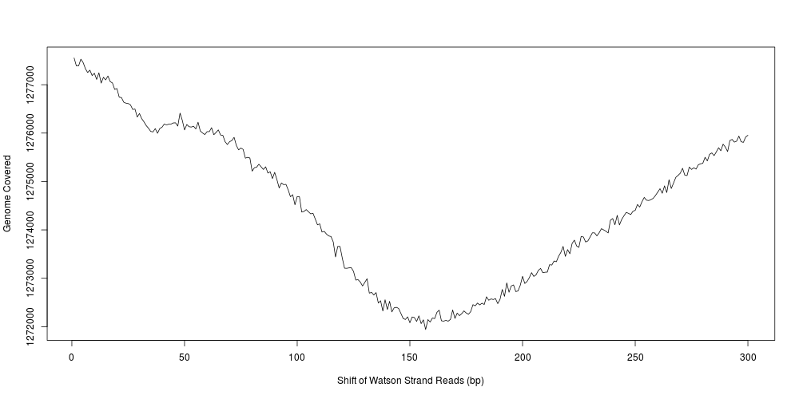
Assessing W/C read clustering
Applied across genome.
Expect reduction at fragment length.

Slide 26
Distributions Of Signal
Narrow/Punctuate enrichment (Transcription Factors).
Broad/Dispersed enrichment (Histone Marks).
Mixed Enrichment (Transcriptional Machinery).
Background control (No IP fragmented DNA).
Different epigentic marks can have dramatically differing signal profiles.
Evaluation of distribution of signal can help:-
  Characterize enrichment profile.
  Allow for comparison between ChIP's efficiencies.
  Identify the presence of artefact signal.

Slide 27
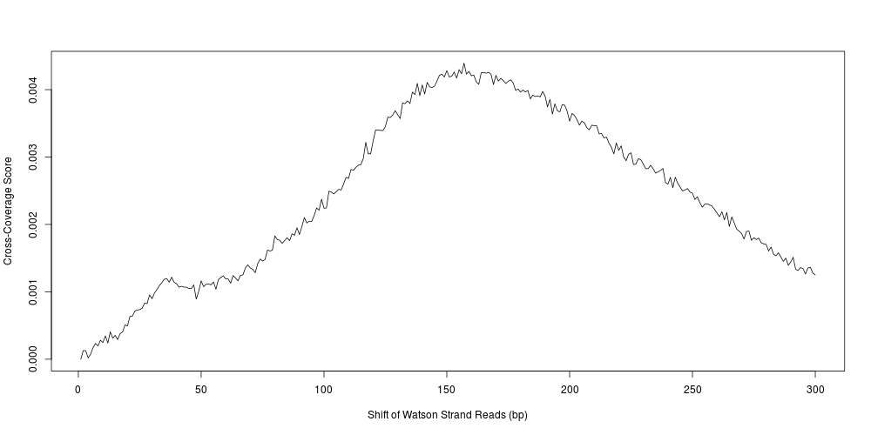
Assessing W/C read clustering
Convert total coverage to cross-coverage scores to allow for comparison between samples (and regions)
    Cross-Coverage Score =(Coverage0 – Coveragen)/Coverage0
Frag_CC = Cross-coverage score at fragment length.

Slide 28
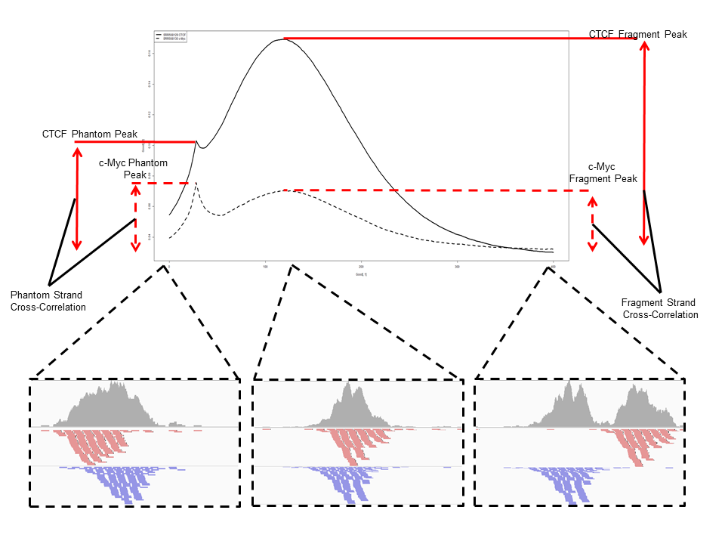
Metrics of read clustering.
By assessing correlation (SPP) or total genome covered (ChIPQC) after successive strand shifts, metrics of ChIP quality can be acquired
Exclude region around read length (+/- 1.5*read length).
Point of maximum reduction in coverage is predicted fragment length.
Fragment_CC
  Maximum over minimum reduction in coverage.
Relative_CC
  Maximum over reduction in coverage at read length

Slide 29
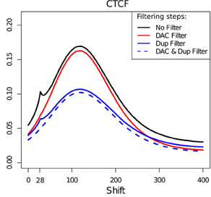
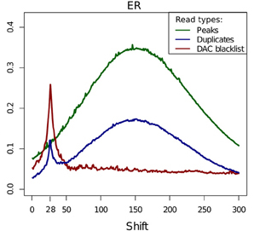
Read-length cross-coverage peak
Carroll et al 2014
Blacklisted regions strongly contribute to read length cross-coverage peak
Rel_CC = Frag_CC/ read length cross-coverage score.

Slide 30
Metrics of W/C read clustering
Frag_CC = Cross-coverage score at fragment length.
Rel_CC = Frag_CC/ Read lengthCross-coverage score

Slide 31
Duplication Rate

Slide 32
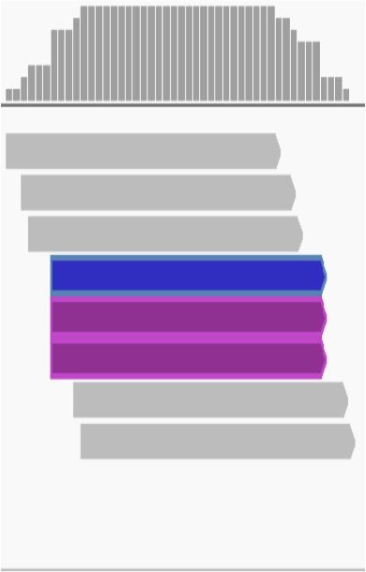
Duplicate FAQ
Typically ChIP-seq is single end sequenced
  Reads with same start position considered duplicates
Removing duplicates saturates dynamic range of signal.
  Maximum signal at base is 2*read length

Slide 33
Why worry about duplicates
“Read duplicates arise from experimental artefacts”
  Is true
“All read duplicates arise from experimental artefacts”
  Is false.
So we need to consider that duplicates may be enriched for artefacts..
..but contribute to genuine ChIP-signal

Slide 34
Duplicates (the bad kind)
Low starting material.
  If initial starting material is low this can lead to overamplification of this material.
  Biases in PCR will compound this problem.
  Can lead to artificially enriched regions.

Slide 35
Duplicates (bad kind 2)
Blacklists with ultra high signal are high in duplicates.
Masking blacklisted regions prior to analysis removes this problem

Slide 36
Duplicates (The Good and Misunderstood)
Duplicates will also exist within highly efficient (or even inefficient ChIP) when deeply sequenced ChIP.
Removal of duplicates can lead to a saturation and so underestimation of ChIP-signal!

Slide 37
Duplicates
Consider enrichment efficiency and sequencing depth.
Remove duplicates prior to peak calling.
Retain duplicates for differential binding analysis.

Slide 38
Practical.
All data is /data/ChIPQC/
Handout and R code in /data/ChIPQC/ or on Bioc2014 materials page.
We will work through first examples.
Few questions using what we learnt.

