Slide 1
Visualisation and assessment of ChIP-seq quality
BioC 2014
Thomas Carroll
MRC Clinical Sciences Centre
Imperial College London

Slide 2
ChIP-seq is noisy
ChIP-seq/ChiP-exo/DNA-seq/MNase-seq is noisy.
Experimental biases:
    Fragmentation/digestion.
    IP strength/efficiency and specificity.
    PCR Bias (Overamplification from low starting material)
Highly variable patterns of enrichment between ChIPs.
    Transcription factors may show sharp/narrow peaks.
    Polymerase II will show mix of sharp/narrow and dispersed/broad peaks

Slide 3
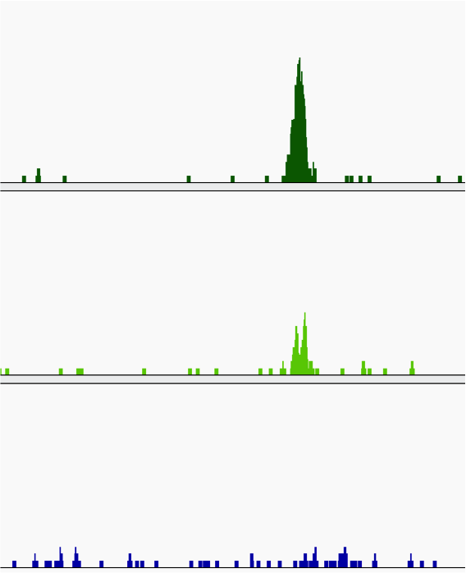
Always visualise your data
Coverage graphs.
    Wigs (Okay)
    bedGraphs (Okay)
    BigWigs (Great)
Allows for quick assessment of data...
..but dependent on user's interpretation/experience.

Slide 4
High-thoughput ChIP-seq quality control with ChIPQC
Need methods to quantify informative characteristics about your ChIP-seq data.
ChIPQC provides workflow to generate metrics per sample/experiment..

Slide 5
ChIPQC package
A workflow package providing common metrics and visualisations useful for ChIP-seq data.
Available on all platforms.
Simple interface.
(Reasonably) low CPU and memory demands.
Integration with DiffBind and rtracktables packages allows us to move to analysis and reporting.

Slide 6
ChIP-seq metrics
Clustering of Watson/Crick reads.
Distribution of Signal
  Across the genome
  Within known artefact regions
  Within enriched regions
  Within/across expected annotation
Duplication Rate.

Slide 7
Clustering of Watson/Crick reads.

Slide 8
Clustering of Watson and Crick reads
ChIP-seq reads cluster around and across epigenetic marks.
For transcription factors the extent of this clustering related to ChIP-seq quality.

Slide 9
Distributions Of Signal
Narrow/Punctuate enrichment (Transcription Factors).
Broad/Dispersed enrichment (Histone Marks).
Mixed Enrichment (Transcriptional Machinery).
Background control (No IP fragmented DNA).
Different epigentic marks can have dramatically differing signal profiles.
Evaluation of distribution of signal can help:-
  Characterize enrichment profile.
  Allow for comparison between ChIP's efficiencies.
  Identify the presence of artefact signal.

Slide 10
Metrics of read clustering.
By assessing correlation (SPP) or total genome covered (ChIPQC) after successive strand shifts, metrics of ChIP quality can be acquired
Exclude region around read length (+/- 1.5*read length).
Point of maximum reduction in coverage is predicted fragment length.
Fragment_CC
  Maximum over minimum reduction in coverage.
Relative_CC
  Maximum over reduction in coverage at read length

Slide 11
ChIPQC
Example of different profiles

Slide 12
Standards for ChIP-seq
(Experimental and practical)
Large-scale mapping and increased throughout from multiplexing has brought about some standards.
  Encode Consortium
    ChIP-seq guidelines and practices of the ENCODE and modENCODE consortia. Landt SG et al (Genome Research. 2012)
    Large-scale quality analysis of published ChIP-seq data. Marinov GK et al (G3. 2014)
  And many other labs/facilities.
    Systematic evaluation of factors influencing ChIP-seq fidelity. Chen Y et al (Nat Methods. 2012)
    Practical guidelines for the comprehensive analysis of ChIP-seq data. Bailey T et al (PLoS Comput Biol. 2013)
    Impact of artifact removal on ChIP quality metrics in ChIP-seq and ChIP-exo data Carroll TS et al (Frontiers Genet. 2014)

Slide 13
Distribution of Signal

Slide 14
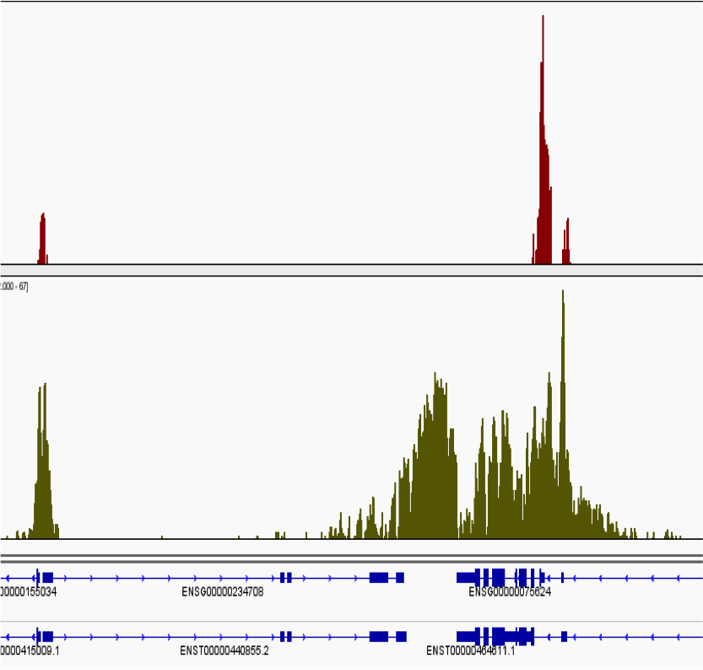
Distributions Of Signal
Narrow/Punctuate enrichment (Transcription Factors).
Broad/Dispersed enrichment (Histone Marks).
Mixed Enrichment (Transcriptional Machinery).
Background control (No IP fragmented DNA).
Different epigentic marks can have dramatically differing signal pile-up profiles.
Evaluation of distribution of signal pile-ups can help:-
  Characterize enrichment profile.
  Allow for comparison between ChIP's efficiencies.
  Identify the presence of artefact signal.

Slide 15
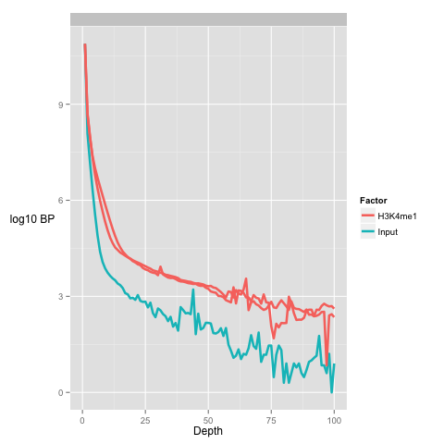
Global signal profile
A simple method to review global distribution is as histograms.
More enriched samples show higher number of bases at greater depths
Input samples show higher number of bases at low depths

Slide 16
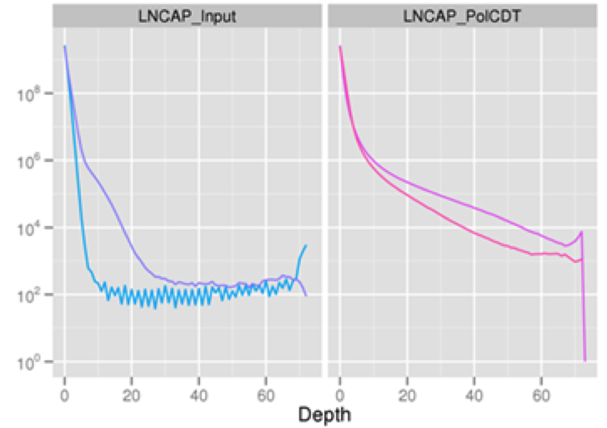
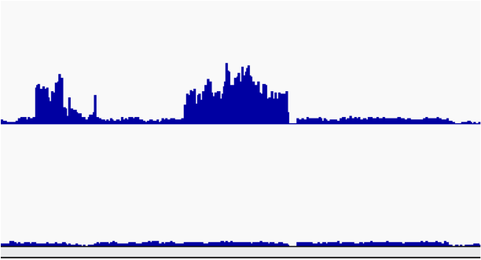
Global Signal Profile
Presence of stretch of high signal depth
Identify anomalous signal region as candidate for blacklisting.

Slide 17
Signal in Peaks (FRIP)
The simplest assessment of enrichment.
  Call enriched regions over input
  Measure fraction of reads in peaks (FRIP)
  Good quality TF > 5%
  Good quality Pol-II > 30%

Slide 18
Signal in Blacklists (FRIBL)
Work from Encode (Kudaje A) has produced curated list of conserved high signal artefact regions.
Available for many species including human, mouse and drosophila genomes.
Can account for high proportion of total signal (> 10%).

Slide 19
Blacklists
Signal from blacklist has been shown to strongly influence both SSD and Cross-Coverage metrics

Slide 20
Duplication Rate

Slide 21
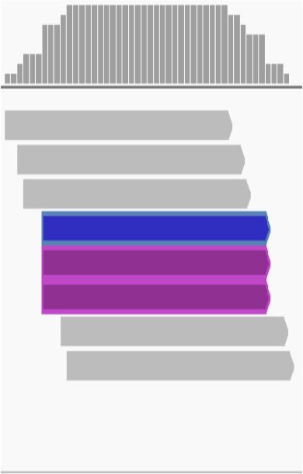
Duplicate FAQ
Typically ChIP-seq is single end sequenced
  Reads with same start position considered duplicates
Removing duplicates saturates dynamic range of signal.
  Maximum signal at base is 2*read length

Slide 22
Why worry about duplicates
“Read duplicates arise from experimental artefacts”
  Is true
“All read duplicates arise from experimental artefacts”
  Is false.
So we need to consider that duplicates may be enriched for artefacts..
..but contribute to genuine ChIP-signal

Slide 23
Duplicates (the bad kind)
Low starting material.
  If initial starting material is low this can lead to overamplification of this material.
  Biases in PCR will compound this problem.
  Can lead to artificially enriched regions.

Slide 24
Duplicates (bad kind 2)
Both highly repetitive and non-repetitive genomic regions found to be highly enriched for ChIP signal.
These ultra-high signal regions will contain large numbers of duplicate due to their massive enrichment for signal.
Ultra high signal here can confound between sample comparisons and enrichment calls.

Slide 25
Duplicates (The Good and Misunderstood)
Duplicates will also exist within highly efficient (or even inefficient ChIP) when deeply sequenced ChIP.
Single-end sequencing can grossly overestimate the extent of duplication.
Paired-end or random barcodes may allow for better resolution.
Removal of duplicates can lead to a saturation and so underestimation of ChIP-signal!

