Slide 1
Insert and Format Slides
Microsoft Office Specialist Study Guide for PowerPoint 2019

Slide 3
Spring Into Action

Slide 4
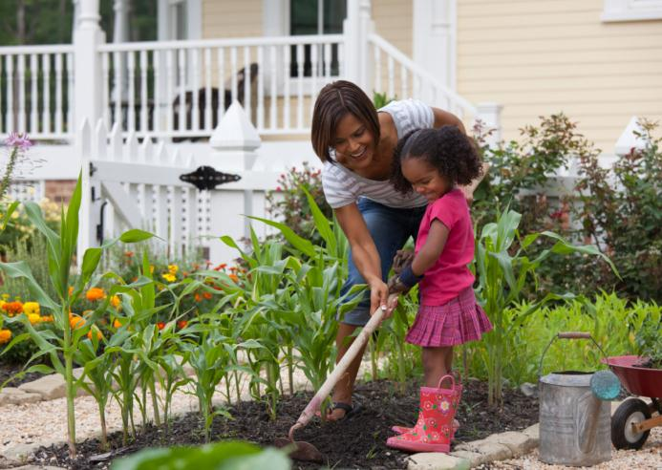
Grow Your Own Gardener
Time together in the garden offers many opportunities for sharing information with youth

Slide 5
Summer Savings

Slide 6
Water Conservation
Plant succulents and ground cover that retain water within the soil
Decorate a portion of your landscape with rocks, colored concrete, or colored glass
During hot periods, check sprinklers weekly for damaged heads and to ensure they’re delivering water where it’s needed

Slide 7
Falling Rates

Slide 8
Winter Wonders

Slide 9
Water Conservation
Plant succulents and ground cover that retain water within the soil
Decorate a portion of your landscape with rocks, colored concrete, or colored glass
During hot periods, check sprinklers weekly for damaged heads and to ensure they’re delivering water where it’s needed

