Slide 1
Buying Trips
Ensuring Successful Outcomes

Slide 2
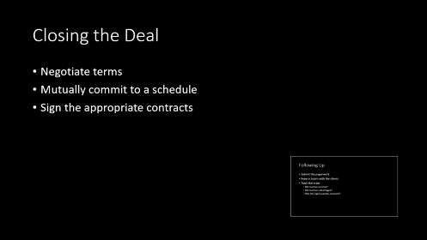
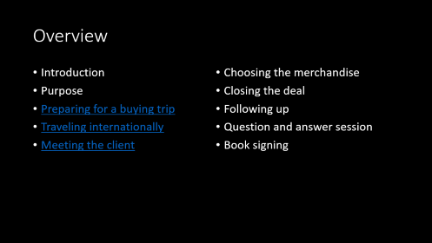
Summary

Slide 3
Overview
Introduction
Purpose
Preparing for a buying trip
Traveling internationally
Meeting the client
Choosing the merchandise
Closing the deal
Following up
Question and answer session
Book signing

Slide 4
Preparing for a Buying Trip
Know your needs
  Know your customers
  Know the current trends
Set up your meetings
Plan the itinerary
Read the Buyer manual
Pack what you need

Slide 5
Traveling Internationally
Know the culture
Read the latest advisories
Check your passport
Update your immunizations

Slide 6
Meeting the Client
Make proper introductions
Dress appropriately
Build good relationships

Slide 7
Choosing the Merchandise
Is it available?
Is it good quality?
What’s the production time?
What’s our profit margin?

Slide 8
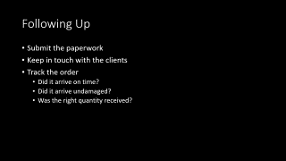
Closing the Deal
Negotiate terms
Mutually commit to a schedule
Sign the appropriate contracts

Slide 9
Following Up
Submit the paperwork
Keep in touch with the clients
Track the order
  Did it arrive on time?
  Did it arrive undamaged?
  Was the right quantity received?

