Slide 1
Time Management
Better organization for better results

Slide 2
Spend Your Time Wisely
Effect of Focused Activity
Task | Minutes/Day | Hours Saved/Week
Document management
Email management
Calendar management

Slide 3
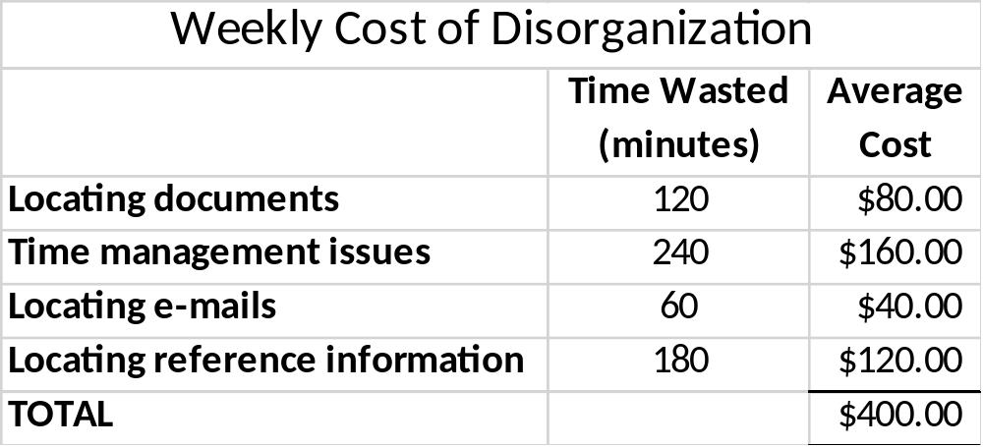
Cost of Mismanagement

