Slide 1
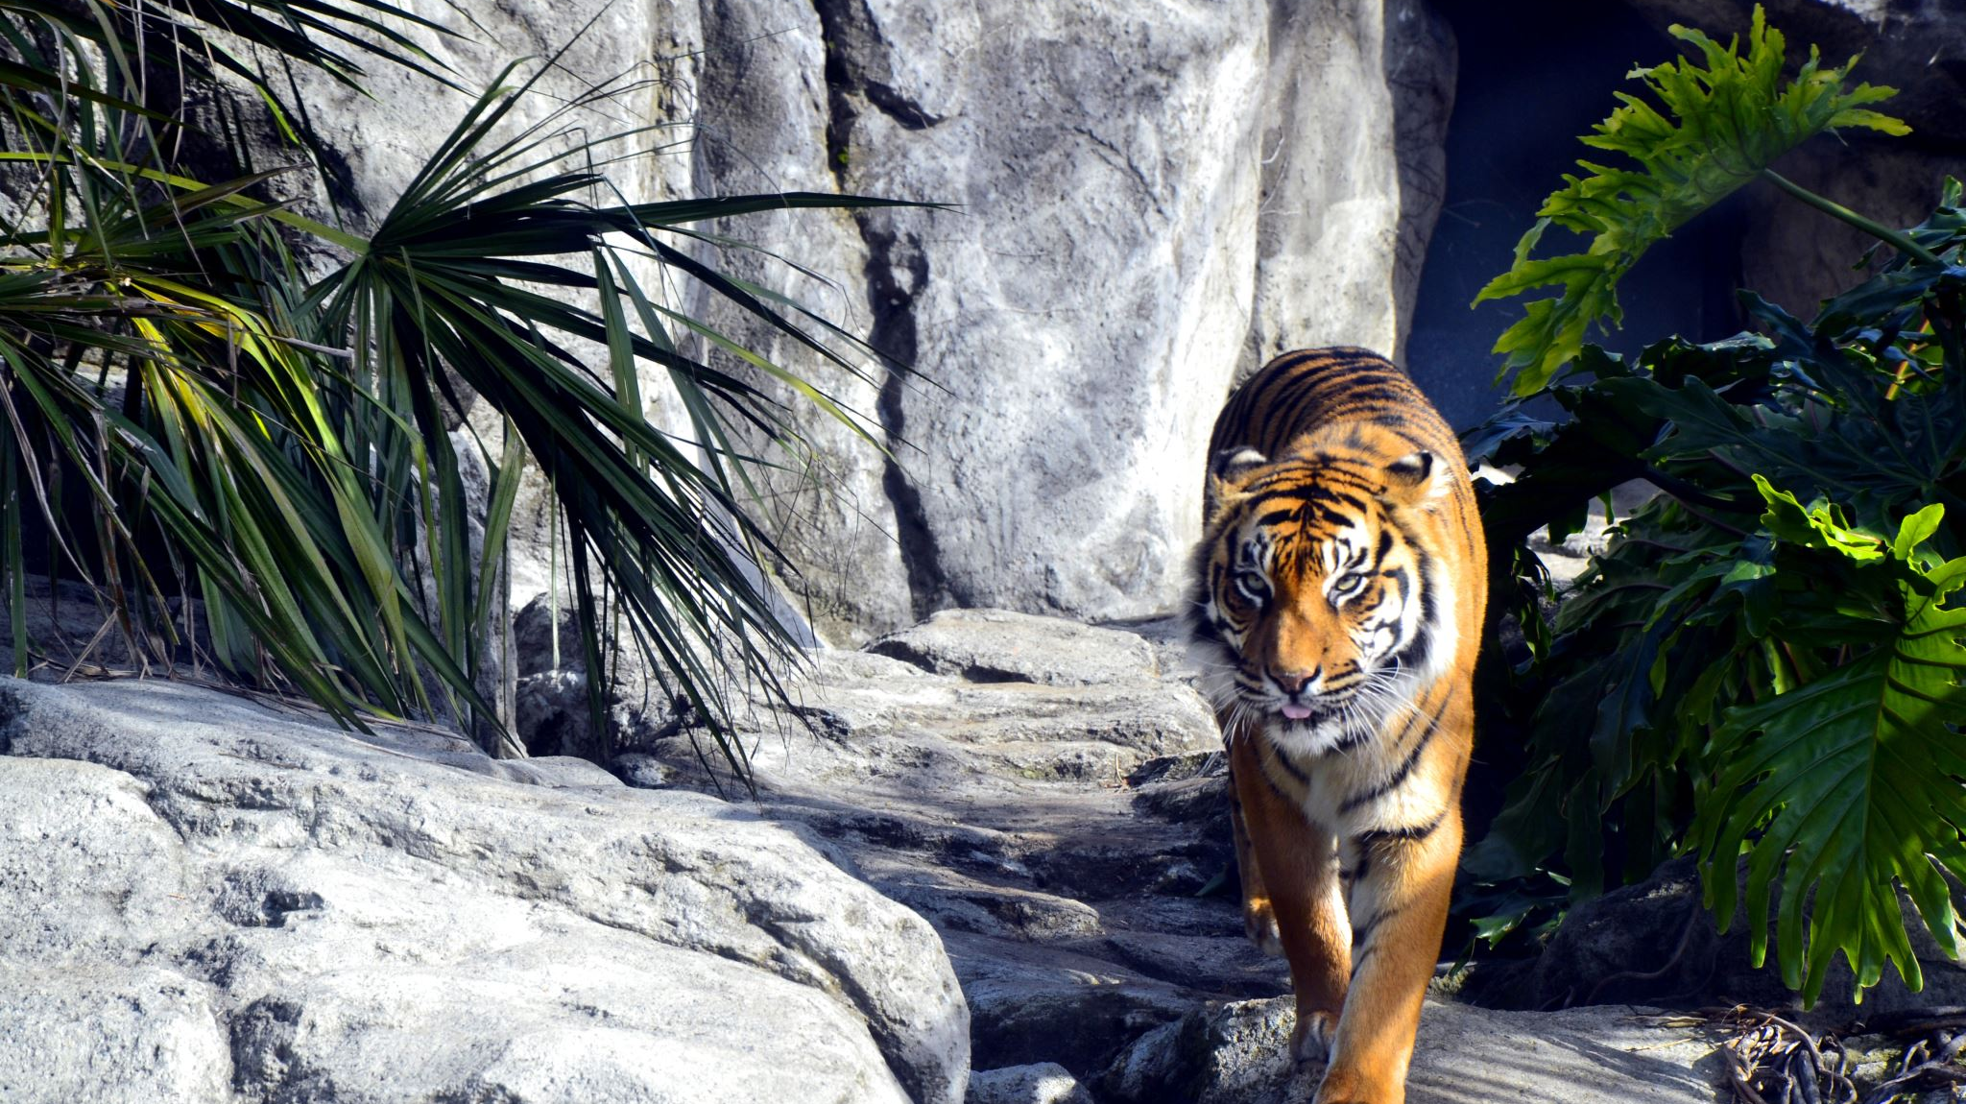
Wild Cats
Animal Nature Series

Slide 2
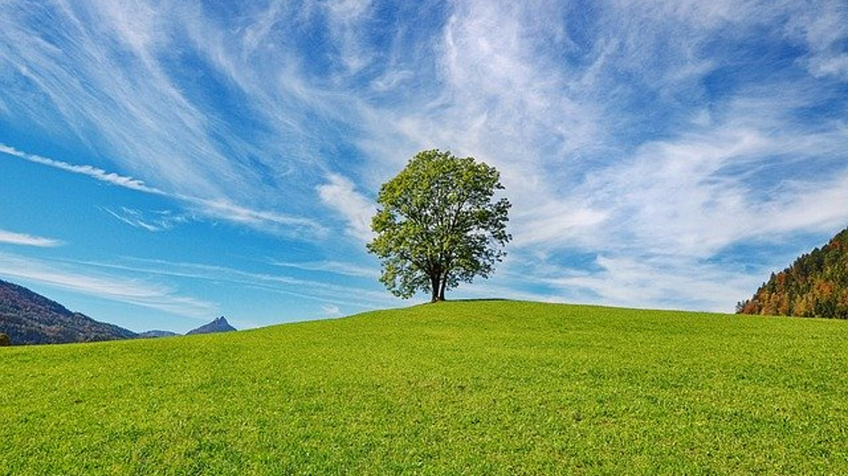
Furry Felines

