Slide 1
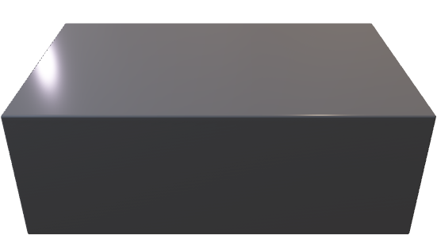

Alice’s Apparatus
Laser
Intensity
modulator

