Slide 1
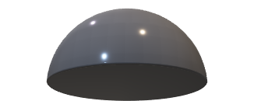

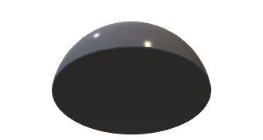
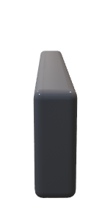
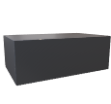
Alice
Bob
D_{B}
t_{B}
D_{M1}
1-t_{B}
Laser
Variable
attenuator
0.5 t_{bit}
D_{M2}

