Slide 1
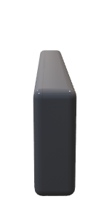

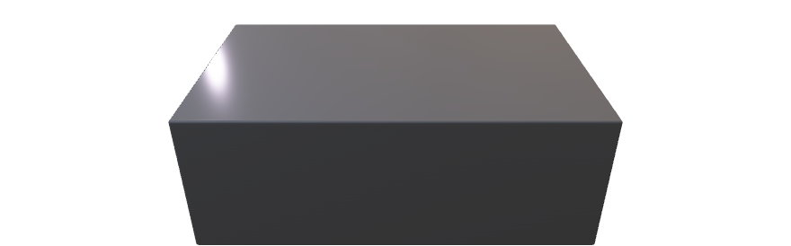
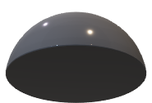
Alice
Bob
Intensity
Modulator
t_{B}
D_{B}
1-t_{B}
Laser
Optical
attenuator
D_{M1}
0.5 t_{bit}
D_{M2}

Slide 2


Alice
Bob
Quantum Channel
Authenticated Classical Channel

Slide 3

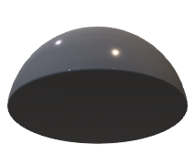
Bob
D_{B}
t_{B}
1-t_{B}
D_{M1}
0.5 t_{bit}
D_{M2}

Slide 4
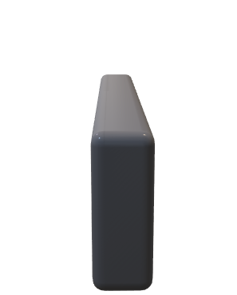

Alice
Intensity
Modulator
Laser
Optical
attenuator

Slide 8
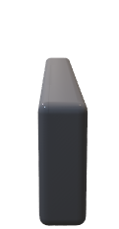




Alice
Eve
Intensity
Modulator
Bob
t_{B}
D_{B}
1-t_{B}
Laser
Optical
attenuator
D_{M1}
0.5 t_{bit}
D_{M2}

