Slide 1
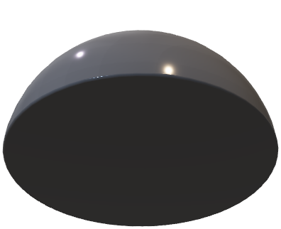
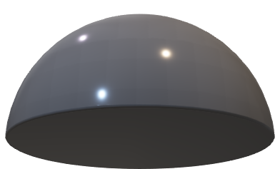
Bob’s Apparatus
D_{B}
t_{B}
D_{M1}
1-t_{B}
D_{M2}

