Slide 1
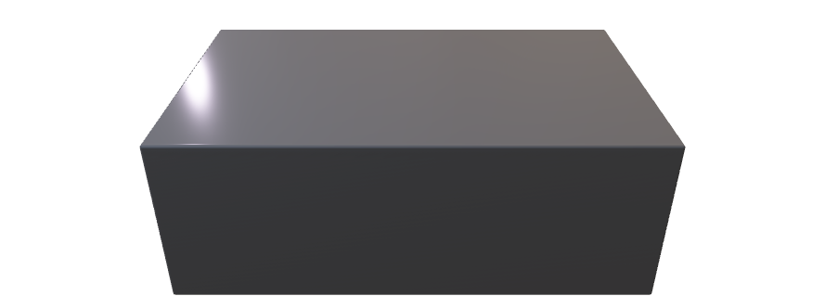
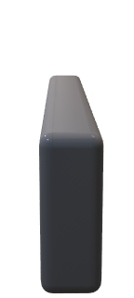

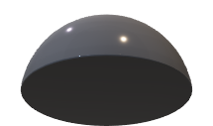
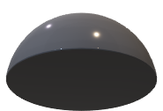

Alice
Bob
Intensity
Modulator
D_{B}
t_{B}
1-t_{B}
Laser
Optical
attenuator
D_{M1}
0.5 t_{bit}
D_{M2}

Slide 2


Alice
Bob
Quantum Channel
Authenticated Classical Channel

Slide 3

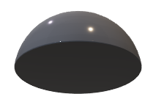
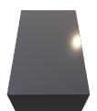
Bob
D_{B}
t_{B}
1-t_{B}
D_{M1}
0.5 t_{bit}
D_{M2}

Slide 5
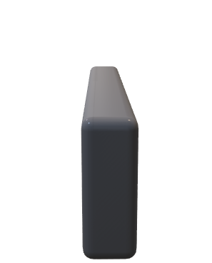

Alice
Intensity
Modulator
Laser
Optical
attenuator

Slide 8

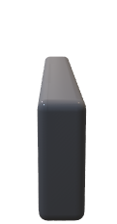
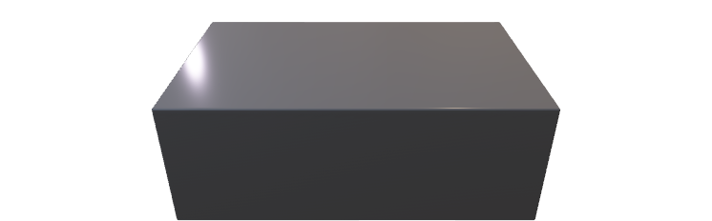


Alice
Intensity
Modulator
Eve
D_{E}
Laser
Optical
attenuator
Bob
Intensity
Modulator
t_{B}
D_{B}
1-t_{B}
D_{M1}
0.5 t_{bit}
Laser
Optical
attenuator
D_{M2}

Slide 10
 | Eve Efficiency=0.1 |  |  | Eve Efficiency=0.1 |  |  | Eve Efficiency=1
 | Min | Average | Max | Min | Average | Max | Min | Average | Max
QBER | 0.0020583 | 0.73014 | 1 | 0.0016881 | 0.22776 | 1 | 0.001729 | 0.0023946 | 0.00032631
B_{M1}+B_{M2} | 0 | 1106 | 9261 | 0 | 4602 | 9383 | 8889 | 9173 | 9404
Key Length | 85 | 4968 | 40642 | 91 | 20361 | 40883 | 40034 | 40438 | 40748

Slide 11
 | Min | Average | Max
QBER | 0.00013664 | 0.73014 | 1
B_{M1}+B_{M2} | 96289 | 1106 | 9261
Key Length | 864089 | 4968 | 40642

