Slide 1
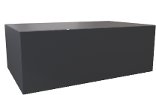
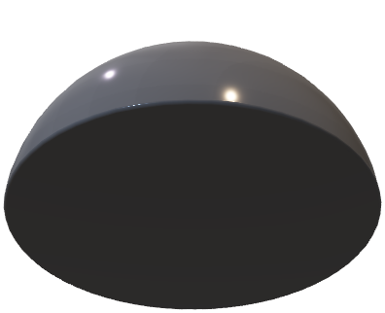
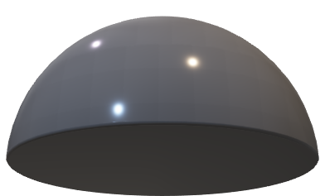
Bob’s Apparatus
D_{B}
t_{B}
D_{M1}
0,5 T_{bit}
1-t_{B}
D_{M2}

