Slide 1


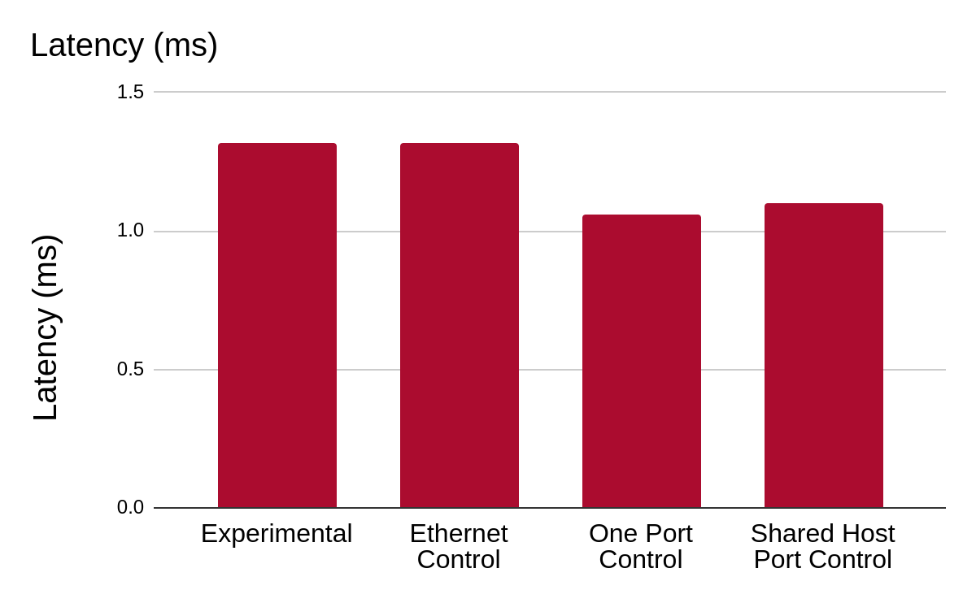
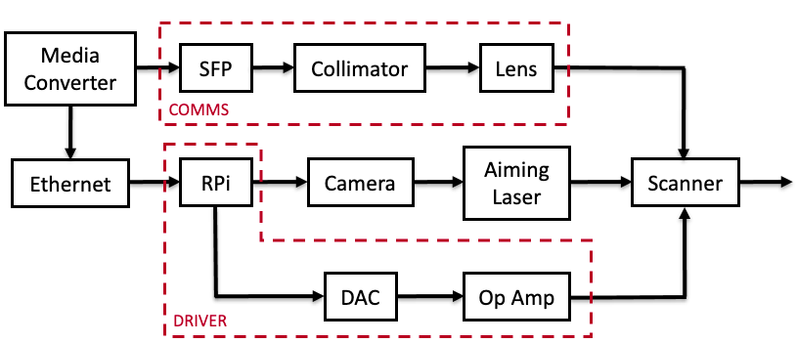
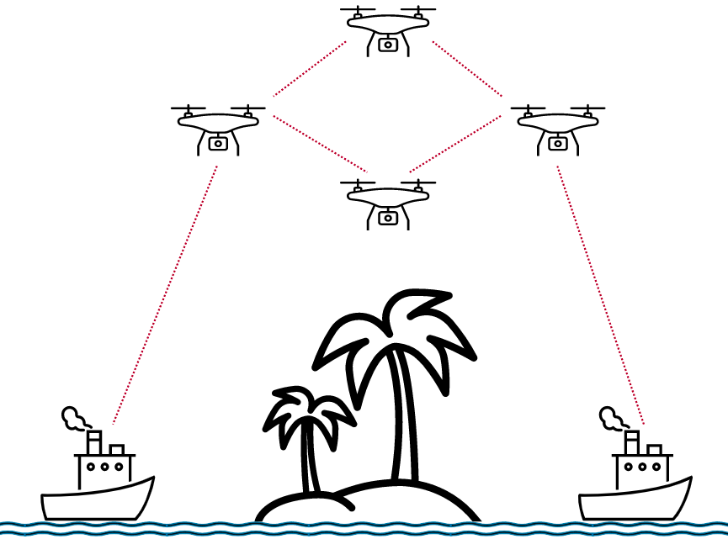
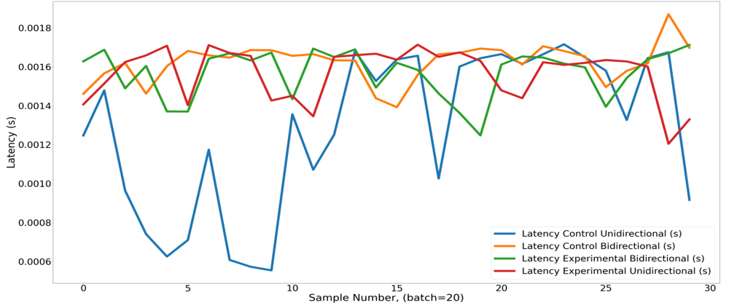
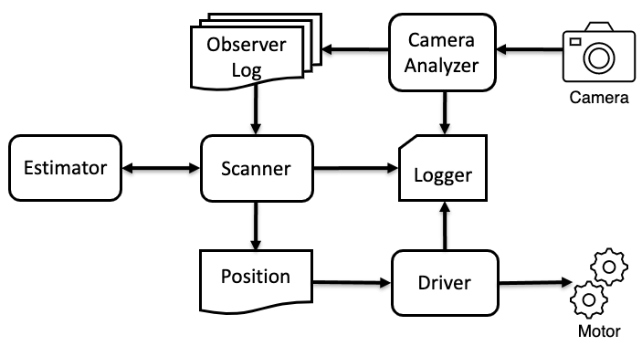
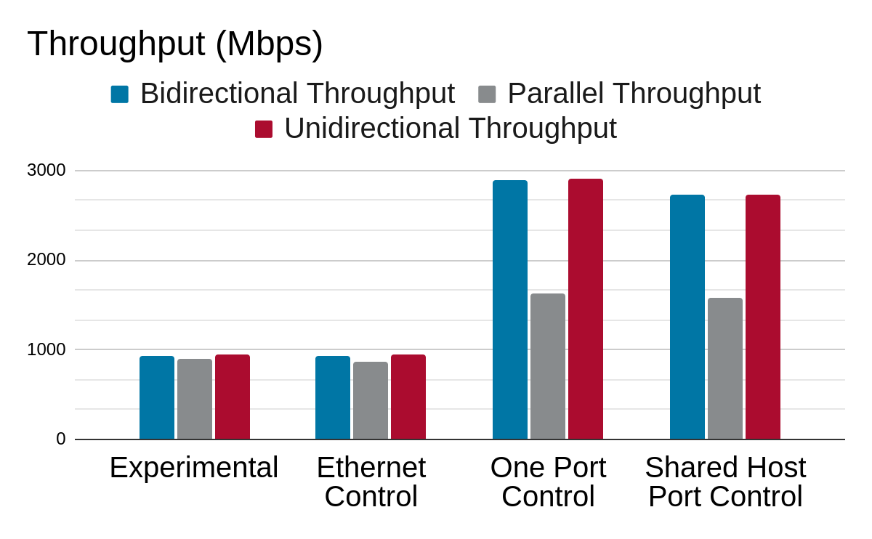
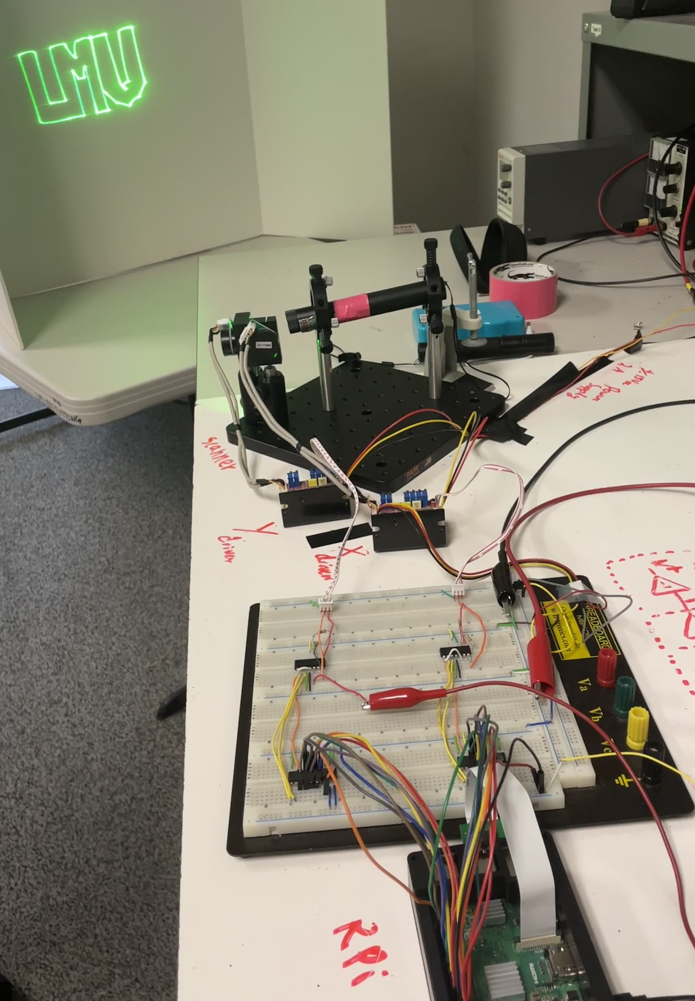
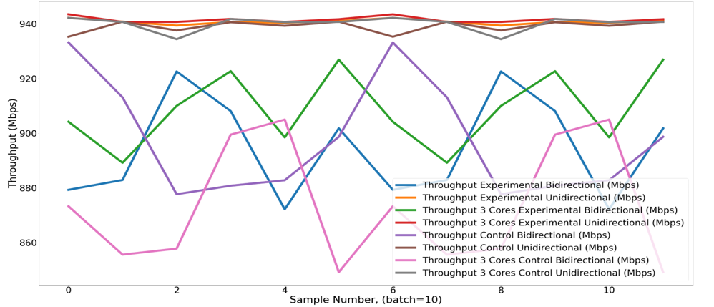
Marine Infrared Communication Repeater with Optical Propagation
Ian Green & Natalia Cedeño
Department of Electrical & Computer Engineering
Loyola Marymount University, Los Angeles 2022
INTRODUCTION
PROPOSED SOLUTION
LATENCY RESULTS
An affordable dynamic free-space optical communication (FSOC) system is required for the creation of ad-hoc networks. The Marine Infrared Communication Repeater with Optical Propagation (MICROP) system developed creates a proof of concept for dynamic FSOC systems. It uses a visible aiming laser and a small-factor form pluggable (SFP).
An affordable dynamic FSOC system was designed using commercial off-the-shelf products and widely accepted standards, allowing for hobbyist and personal use. This type of system would expand utility to smaller units and allow for the sharing of data with more components.
Average Latency Test | Latency (ms)​
Control Unidirectional​ | 1.30​
Control Bidirectional​ | 1.62​
Experimental Bidirectional​ | 1.57​
Experimental Unidirectional​ | 1.57​
HARDWARE SYSTEM DIAGRAM
SOFTWARE SYSTEM DIAGRAM
THROUGHPUT RESULTS
Average Experimental ​Throughput | Average Experimental Throughput (Mbps)​ | Average Control Throughput (Mbps)​
Bidirectional​ | 894​ | ​898​
Unidirectional​ | 941​ | ​939​
3 Cores Bidirectional​ | 909​ | ​873
3 Cores Unidirectional​ | 942​ | 940​
DISCUSSION
The system was tested by connecting it to two virtual machines which would communicate exclusively through the MICROP system. Throughput and latency tests were run with the experimental setup, with a direct ethernet connection, with a shared connection to the same ethernet port, and with a shared connection to the host internet driver. Latency tests showed a slight increase in latency when using the ethernet adapter, with a baseline delay from standard software delays. This result points to the ethernet adapter as a cause of delay. Throughput tests showed a massive increase in throughput when not using the ethernet adapter, again pointing to the adapter as the system bottleneck. From this, we were able to conclude that the experimental setup was neither introducing delays nor bottlenecks.
ERROR AND DIVERGENCE RESULTS
Testing Setup ​ | Bidirectional Bit Error​ Rate | Parallel Bidirectional Bit Error Rate ​ | Unidirectional Bit Error ​ Rate
Hardware-in-the-loop fiber ​ | 4.24E-08 ​ | 2.18E-07 ​ | 6.99E-08 ​
Ethernet only ​ | 1.08E-07 ​ | 2.46E-07 ​ | 7.26E-08 ​
Shared port ​ | 5.39E-06 ​ | 2.78E-06 ​ | 5.34E-06 ​
Shared network adapter | 5.53E-06 ​ | 2.55E-06 ​ | 5.49E-06 ​
Setup​ | Divergence (mm)​
SFP Only​ | 117.7​
Fiber Only​ | 100.8​
SFP with Lens​ | 5.6​
Fiber with Lens​ | 4.8​

