Slide 1

LMX Cloud
Build Update — September 2026
What's built, what's in progress, and where it's headed
lmxcloud.io

Slide 2
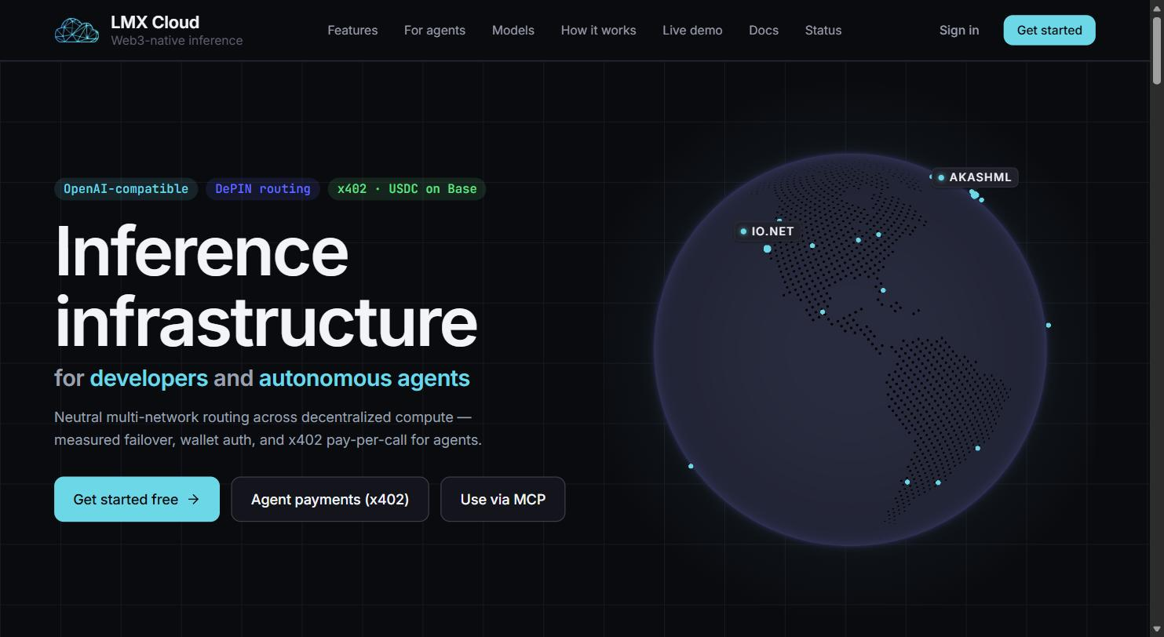



THE PRODUCT
Inference infrastructure for developers and autonomous agents
An OpenAI-compatible API that routes inference requests across decentralized compute networks instead of one cloud provider — same request format developers already use, with automatic failover if a provider is degraded.
Multi-network routing
io.net, Akash, and Aethir Mesh behind one API, with health-aware fallback.
Wallet-native
Sign in and fund with USDC on Base — no card, no corporate account required.
Built for agents
Autonomous agents can pay per call with a wallet and no prior relationship.
LMX CLOUD · BUILD UPDATE · 02

Slide 3



ROADMAP AT A GLANCE
Four phases, one build
DONE
DONE
ACTIVE
DIRECTION
Phase 0
Phase 1
Phase 2
Phase 3
Foundation
Distribution
Settlement + Proof Platform
Full Stack
Deploy, security hardening, wallet identity, on-chain receipts, x402 payment plumbing.
Findable & payable by autonomous agents — Bazaar, MCP registry, ElizaOS plugin.
LMX Grid: agent memory (Vault), the open agent framework, callable function registry.
Open coordination protocol and native DePIN compute supply — the long-term ambition.
LMX CLOUD · BUILD UPDATE · 03

Slide 4
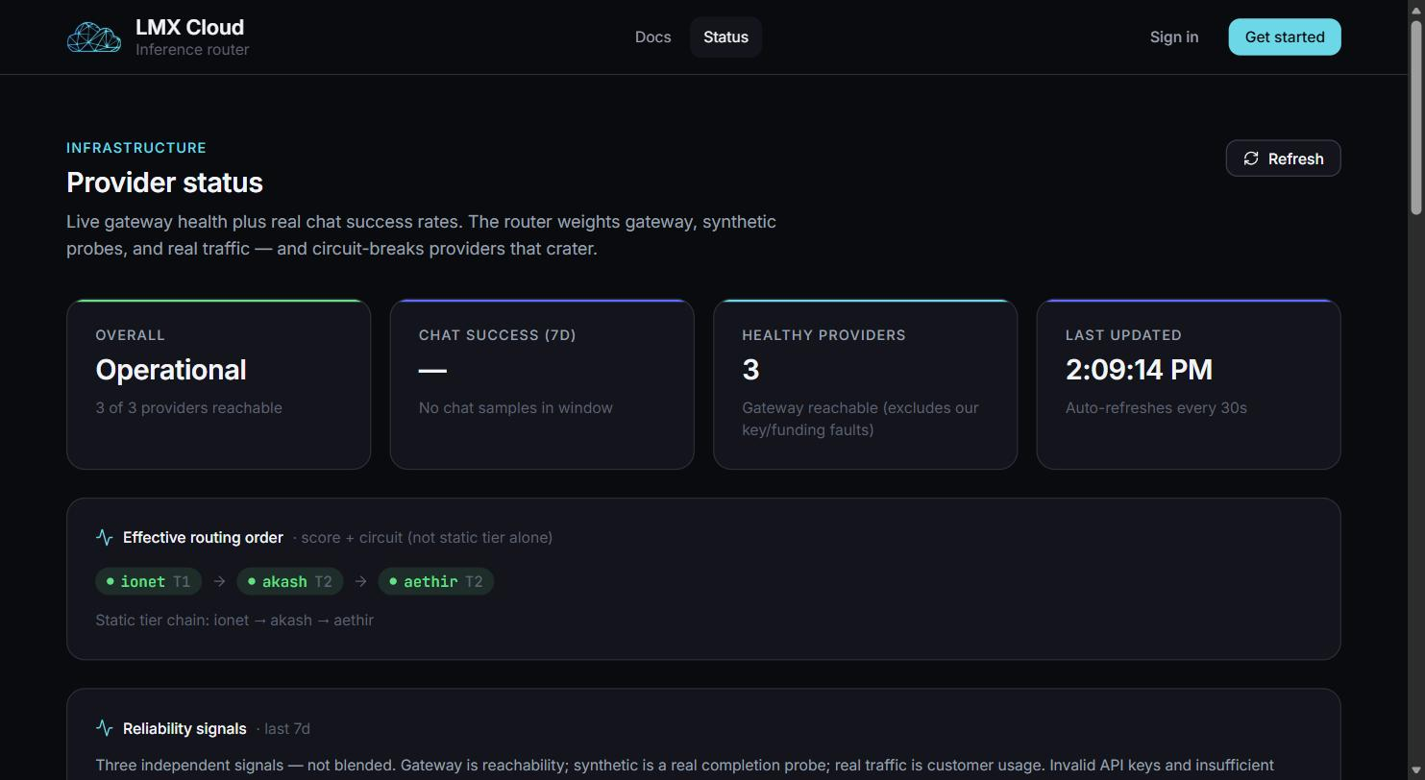

BUILT
Core inference router, live and measured
3
decentralized provider networks — io.net, Akash, Aethir
30+
models available through one OpenAI-compatible API
Live
streaming completions, real SSE, not simulated
Weighted routing + circuit breaker
Rolling 6h real + synthetic success weighting; providers that crater get circuit-broken automatically.
LMX CLOUD · BUILD UPDATE · 04

Slide 5
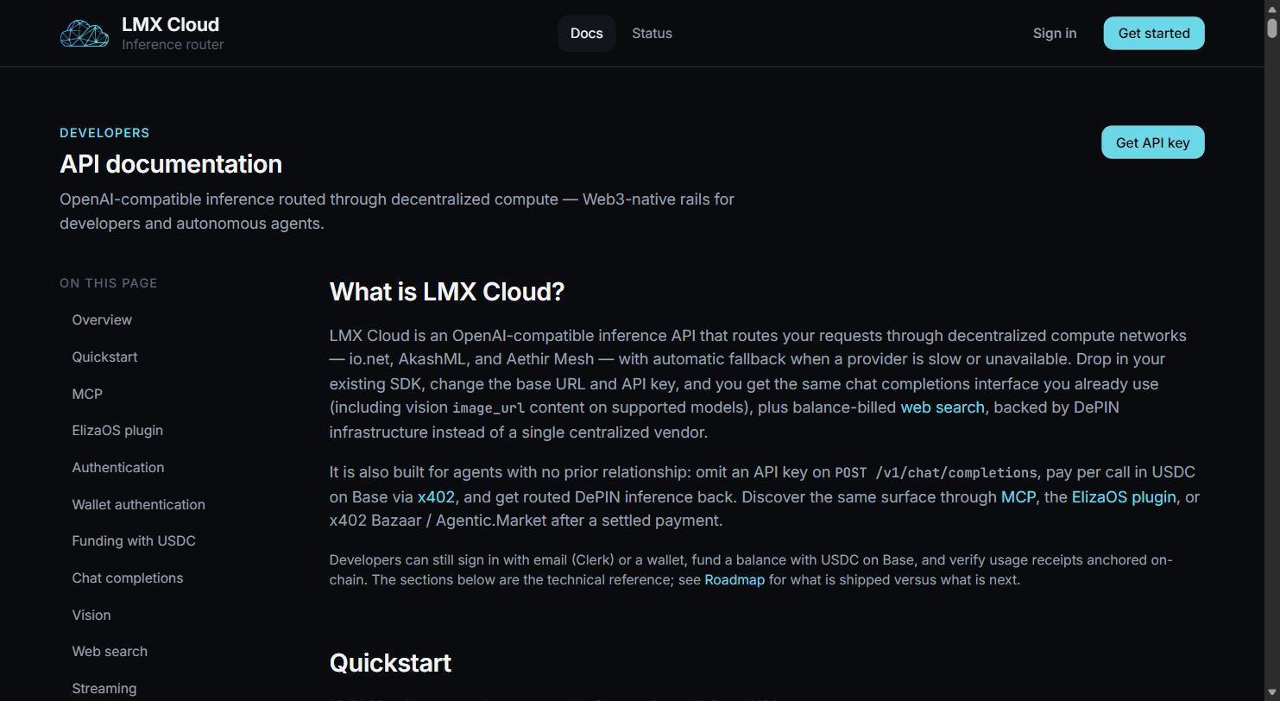

BUILT
Payments and identity built for wallets, not just cards
Wallet sign-in + USDC funding on Base
SIWE sign-in, on-chain USDC deposits auto-credit a balance — no card required.
Verifiable on-chain receipts
Every request gets a Merkle-anchored receipt — provable proof it happened as billed.
True pay-per-call via x402
An agent with a wallet and no account can pay for a single request and get routed inference back.
LMX CLOUD · BUILD UPDATE · 05

Slide 6

BUILT
Findable and payable by autonomous agents
Phase 1 shipped all three channels an agent actually uses to discover and pay for a service — no human in the loop.
x402 Bazaar + Agentic.Market
MCP server
ElizaOS plugin
Listed on Coinbase's discovery layer for x402-paid services — protocol-level, framework-agnostic.
Published to the official Model Context Protocol registry — reachable by Claude, ChatGPT agents, and more.
Live on npm as a wallet-funded model provider; community registry PR open for review.
LMX CLOUD · BUILD UPDATE · 06

Slide 7
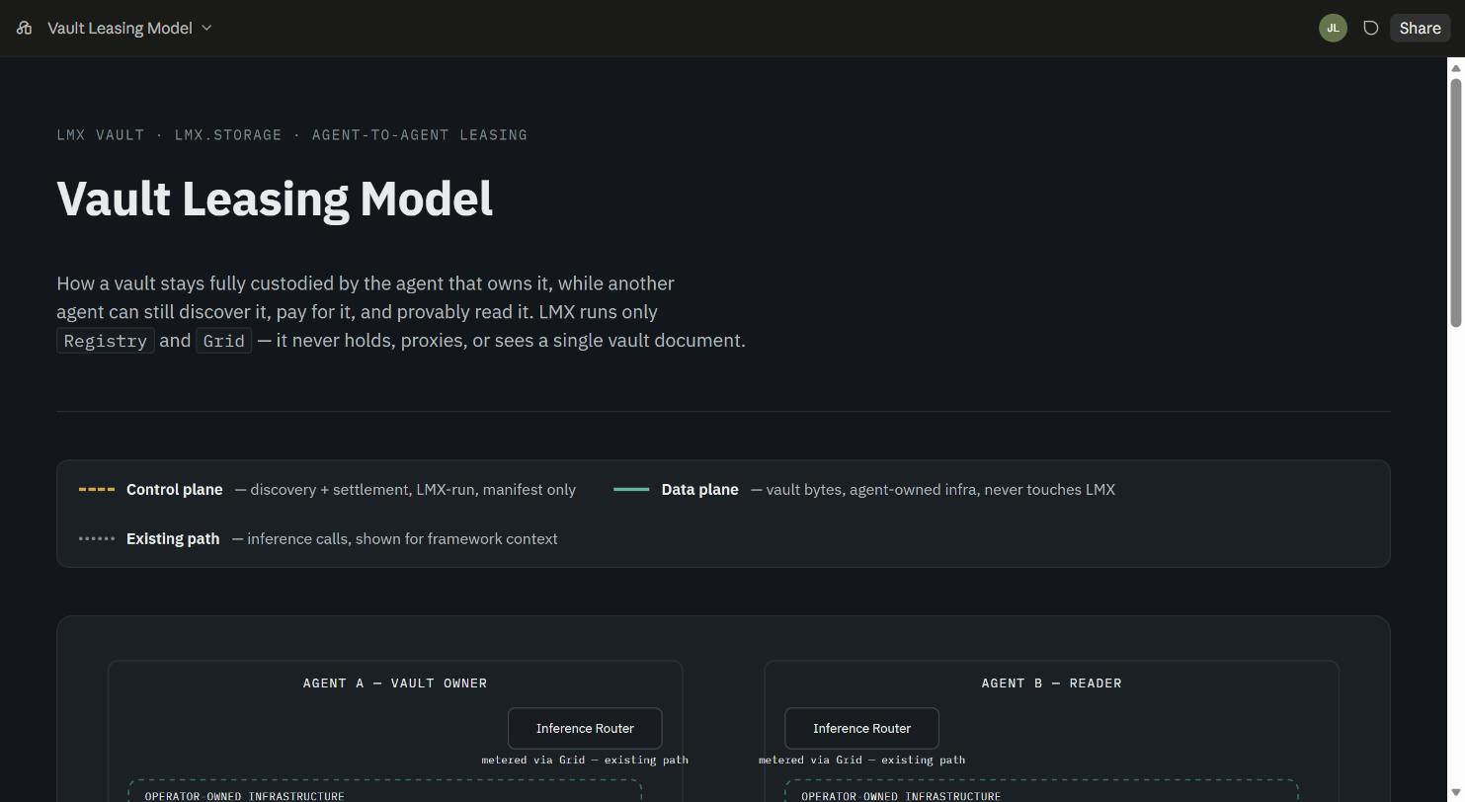

BUILT
Every agent gets its own memory — self-hosted, not ours
Markdown notes, structured metadata
Each vault is markdown + YAML frontmatter — queryable fields, prose, and linked context.
Self-hosted by the operator
Runs on the agent operator's own infrastructure. LMX never stores the content — only a manifest pointer.
Verified end to end
PUT / GET round-trip is byte-identical; zero-config SQLite default makes it a one-command start.
LMX CLOUD · BUILD UPDATE · 07

Slide 8




IN DEVELOPMENT
An open framework, and the first real agent built on it
lmx-agent-template
Every agent gets a wallet, memory, and a connection to the router — out of the box, zero setup.
Flagship agent: @LMXCloudio
LMX's own marketing account, run by an agent built on the template — real dogfooding, real Grid traffic.
Zero-setup run verified
pnpm dev “<question>” mints a demo identity and derives a stable vault namespace automatically.
1. Draft
generator.write_copy via the router
Recall → reason → remember proven
A second run reused the cached identity and correctly recalled the first run's note.
2. Publish
posts live to X through lmx-tool-publish-x
Wallet-paid x402 signing — finishing now
3. Collect
Settlement is wired; exercising it with a real signed payment is the last piece going in.
pulls engagement back via analytics tool
4. Remember
writes a note to its own vault
LMX CLOUD · BUILD UPDATE · 08

Slide 9


IN DEVELOPMENT
Getting the router in front of real users
Demand-seeding runs daily, in parallel with the build — warm outreach, community posting, and starter credits for anyone who wants to try it.
Warm + cold outreach
Developer communities
Starter credits
Direct outreach to builders who need wallet-native, machine-payable compute.
Posting where builders already are — Latent Space, r/LocalLLaMA, Cursor, and more.
Free credits for early testers to try the router with zero commitment.
LMX CLOUD · BUILD UPDATE · 09

Slide 10

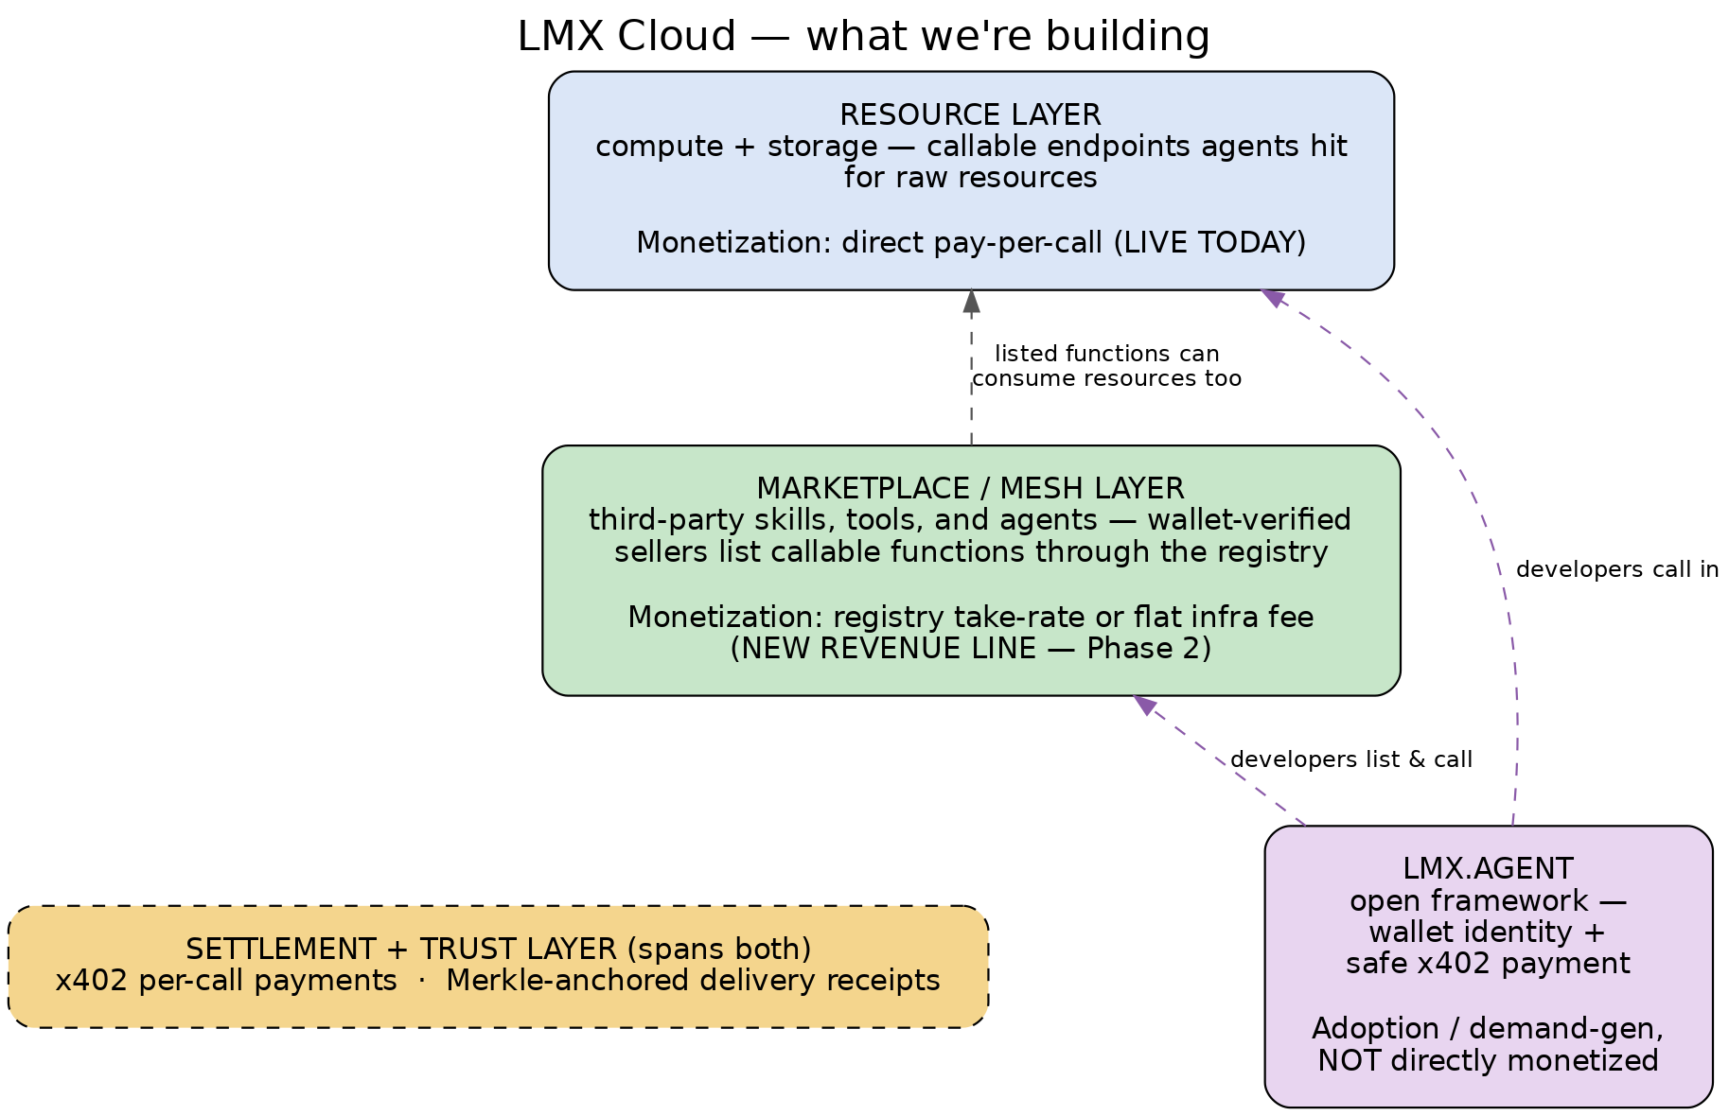
DIRECTION
LMX Grid: the settlement and proof layer underneath everything
Payment alone isn't a moat, and discovery alone isn't a moat — proof of delivery is the wedge. Grid meters and receipts every call, whether it's inference today or other tools later.
LMX CLOUD · BUILD UPDATE · 10

Slide 11

DIRECTION
An open economy where agents find, pay, and get paid by each other
Wallet + Vault by default
Every agent scaffolds with its own identity and its own memory — not an opt-in add-on.
Decentralized by design
North star
Vault custody stays with whoever runs the agent. LMX hosts only a thin manifest pointer, never the data.
“Every agent can easily mint its own vault. It needs to be frictionless, and it needs to make agents better. And secondly, it's monetizable.”
Open function registry
Once proven, other builders and agents list their own tools and get paid through the same rails — not just LMX's own compute.
Near-term goal: a cashflow-positive router and agent products, growing a real developer ecosystem on top of Grid.
LMX CLOUD · BUILD UPDATE · 11

Slide 12
Built in the open.
Route a request, watch it happen, or come build on it with us.
lmxcloud.io
github.com/LMXCloud
@LMXCloudio
LMX CLOUD · BUILD UPDATE · 12

