Slide 1
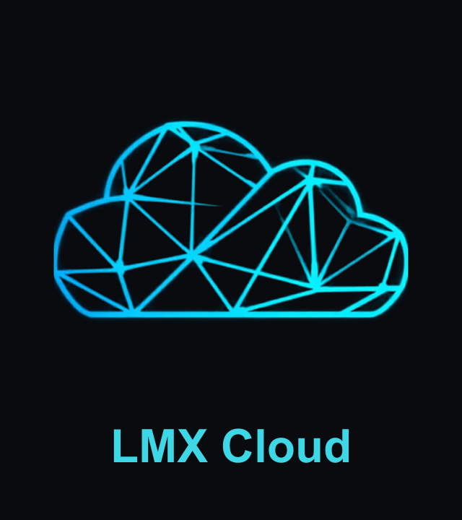
WEB3, DECODED
The Principles Behind the Next Internet—
and How LMX Cloud Is Building Them
A field guide to decentralization, verifiable trust, and machine-native money—told through the DePIN inference network LMX is shipping today.
Notes:
Cold open. Hi, I'm [name] from LMX Cloud. Web3 gets thrown around as a buzzword, but underneath the hype it's a handful of real engineering principles. In this video I'll walk through five of them, and show you exactly where each one shows up in the product we're building at LMX Cloud—not as theory, as shipped code.

Slide 2
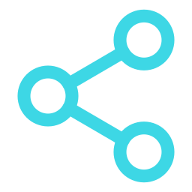



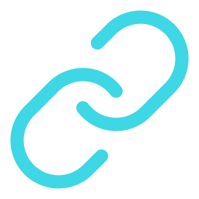
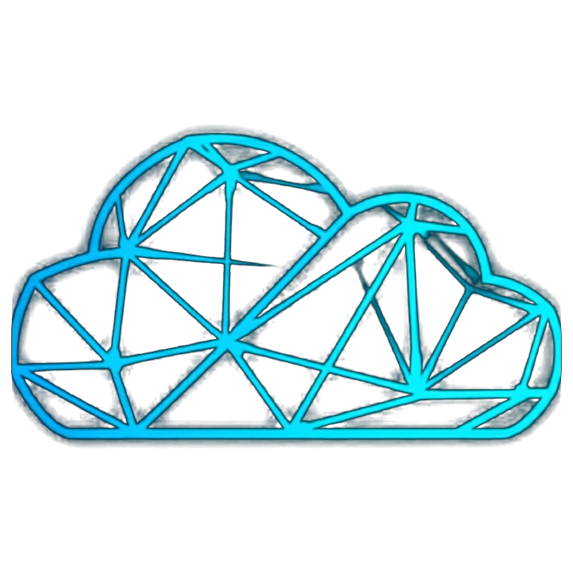
WHAT WE'LL COVER
Five principles. One architecture.
We'll define each Web3 principle in plain terms, then point at the exact piece of LMX Cloud that embodies it.
01
Decentralization
No single point of control or failure
LOCKED-IN MODEL
Wallet + Agent +
Vault + Router,
settled by Grid
02
Verifiable Trust
Cryptographic proof instead of blind faith
03
Programmable Money
Value that moves at software speed
The reference architecture every LMX agent is built from—we'll assemble it piece by piece as each principle lands.
04
Self-Custody
You (or your agent) hold what's yours
05
Open Composability
Protocols as building blocks, not walled gardens
02
Notes:
Quick roadmap for the viewer: five principles, each mapped to something real. And by the end we'll have assembled the whole LMX agent model—Wallet, Agent, Vault, Inference Router, all settled underneath by Grid.

Slide 3


LEVEL-SET
Web3 in one sentence
An internet where ownership, trust, and value move through open, cryptographically verifiable networks—instead of through a company's private database.
Web2
Web3
A platform holds your data
You (or your agent) hold your own data
You trust the company's word
Math and cryptography prove the claim
Money moves through the platform's rails
Money moves peer-to-peer, programmably
Integrations need permission
Anyone can build on the open protocol
03
Notes:
Strip away the jargon and Web3 is really just this contrast. Not better or worse in every case—different trust model. Everything we cover next is one specific engineering answer to “how do you actually build the right column.”

Slide 4
PRINCIPLE 1 OF 5
Decentralization
No single company, server, or provider is a load-bearing wall. The network keeps working even if any one participant disappears.
WEB3 PRINCIPLE
LMX CLOUD, TODAY
Work spreads across many independent operators instead of one data center
No single outage, policy change, or provider decision can take the network down
Classic Web3 example: Bitcoin/Ethereum nodes run by thousands of independent parties, not one company
Grid routes every inference call across independent DePIN compute providers.
Requests fail over live across io.net, Akash, and Aethir—no single provider is the pipe
Adding or dropping a provider is a routing change, not an outage
Same logic scales to storage and other resources next
04
Notes:
First principle: decentralization. This is where LMX started—it's literally in the name of the product. The inference router doesn't call one cloud; it spreads requests across multiple independent DePIN networks and fails over between them live. That's decentralization as an engineering property, not a slogan.

Slide 5
PRINCIPLE 2 OF 5
Verifiable Trust
"Don't trust, verify." Claims are backed by cryptographic proof that anyone can check, not by a brand's reputation.
WEB3 PRINCIPLE
LMX CLOUD, TODAY
A receipt, signature, or on-chain record lets any party independently confirm what happened
Removes the need to take a counterparty's word for it
The proof is about *delivery*—that something happened as specified—not a guarantee of quality
Every call through Grid gets a Merkle-anchored delivery receipt.
Cryptographic proof a call was fulfilled as specified—proof of delivery, not proof of correctness
Same receipt mechanism will back paid cross-agent Vault reads
The trust layer LMX is building on top of x402 payments
05
Notes:
Second principle: verifiable trust. In Web2 you trust the platform's dashboard. In Web3 you get a receipt you can check yourself. LMX anchors a Merkle proof to every call through Grid—and it's worth being precise here: it proves delivery, not correctness. We're not vetting output quality, we're proving the call happened as specified. That distinction matters a lot once other people start selling functions through us.

Slide 6
PRINCIPLE 3 OF 5
Programmable Money
Value moves as fast as software—micropayments, instant settlement, and machines paying machines without a human clicking "approve."
WEB3 PRINCIPLE
LMX CLOUD, TODAY
Payments are just another API call, not a multi-day settlement process
Enables pay-per-use pricing down to a single request
Unlocks a genuinely new buyer: autonomous agents transacting with each other
Every agent gets a wallet; Grid settles pay-per-call in USDC via x402.
Inference, storage, and tool calls are metered and settled per request
No invoices, no manual top-ups required to transact
The rail that makes agent-to-agent commerce possible on LMX
06
Notes:
Third principle: programmable money. This is the one that unlocks agents as an economic actor, not just a human clicking a checkout button. Every agent on LMX gets a wallet, and Grid settles usage through x402—USDC, per call, automatically. That's the plumbing an agent economy actually needs.

Slide 7
PRINCIPLE 4 OF 5
Self-Custody & Ownership
You—or your agent—hold your own data and assets. A platform can't quietly take them away, lock them in, or sell access without you.
WEB3 PRINCIPLE
LMX CLOUD, TODAY
Your keys, your data—not a platform's terms of service
Data can still be permissioned and monetized, just under owner control
The opposite of a walled garden where the platform is the only custodian
The Vault: every agent's memory, owned and hosted by its own operator.
Federated, self-hosted per operator—never one LMX-run warehouse of everyone's data
LMX runs only a thin manifest registry (owner, endpoint, price)—never the content
Permissioned reads settle through the same Grid + receipt mechanism
07
Notes:
Fourth principle: self-custody. A vault could easily have been one LMX-hosted database—that would've been faster to build. We chose federated instead: every operator runs their own storage, LMX only keeps a thin pointer registry. Your agent's memory is genuinely yours.

Slide 8
PRINCIPLE 5 OF 5
Open Composability
Protocols are building blocks anyone can plug into permissionlessly—"money legos"—instead of a closed API only the platform's own apps can use.
WEB3 PRINCIPLE
LMX CLOUD, TODAY
Open standards let independent builders integrate without asking for a partnership deal
Value compounds as more builders stack on top of the same primitives
The network effect of Web3: composability, not lock-in
LMX plugs into the open agent economy instead of walling it off.
MCP server registry: any wallet-verified provider can list a callable function
Distribution through x402 Bazaar, Agentic.Market, and an ElizaOS plugin
A listed seller and a callable function are the same object—self-serve, no human review gate
08
Notes:
Fifth principle: composability. Instead of building one closed app, LMX exposes an MCP server that any agent framework can call, lists functions on the emerging x402 marketplaces, and ships an ElizaOS plugin. The bet is that showing up everywhere agents already are beats trying to be the one place they have to come to.

Slide 9






ASSEMBLED
Five principles, one agent model
Every lmx.agent is built from the same four primitives—Grid is the settlement and proof layer underneath all of them.
Wallet
Agent
Vault
Inference Router
Identity + x402 settlement
input → tools → inference → persist
Owned, federated memory
Multi-provider reasoning calls
Grid
Meters and settles every call above, mints Merkle-anchored receipts, and gates cross-agent Vault reads. The proof layer every other primitive relies on.
09
Notes:
Put the five principles together and you get LMX's actual reference architecture: Wallet, Agent, Vault, Inference Router—and Grid running underneath all four as the settlement and proof layer. This isn't a diagram we drew for a pitch deck after the fact; it's the template every new agent gets forked from.

Slide 10

WHY THIS MATTERS NOW
Software agents are becoming economic actors
An agent that reasons, remembers, and transacts needs infrastructure a human-run platform was never built for.
Agents need to pay each other
without a human approving every transaction — solved by programmable, wallet-native money
Agents need to verify each other’s work
without a shared employer to arbitrate disputes — solved by cryptographic receipts
Agents need to own their own memory
without a platform holding it hostage — solved by self-custodied vaults
Agents need to find and call each other
without a walled-garden API — solved by open, composable protocols
10
Notes:
So why does any of this matter right now, in 2026? Because the buyer is changing. It's not just people clicking checkout anymore—it's agents transacting with other agents, needing to verify each other's work, and needing to own their own memory instead of renting it from a platform. Web3 principles aren't ideology here—they're the only architecture that actually works for machine-to-machine commerce.

Slide 11
CURRENT STATE
Where LMX Cloud stands today
LIVE TODAY
BUILDING NOW
The Inference Router
The Rest of the Stack
Multi-provider routing + failover across io.net, Akash, Aethir
30+ models, streaming responses
Wallet sign-in, USDC funding on Base
x402 pay-per-call already wired
Vault: own-namespace storage shipped; paid cross-agent reads next
lmx-agent-template: reusable framework, marketing agent as flagship
MCP function registry: marketplace + third-party sellers
This is the wedge, not the whole business—it’s how developers walk through the door.
North star: a cashflow-positive Cloud with a real developer ecosystem—every goal ladders up to that.
11
Notes:
So where does this leave LMX Cloud right now? The router is live today and it's the wedge—free credits, developers kicking the tires, building demand. Underneath that, we're building out Vault, the reusable agent framework, and the MCP marketplace. Every one of those is a direct, shipped answer to one of the five principles we just walked through. The north star is simple: a cashflow-positive Cloud with a real developer ecosystem around it.

Slide 12
Decentralized. Verifiable. Programmable.
That’s not marketing copy—it’s the architecture.
Try the inference router, fork the agent template, or follow the build.
lmxcloud.io
@LMXCloudio
github.com/LMXCloud
12
Notes:
That's the tour—five Web3 principles, and a real product built on all five of them at once. If you want to see it running, the router's live at lmxcloud.io, the agent template is open source, and we're posting the build in public on X. Thanks for watching.

