Slide 1
Palindrome2
Member：刘宓祎 陈佳怡 张恺茗

Slide 2
Catalogue：
➢
What is Palindrome
Problem
➢
Algorithm: Backtracking and dynamic programming
➢
Algorithm complexity
➢
Algorithm 2
➢

Slide 3
What is Palindrome

Slide 4

❖ What is palindrome
A palindrome is a string that can be read both forward and backward.
I, DEED, RACECAR.
BUBBASEESABANANA
BUBBASEESABANANA
BUBBASEESABANANA
BUBBASEESABANANA
BUBBASEESABANANA

Slide 5
❖ Problem
Target : Get the minimum number of palindromes that can be split for a given string
Tool : Backtracking and dynamic programming
Judge: 1. A single character must be a palindrome string.
2.If two characters are equal, it is a palindrome string.
3.For multiple characters, if the first and last bits are equal, and the middle is palindrome, then the whole is palindrome.

Slide 6
j
Algorithm: Backtracking
and dynamic programming
i
j
j
a
a
b
a
a
b
How to avoid repeated
calculation and
reduce algorithm complexity
Ans[ ]
{a} {a} or {aa}

Slide 7

f[i][j] = (s[i] == s[j]) and f[i + 1][j - 1]
Judge whether it is palindrome
( i , j )
def partition(self, s: str) -> List[List[str]]:
n = len(s)
# the data type for f is boollean
f = [[True] * n for _ in range(n)]
# the for loop, begins with n-1, ends when meet -1
for i in range(n - 1, -1, -1):
for j in range(i + 1, n):
f[i][j] = (s[i] == s[j]) and f[i + 1][j - 1]
(i+1)(j-1)
➢ Thus, f[i][j] depends on f[i+1][j-1]
O(1)

Slide 8
A | A | B | B
AABB
A
AA
AAB
null
ABB
BB
A
AB
ABB
null
B
BB
null
null
BB
B
null
B
B
BB
null
B
null
B
the tree to find substrings
A,A,B,B
null

Slide 9
class Solution:
def partition(self, s: str) -> List[List[str]]:
n = len(s)
f = [[True] * n for _ in range(n)] for i in range(n - 1, -1, -1):
for j in range(i + 1, n):
f[i][j] = (s[i] == s[j]) and f[i + 1][j - 1]
#depth first search
def dfs(i: int):
if i == n:
ret.append(ans[:])
return
for j in range(i, n):
if f[i][j]:
ans.append(s[i:j+1])
dfs(j + 1)
ans.pop() dfs(0)
return ret
True, i≥j
f(i+1,j−1)∧(s[i]=s[j]),​otherwise​
F(x)
1
 | 1
 |  | 1
 |  |  | 1

Slide 10
❖ Algorithm complexity
Time complexity: O (n *2^n).
n is the length of string.
【worst case 】s contains n identical characters, so any of its partitioning methods meets the requirements.
The number of partition schemes for strings with length n is
2^ (n-1) =o (2^n).
Each partition method requires o (n) time to find the corresponding partition result and put it into the answer. Therefore, the total time complexity is
O (n*2^n).
➢ Space complexity: O (n^2).
The space occupied by the returned answer is not calculated here.
The space required for array f is O (n^2)
In the process of backtracking, we need to use o (n) stack space and O (n) space to store the current string segmentation method.
Because o (n) is less than o (n^2) in the progressive sense, the spatial complexity is O (n^2).

Slide 11
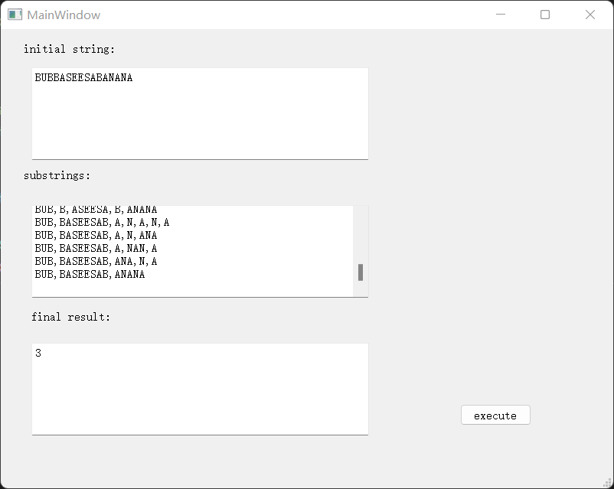
label
textEdit
Button
PyQt5
Matplotlib

Slide 12
❖ Algorithm 2
Tool : Backtrackinge and mnemonic search
Time complexity: O (n *2^n).
➢ Space complexity: O (n^2).
def isPalindrome(i: int, j: int) -> int:
if i >= j:
return 1
return isPalindrome(i + 1, j - 1) if s[i] == s[j] else -1

Slide 13
Thank you
present by: 刘宓祎
张恺茗
陈佳怡

