Slide 1


data acquisition tool
Project introduction
Murshed Alam
Notes:
Introduction
Doing a Project with co operation with LMZ and Hochschule.
Project name Data Acquisition tools.

Slide 2
agenda
introduction & maintask
the team
project plan & current position
detailed project requirements & milestones
used tools (planned)
next steps
Notes:
Introduction and Maintask
The Team
Project Plan (Time Plan) & and our current Position within this plan
Detailed Project requirements & Milestones
Mock up of the GUI (with the functions)
Mock up of theBackEnd
Milestons and rough overview of their content (detailled content -> report)
Used Tools (planned)
Front End (Browser)
Backend (Angular, Leaflet
Project Managemet (GitHub, ProjectLibre, …)

Slide 3
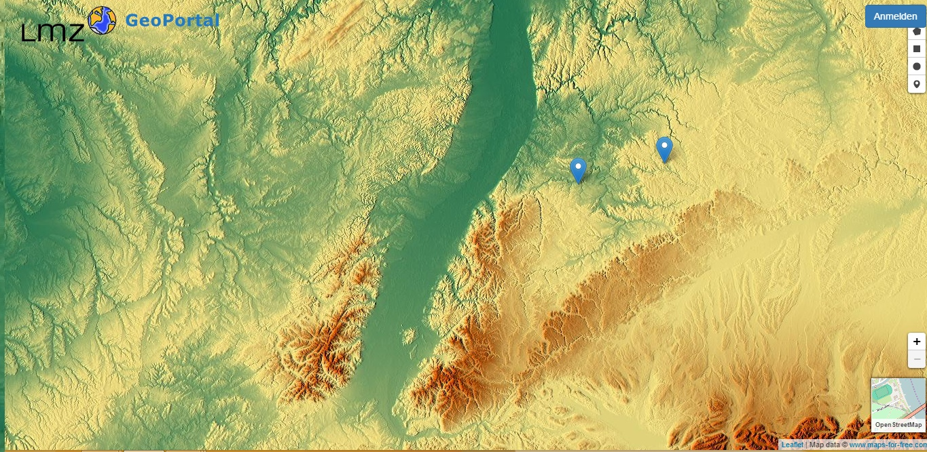
maintask
collection of data
Notes:
Introduction
- Tool for aquisition and processing of data
- Target group: pupils
Rough overview
Collection of data, this case temperature - Simultaniosly -> updating

Slide 4
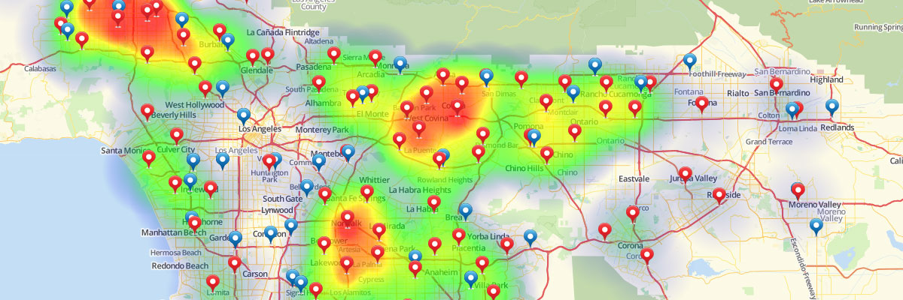
maintask
interpolation of data
Notes:
Processing of data
Here interpolation
Displayed as heat-map with transparency
Automatically added tiles (no interpolation over the whole area)
OPTIONAL
- Printing plugin

Slide 5
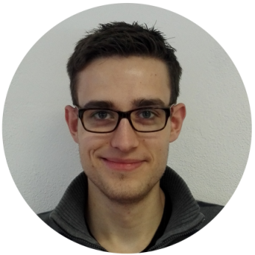




the team
Sebastian Lemstra Chair
Georg Stubenrauch Project Manager
Murshed Alam
Lili Friesen
Eltaieb Al-Basheer
Notes:
Team Member: Sebastian Lemstra(Chair)
Georg Stubenrauch
Lili Frisen
Eltaieb Al- Basheer

Slide 6
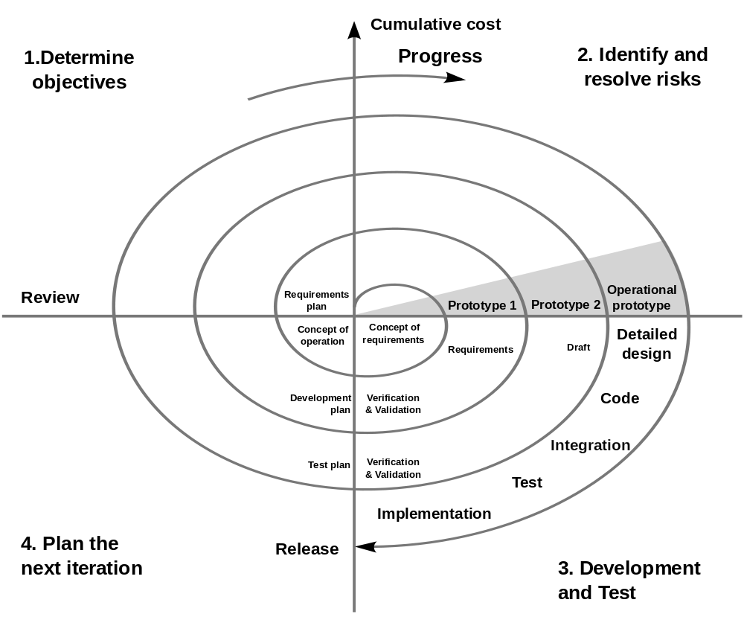
project plan
Notes:
Project Plan (Time Plan) & and our current Position within this plan
We are following spiral model
Determine the objectives, alternatives, and constraints on the new iteration.
Evaluate alternatives and identify and resolve risk issues

Slide 7
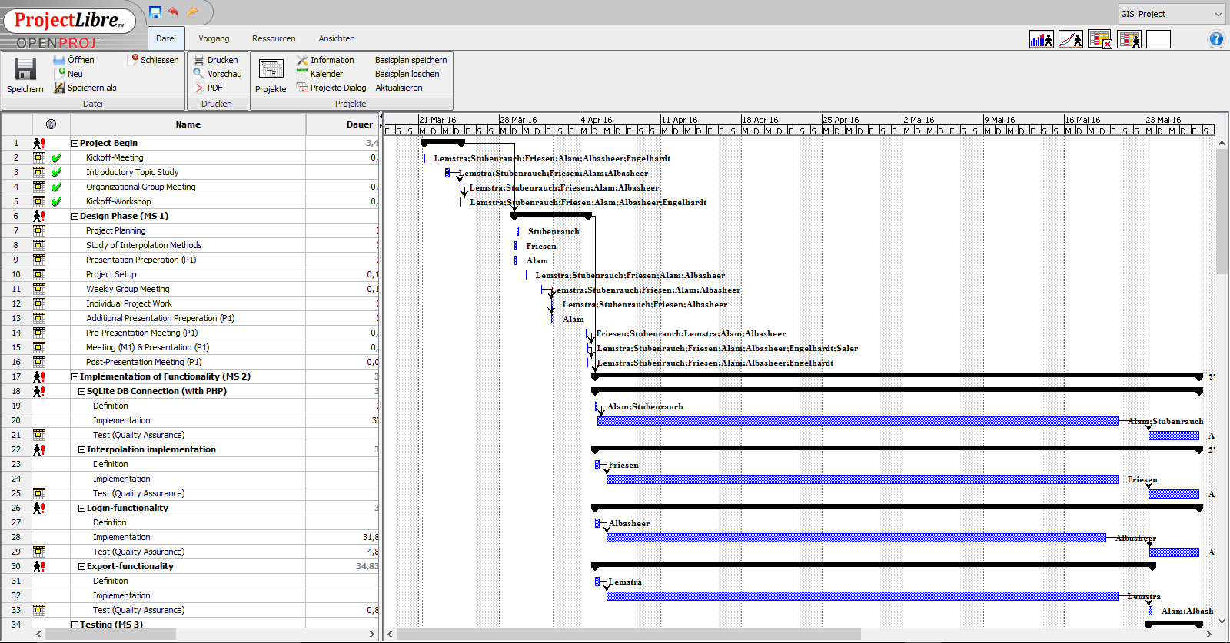
gantt chart
Notes:
Task is divided to every group member with date.

Slide 8
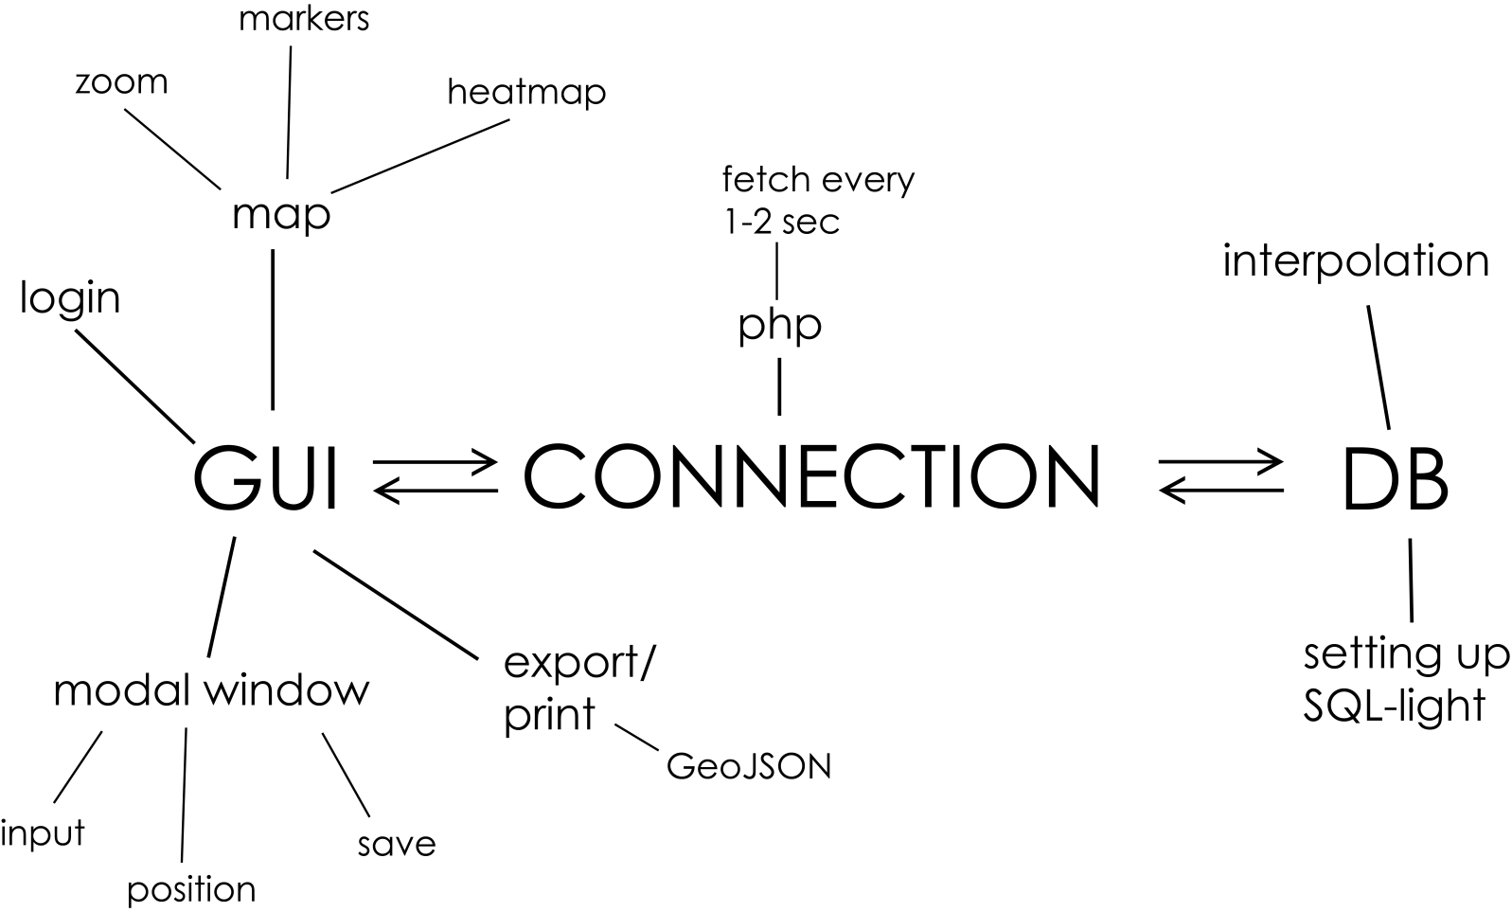
project requirements
Notes:
Mock up of the GUI (with the functions)
Login
Basemap
Zoom
Markers
Heatmap
Modal window, Input position and save option

Slide 9
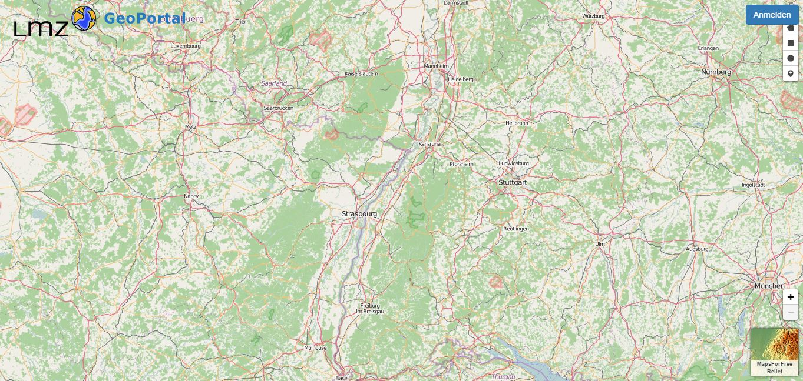
project requirements
Notes:
Mock up of the GUI (with the functions)
Zoon in /zoom out
Drag Marker
Basemap
Log in
popup

Slide 10
milestones
value stores with Coordinates in database and retrieves from database.
Notes:
First milestone is value stores with Coordinates in database and retrieves from database.

Slide 11








used tools
backend
frontend
project management
Notes:
Backend-PHP,Angular JS, Geojason
Frontenf-HTML5, CSS3, Leaflet
Github and libre for project management

Slide 12
next steps
Database connection
Log in functionality
data store with Coordinates in database and retrieves from database.

Slide 13
thank you for your attention! questions?

Slide 14
sources
https://upload.wikimedia.org/wikipedia/commons/thumb/6/61/HTML5_logo_and_wordmark.svg/2000px-HTML5_logo_and_wordmark.svg.png date:31.03.2016
http://friendlyprospect.com/img/logo/css3.png date:31.03.2016
https://webmentor.org/blog_images/php-logo.png date:31.03.2016
https://s3.amazonaws.com/media-p.slid.es/uploads/rohs/images/314622/leaflet-logo.pngdate:31.03.2016
http://www.debugging.co/img/js.png date:31.03.2016
https://upload.wikimedia.org/wikipedia/commons/thumb/9/9d/Projectlibrelogo.jpg/250px-Projectlibrelogo.jpg date:31.03.2016
http://ivyr.github.io/img/logos/github.png date:31.03.2016

