Slide 1


data acquisition tool
Project introduction
Murshed Alam

Slide 2
agenda
introduction & maintask
the team
project plan & current position
detailed project requirements & milestones
used tools (planned)
next steps
Notes:
Introduction and Maintask
The Team
Project Plan (Time Plan) & and our current Position within this plan
Use maybe his spiral
Detailed Project requirements & Milestones (can be called concept)
Mock up of the GUI (with the functions)
Mock up of theBackEnd (not a bend)
Milestons and rough overview of their content (detailled content -> report)
Used Tools (planned)
Front End (Browser)
Backend (Angular, Leaflet
Project Managemet (GitHub, ProjectLibre, …)

Slide 3
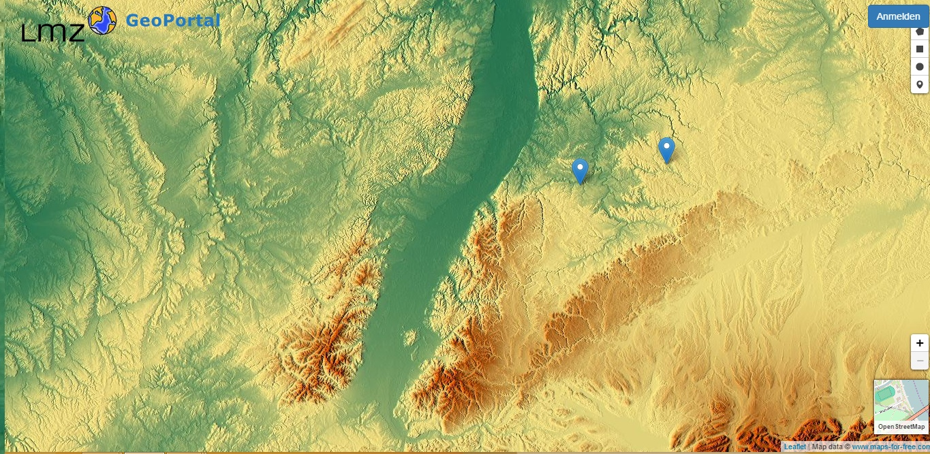
maintask
collection of data
Notes:
Introduction
- Tool for aquisition and processing of data
- Target group: pupils
Rough overview
Collection of data, this case temperature - Simultaniosly -> updating

Slide 4
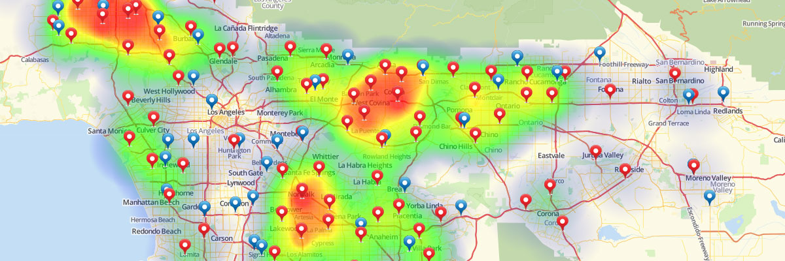
maintask
interpolation of data
Notes:
Processing of data
Here interpolation
Displayed as heat-map with transparency
Automatically added tiles (no interpolation over the whole area)
OPTIONAL
- Printing plugin

Slide 5
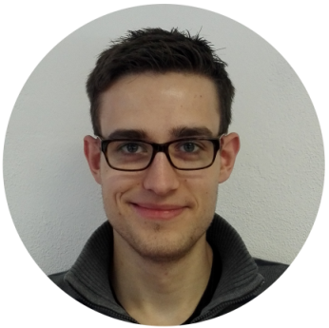


the team
Sebastian Lemstra Chair
Georg Stubenrauch Project Manager
Murshed Alam
Lili Friesen
Eltaieb Al-Basheer
Notes:
Processing of data
Here interpolation
Displayed as heat-map with opacity
Automatically added tiles (no interpolation over the whole area)
OPTIONAL
- Printing plugin

Slide 6
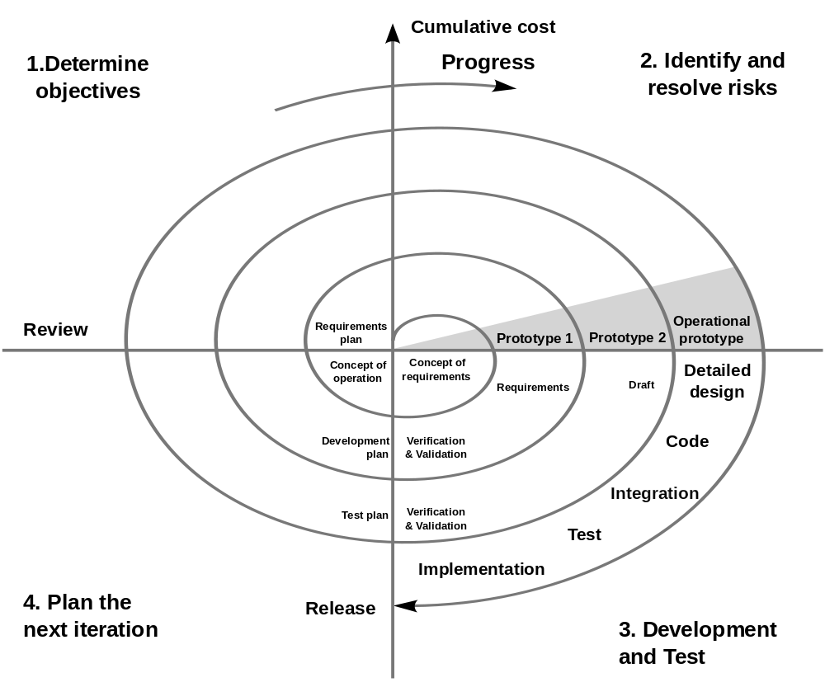
project plan
Notes:
Project Plan (Time Plan) & and our current Position within this plan
Use maybe his spiral

Slide 7
gantt chart
Put here clip of the gantt chart

Slide 8
project requirements
Notes:
Detailed Project requirements & Milestones (can be called concept)
Mock up of the GUI (with the functions)

Slide 9
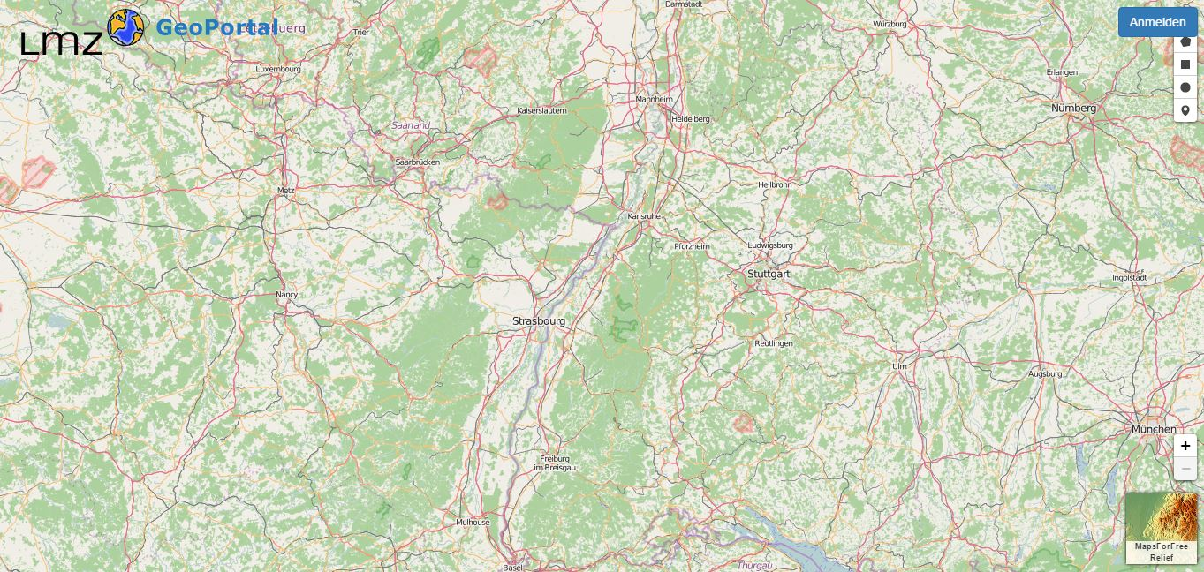
project requirements
Notes:
Detailed Project requirements & Milestones (can be called concept)
Mock up of the GUI (with the functions)
Zoon in /zoom out
Drag Marker
Basemap
Log in
popup

Slide 10
milestones
value store with Coordinates in database and retrieves from database.
Notes:
Detailed Project requirements & Milestones (can be called concept)
Mock up of the GUI (with the functions)

Slide 11








used tools
backend
frontend
project management
Notes:
Detailed Project requirements & Milestones (can be called concept)
Mock up of the GUI (with the functions)
Github and libre for project management

Slide 12
next steps
Database connection
Log in functionality
data store with Coordinates in database and retrieves from database.
Notes:
Detailed Project requirements & Milestones (can be called concept)
Mock up of the GUI (with the functions)

Slide 13
thank you for your attention! questions?

Slide 14
sources
https://upload.wikimedia.org/wikipedia/commons/thumb/6/61/HTML5_logo_and_wordmark.svg/2000px-HTML5_logo_and_wordmark.svg.png date:31.03.2016
http://friendlyprospect.com/img/logo/css3.png date:31.03.2016
https://webmentor.org/blog_images/php-logo.png date:31.03.2016
https://s3.amazonaws.com/media-p.slid.es/uploads/rohs/images/314622/leaflet-logo.pngdate:31.03.2016
http://www.debugging.co/img/js.png date:31.03.2016
https://upload.wikimedia.org/wikipedia/commons/thumb/9/9d/Projectlibrelogo.jpg/250px-Projectlibrelogo.jpg date:31.03.2016
http://ivyr.github.io/img/logos/github.png date:31.03.2016

