Slide 1
Animating Network Flow
Lucy MacPhail 2183332m

Slide 2
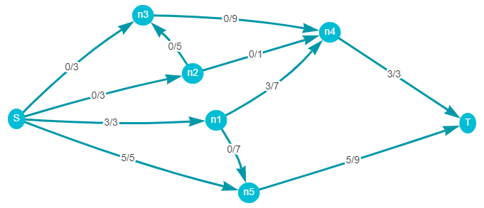
Network Flow

Slide 3
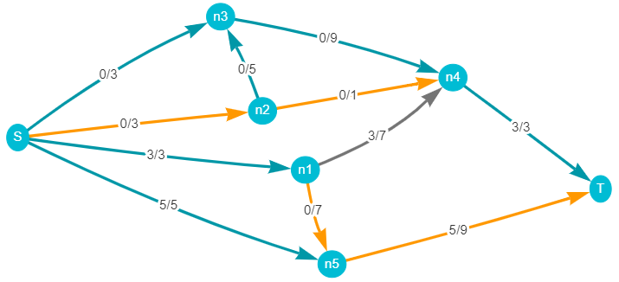
Augmenting path

Slide 4
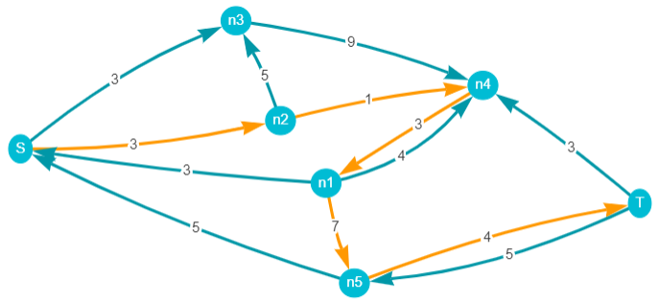
Residual graph

Slide 5
Ford-Fulkerson algorithm
Here be pseudocode

Slide 6
Aims of the project
Enhance understanding of the algorithm
Intuitive UI (don’t want users to struggle with the not-useful part)
Versatility/control to the user (custom graphs, speed control)

Slide 7
Demonstration
https://lmacphail.github.io/l4_project/

Slide 8
Thanks for listening
Any questions?

