Slide 1
Animating Network Flow
Lucy MacPhail 2183332m

Slide 2
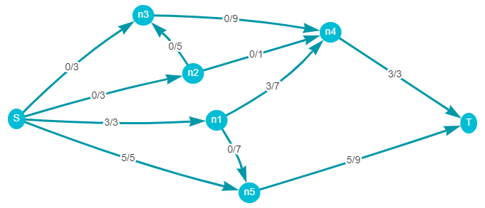
Network Flow

Slide 3
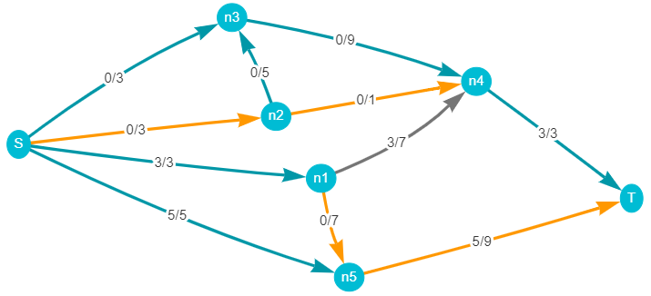
Augmenting path

Slide 4
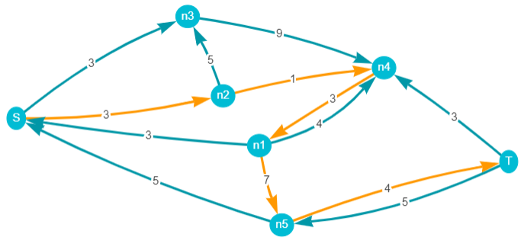
Residual graph

Slide 5
Ford-Fulkerson algorithm
Given a graph G=(V,E) with a source S and a sink T
For((u,v) in E) f(u,v) = 0
Build residual graph G’=(V’,E’)
While(there is a path P from S to T in G’){
m = minimum slack (c(u,v) – f(u,v)) of P
for((u,v) in P){
if((u,v)∈ E) // (u,v) is a forwards edge
f(u,v) += m
else if ((v,u)∈ E) // (u,v) is a backwards edge
f(v,u) -= m
}
update residual graph
}
Maximum flow found

Slide 6
Aims of the project
Teaching/Learning tool
Intuitive UI
Versatility/control to the user

Slide 7
Demonstration
[video]

Slide 8
Thanks for listening
Any questions?

