Slide 1
Animating Network Flow
Lucy MacPhail 2183332m

Slide 2
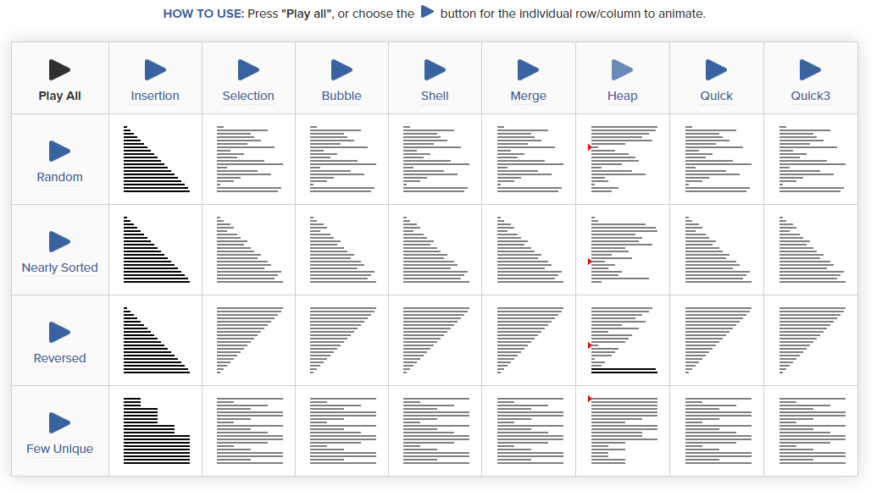
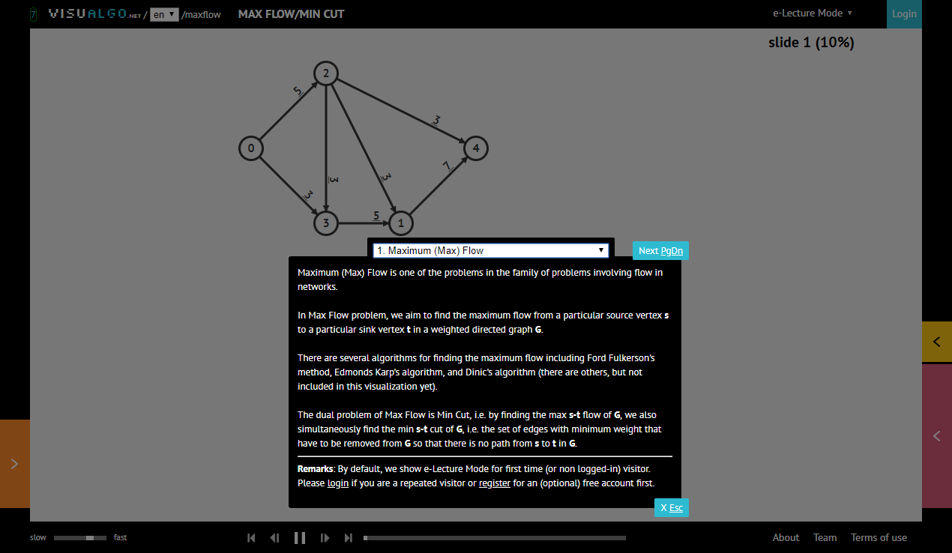
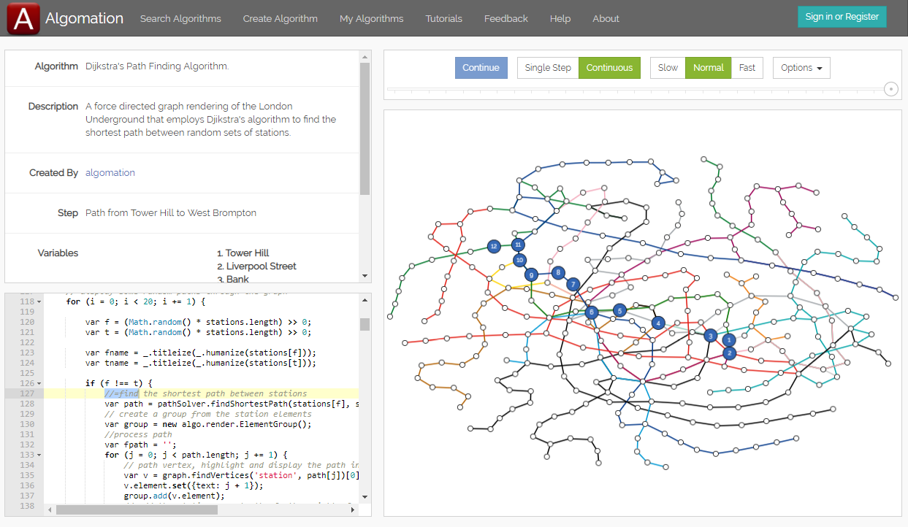
Animating algorithms in education
Notes:
So why animate algorithms?
Teaching purposes, visualisation teaches in an intuitive way before delving into details.
Many different examples of animated algorithms (show them), but only one of network flow.
Can be applied to transportation, resource allocation, network connectivity, and many more, so a shame that visualising it has been avoided.

Slide 3
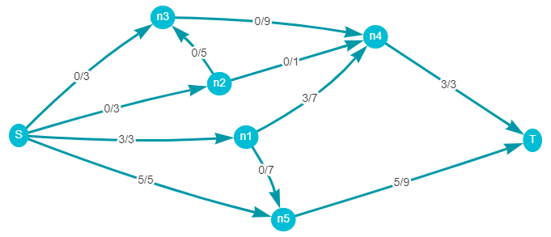
Network Flow
Notes:
Directed graph with S and T.
Each edge has a capacity, and network has a flow.
Capacity constraint and flow conservation constraint.
This flow isn’t at a maximum, we can increase it with….

Slide 4
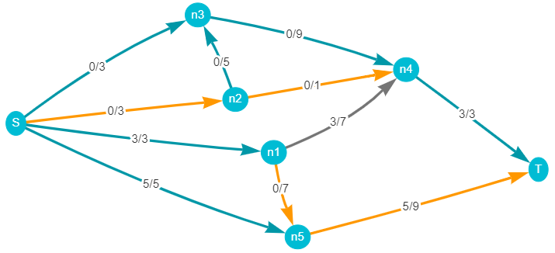
Augmenting path
Notes:
Path from S to T, not necessarily directed in the same way as our network.
Forwards edge, same direction, flow < cap
Backwards edge, opposite direction, flow > 0

Slide 5
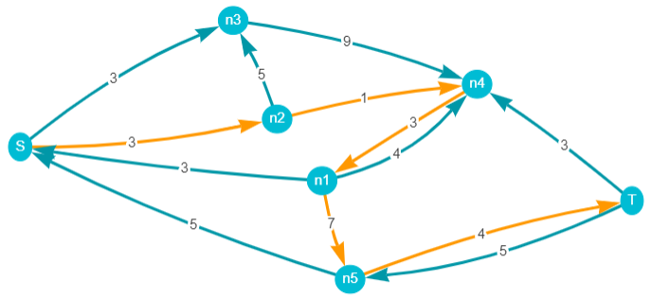
Residual graph
Notes:
Residual graph construction
Forwards edge is “slack”, cap – flow
Backwards edge is flow

Slide 6
Ford-Fulkerson algorithm
Given a graph G=(V,E) with a source S and a sink T
For((u,v) in E) f(u,v) = 0
Build residual graph G’=(V’,E’)
While(there is a path P from S to T in G’){
m = minimum slack (c(u,v) – f(u,v)) of P
for((u,v) in P){
if((u,v)∈ E) // (u,v) is a forwards edge
f(u,v) += m
else if ((v,u)∈ E) // (u,v) is a backwards edge
f(v,u) -= m
}
update residual graph
}
Maximum flow found

Slide 7
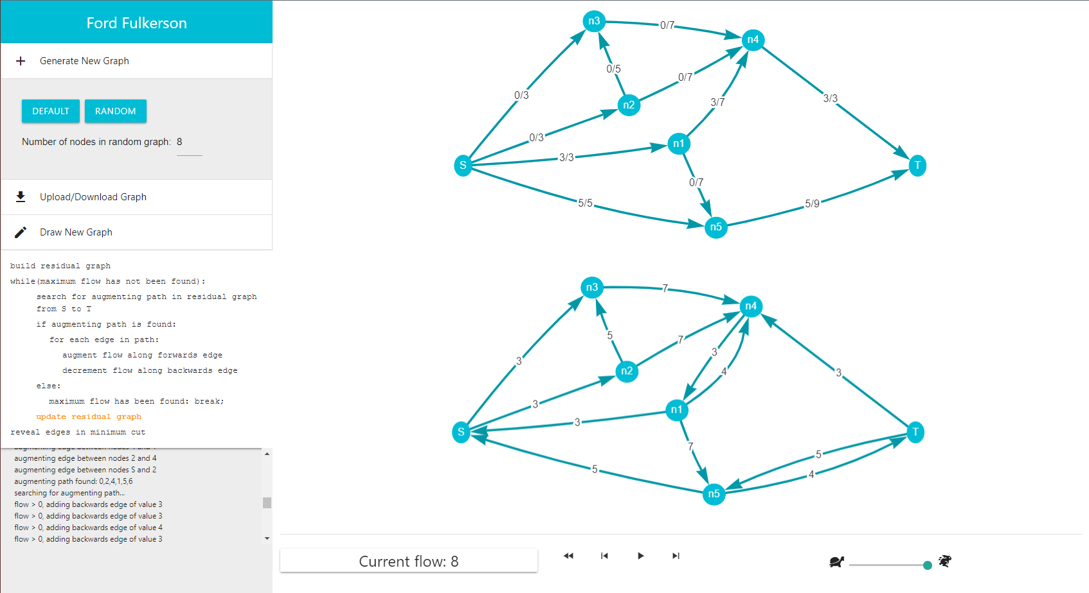
Design
Notes:
Keep consistency with other animation software, big canvas for graphs, some pseudocode, detailed traceback, playback buttons

Slide 8
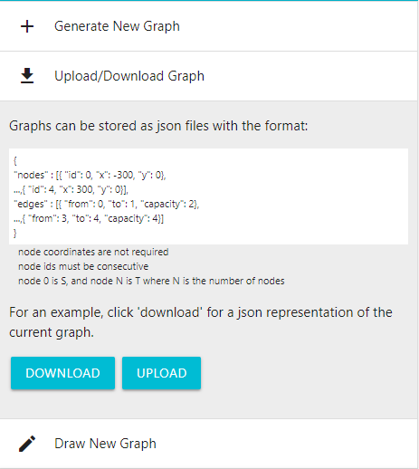
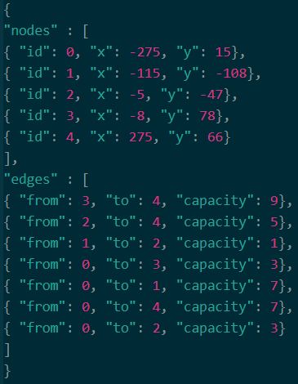
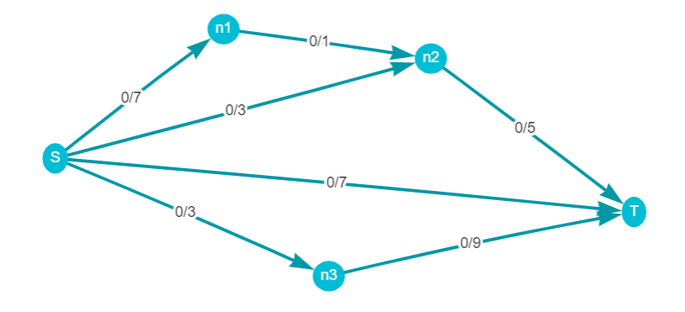
Creating Networks
Notes:
Can download current graph on screen as a json file in this format. 0 is S, last is T.
Wanted to balance detail of graph without making it hard to write.

Slide 9
Demonstration

Slide 10
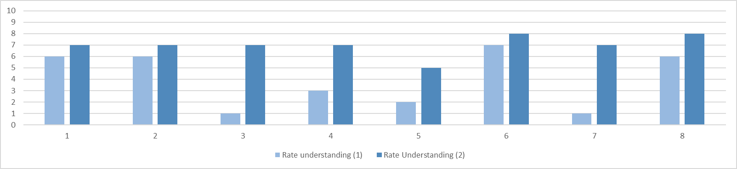
Evaluation
Likes
Dislikes
Clear visuals
Intuitive interface
Stepping forwards/backwards
Execution trace not obvious
Playback not always clear
Aspects of graph drawing

Slide 11
Thanks for listening
Questions?

