Slide 1
CODING 101
By: Landen Fuller

Slide 2
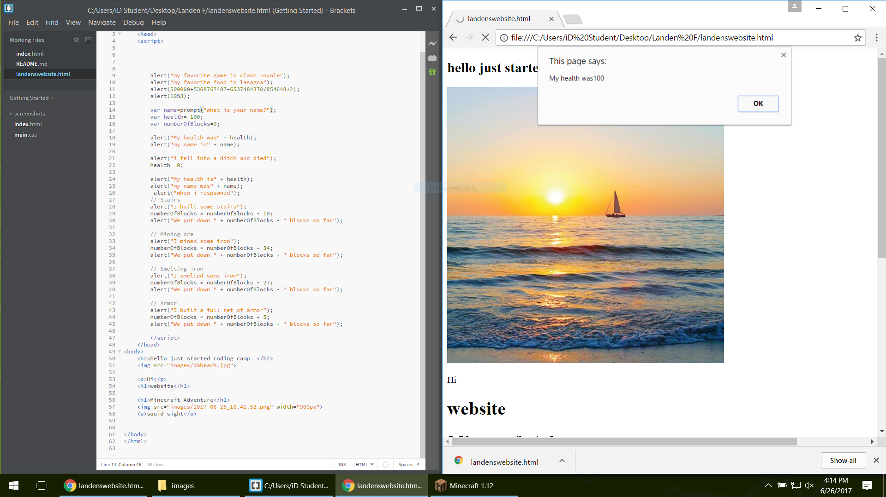
Monday I put down what I did in Minecraft in code and made this.
Type Course Name Here
Type Dates Here (ex: June 22nd – June 27th)

Slide 3
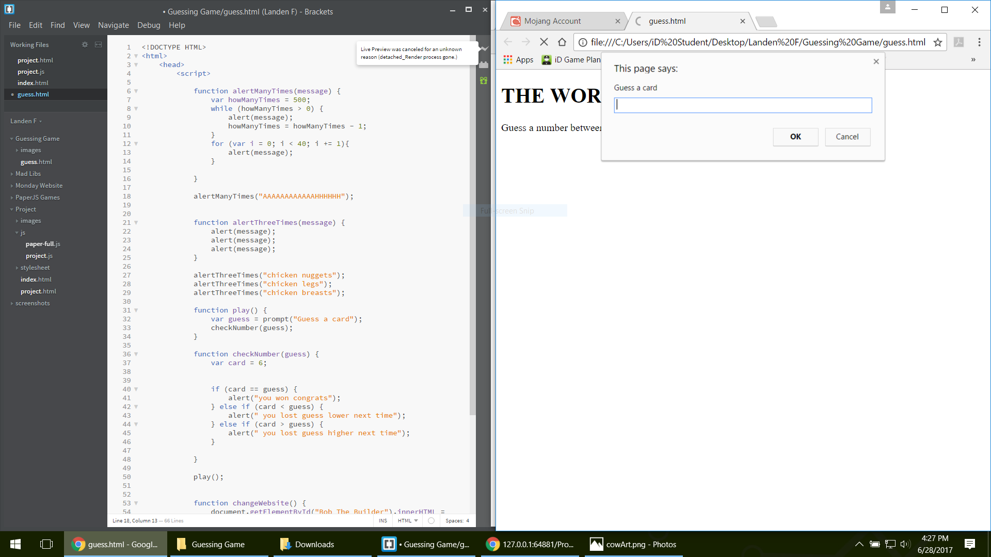
My iDea
THE WORLDS BEST GUESSING GAME
The iDea was to make a Guessing Game but make it simple.
We thought of this iDea because it is a simple way to start learning Programs and HTML.

Slide 4
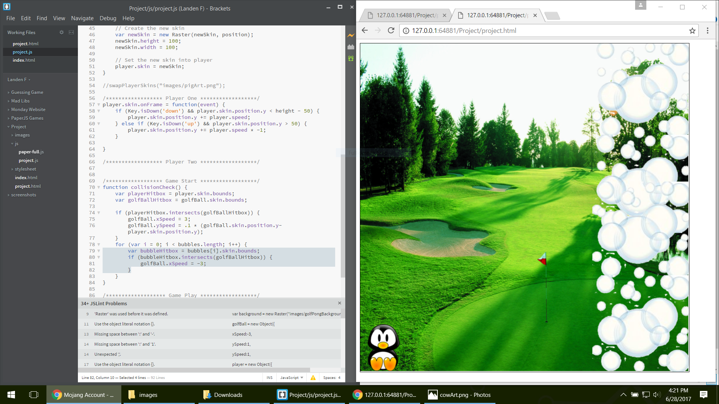
My Project
In the beginning...
We thought of an iDea for a game.
We learned Javascript,Conditionals,Math,Functions,Loops,and we learned about Objects along the way.
This was my first iDea.

Slide 5
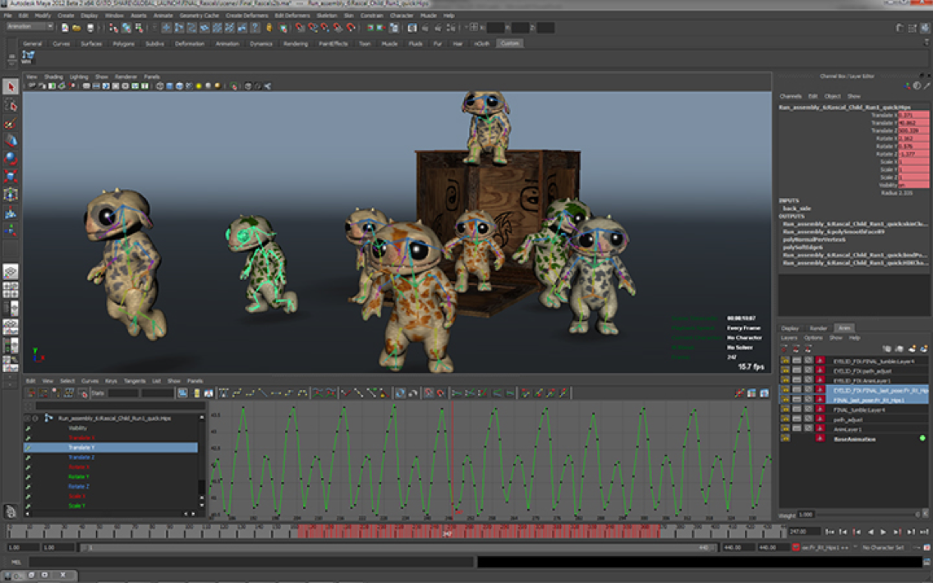
My Project
In the beginning...
Write about your project, and the software you used.
What did you learn in the process?
Right click to “Replace image” with a photo of and early screenshot of your process to create your project. Then delete this text.

Slide 6
My Project
Along the way...
How did your project evolve?
What challenges did you face along the way?
Talk about feedback and collaboration from your Instructor and friends.
Right click to “Replace image” with a photo of a screenshot midway in your process. Then delete this text.

Slide 7
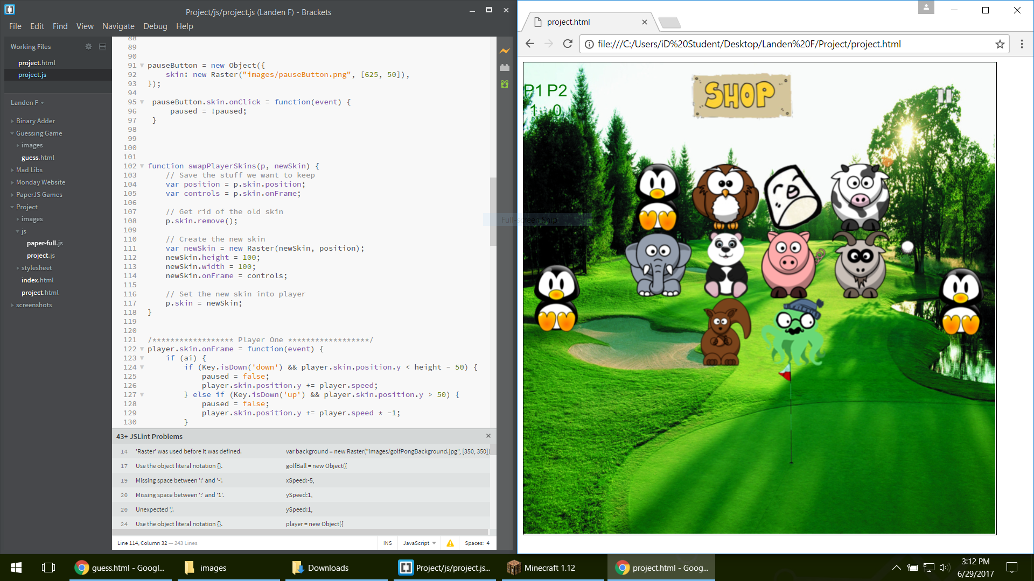
My Project
In the end...
I liked how my Golf game turned out in the end
.

Slide 8
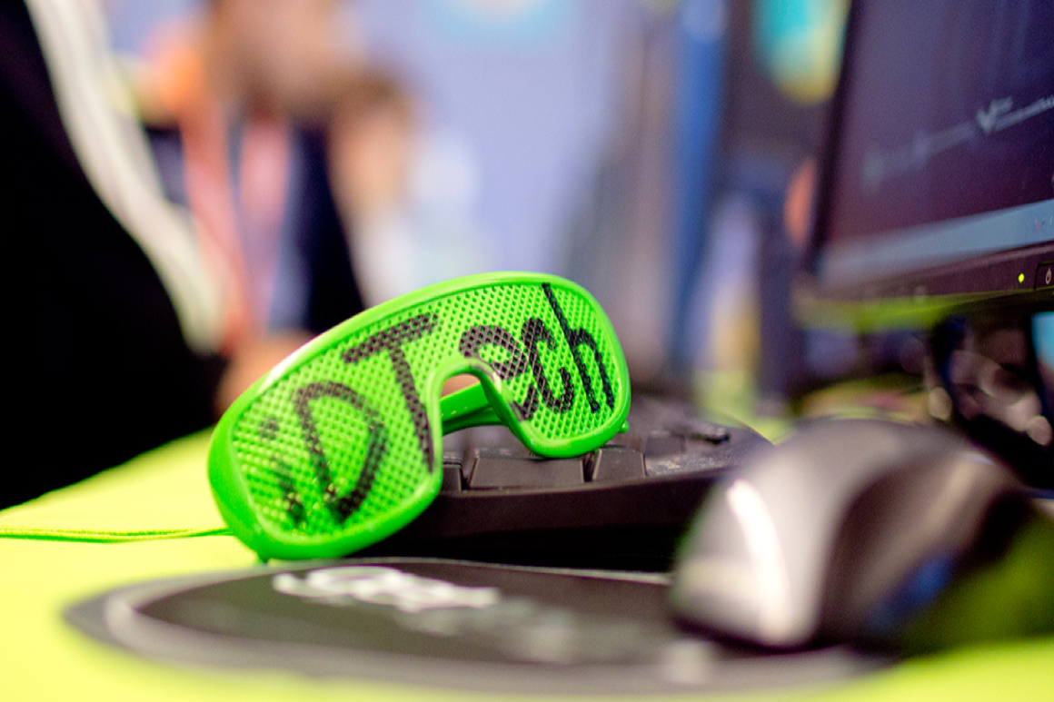
Favorite Camp Memory
Type a few sentences or a paragraph about your favorite camp memory.
Right click to “Replace image” with a photo of your favorite memory. Then delete this text.

Slide 9
Questions?

