Slide 1
Does Age Matter In Formula 1?
Luis Mederos
DSC 530

Slide 2
Variables
The Variables we will be looking into are
Driver Age
Average Finishing Position
Number of Laps Completed
Points Scored
Average Start Positions
One variable impact that might affect my question is what team the drivers are on since they are different cars. (Some are better than others)

Slide 3
Variables
Driver Age: Tells us what the drivers age is.
Average Finishing Position: Where the drivers on average finished the race.
Number of Laps Completed: Total of laps a driver has completed in a race.
Points Scored: Number of points scored on a race weekend.
Average Starting Position: Average start position.

Slide 4
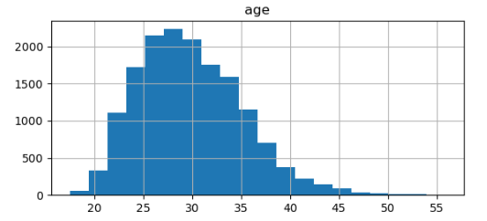
Summary and Analysis
The graph is skewed to the right with no outliers
Mean: 28
Mode: 27
Std: 5.31

Slide 5
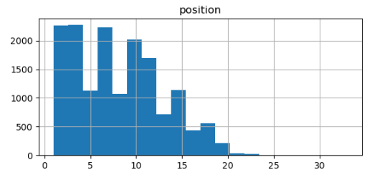
Summary and Analysis
The graph is skewed to the right with no outliers
Mean: 8
Mode: 3.5
Std: 4.8

Slide 6
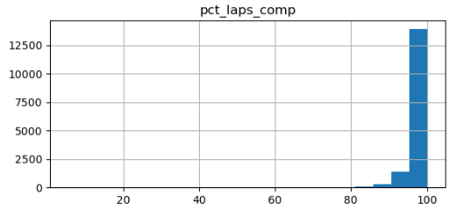
Summary and Analysis
The graph is skewed to the left with no outliers
Mean: 98
Mode: 100
Std: 3.86

Slide 7
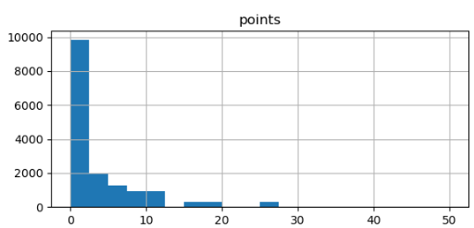
Summary and Analysis
The graph is skewed to the right with no outliers
Mean: 3.36
Mode: 0
Std: 5.23

Slide 8
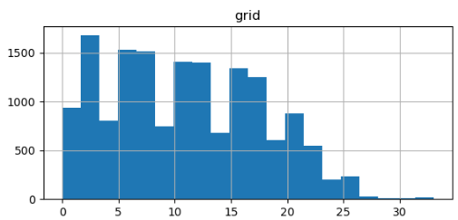
Summary and Analysis
The graph is skewed to the right with no outliers
Mean: 11
Mode: 1
Std: 6.7

Slide 9
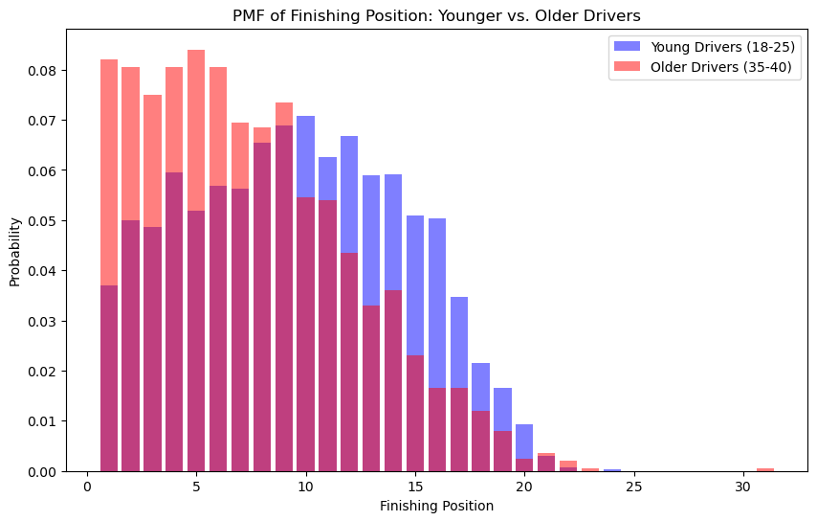
Summary and Analysis
This is the PMF graph comparing younger and older drivers to one another and their chances of getting a certain position
It seems as if older drivers have a higher chance of getting a higher finishing position

Slide 10
Summary and Analysis
This is the PMF graph comparing younger and older drivers to one another and their chances of getting a certain position
It seems as if older drivers have a higher chance of getting a higher finishing position

Slide 11
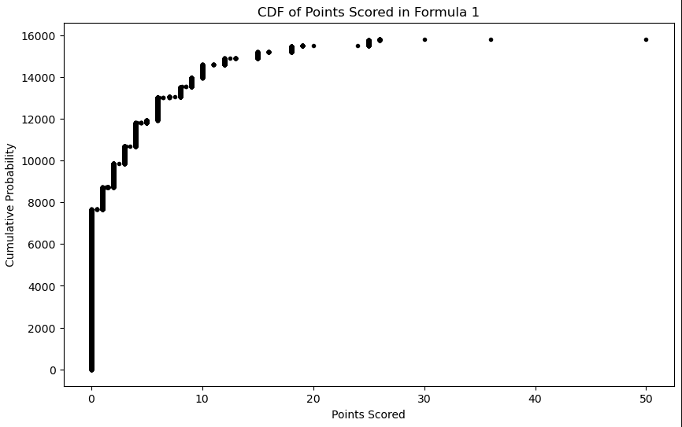
Summary and Analysis
This is the CDF graph for points scored in Formula 1

Slide 12
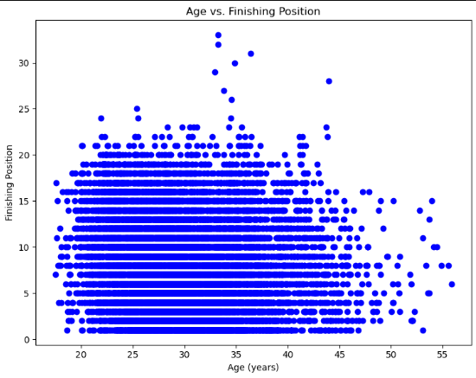
Summary and Analysis
The scatterplot does not show any correlation with -0.14
The scatterplot does not show any causation

Slide 13
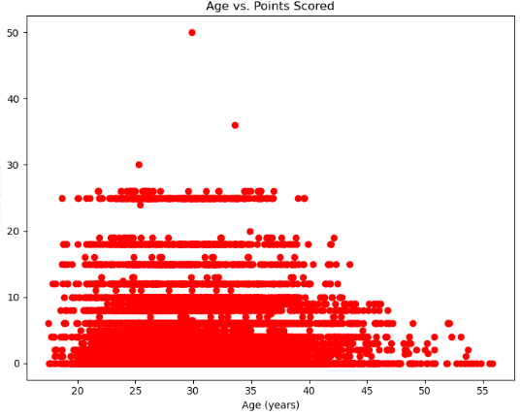
Summary and Analysis
The scatterplot does not show any correlation with 0.001 correlation
The scatterplot does not show any causation

Slide 14
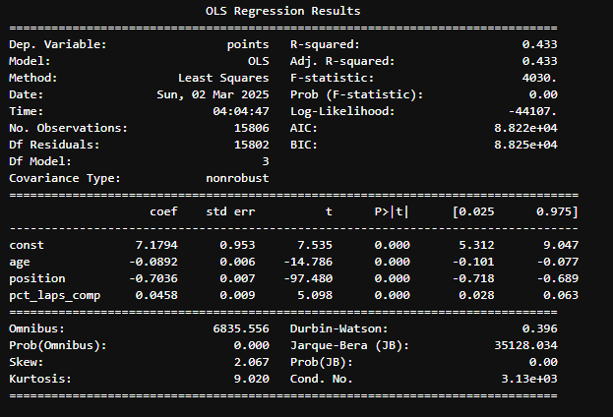
Summary and Analysis
Regression model shows that values are statistically significant since they are all P values of 0

