Slide 2




N
z
x
$$−φ$$
W
$$η$$
y
x
$$−τ$$
$$−τ$$
S

Slide 3


S
z
$$η$$
y
E
$$−α$$
W
N
x

Slide 4

$$θ$$

Slide 5




$$d_{ray}$$
$$h_{trop}$$
$$η$$
$$r_{e}$$

Slide 6
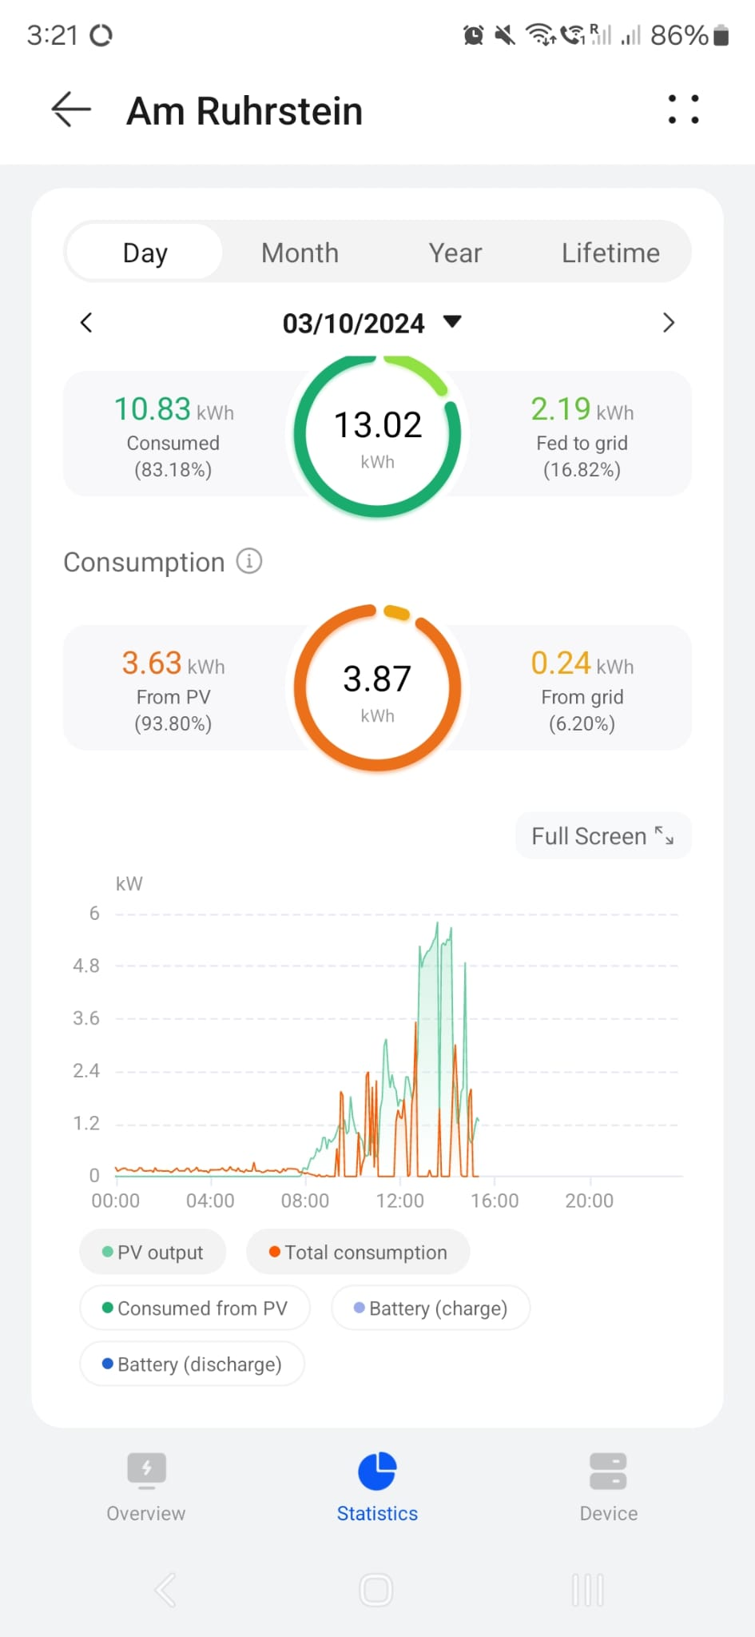
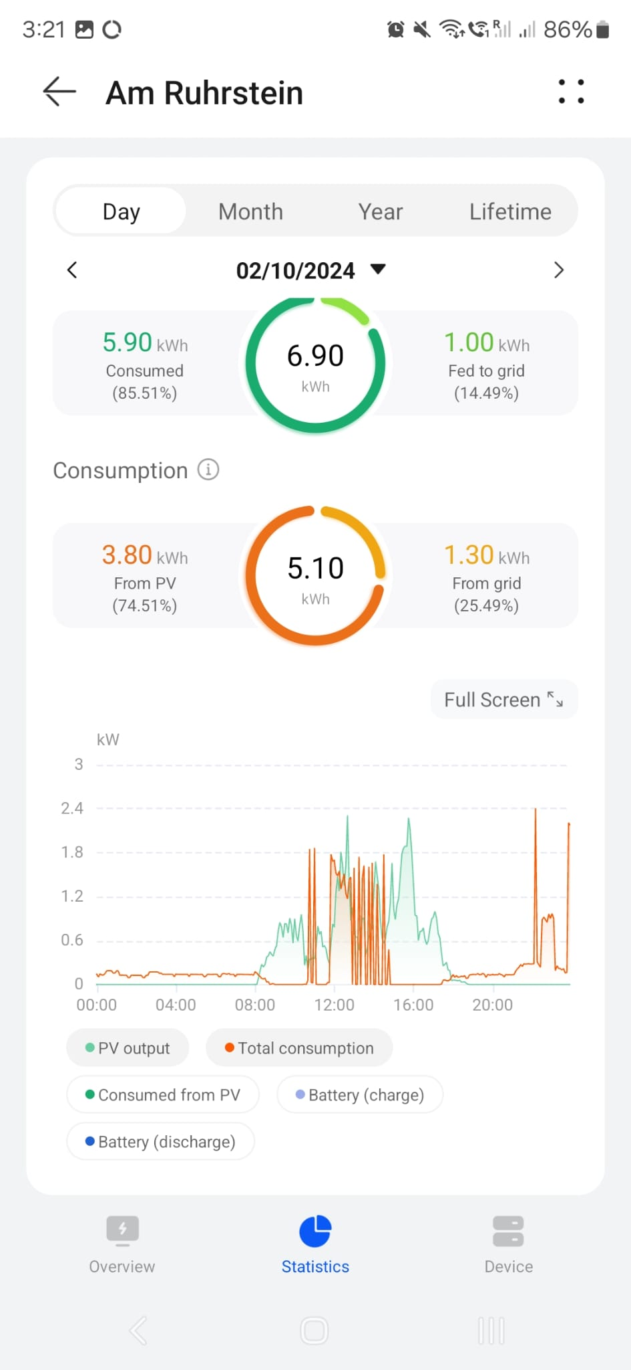
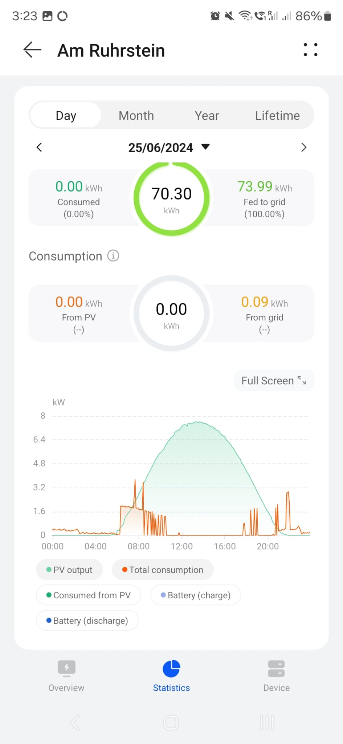

Slide 7





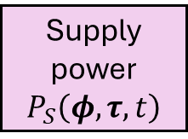
System model
Power supply model
PV System Model
PV Panel
$$P_{P}\left(φ,τ,t\right)$$
Demand
$$P_{D}\left(t\right)$$
PV System
$$P_{PVS}\left(φ,τ,t\right)$$
Battery
$$P_{B}\left(t\right)$$
Supply power
$$P_{S}\left(φ,τ,t\right)$$
Grid load
$$P_{G}\left(φ,τ,t\right)$$

