Slide 1

Analysis by Lakshmi P Mokka
BIG MOUNTAIN DATA ANALYSIS

Slide 2
OBJECTIVE
Provide data driven insight to increase net profit to Big Mountain by determining a data driven ticket price and cost cutting measures that will increase net profit.

Slide 3
Method
Utilize data provided from 330 resorts across the US to obtain data driven results.

Slide 4
Data Analysis
Check the data for missing/duplicate/clearly inaccurate values
Clean data to ensure analysis is not performed on missing/duplicate/inaccurate values
Obtained population data per US state from a reliable data source
Cleaned US state population data to ensure analysis is not performed on missing/duplicate/inaccurate values

Slide 5
Data Analysis
The adult weekend ticket data had more values than the adult weekday ticket data, therefore for the analysis, adult weekend ticket data was used.
Calculated the number of resorts per 100,000 people per state
Calculated the number of resorts per 100,000 square miles per state
Utilized PCA (principle components analysis)
Calculated the following:
- Ratio of resort skiable area to total state skiable area
- Ratio of resort days open to total state days open

Slide 6
Data Analysis
Calculated the following:
- Ratio of resort terrain park count to total state terrain park count
- Ratio of resort night skiing area to total state night skiing area
Created a Feature Correlation Heatmap:
- Created a Feature Correlation Heatmap
- Please see the chart in the next slide

Slide 7
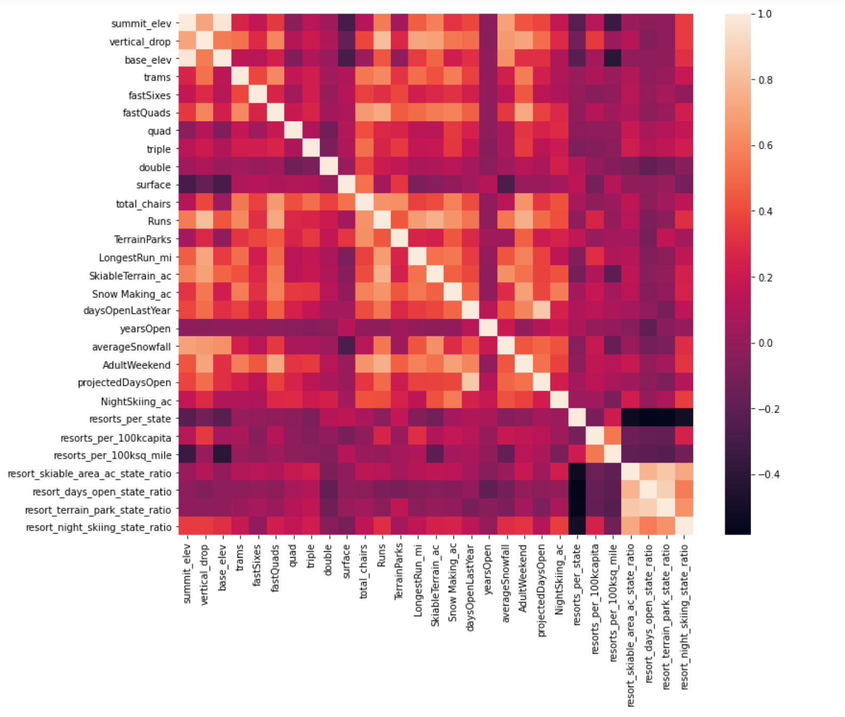
Data Analysis – Feature Correlation Heat Map

Slide 8
Data Analysis – Feature Correlation Heat Map
Analysis of the Feature Correlation Heat Map:
- Summit elevation and base elevation are highly correlated
- The Following items are negatively correlated with resorts per state
- Ratio of resort skiable area to total state skiable area
- Ratio of resort days open to total state days open
- Ratio of resort terrain park count to total state terrain park count
- Ratio of resort night skiing area to total state night skiing area
- This makes sense because as the number of resorts increase, all of the ratios listed above decrease
- There is some correlation between the ratio of night skiing area with the number of resorts per capita.
- Therefore, when resorts are more densely located with population, more night skiing is provided.
- There is some correlation between AdultWeekend ticket price and the following:
- FastQuads
- Runs
- Snow Making_ac
- resort_night_skiing_state_ratio
- total_chairs
- vertical drop

Slide 9
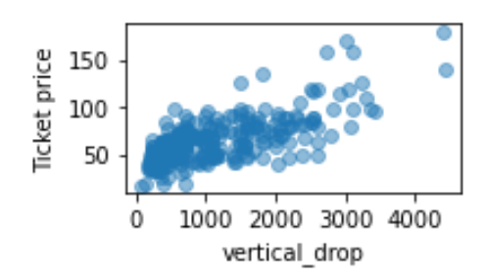
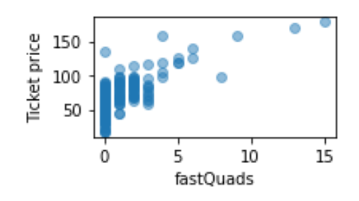
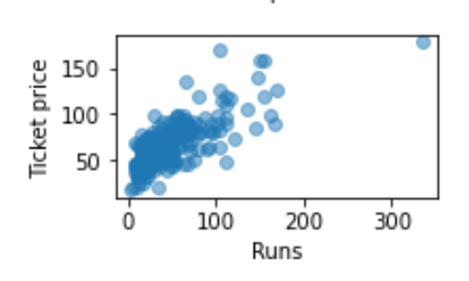
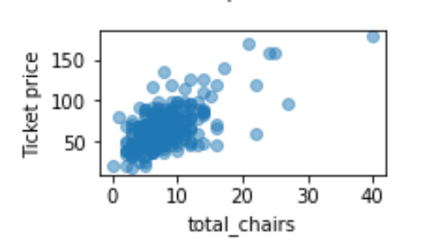
Data Analysis – Scatter Plots
Scatter Plots were run to compare ticket prices to features
The following scatter plots of features versus ticket prices show a high correlation:

Slide 10
Data Analysis – Model Training
Extracted the Big Mountain Data from the dataset so that the rest of the data can be used for model training and testing
Split the data into 70%/30% where 70% of the data is used for model training and 30% of the data is used for model testing
The missing ski data was filled by mean and median data, the error in the predicted data dropped by the same amount for both filled values
Utilized pipeline’s function to train the model
Utilized attributes to determine the features with a high correlation to ticket price. Fast Quads and Vertical Drop showed a high correlation to ticket price.
Utilized a Random Forest Model to model data. Please see the results from this model on the next slide.

Slide 11
Data Analysis – Model Training
Extracted the Big Mountain Data from the dataset so that the rest of the data can be used for model training and testing
Split the data into 70%/30% where 70% of the data is used for model training and 30% of the data is used for model testing
The missing ski data was filled by mean and median data, the error in the predicted data dropped by the same amount for both filled values
Utilized pipeline’s function to train the model using a linear regression model.
Utilized attributes to determine the features with a high correlation to ticket price. Fast Quads and Vertical Drop showed a high correlation to ticket price.
Utilized a Random Forest Model to model data. Please see the results from this model on the next slide.

Slide 12
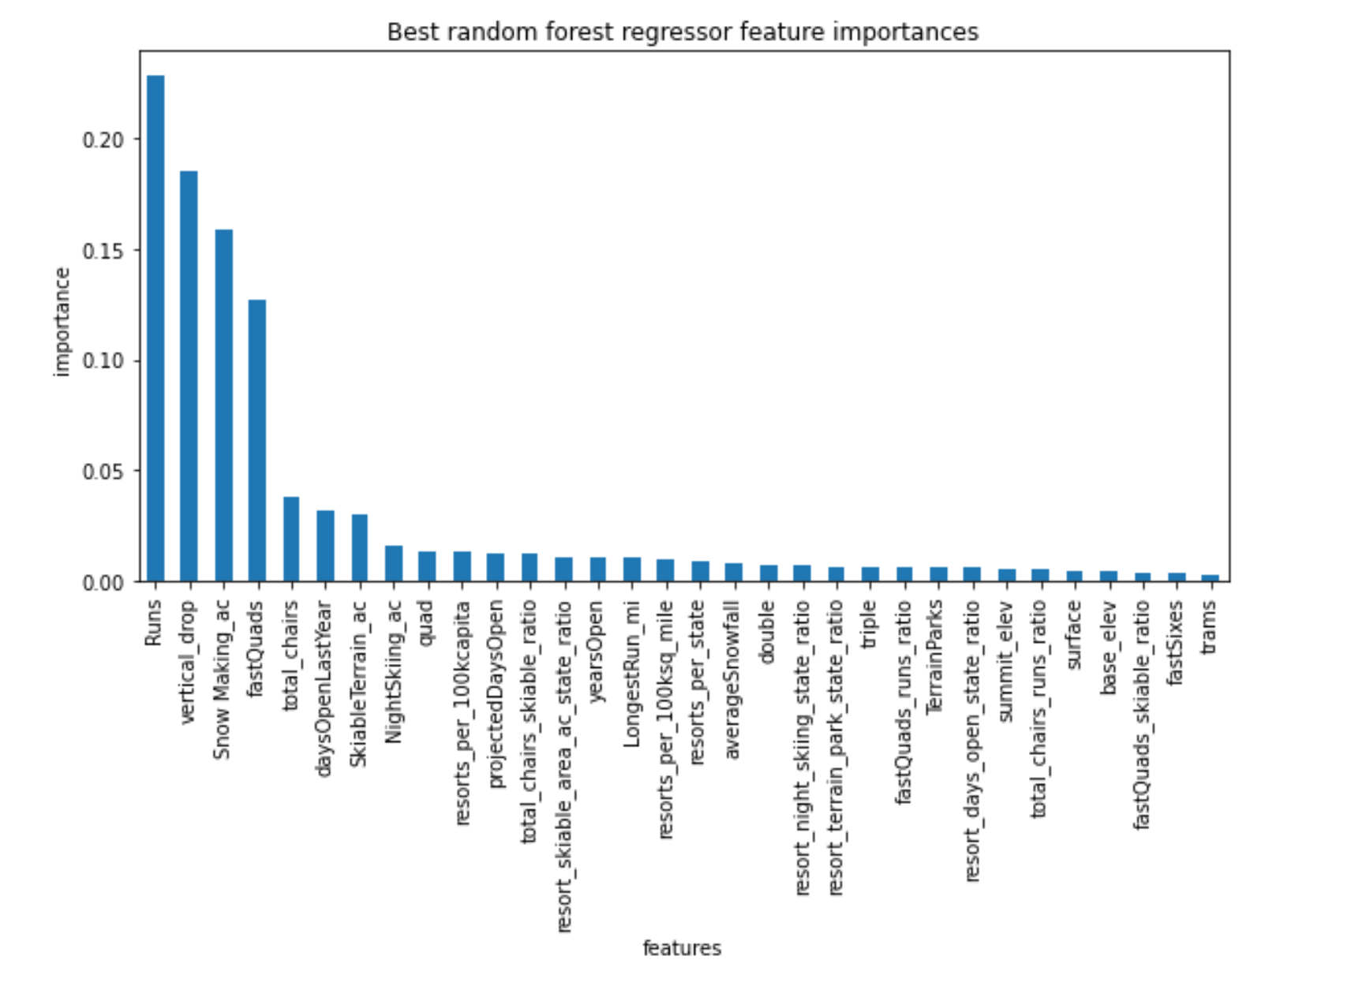
Data Analysis – Model Training

Slide 13
Data Analysis
Compared the linear regression model to the forest regression model – determined the forest regression model had a lower error.
Refit the forest regression model using all the available ski data.
Big Mountain Resort ticket modelled price is $97.79 versus its actual price of $81.00. With the expected mean absolute error of $10.47, this suggests there is room for an increase in price.
Features that came up as important in the modeling included the following:
- vertical_drop
- Snow Making_ac
- total_chairs
- fastQuads
- Runs
- LongestRun_mi
- trams
- SkiableTerrain_ac
The Important features are plotted in the following slides. Please note the Big Mountain Resort data is plotted in red.

Slide 14
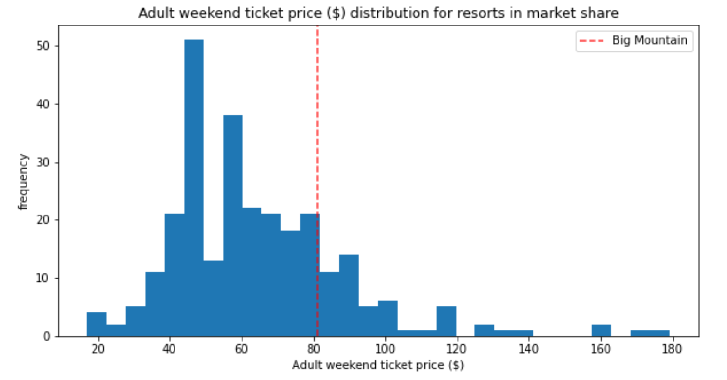
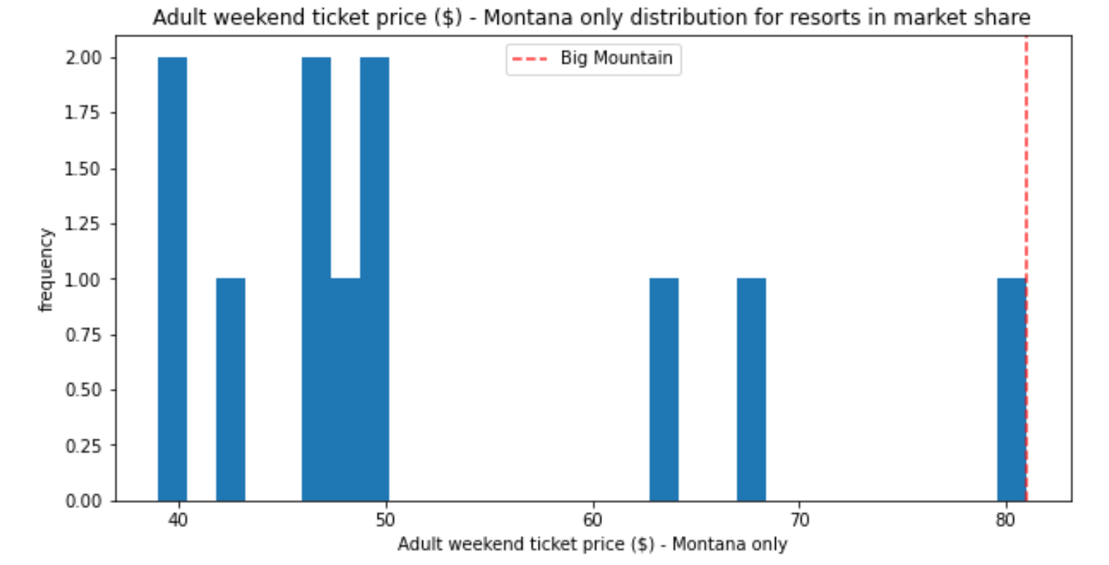
Data Analysis

Slide 15
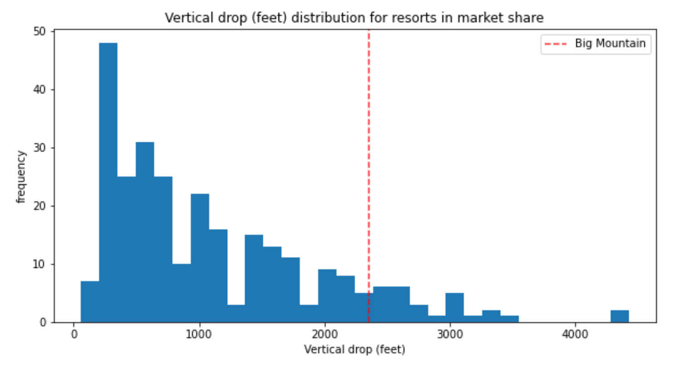
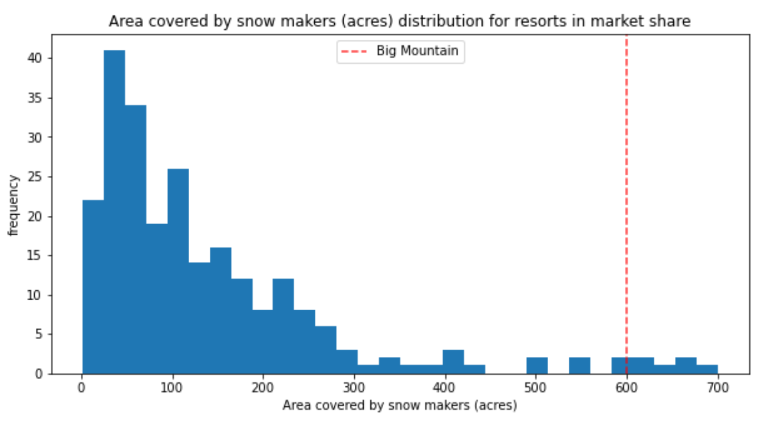
Data Analysis

Slide 16
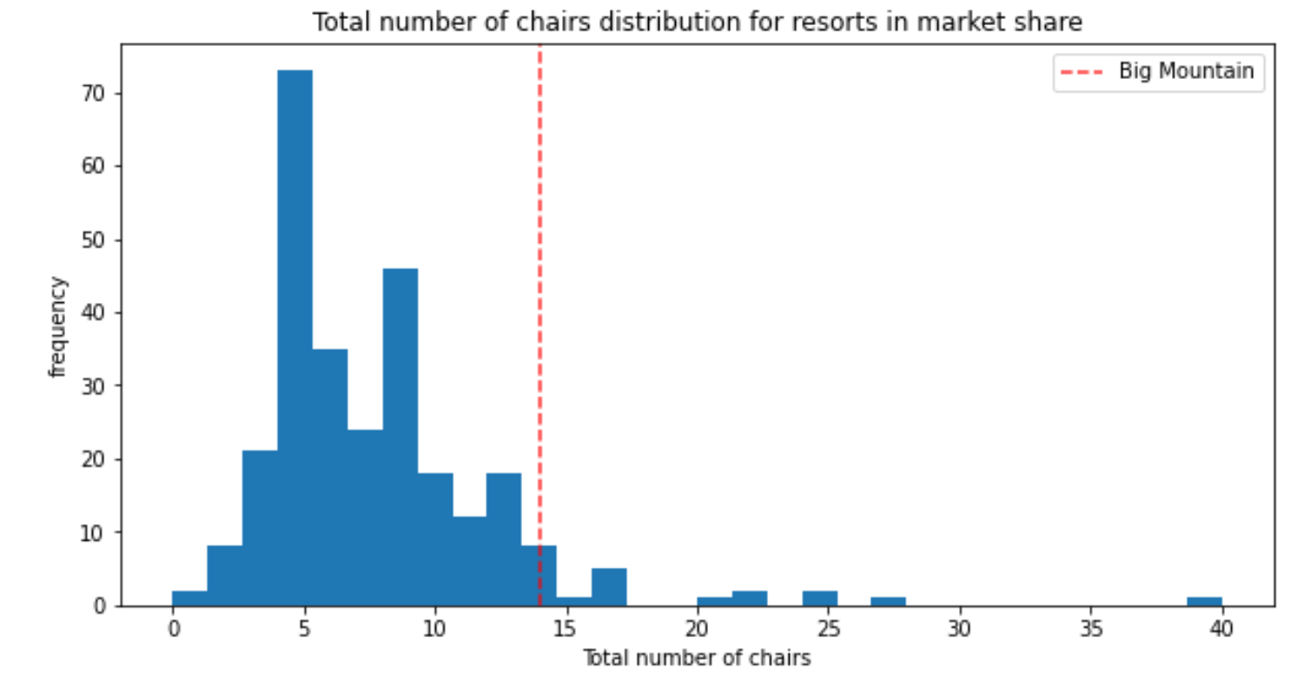
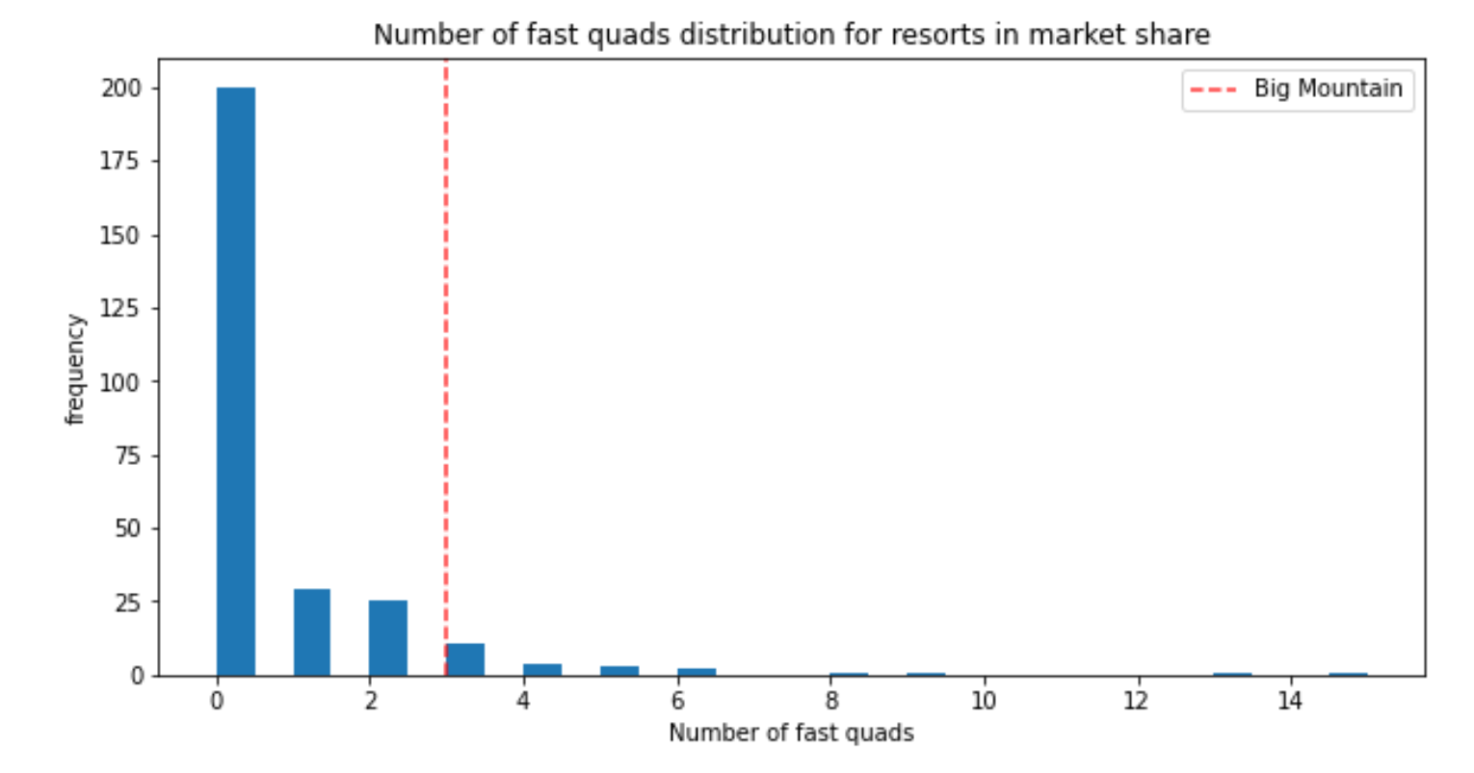
Data Analysis

Slide 17
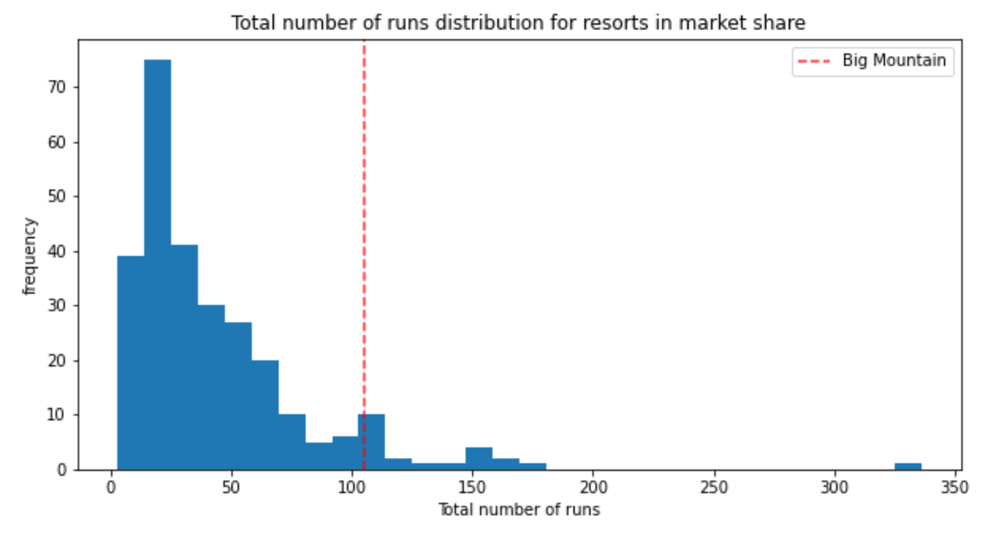
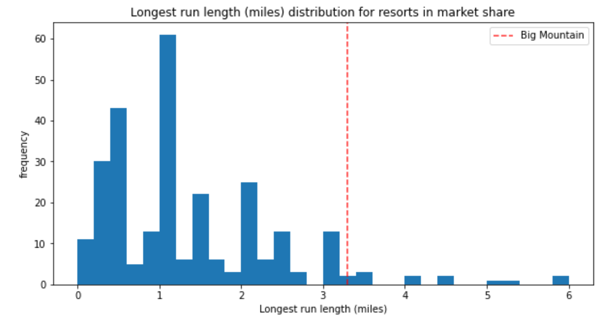
Data Analysis

Slide 18
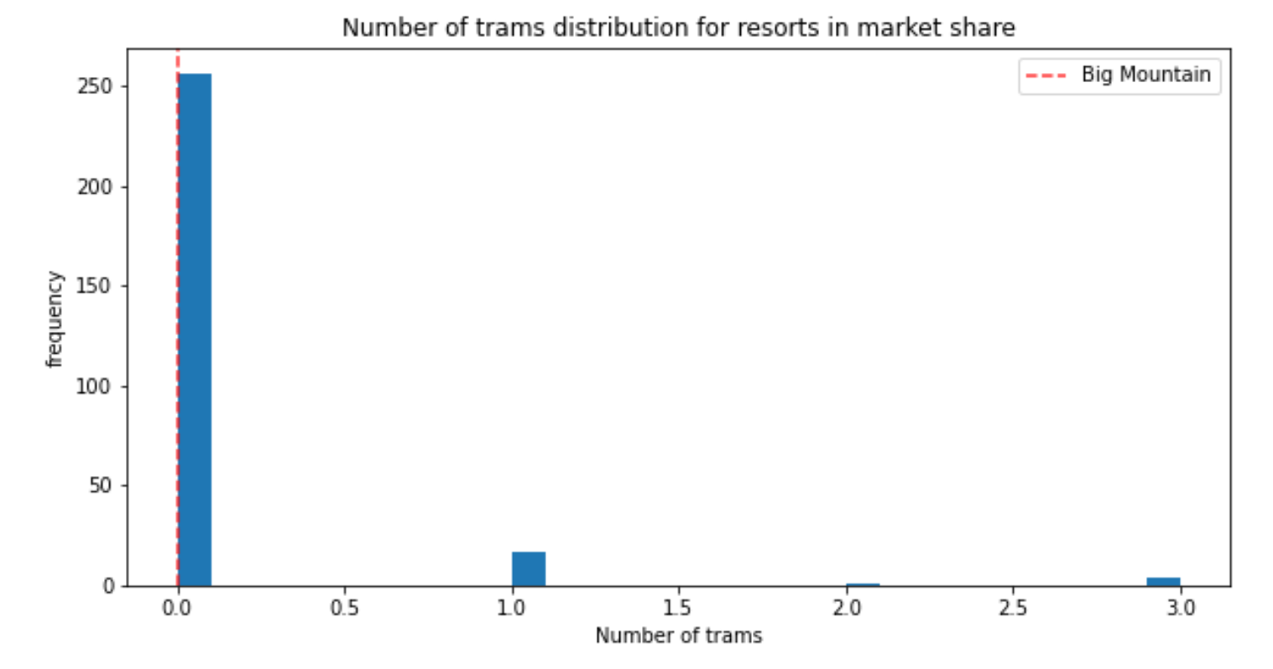
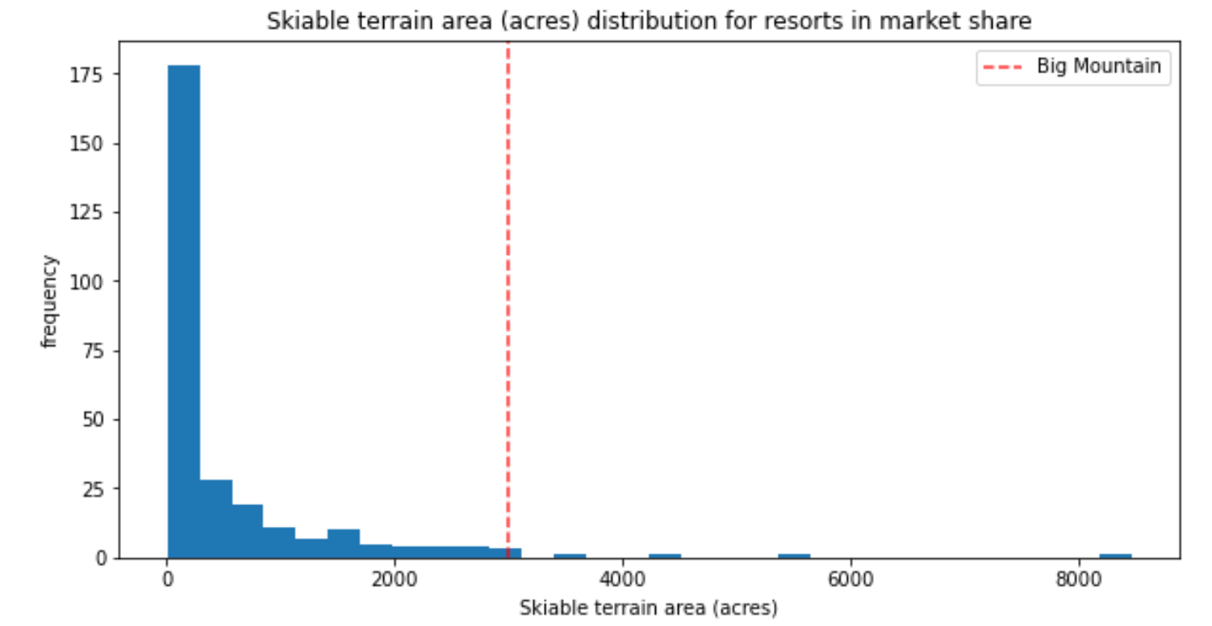
Data Analysis

Slide 19
Data Analysis
Big Mountain Resort shortlisted the following options for cutting costs to increase revenue:
- Permanently closing down up to 10 of the least used runs
- Increase the vertical drop by adding a run to a point 150 feet lower down but requiring the installation of an additional chair
- Same as the above but with adding 2 acres of snow cover
- Increase the longest run by 0.2 miles requiring additional snow making coverage of 4 acres

Slide 20
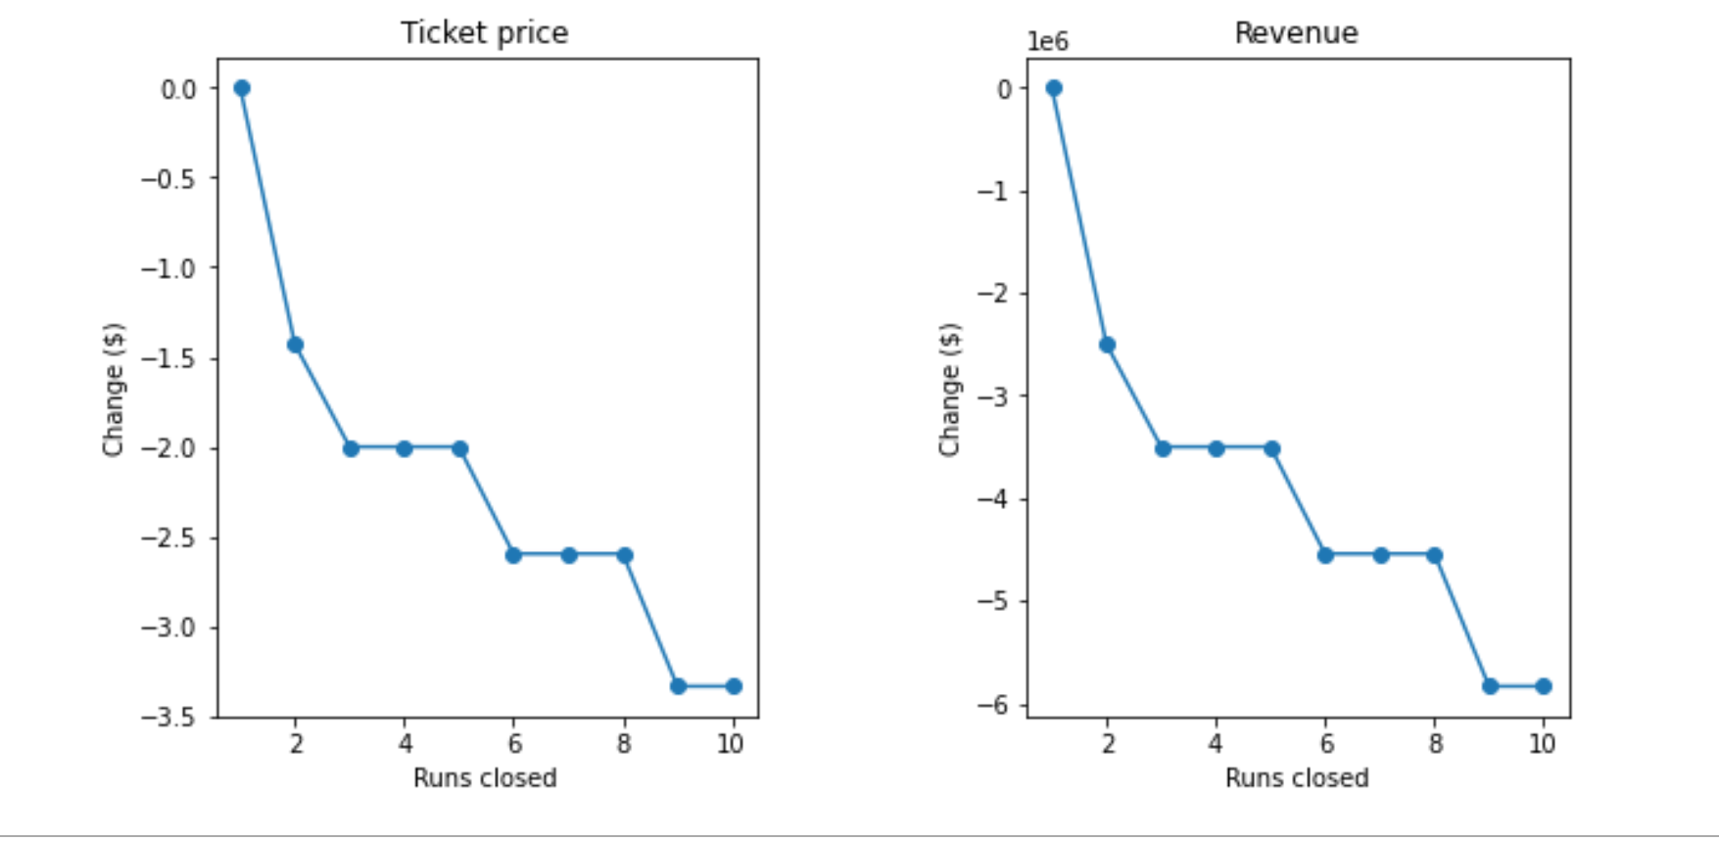
Data Analysis
The model says closing one run makes no difference in revenue. Closing 2 and 3 successively reduces support for ticket price and so revenue
If Big Mountain closes down 3 runs, they may as well close down 4 or 5 as there is no further loss in ticket price.
Increasing the closures down to 6 or more leads to a large drop in predicted ticket price and revenue.

Slide 21
Data Analysis - Conclusions
Based on Big Mountain’s features, the model indicates the ticket price should be $97. However, the error associated with the model is $10.47 therefore an increase in ticket price of $6.32 is suggested, increasing the ticket price to $87.32.
Also, based on the model, closing one run will not impact ticket price. Therefore closing 1 run is recommended.
The data used to train the model does not contain net revenue information, therefore the model could contain resorts that are losing money. Obtaining net revenue data for each resort is recommended for addition to the model.

