Slide 1

Analysis by Lakshmi P Mokka
BIG MOUNTAIN DATA ANALYSIS

Slide 2
Problem Identification
Provide data driven insight to increase net profit to Big Mountain by determining a data driven ticket price and cost cutting measures that will increase net profit.

Slide 3
Recommendation and key findings
Based on Big Mountain’s features, the model indicates the ticket price should be $97. However, the error associated with the model is $10.47 therefore an increase in ticket price of $6.32 is suggested, increasing the ticket price to $87.32.
Also, based on the model, closing one run will not impact ticket price. Therefore closing 1 run is recommended.
The data used to train the model does not contain net revenue information, therefore the model could contain resorts that are losing money. Obtaining net revenue data for each resort is recommended for addition to the model.

Slide 4
Method
Utilize data provided from 330 resorts across the US to obtain data driven results.
Check the data for missing/duplicate/clearly inaccurate values
Clean data to ensure analysis is not performed on missing/duplicate/inaccurate values
Obtained population data per US state from a reliable data source
Cleaned US state population data to ensure analysis is not performed on missing/duplicate/inaccurate values

Slide 5
Data Analysis – Model Training
Extracted the Big Mountain Data from the dataset so that the rest of the data can be used for model training and testing
Split the data into 70%/30% where 70% of the data is used for model training and 30% of the data is used for model testing
The missing ski data was filled by mean and median data, the error in the predicted data dropped by the same amount for both filled values
Utilized pipeline’s function to train the model using a linear regression model.
Utilized attributes to determine the features with a high correlation to ticket price. Fast Quads and Vertical Drop showed a high correlation to ticket price.
Utilized a Random Forest Model to model data. Please see the results from this model on the next slide.

Slide 6
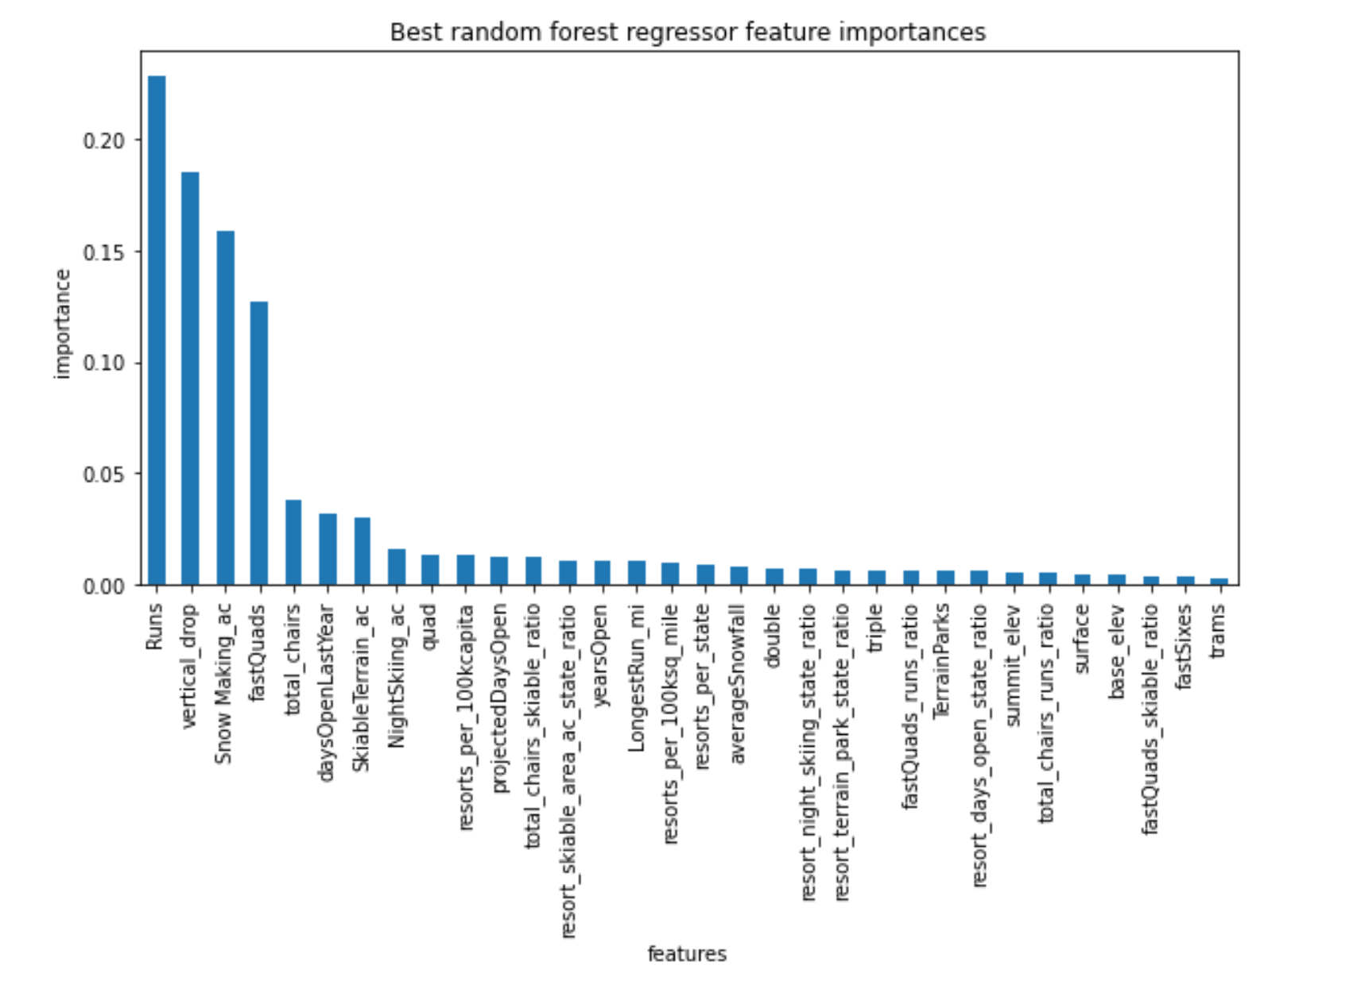
Data Analysis – Model Training

Slide 7
Data Analysis
Compared the linear regression model to the forest regression model – determined the forest regression model had a lower error.
Refit the forest regression model using all the available ski data.
Big Mountain Resort ticket modelled price is $97.79 versus its actual price of $81.00. With the expected mean absolute error of $10.47, this suggests there is room for an increase in price.
Features that came up as important in the modeling included the following:
- vertical_drop
- Snow Making_ac
- total_chairs
- fastQuads
- Runs
- LongestRun_mi
- trams
- SkiableTerrain_ac

Slide 8
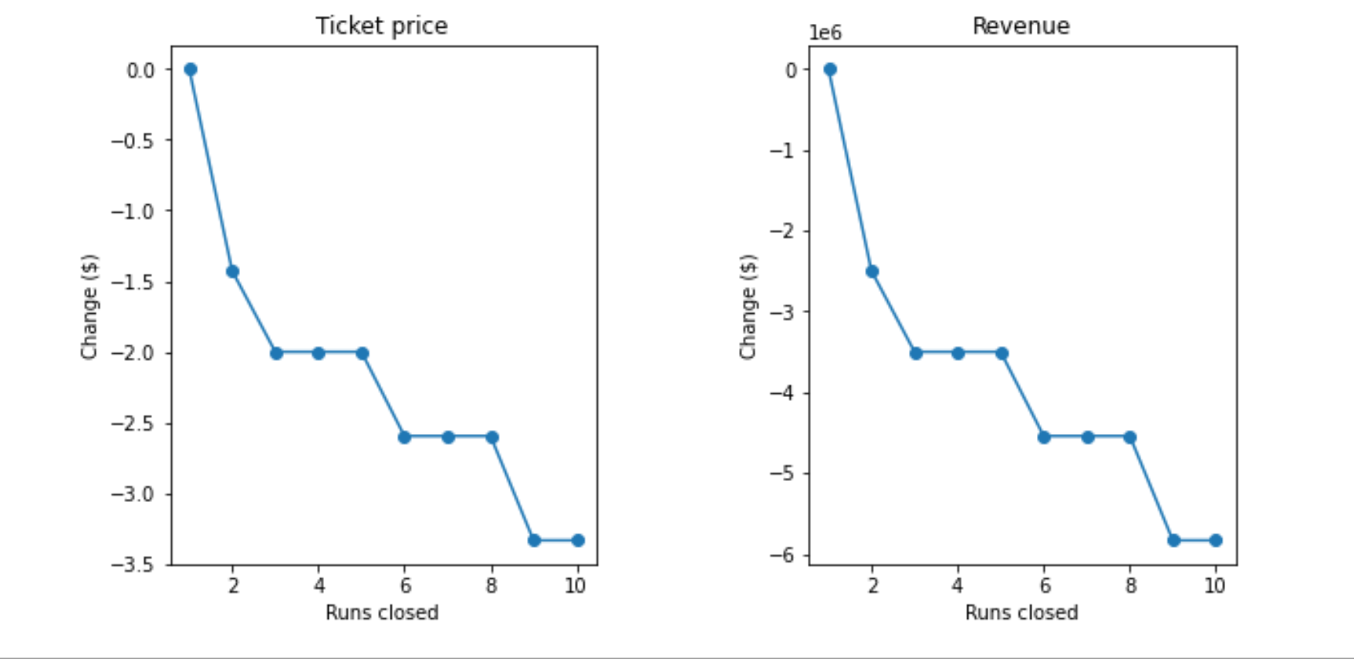
Data Analysis
The model says closing one run makes no difference in revenue. Closing 2 and 3 successively reduces support for ticket price and revenue
If Big Mountain closes down 3 runs, they may as well close down 4 or 5 as there is no further loss in ticket price.
Increasing the closures down to 6 or more leads to a large drop in predicted ticket price and revenue.

Slide 9
Data Analysis - Conclusions
Based on Big Mountain’s features, the model indicates the ticket price should be $97. However, the error associated with the model is $10.47 therefore an increase in ticket price of $6.32 is suggested, increasing the ticket price to $87.32.
Also, based on the model, closing one run will not impact ticket price. Therefore closing 1 run is recommended.
The data used to train the model does not contain net revenue information, therefore the model could contain resorts that are losing money. Obtaining net revenue data for each resort is recommended for addition to the model.

