Slide 1
Feature Pyramid networks for object detection
Tsung-Yi Lin,
Pitor Dollar,
Ross Girshick
Facebook AI Research (FAIR),
Cornell University and Cornell Tech
Presented By:
Sai MUTTAVARAPU
MSc Data Science and Artificial Intelligence – M1

Slide 2
Abstract
Introduction
Pathway Architecture
Generic Solution
Experiments
Results
Conclusions

Slide 3
Abstract
Object detection is the process to identify the meaning full objects in the given input image.
Traditional approach to detect the objects is constrained to time and memory for larger data sets.
Image pyramids plays the key roll in finding the objects but they are avoided due to compute power.
Featuring each level of an image pyramid has obvious limitations.
The architecture has provided in feature pyramids to detect the objects by considering, memory and computational power as main aspect with high accuracy with compared to existing one’s. (FPN)

Slide 4
Introduction
Considering memory and time, Fast and Faster R-CNN opt to not use featurized image pyramids under default settings.
Feature Pyramid built on the images with different scales which helps to detect the object in a better way.
Feature Pyramid Network (FPN) is a feature extractor designed for pyramid concept with accuracy and speed in mind.
It replaces the feature extractor of detectors like Faster R-CNN and generates multiple feature map layers (multi-scale feature maps) with better quality information than the regular feature pyramid for object detection.
Which competed with other best models.

Slide 5
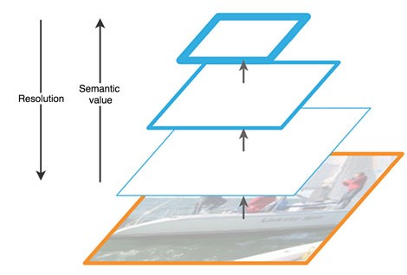
Introduction
Original images will be in higher resolution which is very difficult to identify the larger object even if with object slider.
By forming into different scales by reducing the resolution will helps to identify the larger images also.
Having the higher semantic value will increase the higher chances to identify the object.

Slide 6
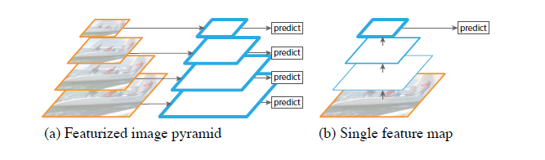
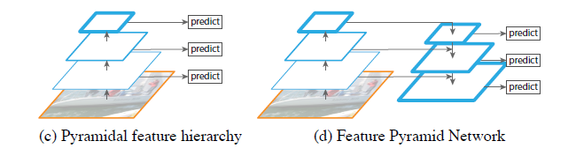
Introduction

Slide 7
Pathway Architecture
FPN composes of a bottom-up and a top-down pathway.
Bottom-up pathway
The bottom-up pathway is the usual convolutional network for feature extraction.
the spatial dimension is reduced by 1/2 (i.e. double the stride).
The output of each convolution module is labelled as Ci and later used in the top-down pathway.
Top-down pathway
The top down pathway hallucinates higher resolution features by upsampling spatially coarser.

Slide 8
Pathway Architecture
Top-down pathway
Semantically strong at each scaled level.
All scaled features will be connected to bottom up scaled features with lateral connections.
Input data will upsampled then merged with the corresponding bottom-up map
This process is iterated until the finest resolution map is generated.
It will get appended a 3X3 convolution on each merged map to generate the final feature map, which is to reduce the aliasing effect of upsampling.

Slide 9

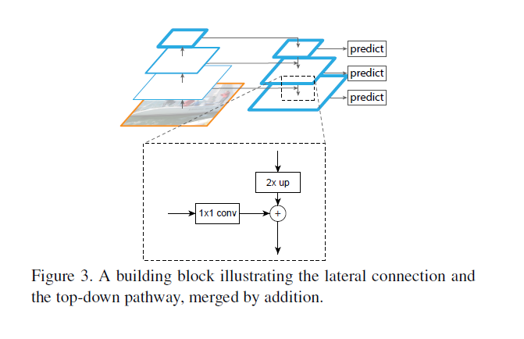

Slide 10
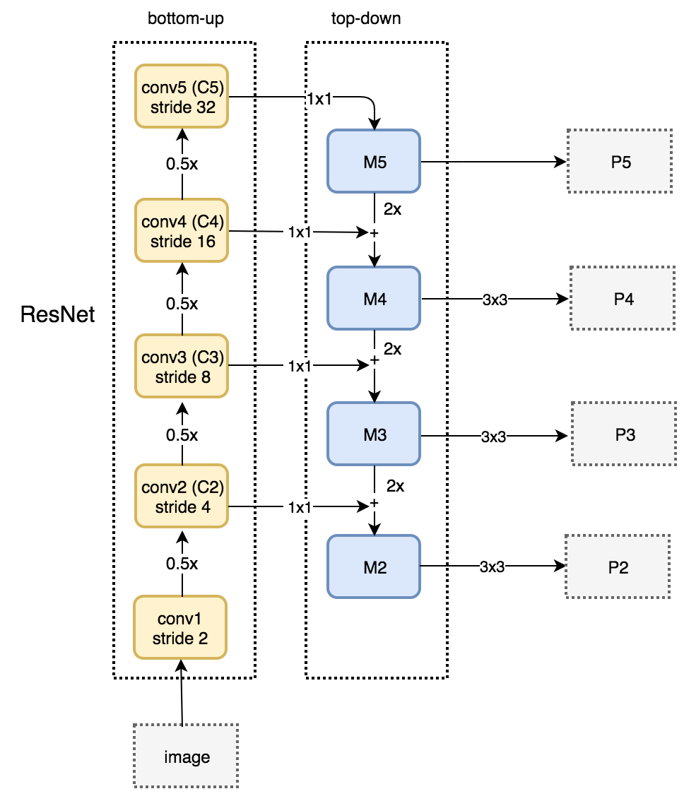

Slide 11
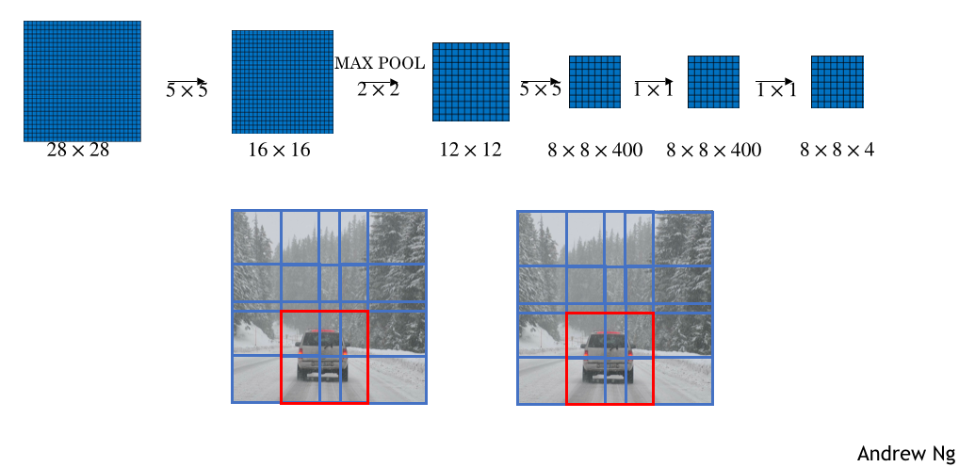
FPN with RPN
FPN is not an object detector by itself. It is a feature extractor that works with object detectors.
FPN extracts feature maps and later feeds into a detector, says RPN, for object detection.
RPN applies a sliding window over the feature maps to make predictions on the objectness (has an object or not) and the object boundary box at each location.

Slide 12
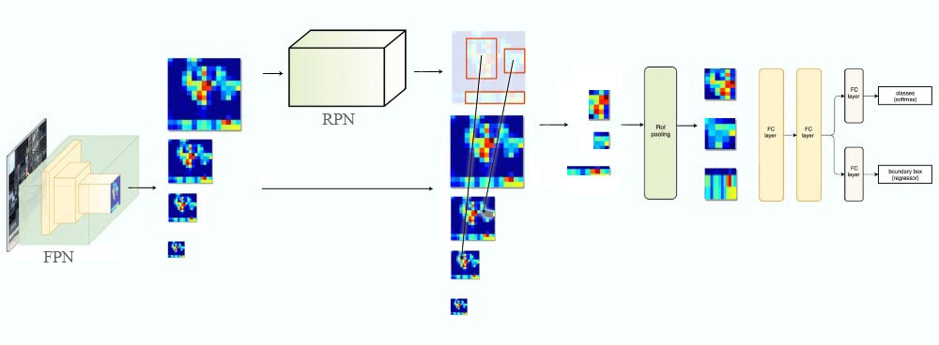
FPN with Faster R-CNN
Fast R-CNN is a object detector in which Region-of-Interest (RoI) pooling is used to extract features.
Generate a pyramid of feature maps then apply the RPN to generate ROIs.
ROIs and the feature map layer to create feature patches to be fed into the ROI pooling.

Slide 13
Experiments
80 category COCO detection dataset.
Training RPN with FPN on 8 GPUs takes about 8 hours on COCO.
Importance for top-down enrichment, lateral connections and pyramid representations.
Compared with COCO Competition Winners.
Comparisons with baselines using the single-scale map of C4 or C5, both using the same hyper-parameters.

Slide 14
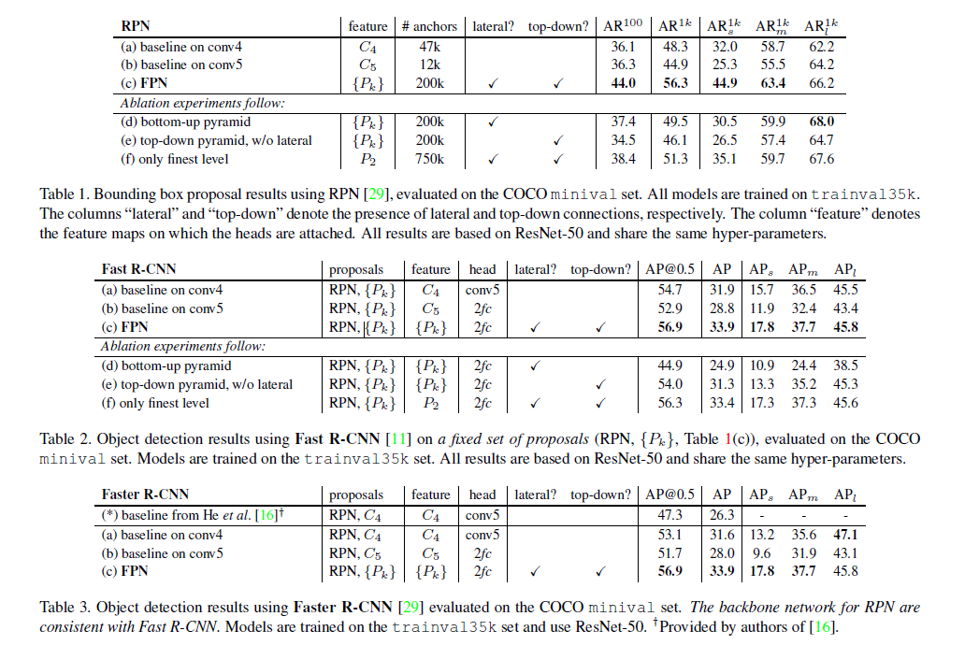
Results

Slide 15
Paper Conclusion
Simple framework for building feature pyramids inside ConvNets.
Method shows significant improvements over several strong baselines and competition winners.
It provides a practical solution for research and applications of feature pyramids, without the need of computing image pyramids.
FPN is independent to Object detector, Region proposal network, backbone.
Top-down pathway plus lateral connections improve accuracy by 8 points on COCO dataset. For small objects, it improves 12.9 points.
Adding more anchors on a single high-resolution feature map layer is not sufficient to improve accuracy.
Conclusion

Slide 16

Thank You..!
Open for Questions

