Slide 1

RetinaNet
Elias Boughosn
Based on “Focal Loss for Dense Object Detection, Facebook AI Research (FAIR)” by Tsung-Yi Lin, Priya Goyal, Ross Girshick, Kaiming He, and Piotr Dollar

Slide 2
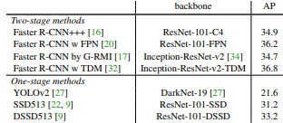
RetinaNet
Context
The highest accuracy object detectors were a two-stage approach popularized by R-CNN.
One-stage detectors are faster and simpler, but never managed to reach the accuracy of two-stage detectors.
Main problem: Extreme foreground-background class imbalance problem in one-stage detector.

Slide 3
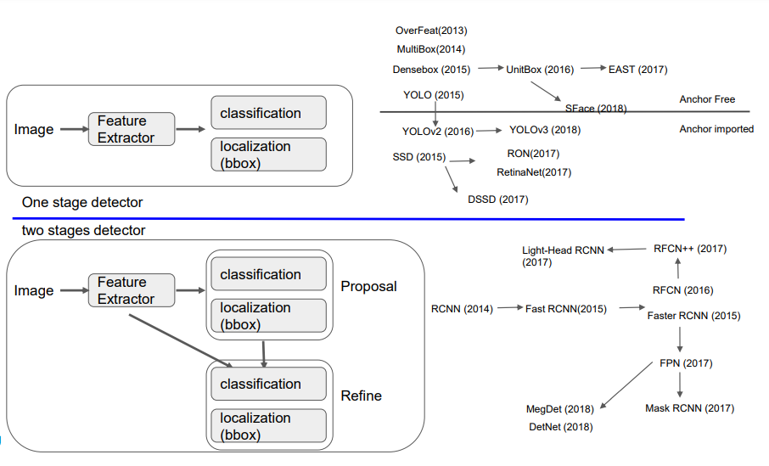
RetinaNet
Stage 1 and Stage 2 detectors
Stage 1 detectors :
A set of candidate object locations is regularly sampled across an image (~100k locations), which densely cover spatial positions, scales and aspect ratios.
Classification
Stage 2 detectors :
Region proposal network (RPN) decreases number of candidate object locations to a small number (e.g. 1-2k) filtering out most background samples.
Classification

Slide 4
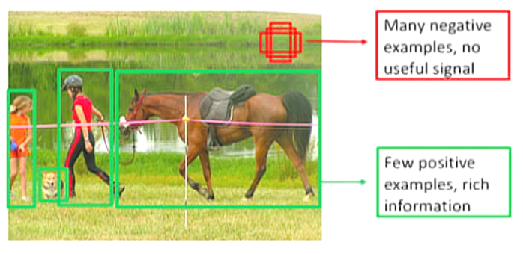
RetinaNet
Problem
Both classic one-stage object detection methods, like boosted detectors and DPMs, and more recent methods, like SSD, face a large class imbalance during training. These detectors evaluate candidate locations per image but only a few locations contain objects. This imbalance causes two problems (due to easy negatives):
Inefficient training
Lower quality models
Solution
In contrast, the proposed focal loss naturally handles the class imbalance faced by a one-stage detector and allows us to efficiently train on all examples without sampling and without easy negatives overwhelming the loss and computed gradients.

Slide 5
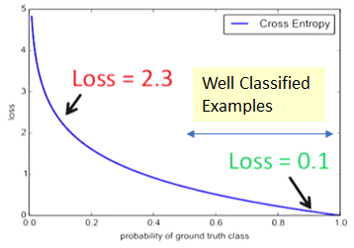
RetinaNet
Concept
Solve these problems:
Dealing with easy negatives.
Differentiating between easy/hard examples.
Using these methods:
Focal loss
Feature pyramid network
Goal:
To reshape the loss function to down-weight easy examples and thus focus training on hard negatives.
The loss from easy examples = 100000×0.1 = 10000
The loss from hard examples = 100×2.3 = 230
CE loss is not a good choice when there is extreme class imbalance.

Slide 6



RetinaNet
Focal loss
Cross Entropy (CE) loss for binary classification:
For notational reasons it has become the following:
y ∈ {±1} specifies the ground-truth class and p ∈ [0, 1] is the model’s estimated probability for the class with label y = 1
The α-balanced (CE) loss:
α balances the importance of positive/negative examples, it does not differentiate between easy/hard examples.
The focal loss:
A modulating factor (1 − pt) γ with tunable focusing parameter γ ≥ 0 to down-weight easy examples and thus focus training on hard negatives.
The α-balanced variant of the focal loss:
This provides improved accuracy over the non-α-balanced form.

Slide 7
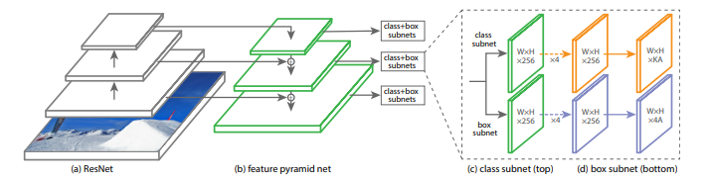
RetinaNet
Architecture
Anchors: The anchors have areas of 32² to 512² on pyramid levels 3 to 7, respectively. At each pyramid level the anchors are at three aspect ratios {1:2, 1:1, 2:1}
Feature Pyramid Network Backbone: An FPN is built on top of the ResNet architecture with levels 3 through 7.
The one-stage RetinaNet network architecture uses an FPN backbone on top of a ResNet architecture
A rich, multi-scale convolutional feature pyramid
A subnetwork for classifying anchor boxes (predicts the probability of object presence)
A subnetwork for regressing from anchor boxes to ground-truth object boxes
The network design is intentionally simple, which enables this work to focus on a novel focal loss function that eliminates the accuracy gap between our one-stage detector and state-of-the-art two-stage detectors like Faster R-CNN with FPN while running at faster speeds.

Slide 8
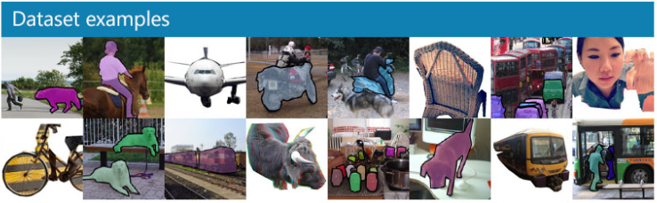
RetinaNet
Dataset
Images from COCO Dataset
For training, COCO dataset is used. The COCO trainval35k split (union of 80k images from train and a random 35k subset of images from the 40k image val split). For the main results, they report COCO AP on the test-dev split, which has no public labels and requires use of the evaluation server.

Slide 9
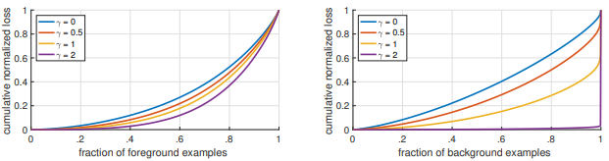
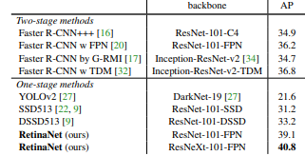
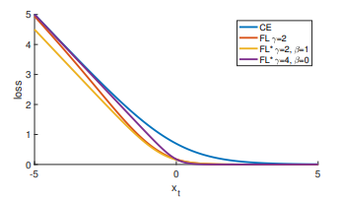
RetinaNet
Results
Figure 1: Cumulative distribution functions of the normalized loss
Figure 2: Focal loss variants compared to the cross entropy
Figure 3:Object detection single-model results vs. 2-stage on COCO test-dev

Slide 10
RetinaNet
Conclusion
Focal loss represented by RetinaNet enables us to:
Identify class imbalance
Focus learning on hard negative examples
Surpass top-performing, two-stage methods with one-stage object detectors.
Achieves state-of-the-art accuracy and speed
For this reason, it has become a popular object detection model to be used with aerial and satellite imagery.

