Slide 1
The graphical system
“Processing large dataset with R”

Slide 2
Introduction to ggplot2
We will be creating plots using the ggplot2 package.
> library(dplyr)
> library(ggplot2)
There are also other packages for creating graphics such as grid and lattice. We chose to use ggplot2 in this book because it breaks plots into components in a way that permits beginners to create relatively complex and aesthetically pleasing plots using syntax that is intuitive and comparatively easy to remember.
Advantages of ggplot2:
Grammar of graphics
Default behaviour
ggplot2 sheet cheat
Disadvantages of ggplot2:
One limitation is that ggplot2 is designed to work exclusively with data tables in tidy format (where rows are observations and columns are variables).
Notes:
Exploratory data visualization is perhaps the greatest strength of R. One can quickly go from idea to data to plot with a unique balance of flexibility and ease. For example, Excel may be easier than R for some plots, but it is nowhere near as flexible. D3.js may be more flexible and powerful than R, but it takes much longer to generate a plot.
grammar of graphics, the ggin ggplot2. This is analogous to the way learning grammar can help a beginner construct hundreds of different sentences by learning just a handful of verbs, nouns and adjectives without having to memorize each specific sentence.
its default behavior is carefully chosen to satisfy the great majority of cases and is visually pleasing. As a result, it is possible to create informative and elegant graphs with relatively simple and readable code.

Slide 3
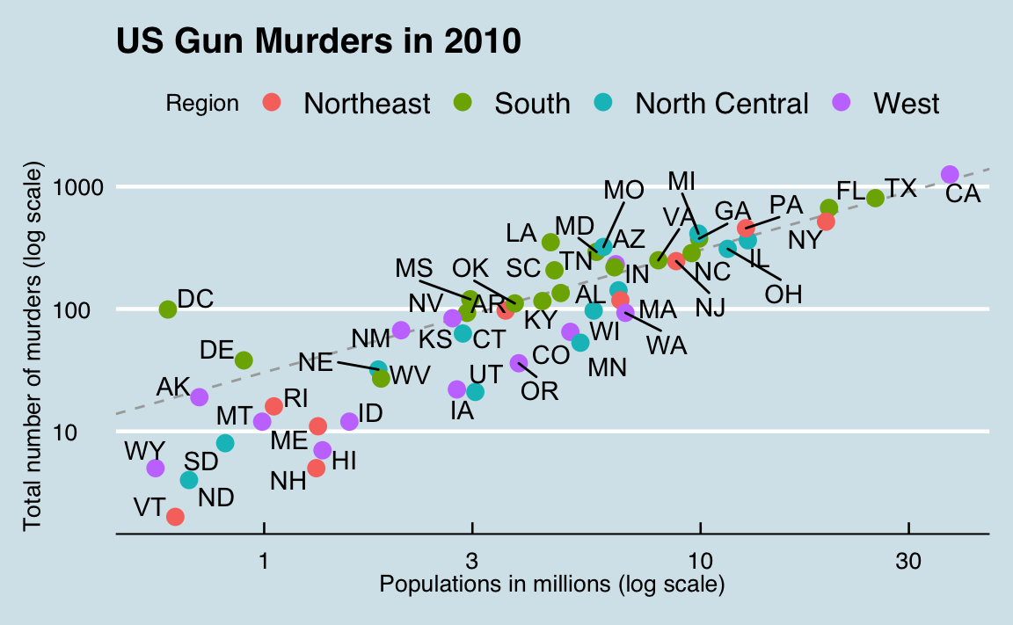
The components of a graph
We will construct a graph that summarizes the US murders dataset that looks like this:
The main three components to note are:
Data: The US murders data table is being summarized.
Geometry: The plot above is a scatterplot. This is referred to as the geometry component.
Aesthetic mapping: The plot uses several visual cues to represent the information provided by the dataset.
Notes:
Other possible geometries are barplot, histogram, smooth densities, qqplot, and boxplot. We will learn more about these in the Data Visualization part of the book.
The two most important cues in this plot are the point positions on the x-axis and y-axis, which represent population size and the total number of murders respectively. Each point represents a different observation, and we map data about these observations to visual cues like x- and y-scale. Color is another visual cue that we map to region. We refer to this as the aesthetic mappingcomponent. How we define the mapping depends on what geometry we are using.

Slide 4

ggplot objects
> ggplot(data = murders) or > murders %>% ggplot() or > p <- ggplot(data = murders)
no geometry has been defined!

Slide 5
Geometries
In ggplot2 we create graphs by adding layers. Layers can define geometries, compute summary statistics, define what scales to use, or even change styles. To add layers, we use the the symbol +. In general, a line of code will look like this:
DATA %>% ggplot() + LAYER 1 + LAYER 2 + … + LAYER N
Geometry function names follow the pattern: geom_X where X is the name of the geometry. Some examples include geom_point, geom_bar and geom_histogram.
> Aesthetics
>
> geom_point understands the following aesthetics (required aesthetics are in bold):
> x
> y
> alpha
> colour

Slide 6
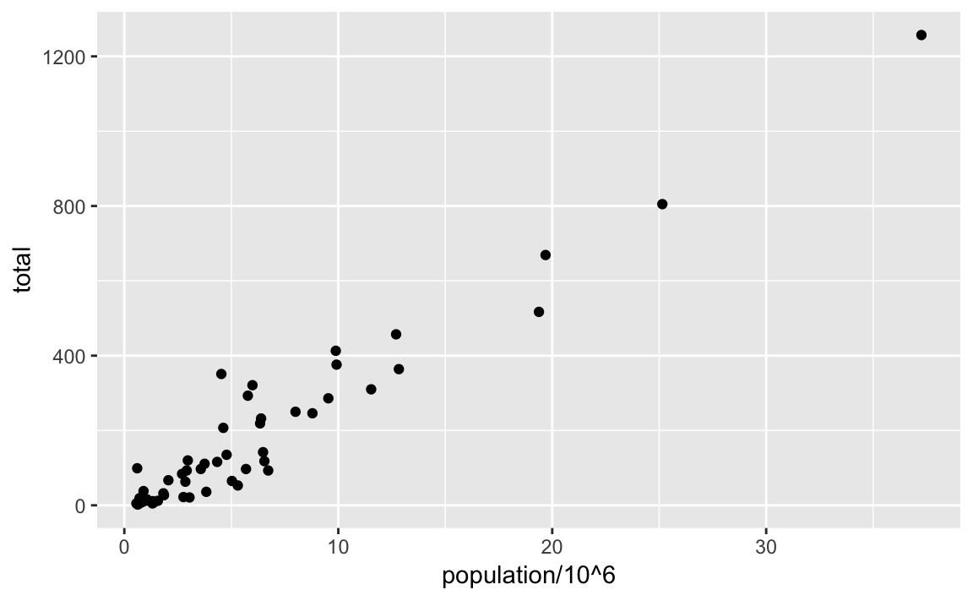
Aesthetic mappings
Aesthetic mappings describe how properties of the data connect with features of the graph, such as distance along an axis, size or color.
murders %>% ggplot() + geom_point(aes(x = population/10^6, y = total))
Or
p + geom_point(aes(population/10^6, total))

Slide 7
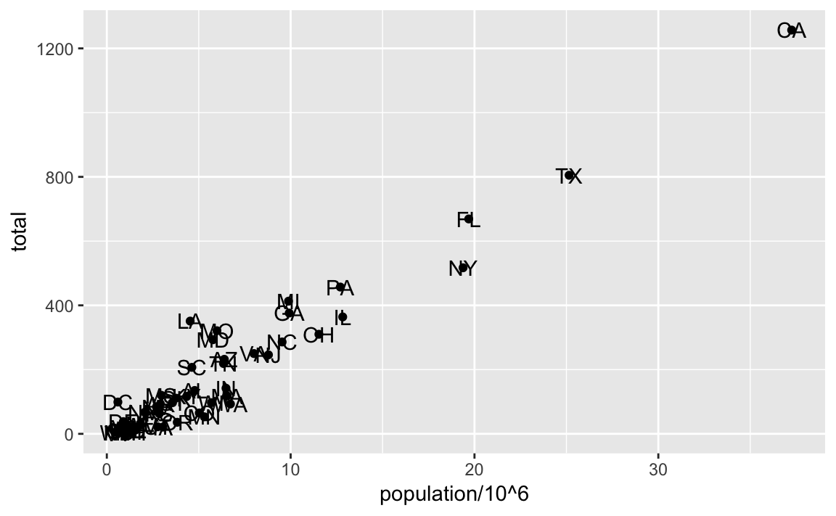
Layers
A second layer in the plot we wish to make involves adding a label to each point to identify the state. The geom_label and geom_text functions permit us to add text to the plot with and without a rectangle behind the text respectively.
p + geom_point(aes(population/10^6, total)) + geom_text(aes(population/10^6, total, label = abb))

Slide 8
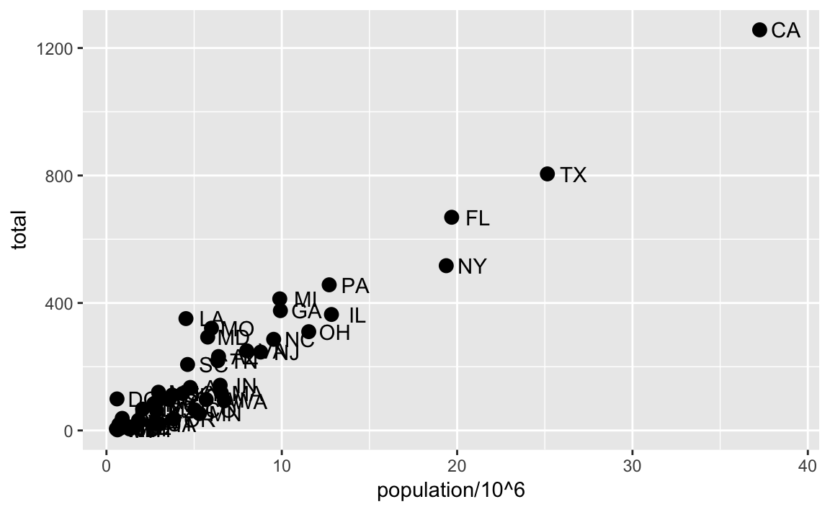
Layers
A second layer in the plot we wish to make involves adding a label to each point to identify the state. The geom_label and geom_text functions permit us to add text to the plot with and without a rectangle behind the text respectively.
p + geom_point(aes(population/10^6, total)) + geom_text(aes(population/10^6, total, label = abb))
p + geom_point(aes(population/10^6, total), size = 3) + geom_text(aes(population/10^6, total, label = abb), nudge_x = 1.(-5)

Slide 9
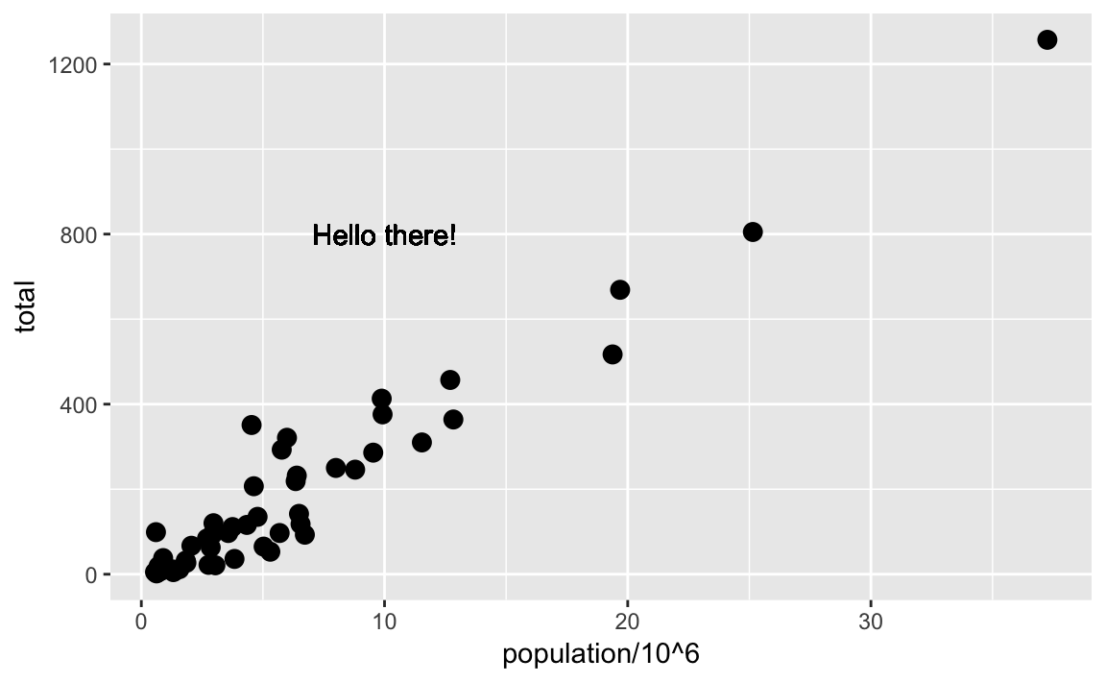
Global versus local aesthetic mappings
p + geom_point(aes(population/10^6, total), size = 3) + geom_text(aes(population/10^6, total, label = abb), nudge_x = 1.(-5)
Or
p <- murders %>% ggplot(aes(population/10^6, total, label = abb))
p + geom_point(size = 3) + geom_text(nudge_x = 1.5)
If necessary, we can override the global mapping by defining a new mapping within each layer. These local definitions override the global. Here is an example:
p + geom_point(size = 3) + geom_text(aes(x = 10, y = 800, label = "Hello there!"))

Slide 10
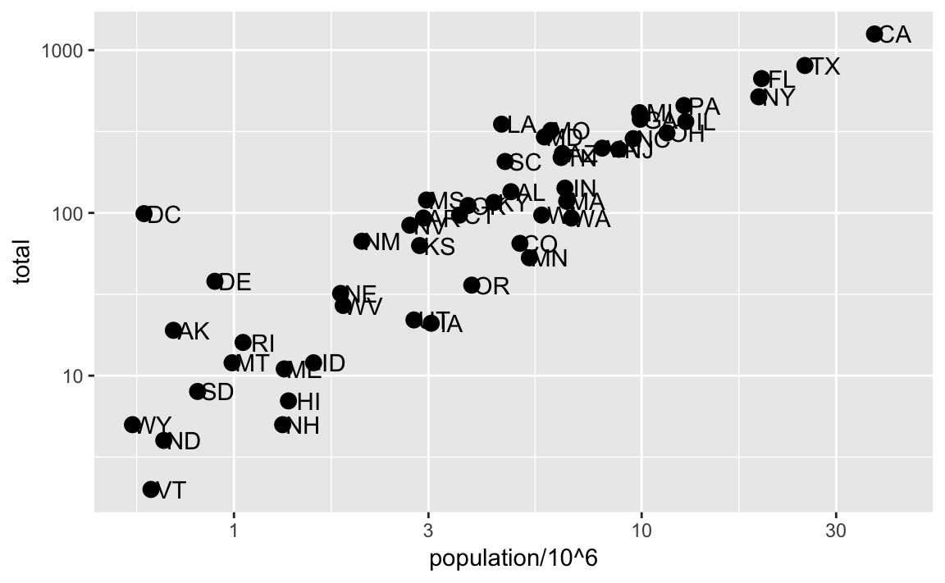
Scales
p + geom_point(size = 3) + geom_text(nudge_x = 0.05) + scale_x_continuous(trans = "log10") + scale_y_continuous(trans = "log10")
p + geom_point(size = 3) + geom_text(nudge_x = 0.05) + scale_x_log10() + scale_y_log10()

Slide 11
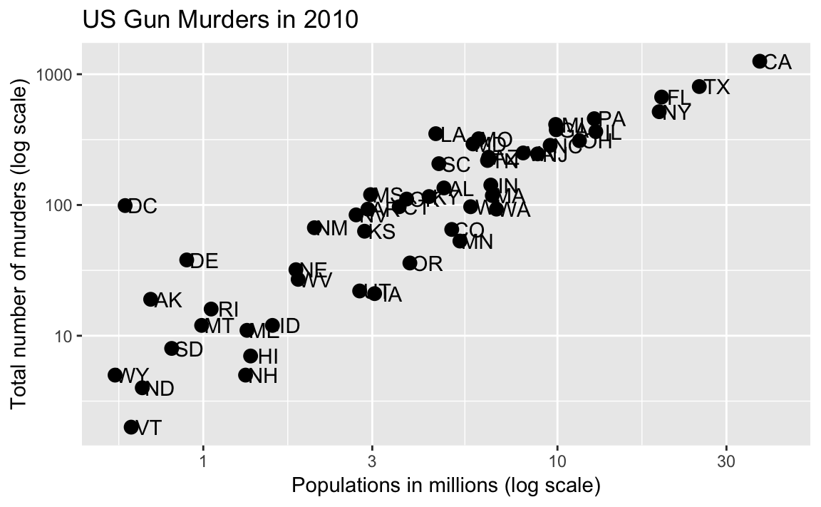
Labels and titles
p + geom_point(size = 3) + geom_text(nudge_x = 0.05) + scale_x_log10() + scale_y_log10() + xlab("Populations in millions (log scale)") + ylab("Total number of murders (log scale)") + ggtitle("US Gun Murders in 2010")
We are almost there! All we have left to do is add color, a legend and optional changes to the style.

Slide 12
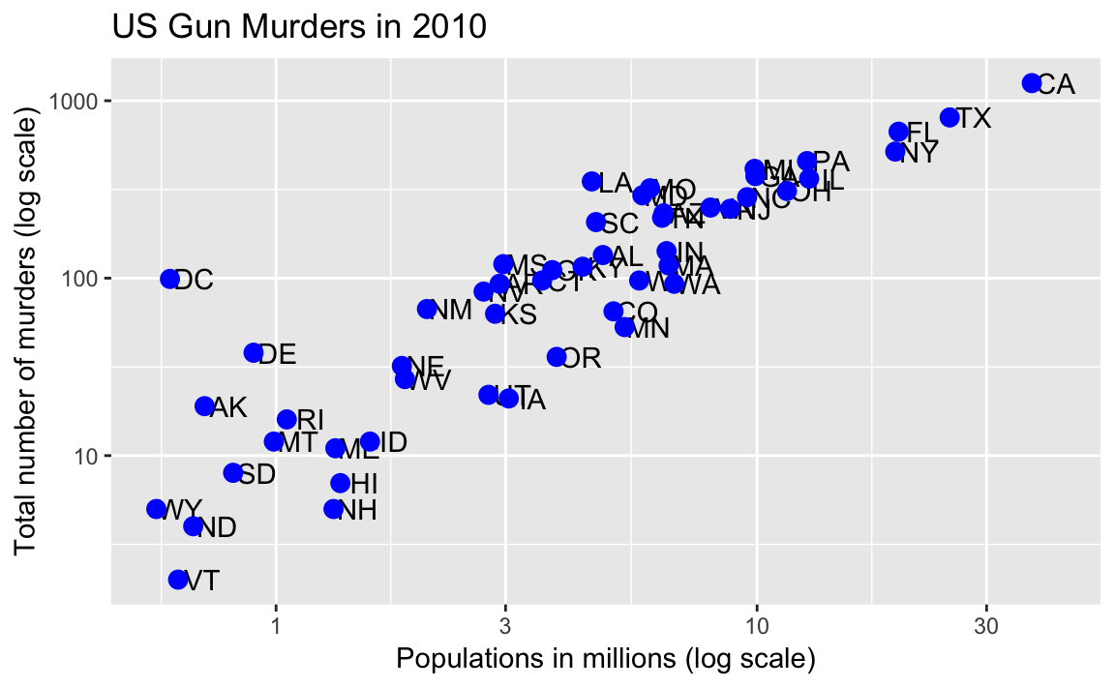
Categories as colors
p <- murders %>% ggplot(aes(population/10^6, total, label = abb)) + geom_text(nudge_x = 0.05) + scale_x_log10() + scale_y_log10() + xlab("Populations in millions (log scale)") + ylab("Total number of murders (log scale)") + ggtitle("US Gun Murders in 2010")
p + geom_point(color ="blue ", size = 3 )
Notes:
We can change the color of the points using the col argument in the geom_point function. To facilitate demonstration of new features, we will redefine p to be everything except the points layer:

Slide 13
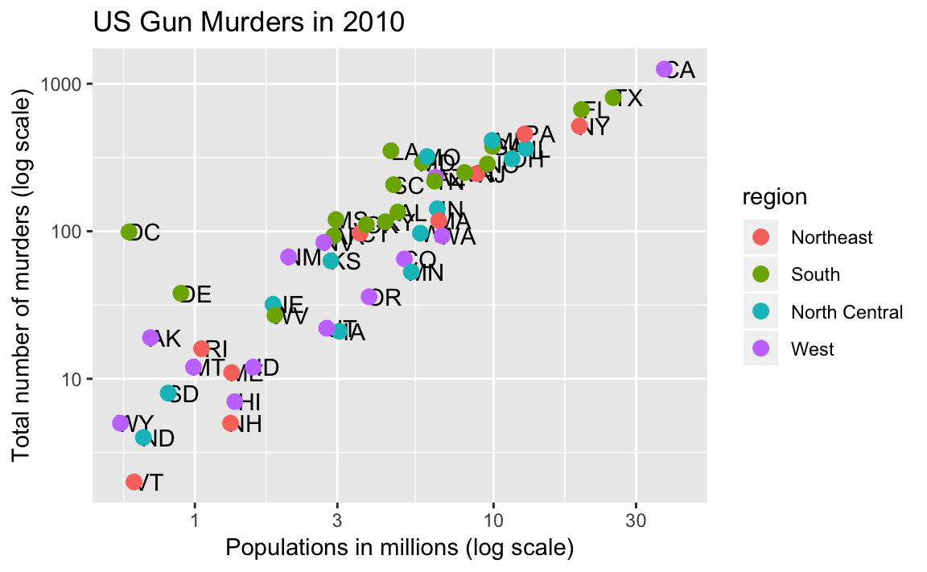
Categories as colors
p <- murders %>% ggplot(aes(population/10^6, total, label = abb)) + geom_text(nudge_x = 0.05) + scale_x_log10() + scale_y_log10() + xlab("Populations in millions (log scale)") + ylab("Total number of murders (log scale)") + ggtitle("US Gun Murders in 2010")
p + geom_point(aes(col=region), size = 3 )
Notes:
We can change the color of the points using the col argument in the geom_point function. To facilitate demonstration of new features, we will redefine p to be everything except the points layer:

Slide 14
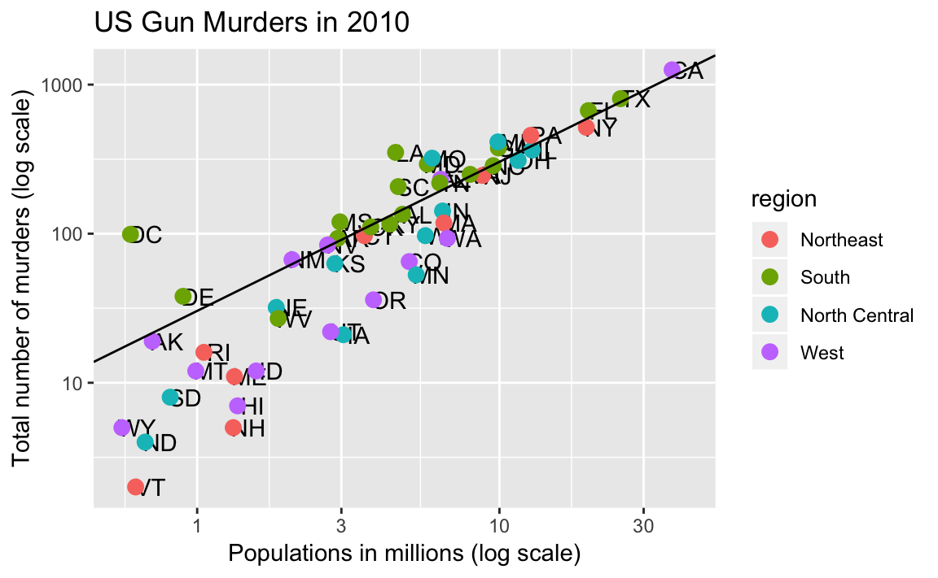
Annotation, shapes, and adjustments
Here we want to add a line that represents the average murder rate for the entire country.
r <- murders %>% summarize(rate = sum(total) / sum(population) * 10^6) %>% pull(rate)
To add a line we use the geom_abline function. ggplot2 uses ab in the name to remind us we are supplying the intercept (a) and slope (b). The default line has slope 1 and intercept 0 so we only have to define the intercept:
p + geom_point(aes(col=region), size = 3) + geom_abline(intercept = log10(r))
Notes:
We often want to add shapes or annotation to figures that are not derived directly from the aesthetic mapping; examples include labels, boxes, shaded areas and lines.

Slide 15
Add-on packages
The power of ggplot2 is augmented further due to the availability of add-on packages. The remaining changes needed to put the finishing touches on our plot require the ggthemes and ggrepel packages.
library(ggthemes)
p + theme_economist()
The add-on package ggrepel includes a geometry that adds labels while ensuring that they don’t fall on top of each other. We simply change geom_text with geom_text_repel.

Slide 16
Putting it all together
Now that we are done testing, we can write one piece of code that produces our desired plot from scratch.

Slide 17
Putting it all together
library(ggthemes)
library(ggrepel)
r <- murders %>% summarize(rate = sum(total) / sum(population) * 10^6) %>%
pull(rate)
murders %>% ggplot(aes(population/10^6, total, label = abb)) +
geom_abline(intercept = log10(r), lty = 2, color = "darkgrey") +
geom_point(aes(col=region), size = 3) +
geom_text_repel() +
scale_x_log10() +
scale_y_log10() +
xlab("Populations in millions (log scale)") +
ylab("Total number of murders (log scale)") +
ggtitle("US Gun Murders in 2010") +
scale_color_discrete(name = "Region") +
theme_economist()

Slide 18
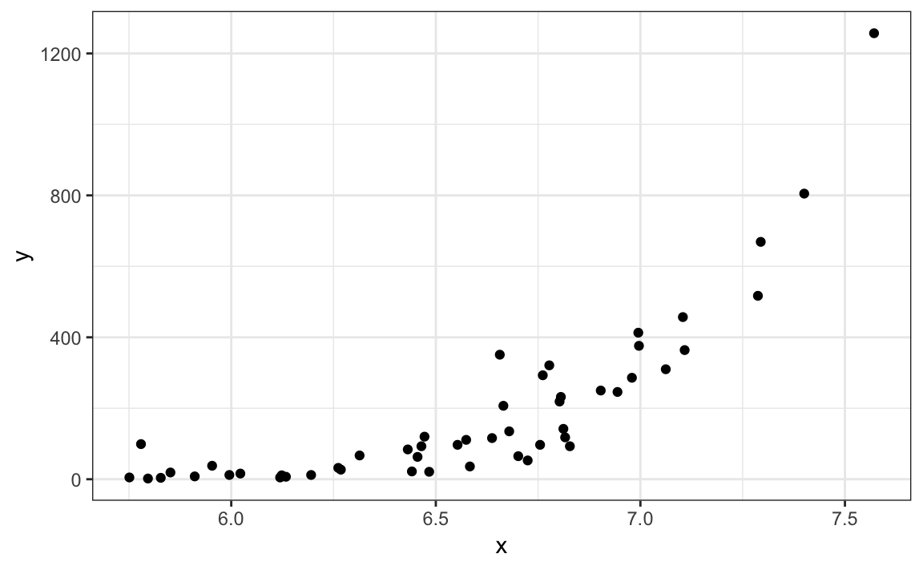
Quick plots with qplot
If we have values in two vectors, say:
data(murders)
x <- log10(murders$population)
y <- murders$total
and we want to make a scatterplot with ggplot, we would have to type something like:
data.frame(x = x, y = y) %>% ggplot(aes(x, y)) + geom_point()
This seems like too much code for such a simple plot. The qplot function sacrifices the flexibility provided by the ggplot approach, but allows us to generate a plot quickly.
qplot(x, y)
Notes:
We have learned the powerful approach to generating visualization with ggplot. However, there are instances in which all we want is to make a quick plot of, for example, a histogram of the values in a vector, a scatter plot of the values in two vectors, or a boxplot using categorical and numeric vectors. We demonstrated how to generate these plots with hist, plot, and boxplot. However, if we want to keep consistent with the ggplot style, we can use the function qplot.

Slide 19
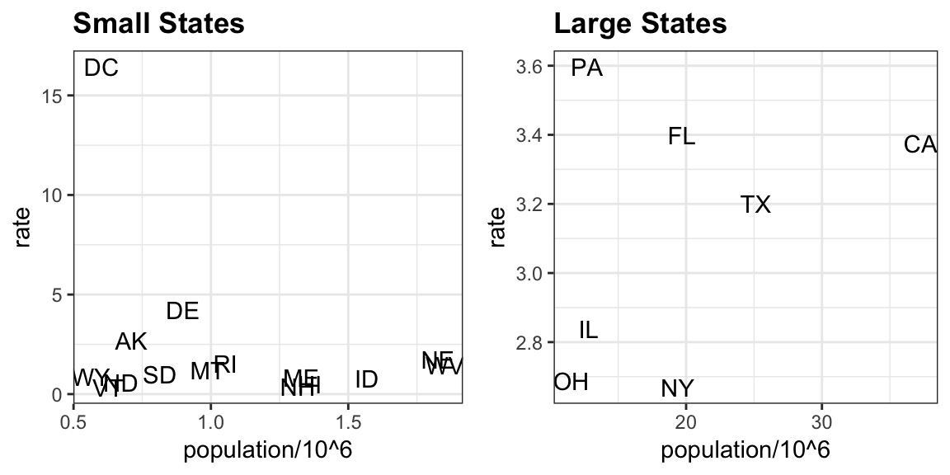
Grids of plots
library(gridExtra)
#> Attaching package: 'gridExtra’
#> The following object is masked from 'package:dplyr’:
#> combine
p1 <- murders %>% mutate(rate = total/population*10^5) %>%
filter(population < 2*10^6) %>%
ggplot(aes(population/10^6, rate, label = abb))
+ geom_text()
+ ggtitle("Small States")
p2 <- murders %>% mutate(rate = total/population*10^5) %>%
filter(population > 10*10^6) %>%
ggplot(aes(population/10^6, rate, label = abb)) +
geom_text() +
ggtitle("Large States")
grid.arrange(p1, p2, ncol = 2)

Slide 20
Exercise
1. Create a grid of plots with (including title, axis labels, colors….):
A. state and abb.
B. total_murders and population_size.
2. Repeat the previous exercise but now change both axes to be in the log scale.

Slide 21
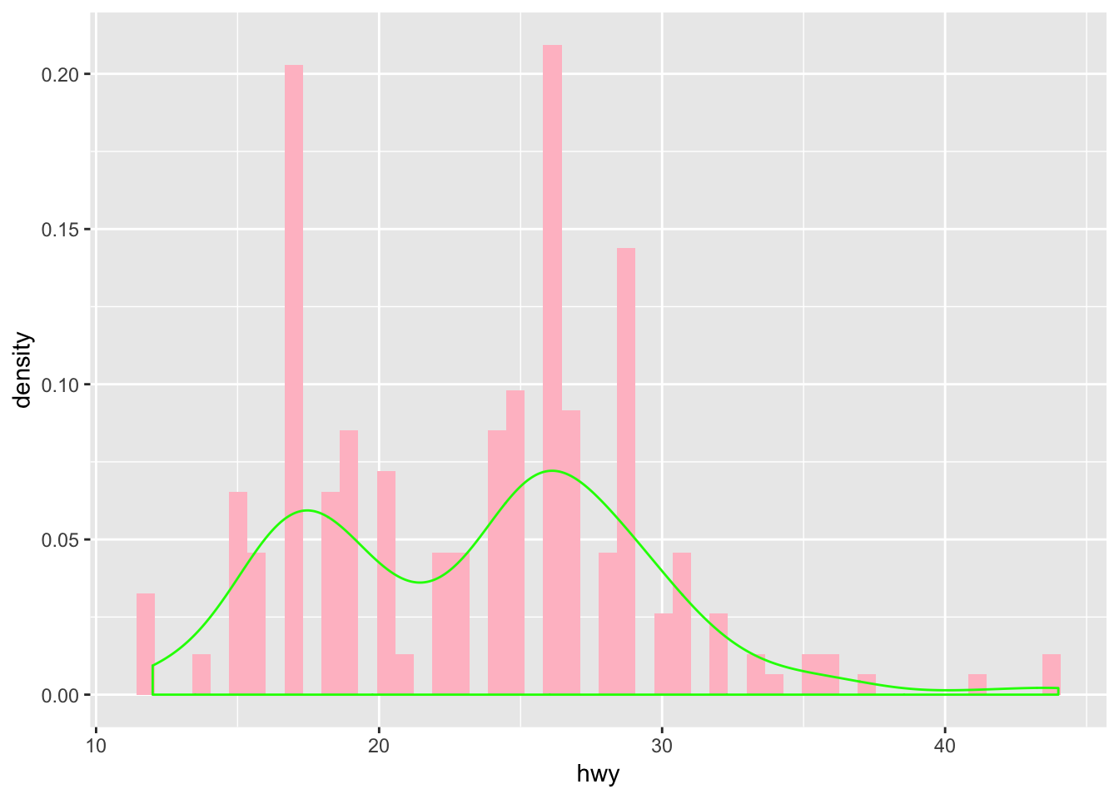
Histograms
ggplot(data = mpg) + geom_histogram(aes(x = hwy, y = ..density..), bins=50, fill = 'pink') + geom_density(aes(x = hwy),col = 'green')

Slide 22
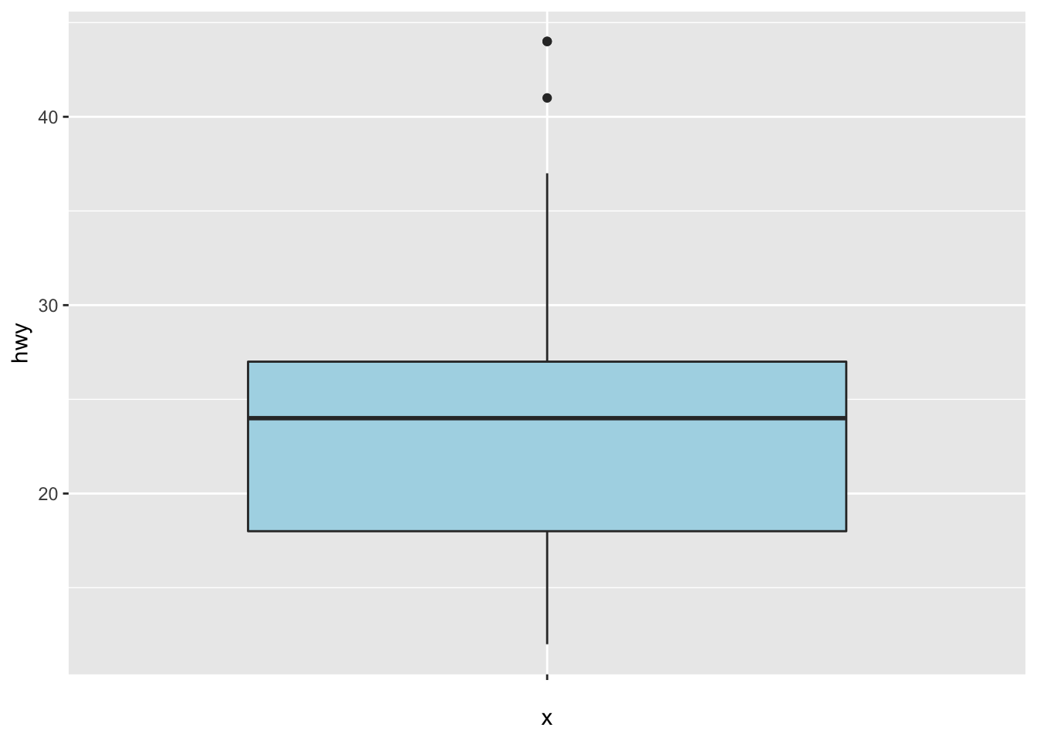
Boxplots
ggplot(data = mpg) + geom_boxplot(aes(x = '',y = hwy), fill = 'lightblue')

Slide 23
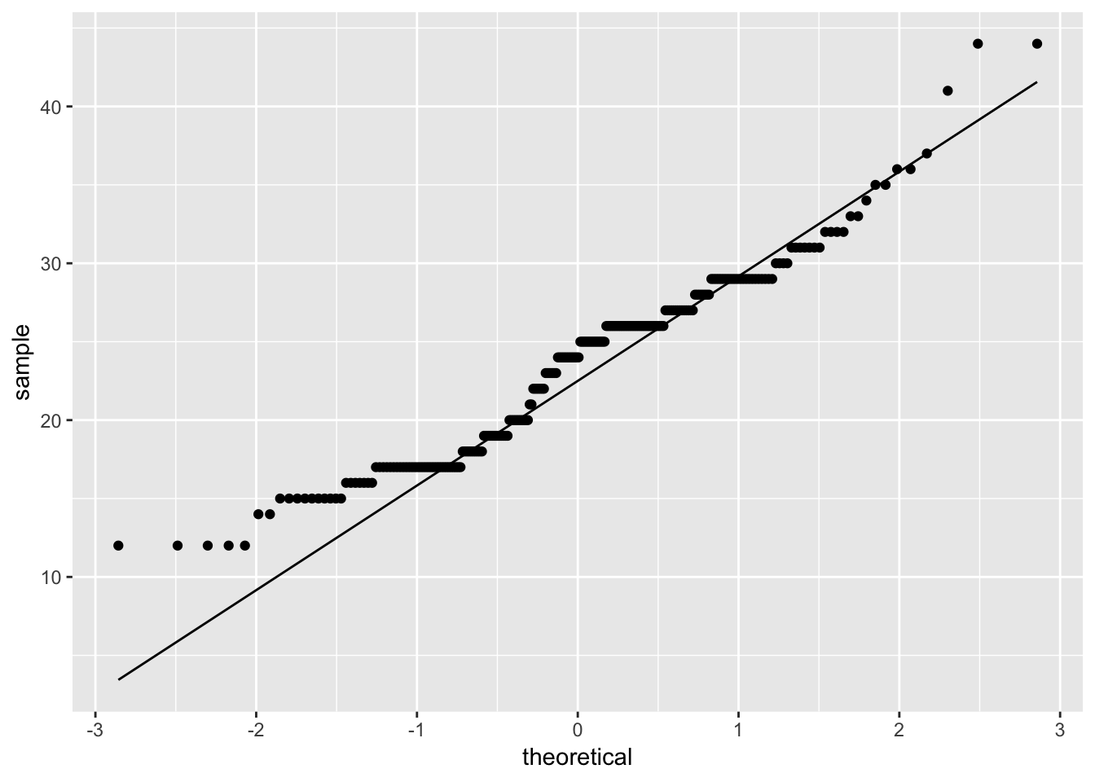
Compare distributions
ggplot(data = mpg) + geom_qq(aes(sample = hwy)) + geom_qq_line(aes(sample = hwy))

Slide 24
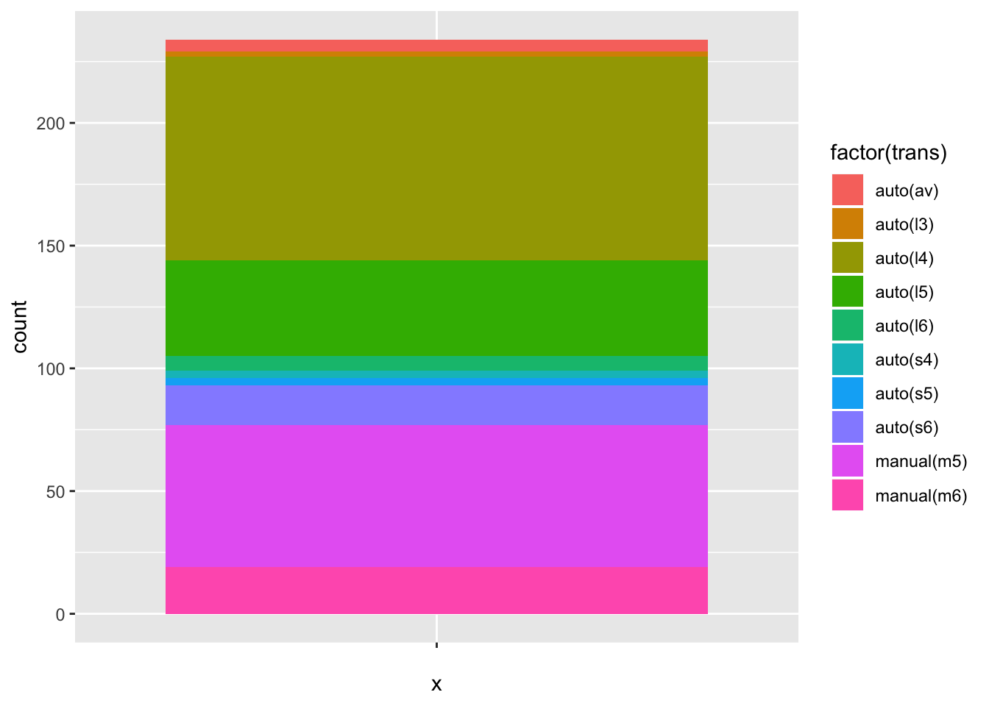
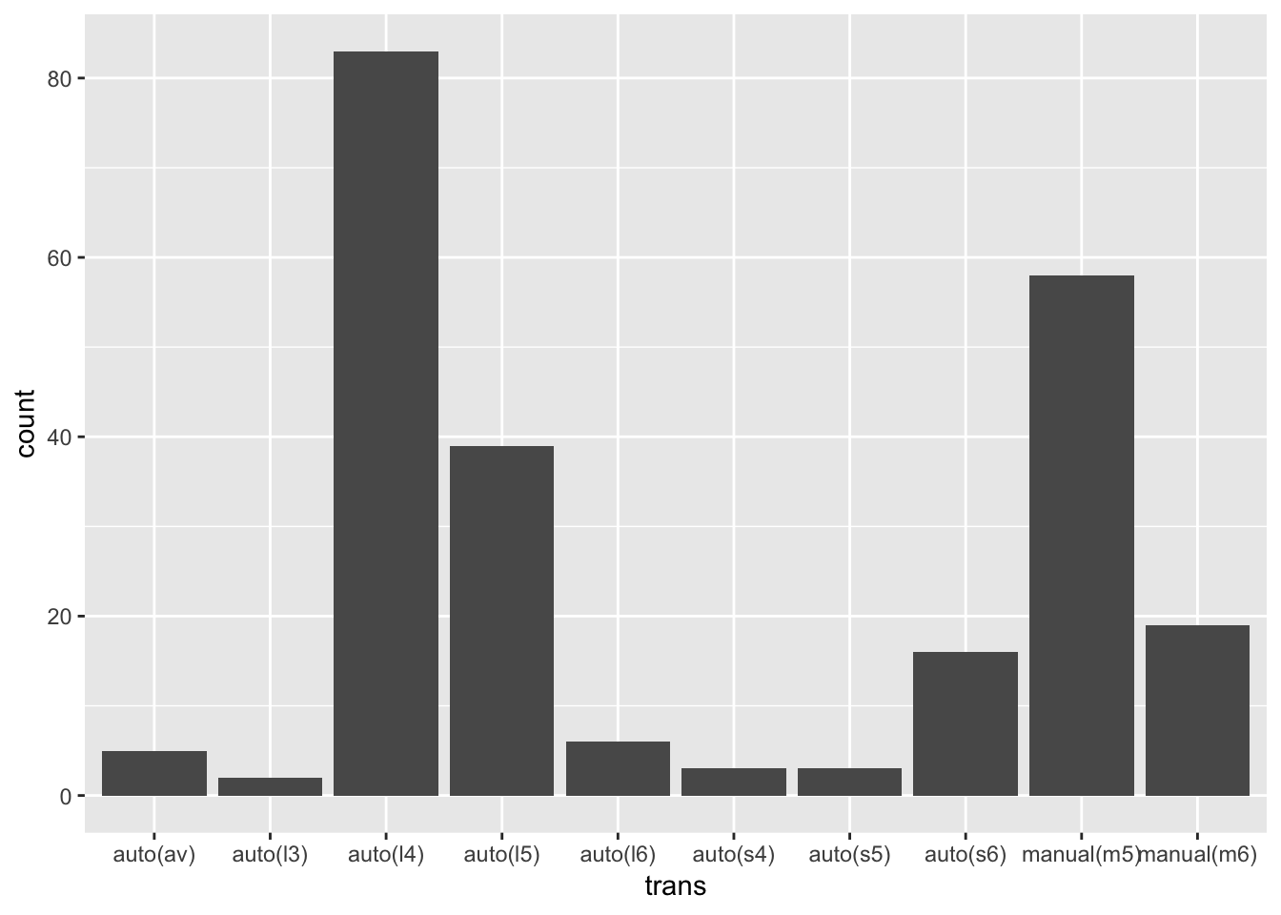
Barplots
ggplot(data = mpg) + geom_bar(aes(x = trans))
ggplot(data = mpg) + geom_bar(aes(x = "", fill = factor(trans)))

Slide 25
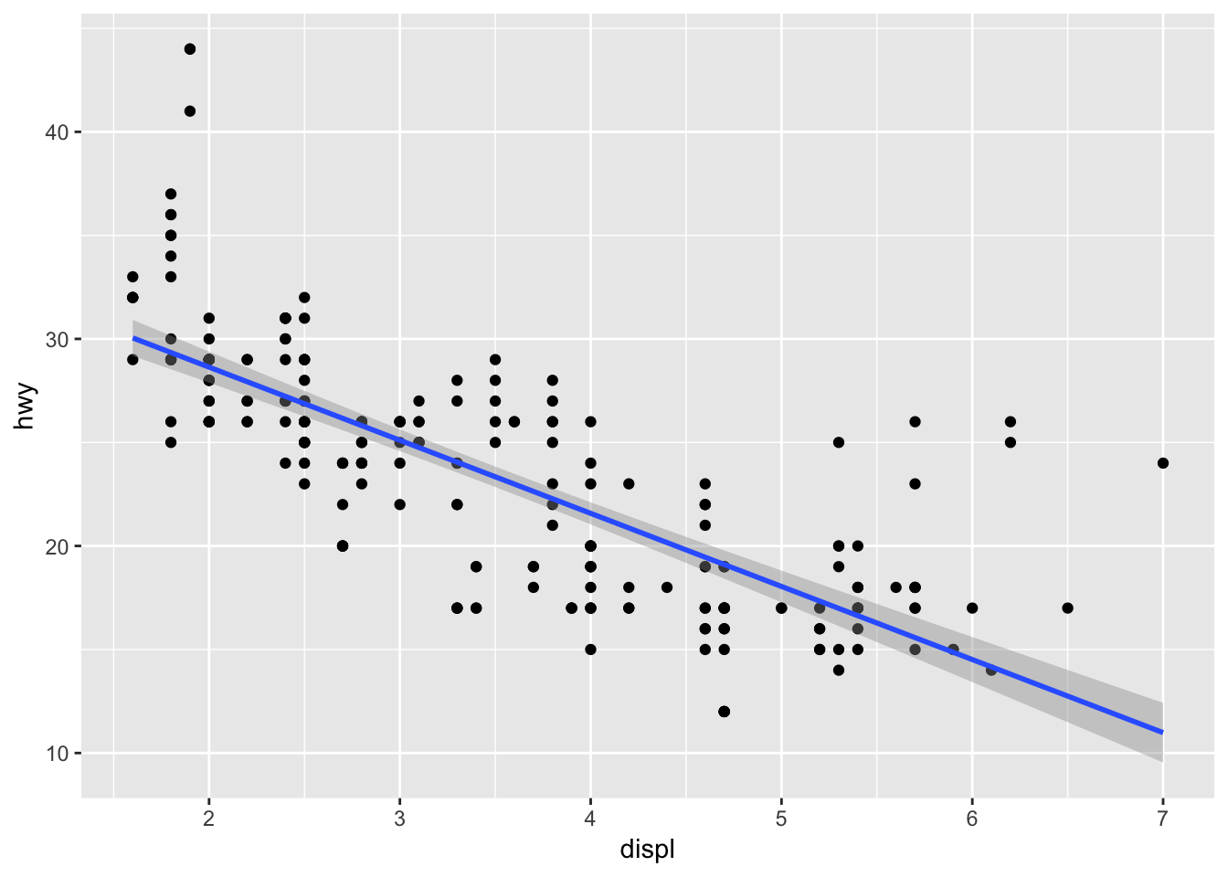
Linear model
gplot(data = mpg) + geom_point(mapping = aes(x = displ, y = hwy)) + geom_smooth(mapping = aes(x = displ, y = hwy),method = 'lm')

Slide 26
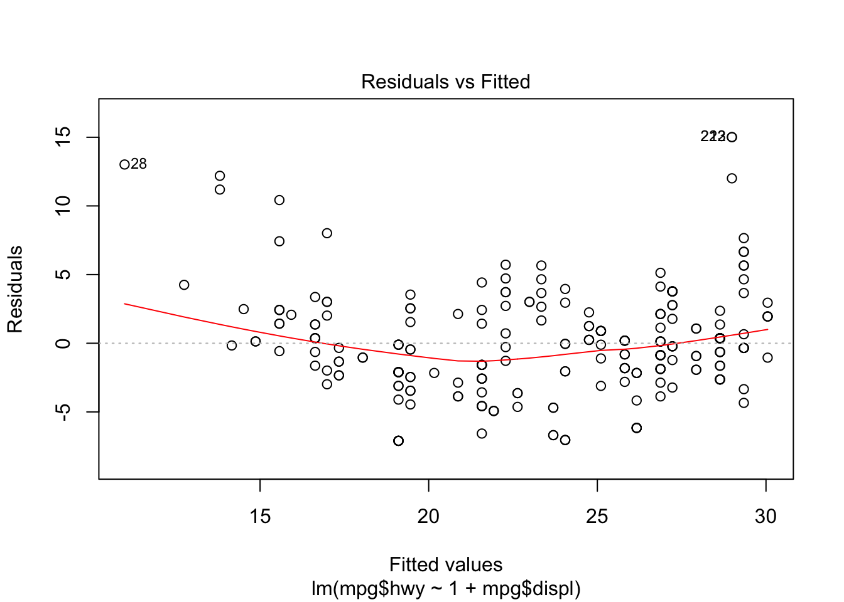
Linear model
out = lm(mpg$hwy ~ 1 + mpg$displ)
plot(out)

Slide 27
Exercise
Use the starwars data set in the dplyr package to:
list the different human characters,
list the different worlds,
compute the average weight and height of the different character types,
display on a plot the number of characters of each type in a deacresing order,
ggplot(data = mpg) + geom_bar(aes(x = trans))
Species$count = table(starwars$species)
visualize the relationship between the height and weight of the different characters.

Slide 28
list the different human characters
?starwars
starwars$name[starwars$species == 'Human']
## [1] "Luke Skywalker" "Darth Vader" "Leia Organa »
## [4] "Owen Lars" "Beru Whitesun lars" "Biggs Darklighter"
## [7] "Obi-Wan Kenobi" "Anakin Skywalker" "Wilhuff Tarkin" ## [10] "Han Solo" "Wedge Antilles" "Jek Tono Porkins"
## [13] "Palpatine" "Boba Fett" "Lando Calrissian"
## [16] "Lobot" "Mon Mothma" "Arvel Crynyd"
## [19] "Qui-Gon Jinn" "Finis Valorum" NA
## [22] NA "Shmi Skywalker" "Mace Windu"
## [25] "Gregar Typho" "Cordé" "Cliegg Lars"
## [28] "Dormé" "Dooku" "Bail Prestor Organa »
## [31] "Jango Fett" "Jocasta Nu" NA
## [34] "Raymus Antilles" NA "Finn"
## [37] "Rey" "Poe Dameron" NA
## [40] "Padmé Amidala"

Slide 29
list the different worlds
unique(starwars$homeworld)
## [1] "Tatooine" "Naboo" "Alderaan" "Stewjon"
## [5] "Eriadu" "Kashyyyk" "Corellia" "Rodia »
## [9] "Nal Hutta" "Bestine IV" NA "Kamino"
## [13] "Trandosha" "Socorro" "Bespin" "Mon Cala"
## [17] "Chandrila" "Endor" "Sullust" "Cato Neimoidia"
## [21] "Coruscant" "Toydaria" "Malastare" "Dathomir"
## [25] "Ryloth" "Vulpter" "Troiken" "Tund"
## [29] "Haruun Kal" "Cerea" "Glee Anselm" "Iridonia"
## [33] "Iktotch" "Quermia" "Dorin" "Champala"
## [37] "Geonosis" "Mirial" "Serenno" "Concord Dawn"
## [41] "Zolan" "Ojom" "Aleen Minor" "Skako"
## [45] "Muunilinst" "Shili" "Kalee" "Umbara"
## [49] "Utapau"

Slide 30
compute the average weight and height of the different character types
weight = tapply(starwars$mass, starwars$species, mean) height = tapply(starwars$height, starwars$species, mean) Species = data.frame(weight,height)
library(ggplot2)
ggplot(data = Species) + geom_point(aes(x = weight,y = height)) + geom_text(aes(x = weight,y = height,label = rownames(Species)),nudge_y = 10)

Slide 31
display on a plot the number of characters of each type in a deacresing order
Species$count = table(starwars$species)
Species = Species[order(Species$count,decreasing = TRUE),]
ggplot(data = Species) + geom_bar(aes(x = count)) barplot(Species$count)

Slide 32
visualize the relationship between the height and weight of the different characters
ggplot(data = starwars) + geom_point(aes(x = mass,y = height)) + geom_smooth(aes(x = mass,y = height),method = 'lm')
.

Slide 33
Exercise
Compare two simulated datasets with a plot and a hypothesis test.
Use the functions below:
visualises the two distributions with a histogram,
uses a t-test to compares means and summarises the results with a string

Slide 34
Result
library(ggplot2)
histogram <- function(x1, x2, binwidth = 0.1, xlim = c(-3, 3)) {
df <- data.frame(
x = c(x1, x2),
g = c(rep("x1", length(x1)), rep("x2", length(x2)))
)
ggplot(df, aes(x, fill = g)) +
geom_histogram(binwidth = binwidth) +
coord_cartesian(xlim = xlim)
}
t_test <- function(x1, x2) {
test <- t.test(x1, x2)
sprintf(
"p value: %0.3f\n[%0.2f, %0.2f]",
test$p.value, test$conf.int[1], test$conf.int[2]
)
}

Slide 35
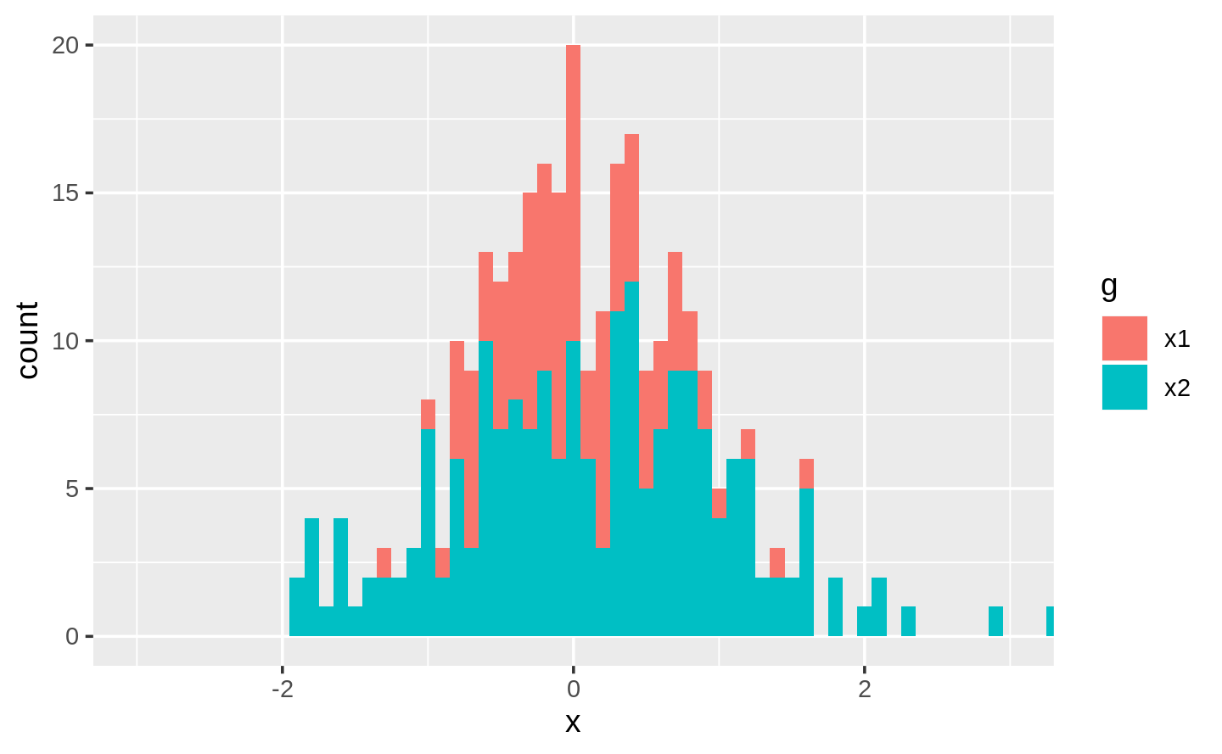
Result
x1 <- rnorm(100, mean = 0, sd = 0.5)
x2 <- rnorm(200, mean = 0.15, sd = 0.9)
histogram(x1, x2)
cat(t_test(x1, x2))
#> p value: 0.131
#> [-0.30, 0.04]

