Slide 1
Workshop 3
10/11/2020
Rmarkdown and Shiny

Slide 2
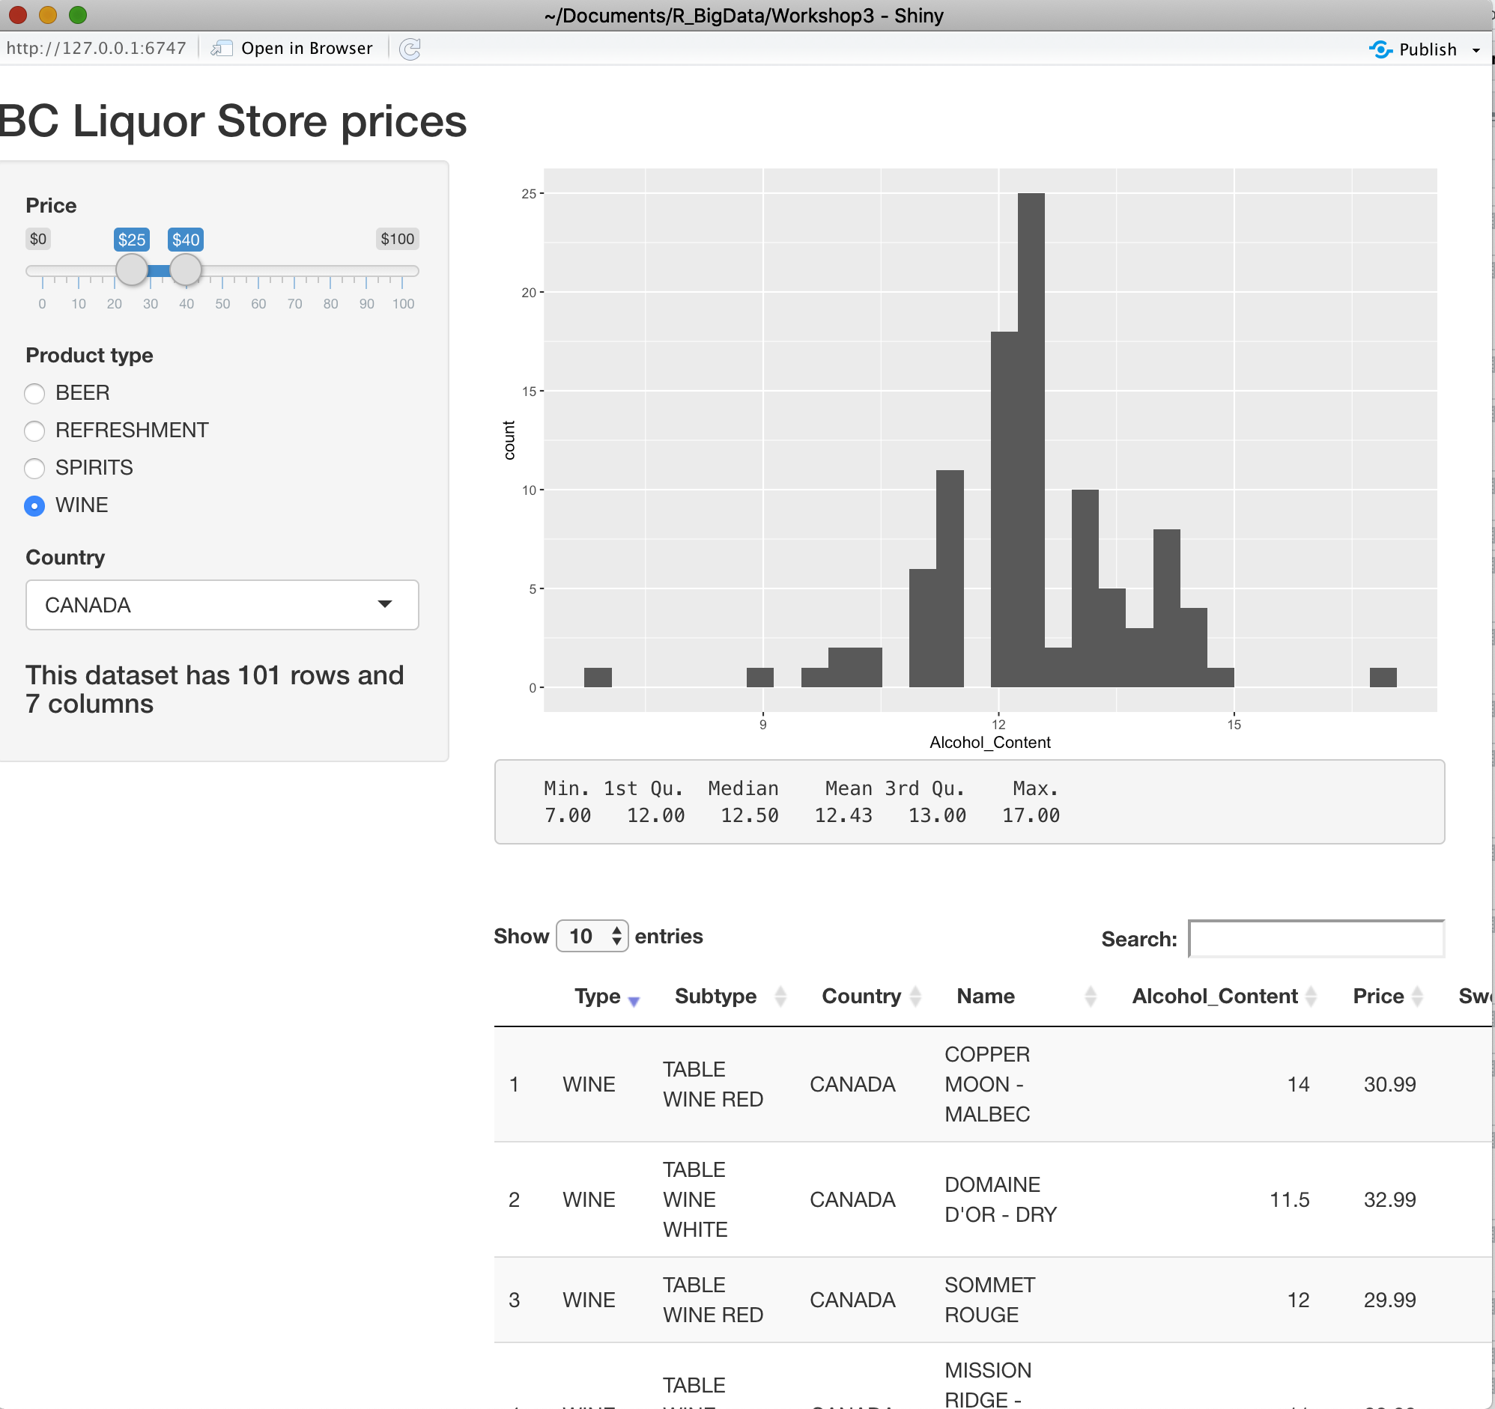
Exercise 1
Download the following dataset: https://drive.google.com/drive/folders/1doMk8cQUMsQ7DK3yeY-shbhDl76K-a3d?usp=sharing
Create a Shiny App that looks like
the one in the picture.
Set the following choices for countries:
CANADA
FRANCE
ITALY
UNITED STATES OF AMERICA
Create the same Shiny App using reactive{}
function when defining data in server.
In this case the choices will include all countries in the
dataset, that will be shown sorted in an alphabetic
order.

Slide 3
Exercise 2
Create a Shiny App with title “Diagnostics for simple linear regression” and subtitle the R and r-squared indexes. As input you can select 5 different trends (Positive Linerar, Negative Linear, Curved up, Curved down and Fan-shaped).
In the main panel you will have as output the regression model plot (scatter plot of data and the regression line) and below the following diagnostics plot for the residuals of the user – specified linear regression model:
Residuals vs Fitted Values
Histogram of residuals
Q-Q Plot of residuals
Add an input button that if clicked will show the residuals in the plot.

Slide 4
