Slide 1
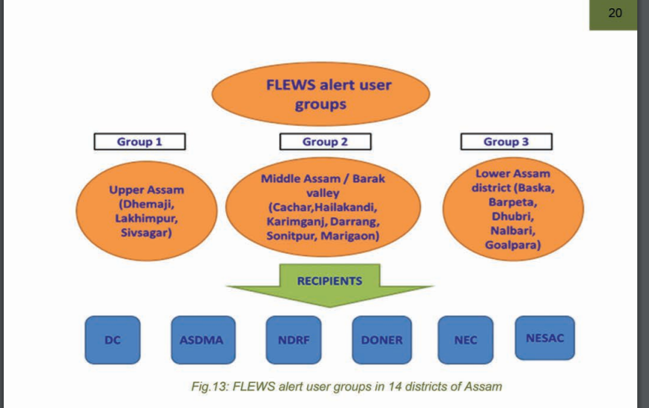
Research
http://www.fmis.bih.nic.in/aboutus.html#AOI
SOURCE::http://asdma.gov.in/pdf/publication/FLEWS.pdf

Slide 2
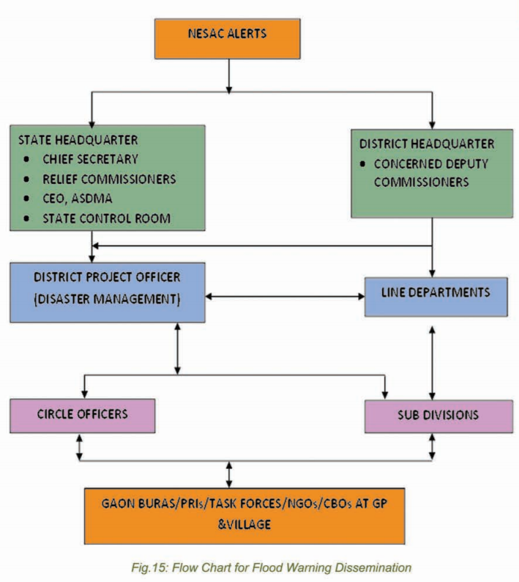
SOURCE::http://asdma.gov.in/pdf/publication/FLEWS.pdf

Slide 3
Budget
One time cost
LoRaWAN:Rs 25,000-40,000
Siren:Rs1,000-Rs5000
Solar panel with Battery:Rs1,500
Esp:Rs300x2=Rs600
Node-red,Mqtt,Grafana: Rs 0
Additional Charges estimated:Rs20,000
Civil Works:
Recurring Cost
Other Costs : SMS/Email-marginal in terms of % of cost
AWS Server:10k-15k per year
Maintenance cost :

Slide 4
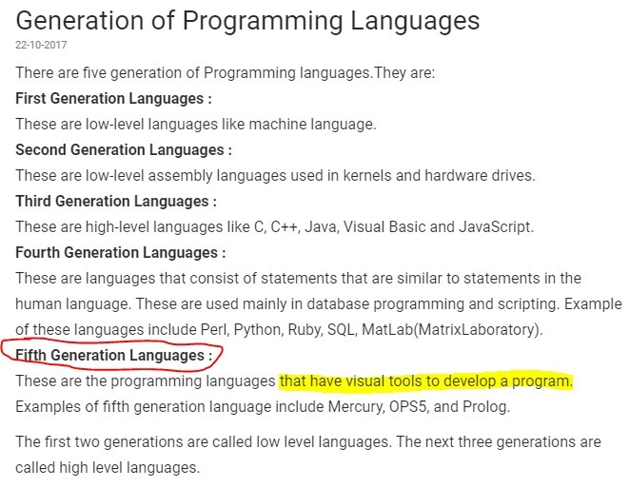
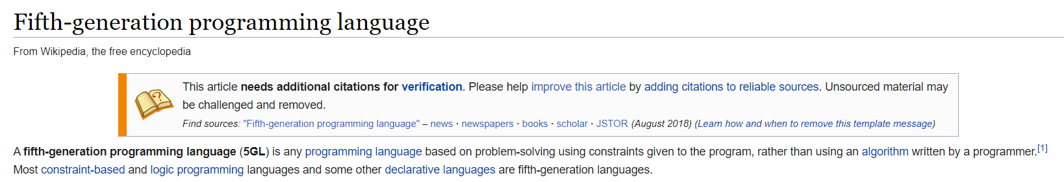
https://awesomeopensource.com/projects/flow-based-programming
Wikipedia

Slide 5
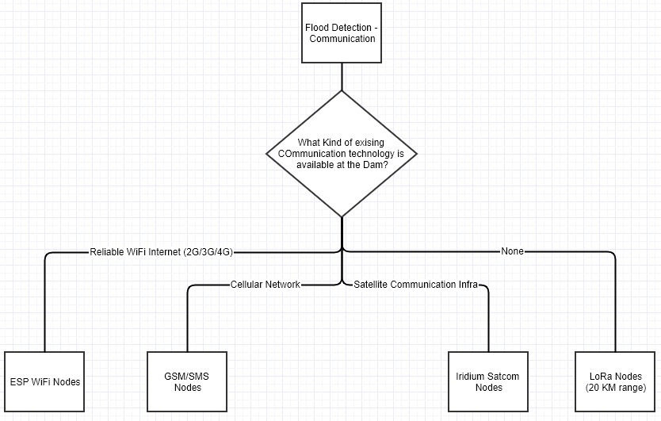
Different ways we can connect our interface with the pre-existing Communication Technologies

Slide 6
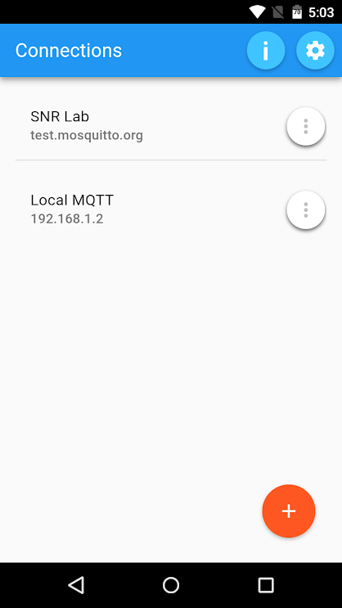
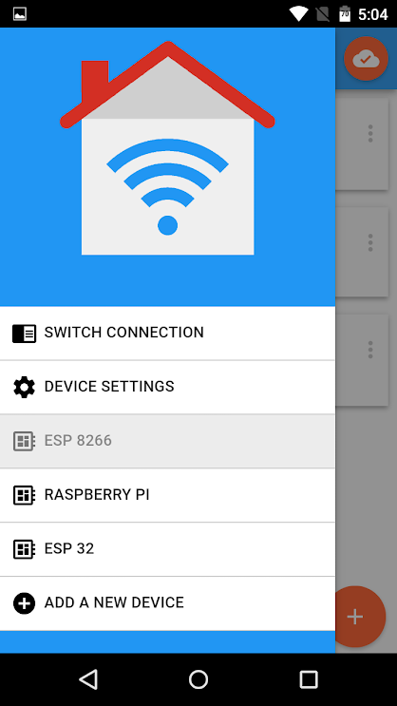
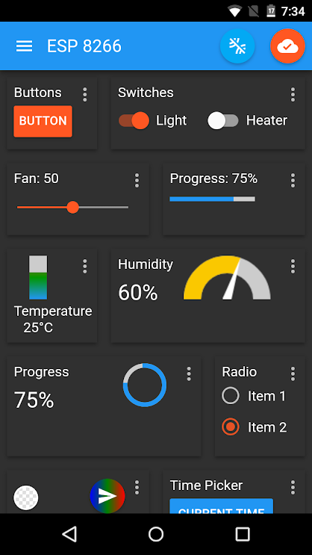
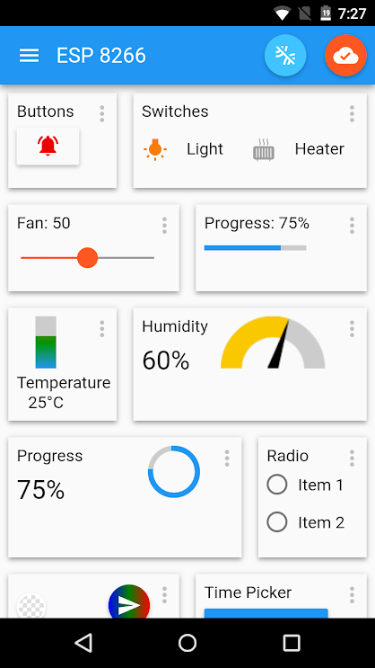
MQTT PANEL, interface

Slide 7
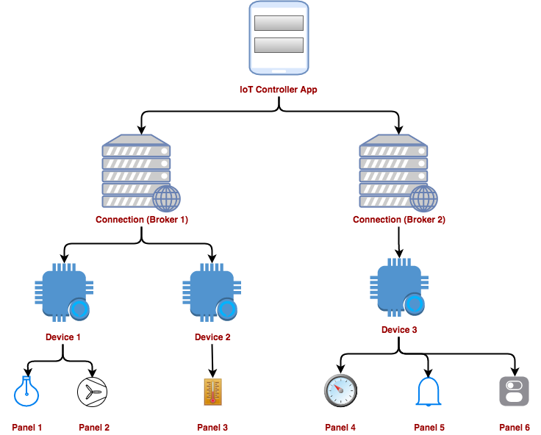

Slide 8
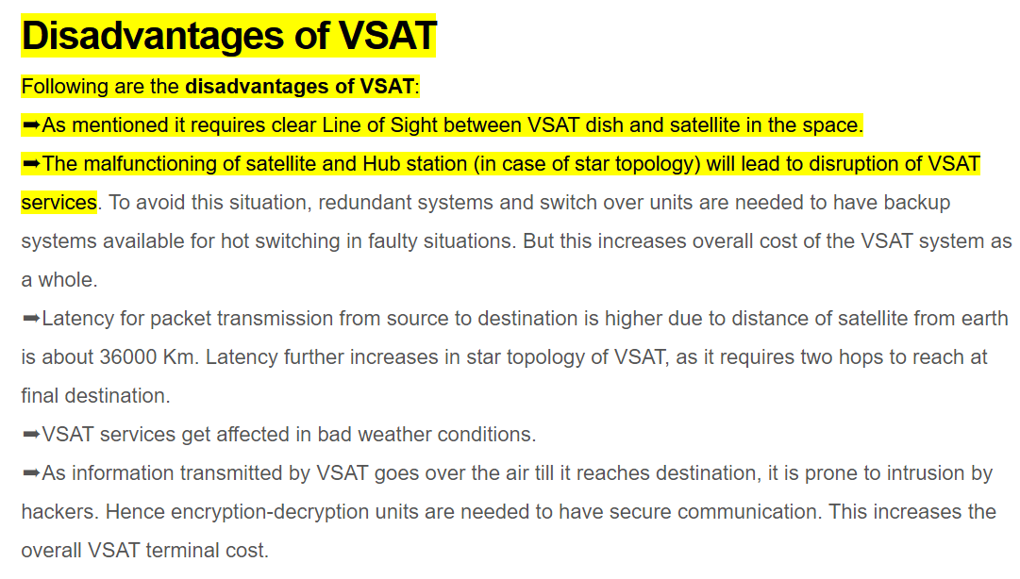
https://www.rfwireless-world.com/Terminology/Advantages-and-Disadvantages-of-VSAT.html#:~:text=in%20VSAT%20operation.-,Disadvantages%20of%20VSAT,to%20disruption%20of%20VSAT%20services

Slide 9
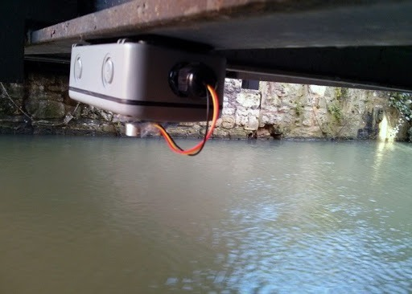
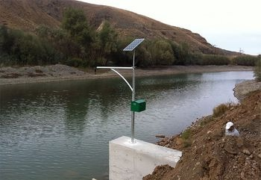
credit: Nepal Dam installation, photo credit : chakrapath.com

Slide 10
