Slide 1
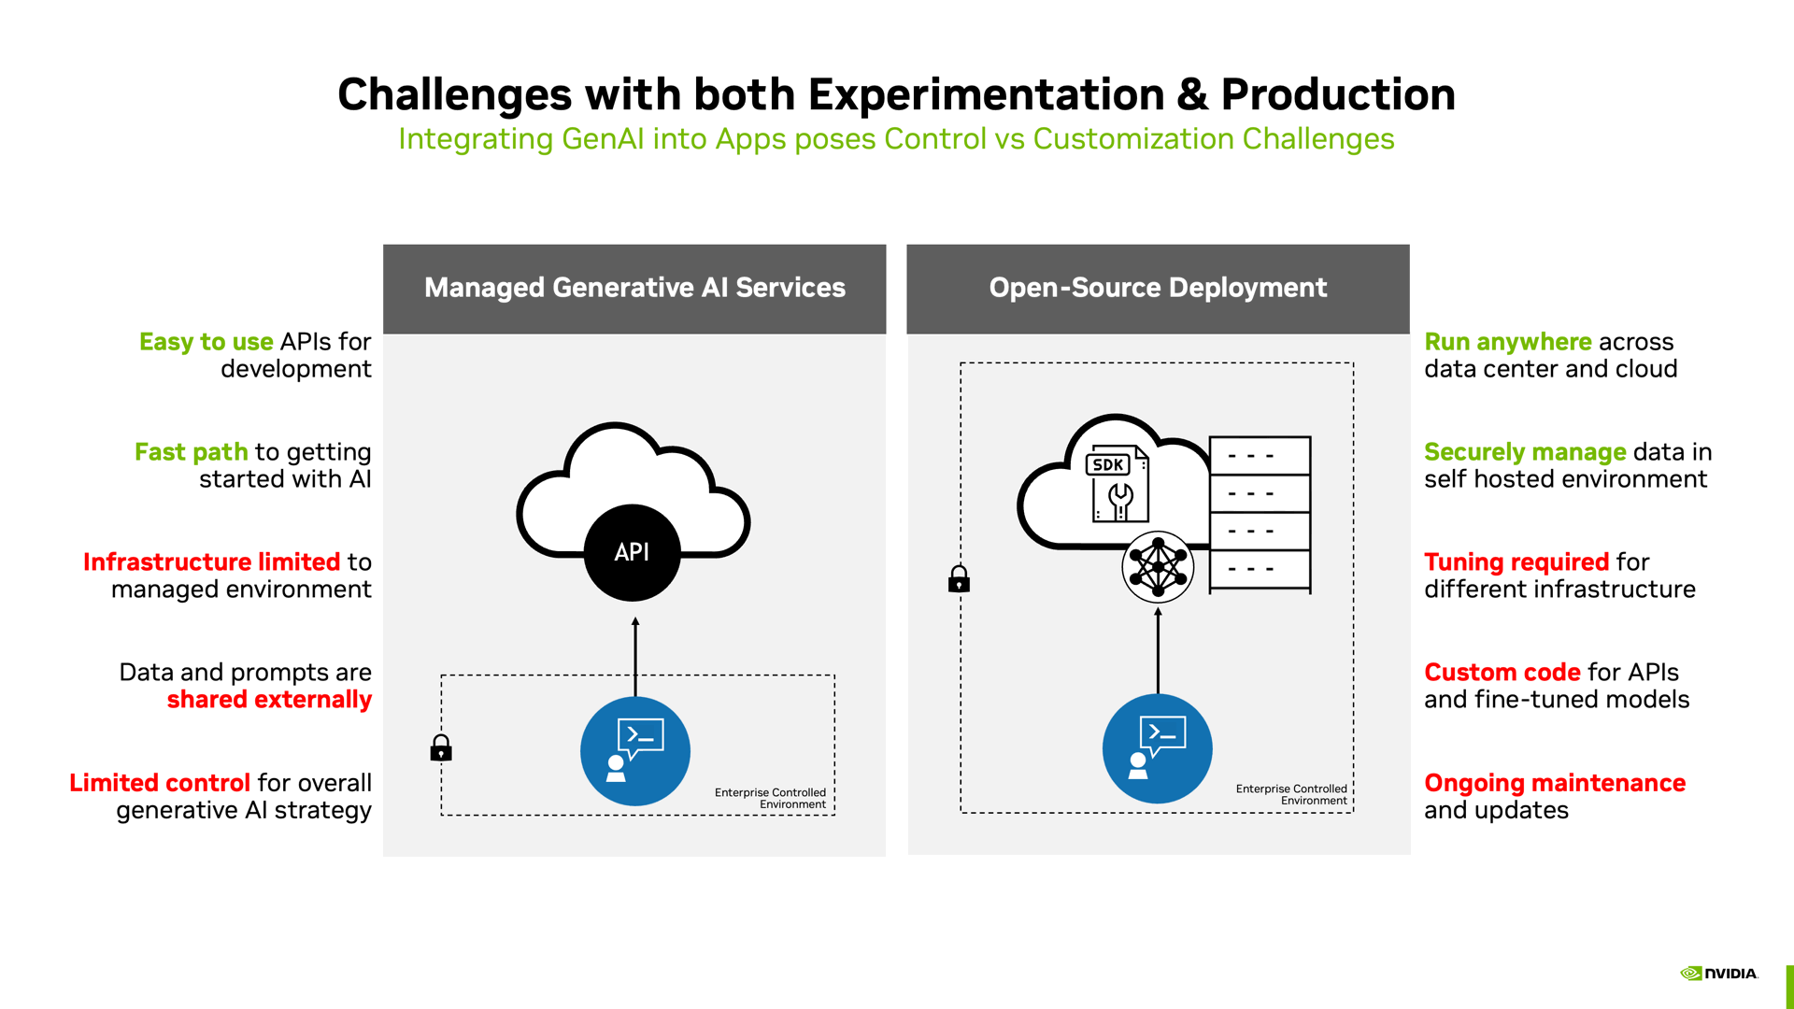

Slide 2
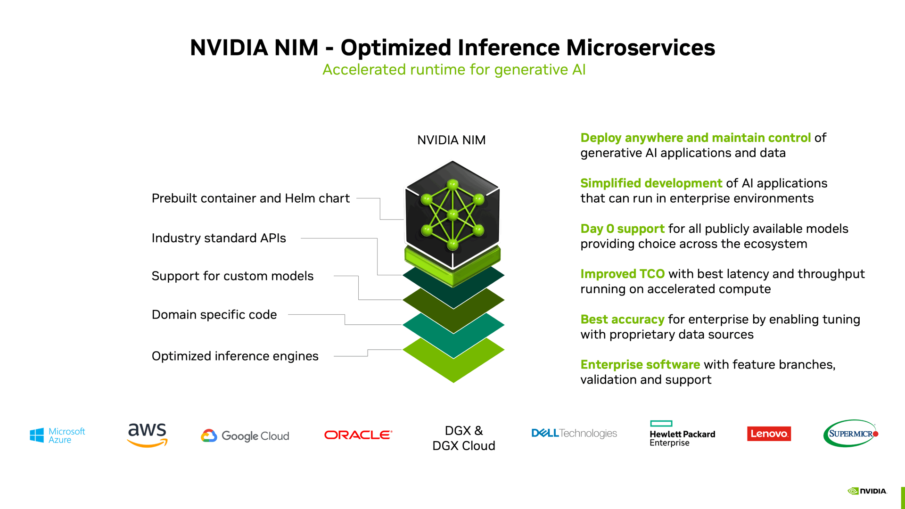

Slide 3
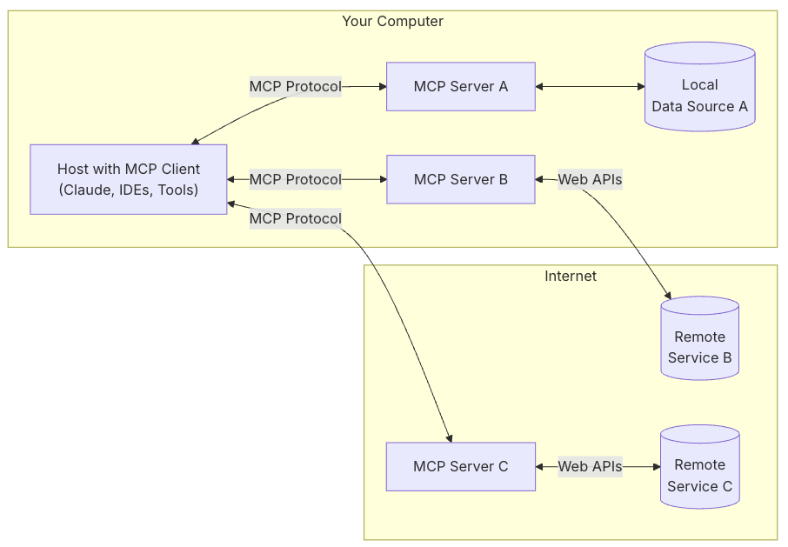
MCP
MCP Hosts: Programs like Claude Desktop, IDEs, or AI tools that want to access data through MCP
MCP Clients: Protocol clients that maintain 1:1 connections with servers
MCP Servers: Lightweight programs that each expose specific capabilities through the standardized Model Context Protocol
Local Data Sources: Your computer’s files, databases, and services that MCP servers can securely access
Remote Services: External systems available over the internet (e.g., through APIs) that MCP servers can connect to
Reference: https://modelcontextprotocol.io/introduction

Slide 4
MCP
Practical Applications
Common use cases include connecting AI assistants to:
Business databases and CRM systems
File storage and document repositories
Development tools and code repositories
APIs and web services
Local system resources
Content creation tools - e.g. Blender MCP

Slide 5
LangGraph
A framework for building stateful, multi-step conversational AI applications as graphs.
Core Concepts
Graph-Based Architecture
LangGraph models AI workflows as directed graphs where nodes represent different agents or processing steps, and edges define the flow of information and control between them.
Stateful Execution
Unlike simple chains, LangGraph maintains state across the entire conversation or workflow, allowing agents to remember context and build upon previous interactions.
Multi-Agent Coordination
Multiple specialized agents can work together, each handling different aspects of a complex task while sharing information through the graph structure.
Key Features
Checkpointing and Persistence
The framework can save execution state at any point, allowing for interruption, resumption, and branching of workflows.
Human-in-the-Loop
Built-in support for human intervention at specific points in the workflow, enabling approval steps or manual input.
Conditional Routing
Dynamic routing between nodes based on current state, agent outputs, or external conditions.
Error Handling and Retry Logic
Robust error handling with configurable retry mechanisms and fallback strategies.

Slide 6
LangGraph
Common Use Cases
Customer Support Systems
Route inquiries to specialized agents (technical support, billing, general inquiries) based on intent classification.
Research and Analysis
Coordinate research agents that gather information, fact-checkers that verify claims, and writers that synthesize findings.
Content Creation Pipelines
Orchestrate planning agents, writers, editors, and reviewers in a structured workflow.
Decision-Making Systems
Build complex decision trees with multiple evaluation criteria and stakeholder input.

