Slide 1

Data Scientista Society
Any volunteers to be today’s
Welcome
officer? No experience necessary
A 501(c)(3)

Slide 2
Welcome by the Welcome Officer
The “officer” for each meeting will…
Great people as they arrive
Look around for new faces.
Kick off the meeting,
If there are new faces, ask for 3 voluntary readers of the mission, vision, and modus operandi
Lead the Update Exercise
Ask who was overlooked and apologize?
Get a volunteer for the next meeting
Give the manual attendance sheet to the datascientistasociety@gmail.com

Slide 3
Mission
The mission of the Data Scientista Society is to educate women pursuing careers related to data science in techniques and competencies needed for career advancement and achieving leadership positions in the field.
Vision
Our vision is to create a world full of data of the women, by the women, and for the women.
Modus Operandi
The modus operandi of the Data Scientista Society is to build relationships among co-located women enthusiastic about data, a.k.a data scientistas, while also practicing mutual supportiveness towards competency, success, and leadership.
Data Scientista Society
A 501(c)(3)

Slide 4
The 8 Things Update Exercise
Happened Last Month
Personal Best
Professional Best
Personal Worst
Professional Worst
Outlook Next Month
Personal Best
Professional Best
Personal Worst
Professional Worst

Slide 5
Update Exercise… In Any Order
LAST MONTH
Best thing that happened personally in the last month
Worst thing that happened personally in the last month
Best thing that happened professionally in the last month
Worst thing that happened professionally in the last month
NEXT MONTH
Best thing that you are looking forward to personally in the last month
Worst thing that you are dreading personally in the last month
Best thing that looking forward to professionally in the last month
Worst thing that you are dreading happened professionally in the last month

Slide 6
Groups
Group 1
Group 2
Group 3
Ashton Burnette
Christy Sowell
colleen mccue
Cori
Gordana Vujec
Heather Mccormick
Hope M.
Jessica Archibald
Julia Kuznetsova
Kelly
Kelsey McDonald
Lindsay B
Meriweather Adams
Mitana Chien
Ola Hamdan
Paula
Rebecca Sabol
Rebekah Callari-Kaczmarczyk
Rp Supriya
Sagar Das
Shannon
Soomi Cheong
soundarya
Tolga Akiner

Slide 7
Agenda
Personal update exercise
Featured speaker or discussion
Officer's introduction and reports
Group updates

Slide 8
Kelly’s Talk More than Math: Bringing More Science, Less Fiction to Data Science Practice

Slide 9
Lessons Learned
Data science is more than math
And it’s transdisciplinary
The team sport
Peer review is a gift
KYC
“If I can’t explain it…”
“All models are wrong…”

Slide 10
Officers
Anna Kirkland Smith, President
Jaronda Ingram, Vice President
Janel Kinlaw, Treasurer
Maria Matkovska, Secretary
Shannon Kreps, Director of Moments
Julia Kuznetsova, Director of Programs

Slide 11
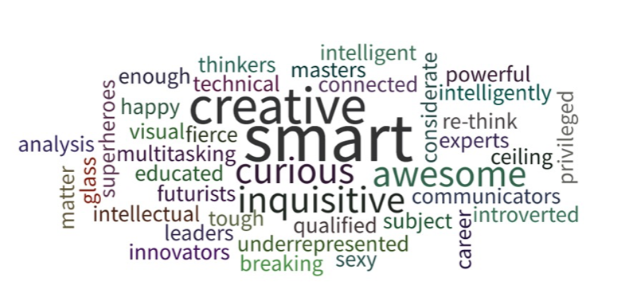
Create a world full of data by women with us
Join us or start a chapter near you for free

Slide 12

Data Scientista Society
a 501(c)(3)

Slide 13
Data Scientista Society
501(c)(3)

Slide 14
Kelly,
Thank you so much for your talk last night! You really exceeded our expectations. There were many phrases you had assembled (some professional, some your own, some quoted), like "...someone's opinion written in code.." and, your collection of these is a treasure trove. Of course someone was saying, "I wish we had recorded this..." but, counterintuitively, I am glad we did not, in the hopes that you will be doing this kind of talk somewhere else, and you will latch harder on what was worth repeating a 2nd time.
I believe you when you say you have met women, that were some of the first, and bravest, in our career field. I was hoping that our group, which tries to be a mix of women and career levels and types, would attract more of you and your peers, but either the numbers aren't out there for us to attract (as your recounting suggests), or else the group is not doing something it should be doing (what, I do not know). Myself, I am 44.
Plainly: I believe everyone woman at the meeting last night would like to talk more like you do. More elegantly, you have much example to offer. You have the warmest of invitations to become more involved and invite others who are enthusiastic about data in any way to join us.
Thanks agai
Data Scientista Society | 4:54 PM (0 minutes ago)
to Colleen, me

