Slide 1

Data Scientista Society
Any volunteers to be today’s
Welcome
officer? No experience necessary
A 501(c)(3)

Slide 2
Welcome by the Welcome Officer
The “officer” for each meeting will…
Maybe launch the Zoom meeting
Great people as they arrive
Kick off the meeting, asking for 3 voluntary readers of the mission, vision, and modus operandi
Lead the Update Exercise
Ask who was overlooked and apologize?
Get a volunteer for the next meeting
Give the manual attendance sheet to the datascientistasociety@gmail.com

Slide 3
Mission
The mission of the Data Scientista Society is to educate women pursuing careers related to data science in techniques and competencies needed for career advancement and achieving leadership positions in the field.
Vision
Our vision is to create a world full of data of the women, by the women, and for the women.
Modus Operandi
The modus operandi of the Data Scientista Society is to build relationships among co-located women enthusiastic about data, a.k.a data scientistas, while also practicing mutual supportiveness towards competency, success, and leadership.
Data Scientista Society
A 501(c)(3)

Slide 4
The 8 Things Update Exercise
Happened Last Month
Personal Best
Professional Best
Personal Worst
Professional Worst
Outlook Next Month
Personal Best
Professional Best
Personal Worst
Professional Worst

Slide 5
Update Exercise… In Any Order
LAST MONTH
Best thing that happened personally in the last month
Worst thing that happened personally in the last month
Best thing that happened professionally in the last month
Worst thing that happened professionally in the last month
NEXT MONTH
Best thing that you are looking forward to personally in the last month
Worst thing that you are dreading personally in the last month
Best thing that looking forward to professionally in the last month
Worst thing that you are dreading happened professionally in the last month

Slide 6
Agenda
Personal update exercise
Featured speaker or discussion
Officer's introduction and reports
Group updates

Slide 7
Officers
Anna Kirkland Smith, President
Jaronda Ingram, Vice President
Janel Kinlaw, Treasurer
Maria Matkovska, Secretary
Shannon Kreps, Director of Moments
Julia Kuznetsova, Director of Programs

Slide 8
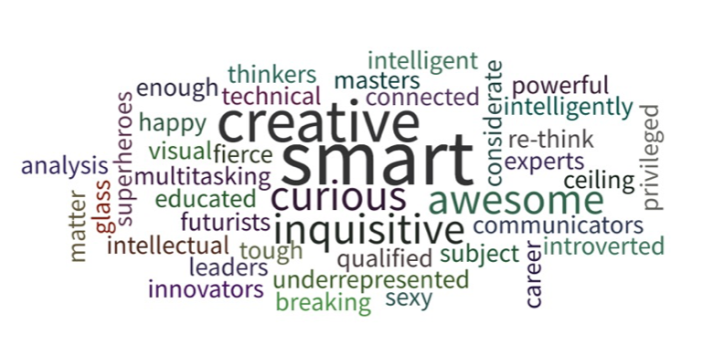
Create a world full of data by women with us
Join us or start a chapter near you for free

Slide 9

Data Scientista Society
a 501(c)(3)

Slide 10
Data Scientista Society
501(c)(3)

