Slide 1

TrashSters
By Tech_Knights

Slide 2
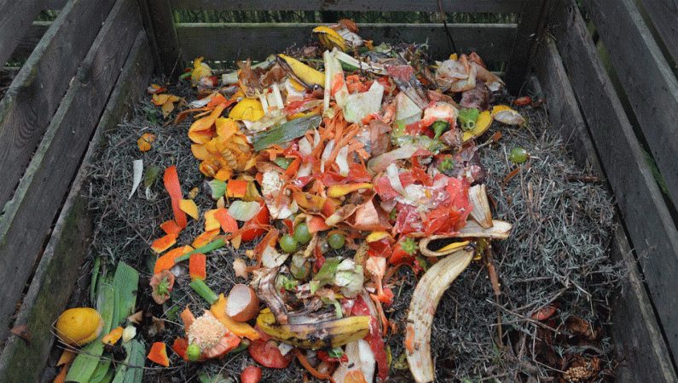
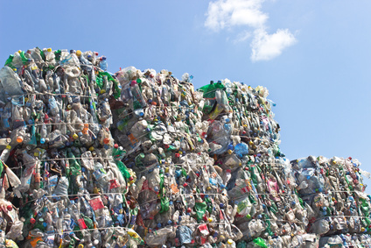
Types of waste
Biodegradable waste
Non-Biodegradable waste

Slide 3
What in biodegradable and non-biodegradable waste
Biodegradable Waste
Non-Biodegradable Waste
Biodegradable waste is a type of waste, typically originating from plant or animal sources, which may be degraded by other living organisms.
These are the waste that can be changed into manure.
Non-Biodegradable wastes are those that cannot break down or degrade for many years.
These are waste that cannot change into manure.

Slide 4
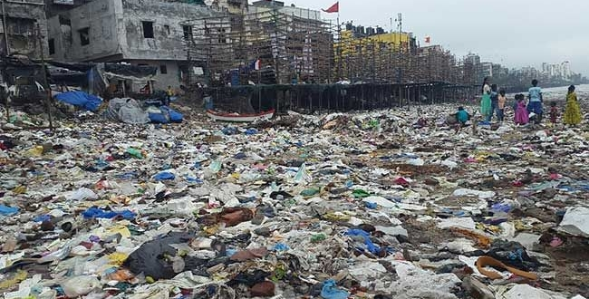
Quantity of daily waste produced in India
On an average around 2.2 kg/capita/day of waste is produced in India.

Slide 5
Necessity of separation of waste into biodegradable and non-biodegradable waste
People should separate their daily waste into biodegradable and non-biodegradable waste because it becomes very difficult to separate waste when it got dumped collectively.
Once the waste is separated it can be easily collected and can be sent to their respective treatment plants.
This simple effort from people can save lots of money and time.

Slide 6
What is TrashSters

Slide 7
We at TrashSters, provides a platform where users can schedule a trash pickup from their home and have to keep biodegradable and non-biodegradable waste separately.
After the registration on our platform, trash(both biodegradable and non-biodegradable) will get collected from their door on a daily basis.
In the case of bulk trash, the user can request an immediate trash pickup.
Once the pickup is done, the user will get notified. In case if our pickup guy misses the pickup, the user just have to contact us and we will send him again.
After the trash is collected, biodegradable waste will be sent for further processing.
The part which can be reused or recycled will be separated from non-biodegradable waste and the remaining will be dumped.
This practice will reduce the size of hills of waste in dump yards.

Slide 8
Waste Processing
1 ton of biodegradable waste can be used to produce approx. 150-200 kg of manure

Slide 9
Statistics
Suppose, the biodegradable waste collected per day is around 1 ton, then approx. 15-20% of it i.e. 150-200 kg of manure can be produced from it.
The cost of processing 1 ton of waste is approx. Rs 1600 which is about 10 Rs/kg and the cheapest rate manure available in market is around 20 Rs/Kg.
So, the farmers will be able to get manure at cheap rates, also amounts of trash building up in dump yards will be controlled.

Slide 10
Reducing Corruption
Govt. runs many initiatives to provide manure to farmers in subsidized rates but due to lack of honesty of some people, the initiatives can’t be able to give their 100% output.

Slide 11
Overcoming the Obstacles
Our platform will keep track of the weight of trash and compare the calculated & actual weight of manure produced from it.
1 ton waste should yield around 150-200kg of manure and if the produced manure is, let’s say 80 kg then there is something fishy.
We will use technology at every step to avoid any human errors and character flaws( may lead to corruption ) as technology will work as programmed and not according to its self interest.

Slide 12
Thankyou

