Slide 1



Slide switching using Opencv
slide 1 slide 2

Slide 2
Introduction of project
This project is made to simply make the presenting way of Power Point projects more attractive. Here, we have used a specific color to be detected by webcam which can change accordingly and according to that we have coded for forward and backward movement of slides.

Slide 3
Applications..
Prevents wasting of time from switching slides using keyboard.
Looks attractive
No requirement of a person to switch the slide
Other than PowerPoint presentations, color detection can be used in Gaming.
It is an aid for physically handicapped people.
It can be used in reel life.

Slide 4
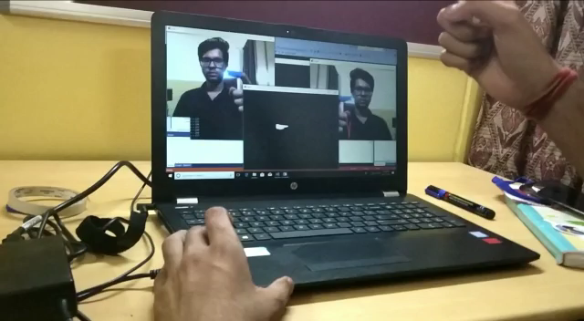
Working of project..

Slide 5
Components of the project
This project is made using the following –
C++ language
Open cv
Visual studio
Webcam

