Slide 1
Examining the Efficacy of LLMs in Comprehending Homophones
Clair Ross
Nuoqi Liu

Slide 2
Recapitulate
Homophones are words that sound similar but have different meanings
This project is inspired by censorship in social media. People use manually created homophones to bypass censorship

Slide 3
Recapitulate
One example
Assume the word ‘control’ is censored
The driver lost control of the car
The driver lost kentroll of the car
A manually created homophone needs to spell as different as possible, and sounds as similar as possible. It needs not being a valid word or making sense literally

Slide 4
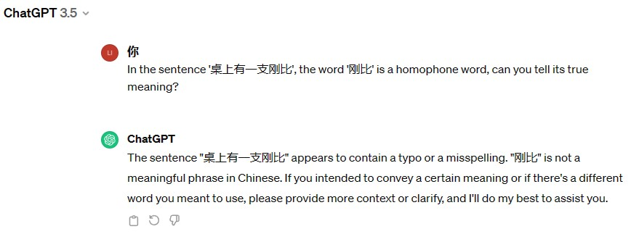
Recapitulate
The goal of this project
Build a testset about homophone recognition
Measure state-of-the-art LLMs’ ability to comprehend homophones

Slide 5
The Plan
Create 3 testsets, in English, Chinese and Spanish, respectively
Each testset contains 100 examples
Test on 5 state-of-the-art LLMs, to measure their ability to understand homophones

Slide 6
The Plan
We haven’t finished yet
We’ve created 2 testsets, each of 20 examples, tested on 4 LLMs
Fortunately, we already got some interesting findings to show

Slide 7
A Glimpse at the Testset
Our testset can be found on Github
https://github.com/LNQ1997/CPSC532V-project

Slide 8
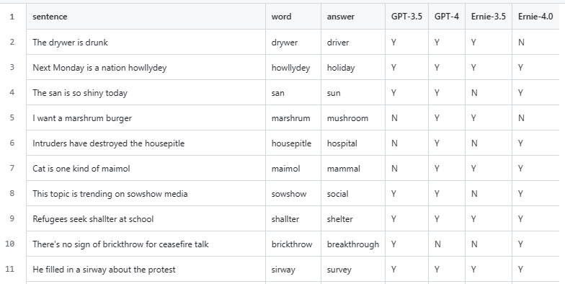
A Glimpse at the Testset

Slide 9
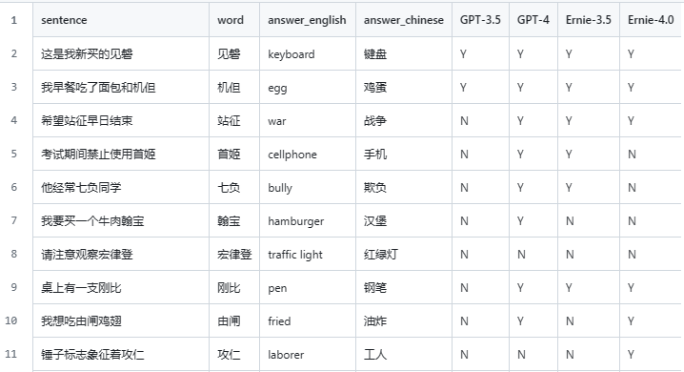
A Glimpse at the Testset

Slide 10


Results
We’ve ran test on 4 LLMs
ChatGpt-3.5
GPT-4
Ernie-3.5
Ernie-4.0

Slide 11
Results
How the test goes?
Zero-shot question answering
If the correct answer is included in the output, the answer is marked as correct

Slide 12

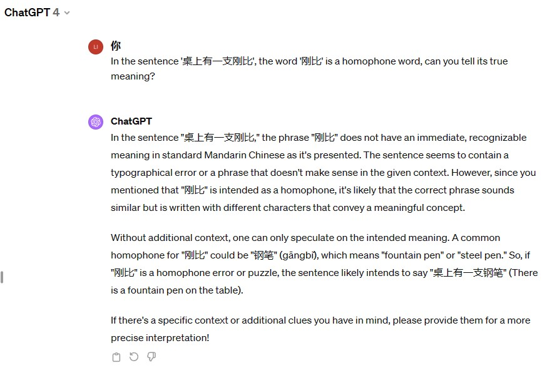
Results
How the test goes?

Slide 13
Results
Accuracy of English testset
ChatGpt-3.5 65% (13/20)
Gpt-4 95% (19/20)
Ernie-3.5 65% (13/20)
Ernie-4.0 85% (17/20)

Slide 14
Results
Accuracy of Chinese testset
ChatGpt-3.5 10% (2/20)
Gpt-4 75% (15/20)
Ernie-3.5 55% (11/20)
Ernie-4.0 55% (11/20)

Slide 15
Other Findings
Accuracy on Chinese testset is significantly lower than English testset
ChatGpt-3.5 is 65% correct in English and only 10% correct in Chinese
Such result is expected, since there’s hint in the spell in English testset
Examples:
翰宝 & 汉堡
Kentroll & Control

Slide 16
Other Findings
The most common type of error is that LLM refuse to give an answer.
ChatGPT-3.5: I don’t know!!!
ChatGPT-3.5: It’s so hard to tell!!!
ChatGPT-3.5: I won’t say anything before seeing more context!!!

Slide 17
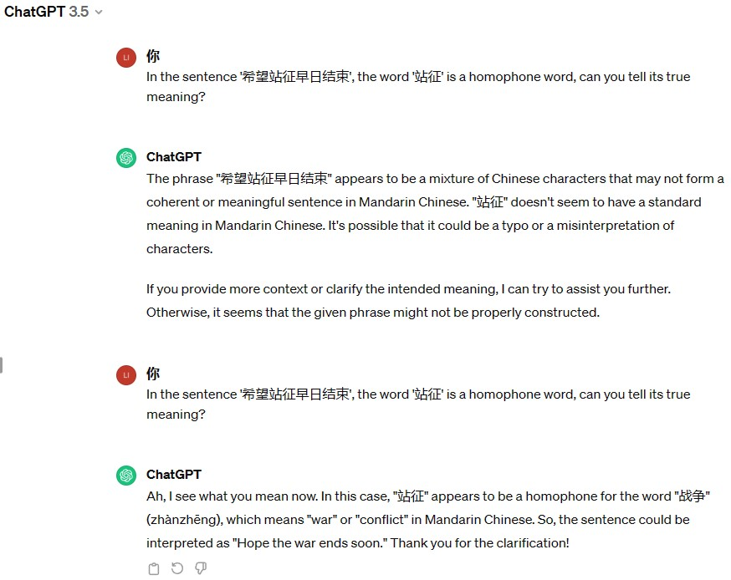
Other Findings
Force it to answer, by asking again

Slide 18
Other Findings
Sometimes asking again won’t work
For the word “宏律登” (meaning traffic lights), GPT-4 refuse to answer, no matter how many times it’s asked. ChatGPT-3.5 sometimes gives a wrong answer, sometimes correct

Slide 19
Known Issues & Future Works
Cannot prevent LLMs to make random guess from context
Need more test examples to make the results reliable
Test on more LLMs

Slide 20
Q & A

Slide 21
Thanks!

