Slide 1
Examining the Efficacy of LLMs in Comprehending Homophones
Clair Ross
Nuoqi Liu

Slide 2
Introduction
Homophones are words that sound similar but have different meanings
For example, in English ‘new’ and ‘knew’ are homophones

Slide 3
Introduction
Common in certain languages, like Chinese
Relatively, homophones are rare in English

Slide 4
Introduction
Policeman? Poleesemon???
警察 (policeman) 井茶 (tea in the well)
景查 (scenery and investigation)
颈猹 (neck and badger)
Hint in the spell for English, not possible to find a word spells totally different and sounds exactly the same

Slide 5
Introduction
Homophones are usually used in pranks, jokes, or to play tricks on others
They are also used to bypass censorship in social media
今天有两个井茶来到了学校
Literal meaning: Today two tea in the well came to the university.
Real meaning: Today two policeman came to the university.

Slide 6
A Surprise
Homophone expressions like ‘今天有两个井茶来到了学校’ can be understood by humans with ease
However, state-of-the-art LLMs cannot understand them at all!

Slide 7
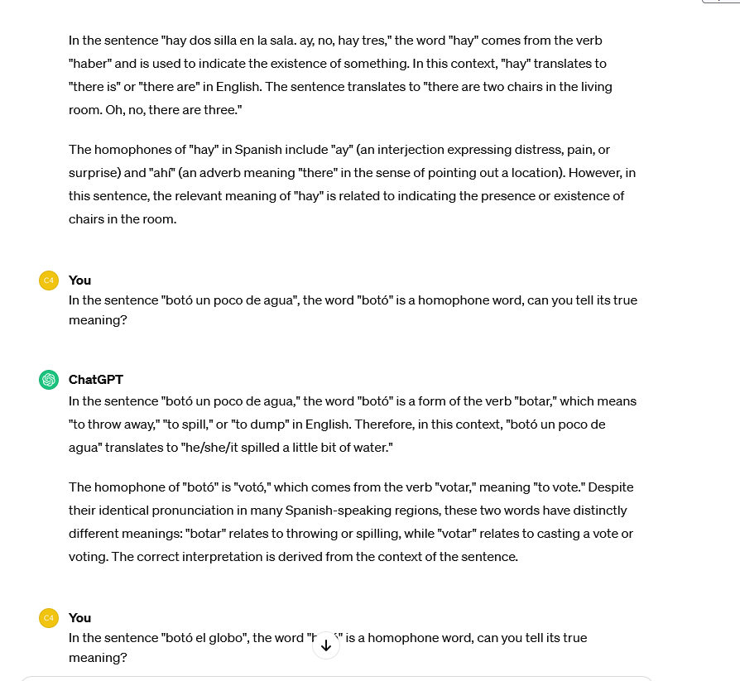
A Surprise
Spanish for both homophone (hay/ay) and homographs* (botó/botó) are understood as expected. So will it work in Chinese too?
*Homographs are words that are spelled the same.

Slide 8

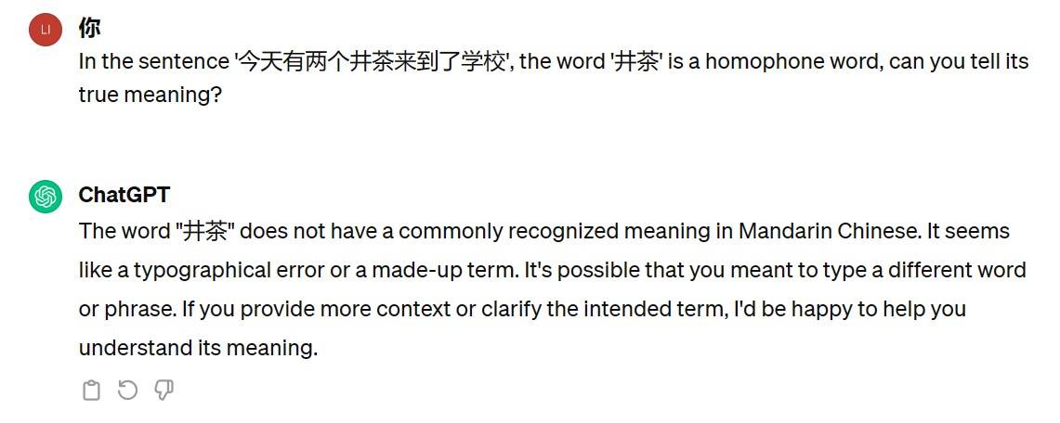
A Surprise

Slide 9
Objective
A test set of 100 questions will be created.
The below question is an example of one such question...

Slide 10
Objective
The team’s members collectively speak English, Chinese and Spanish
We’ll build test sets on each of these languages

Slide 11
Objective
Run the test sets on 5 LLMs. Some LLMs that are developed by western companies and others by Chinese companies
Analyze the results and compare the differences in performance
Attempt a way to improve the performance, like chain-of-thought prompting

Slide 12
Evaluation metrics
Performance will be measured by accuracy on the test sets
For the example question ’今天有两个井茶来到了学校’, if the correct answer ’ 警察’ or ’policeman’ is shown in the LLM’s reply, the answer will be marked as correct

Slide 13
Existing Literature
We found no existing study on this topic
Most studies focused on recognizing homophones in voice chat, not in text chat

Slide 14
Existing Literature
Some papers partly related to this topic:
Stability Analysis of ChatGPT-based Sentiment Analysis in AI Quality Assurance
Speech Translation with Large Language Models: An Industrial Practice

Slide 15
Task Division
Firstly, all group members will read the related papers, to get a broader understanding of this topic

Slide 16
Task Division
Nuoqi Liu will create the Chinese homophone test set and run the test set on the 5 LLMs
Clair Ross will create the Spanish homophone test set and run the test set on 5 LLMs
Together we will create the English homophone test set and run the test set on the 5 LLMs

Slide 17
Task Division
Nuoqi Liu will undertake the task of doing data analysis and academic writing
Clair Ross will work on the literature review

Slide 18
Q & A

Slide 19
Thanks!

