Slide 1
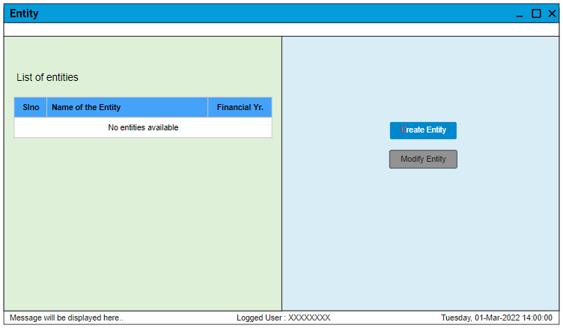
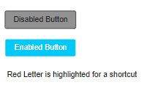
1. Entity screen with no entities available (Initial Screen)
Notes
Initially, if there are no entities available in the tool. We need to load the screen as shown here.
We have to enable the “Create Entity” button.
We have to disable the “Modify Entry” button.
We need to show the grid on the left side with empty rows with a message “No entities available”.
Cursor should always be pointed on the “Create Entity” button on this screen.
Enabled button should be allowed to click or even use the shortcut key “C” to navigate or do action.

Slide 2
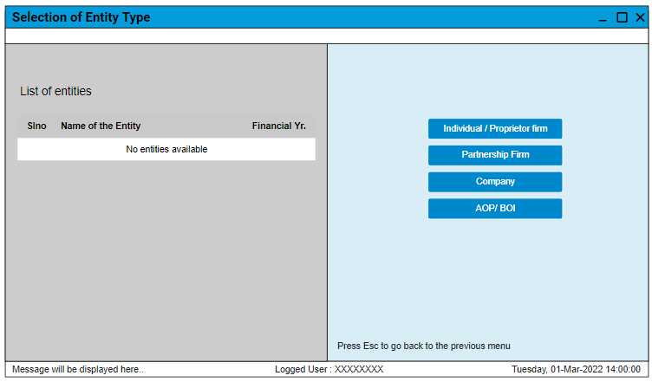
2. Selection of Entity Type
Notes
Upon opening this screen, the left side grid or table will be disabled (Grey color) or not allow the user to select any.
User can click on the button to create the type of entity.
User can always go back to the previous menu upon pressing Esc button.

Slide 3
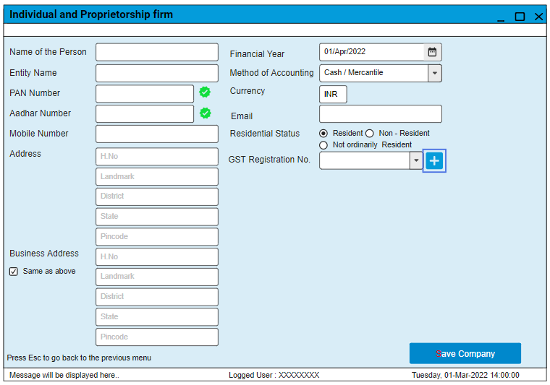
3. Filling the details for Individual or Proprietorship firm
Notes
PAN number is to be validated (Correct/not) if correct, show GREEN otherwise RED
Aadhar number is to be validated (correct/not) if correct, show GREEN otherwise RED
If the Business address is checked, all the first address fields will be copied to the business address.
If unchecked, the text boxes from the business address are to be enabled.
We will show the current financial year starting date by default, if required user can change it.
Email format is to be validated
GST Registration number can be added multiple display list of all the GST numbers linked in a drop-down list.
Using the “+” button, the user can add multiple GST numbers.
Display Entity name in CAPS (only display) but keep it as same as the user entered when we are using it in the invoices.
Business address to be taken as invoice address if it is different from the actual address.
If the user clicks on the “Save Company” button, the entity will be saved as an individual entity/firm and make this entity available in the list.

Slide 4
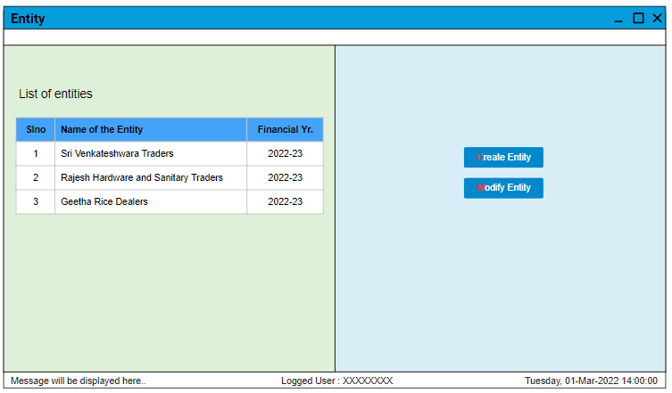
4. View all entities
Notes:
If the user selects an entity from the list, then only enable the “Modify Entity” button.
Modify Entity Button should take us to the same creation screen and allow the user to change the details.

