Slide 1
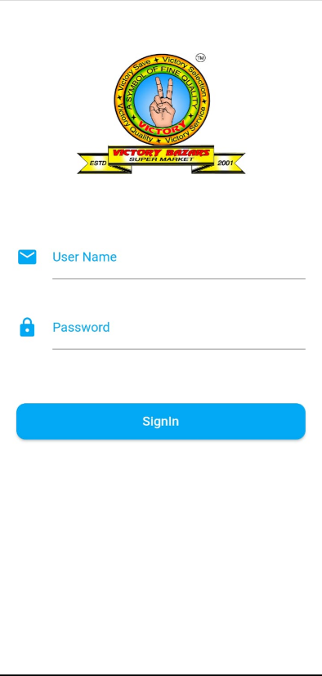
User Login
App Version
User should be able to login with valid credentials.
If username or password is invalid, show an error message.
If user is valid Navigate to Main Menu

Slide 2
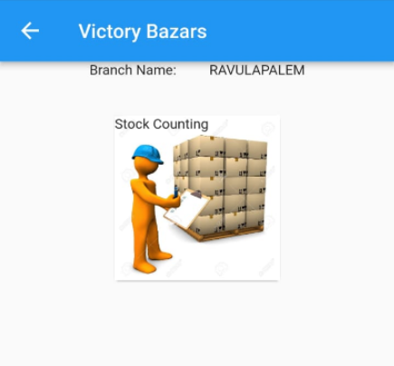
Main Menu
There should 3 buttons to navigate further.
Stock Entry
Stock Counting
Stock Dispatch
Item Details
Login will give access rights to these three menu items
IsDispatchEnable == true ? Show Dispatch button
IsEntryEnable == true ? Show entry button
IsCountingEnable == true ? Show counting button
User Name
Logout button and App version
Stock Dispatch
Stock Entry
Item Details

Slide 3
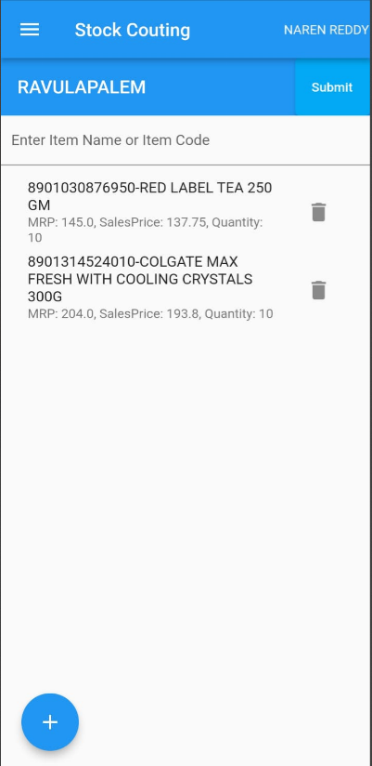
Stock Entry
Item list
User will select Supplier Name and Invoice Number.
There should be a button to add a new item.
On clicking of new, it should navigate to item entry.
There should an option to delete entry.
There should be an option to edit entry.
On clicking of submit in the list, save the invoice.
Add item
There should be a button to scan item code using camera
All fields should be cleared on saving item.
Item should be added to item list in background.
On clicking of save focus should move to item code
Active page should be always add item.
On clicking of back button, navigate to list.
Stock entry
Supplier & Invoice#
Adding Item screen refer next slide
Stock Entry preview Refer next next slide
Discard
Supplier DropDown
Invoice Number
Invoice Date
Tax Inclusive
Next

Slide 4
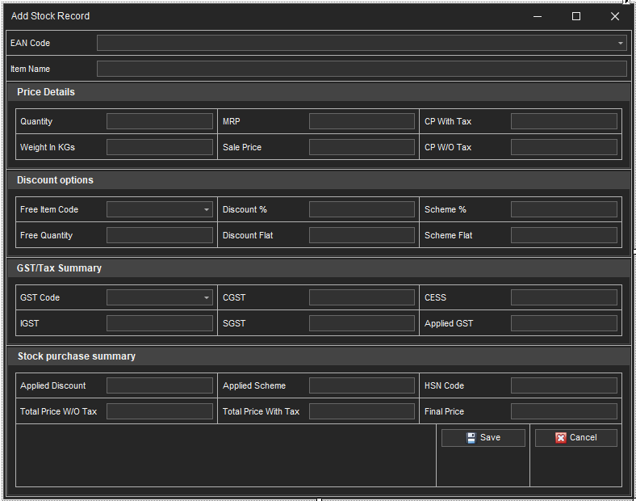

Slide 5
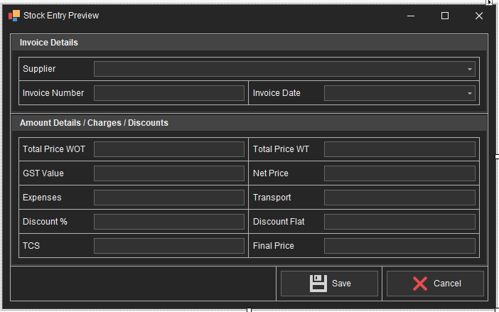

Slide 6
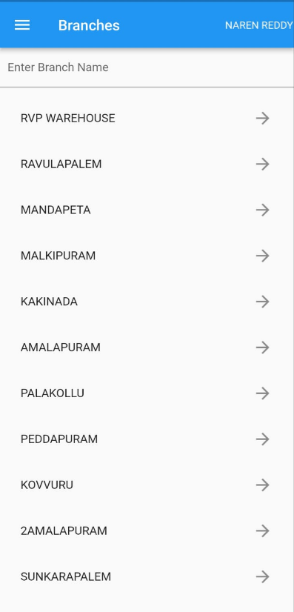
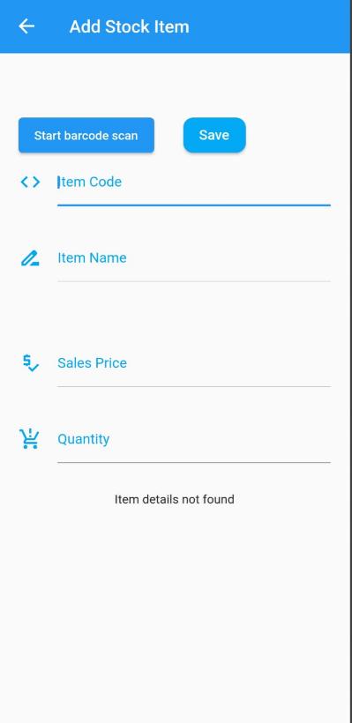
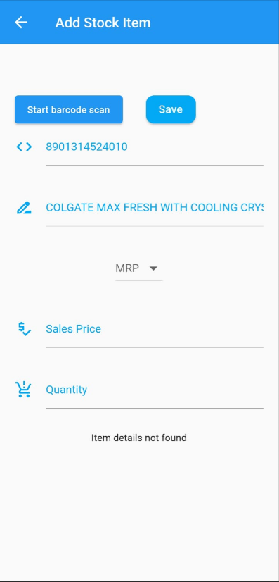
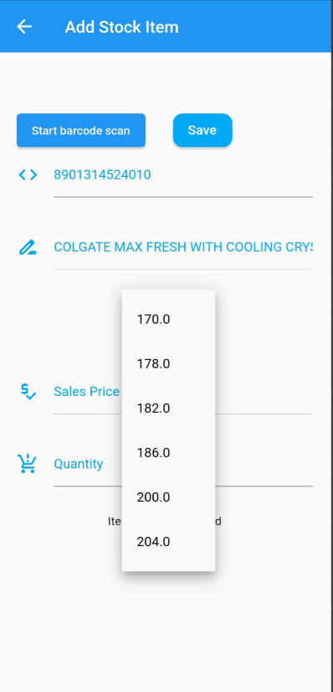
Stock Dispatch
Counting Item List
On clicking of Stock dispatch in Main Menu, navigate to Branch list
On selecting branch name if user having specific category navigate to dispatch item list other wise navigate to category list
On selecting one category from list navigate to Dispatch list.
There should be a button add a new item.
On clicking of new, it should navigate to item entry.
There should an option to delete item.
There should be an option to edit item.
On clicking of submit in the list, save the dispatch.
Add item
There should be a button to scan item code using camera.
All fields should be cleared on saving item except Tray No.
Item should be added to item list in background.
On clicking of save focus should move to item code
Active page should be always add item.
On clicking of back button, navigate to list.
Category List
Stock Dispatch
Tray No
Tray No
Tray No
Tray No
Tray No

Slide 7
Stock Counting
Dispatch List
On clicking of Stock counting in Main Menu, navigate to Branch list
On selecting one branch from list navigate to counting item list.
There should be a button add a new item.
On clicking of new, it should navigate to item entry.
There should an option to delete item.
There should be an option to edit item.
On clicking of submit in the list, save the counting sheet
Add item
There should be a button to scan item code using camera.
All fields should be cleared on saving item.
Item should be added to item list in background.
On clicking of save focus should move to item code
Active page should be always add item.
On clicking of back button, navigate to list.
Tray No
Tray No

Slide 8
Item Details
Warehouse
Cloud
Itemcode
SKUCode
Item Name
Price Details
MRP1, Sale Price1
MRP2, Sale Price2
MRP3, Sale Price3
MRP4, SalePrice4
Offer Details
Offer1 Name, Offer1 Type, Offer1 Value, Offer1 Price
Offer2 Name, Offer2 Type, Offer2 Value, Offer2 Price
Offer3 Name, Offer3 Type, Offer3 Value, Offer3 Price
Offer4 Name, Offer4 Type, Offer4 Value, Offer4 Price
Cost Price Details
Cost Price1, GST1
Cost Price2, GST2
Stock Details
Branch1, Value1, Intransit1, Running sale1

Slide 9
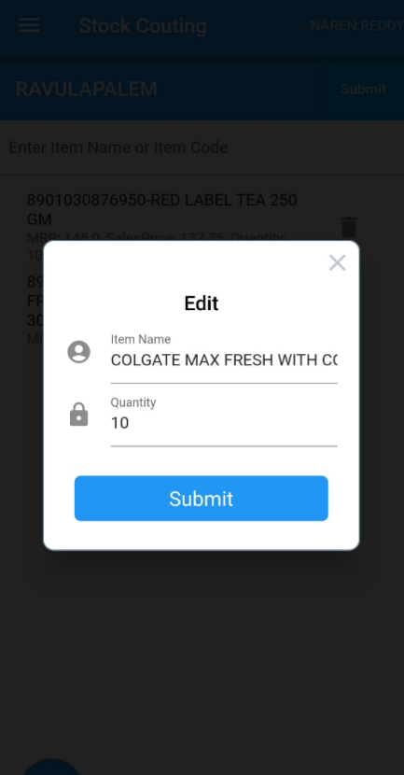
Entry Edit
User will Tap and hold an item to edit in the list.
Open a popup with item details.
Save item on clicking of save button.
User will tap on delete button in list, then item should be deleted.

Slide 10
Mobile App
Web API
Cloud Database
Request
Request
Response
Response
Few points to be covered
If SKU entered, fetch Item code details.
If Multiple Item codes exists under one SKU, Show message to User.
If Multiple item prices entered under item code, show a dropdown to select one item price, on selecting item price focus quantity.
If only one item price is exists, populate item price directly and keep focus on quantity.
Check item current stock before item dispatch.
Show current stock of warehouse and branch on selecting item code.
If item already exists in list, add new record to existing item
If item already exists with diff tray number in list, cerate a new record.

Slide 11
Data Synchronization
Item, Item Code, Item Price
Item Cost Price, Category,
Sub Category, Users,
Roles, Branches, Item Stock
Item, Item Code, Item Price
Item Cost Price, Category,
Sub Category, Users,
Roles, Branches, Item Stock
Cloud Database
Web Service/
Windows Service/
Console Application
Warehouse Database
Stock Entry, Stock Dispatch, Stock Counting
Stock Entry, Stock Dispatch, Stock Counting
Few points to be covered
Warehouse data will be updated in warehouse internal transactions, Periodically data should be updated in cloud for every (5 – 10 Mins)
Stock Entry, stock dispatch, stock counting data should sent warehouse database.
Identify data which is not processed and move to Warehouse
Before inserting data into warehouse database, prepare the data in predefined format.

