Slide 1

JUnit
Testing Dojo

Slide 2
What it’s?
Is an open source framework
Runs Java Test
Can be used in TDD
Is currently in version 4

Slide 3
How to run test
Compile the code
javac –cp [test class name].java
Compile testing class
javac -cp .:junit-4.12.jar CalculatorTest.java
Run test
java -cp .:junit-4.XX.jar:hamcrest-core-1.3.jar org.junit.runner.JUnitCore CalculatorTest

Slide 4
Annotations
@Test
@Test(expected=IndexOutOfBoundsException.class)
@Test(timeout=100)
@Before
@After
@AfterClass
@BeforeClass
@Ignore
@Runwith

Slide 5
Asserts
void assertEquals(string msg, boolean expected, boolean actual)
void assertTrue(string msg, boolean expected, boolean actual)
void assertFalse(string msg, boolean condition)
void assertNotNull(string msg, Object object)
void assertNull(string msg, Object object)

Slide 6
Asserts
void assertSame(string msg, boolean condition)
void assertNotSame(string msg, boolean condition)
void assertArrayEquals(string msg, expectedArray, resultArray)

Slide 7
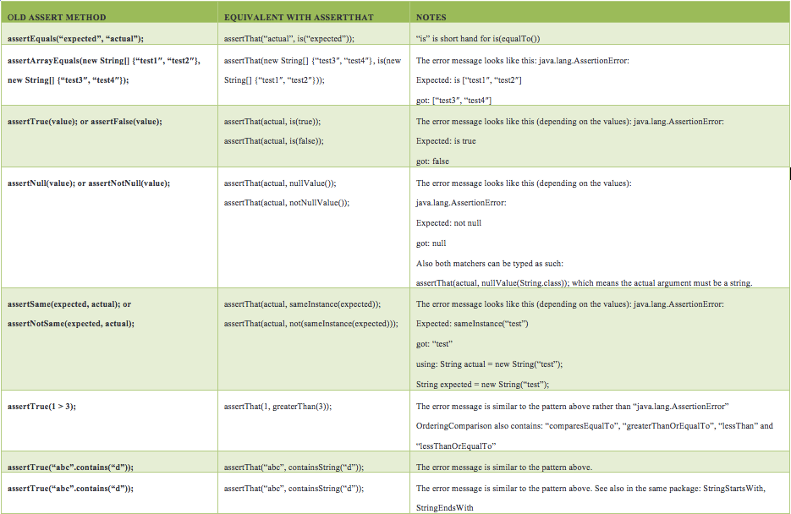
AssertThat
Source: https://objectpartners.com/2013/09/18/the-benefits-of-using-assertthat-over-other-assert-methods-in-unit-tests/

Slide 8
FIRST principle
Fast
Isolated
Repeatable
Self-Validating/Self-explainable
Timely

Slide 9
Right-BICEP
Are the results right?
Are all the boundary conditions correct?
Can you check inverse relationships?
Can you cross-check results using other means?
Can you force error conditions to happen?
Are performance characteristics within bounds?

Slide 10
The CORRECT way
Conformance: Does the value conform to an expected format?
Ordering: Is the set of values ordered or unordered as appropriate?
Range: Is the value within reasonable minimum and maximum values?
Reference: Does the code reference anything external that isn’t under direct control of the code itself?
Existence: Does the value exist (is it non-null, nonzero, present in a set, and so on)?
Cardinality: Are there exactly enough values?
Time: Is everything happening in order? At the right time? In time?

Slide 11
References
Pragmatic Unit Testing in Java 8 with JUnit
Testing with JUnit
Junit Recipes

