Slide 1
EENG 284 Lab 11
Stopwatch Datapath and Control
Notes:
Usually the <title of the lab> is what will be called the “System” through the rest of this document

Slide 2
Lab Objectives
The objective of this lab is to unify the stopwatch datapath and control units into a working design that runs on the CG5.

Slide 3
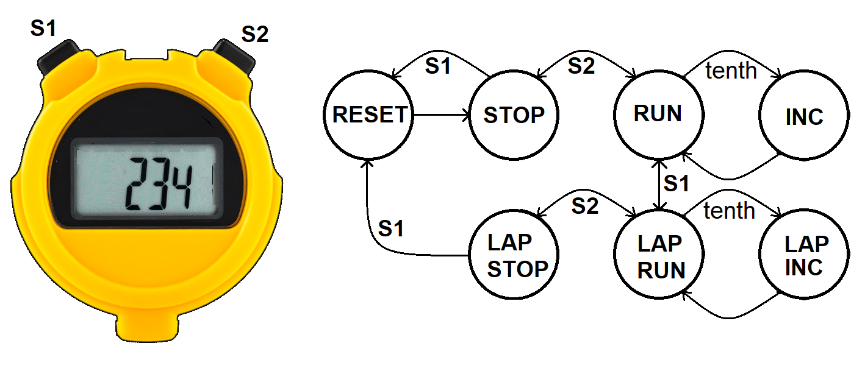
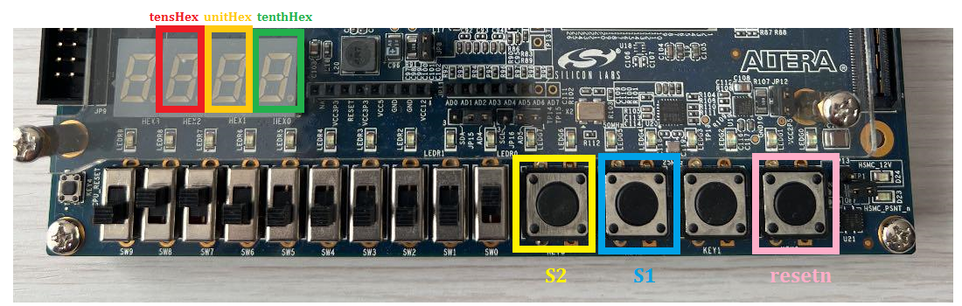
Stopwatch Behavior
The stopwatch’s behavior is dictated by buttons S1 and S2.
The buttons and display on the CG5 board.
Notes:
Replace <System> with the name of the

Slide 4
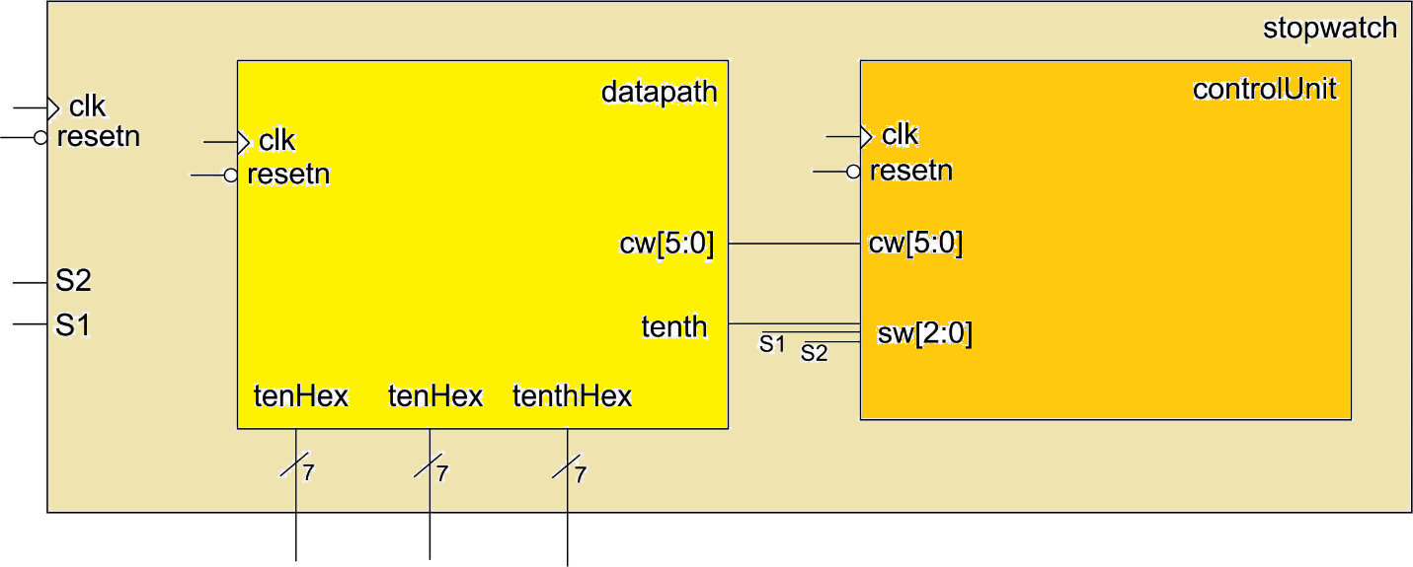
Top Level Stopwatch
The top-level contains “2” lines of Verilog
Instantiate Datapath
Instantiate Control Unit
Notes:
Replace <System> with the name of the

Slide 5
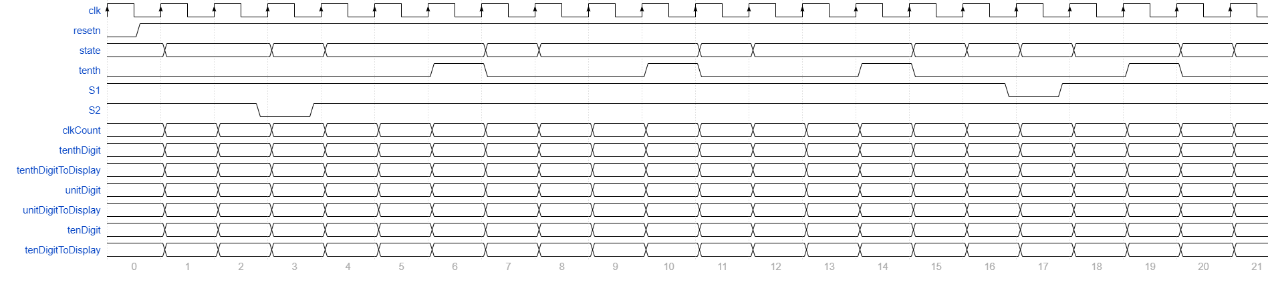
Simulation
Perform simulation by hand
Before performing actual sim so you can verify integrity of sim
Use state names from Figure 3 in Lab 10
Fill in all sausage links with values, even if they repeat

Slide 6
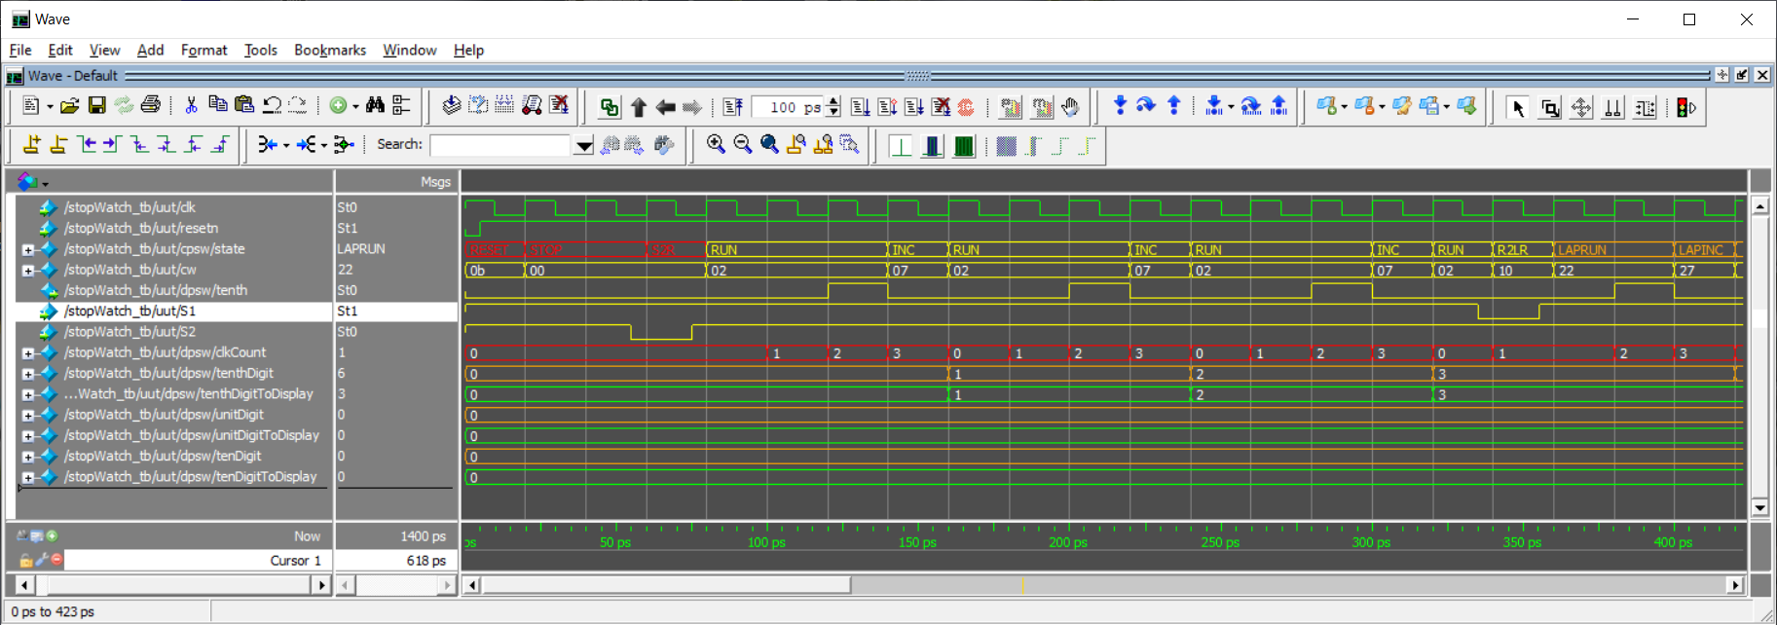
Simulation
Use Quartus to perform simulation of your design
Testbench and DO file provided
Should exactly match the hand drawn simulation

Slide 7
Deliverables
Stopwatch Simulation
Completed Figure 4 and Figure 5
Paste the images in landscape format into your solutions
Complete Simulation
Screen shot the simulation into three parts,
0 to 400ps 400ps to 800ps 800ps to 1200ps
Paste the simulation in landscape format into your solutions
Stopwatch Synthesis
Completed pin assignment table
Demo working stopwatch

