Slide 1
EENG 284 Lab 08
Mod 10 Counter
Notes:
Usually the <title of the lab> is what will be called the “System” through the rest of this document

Slide 2
Lab Objectives
The objective of this lab is to design a mod10 counter that you will use as part of a digital stopwatch to represent the digits of a stopwatch.

Slide 3
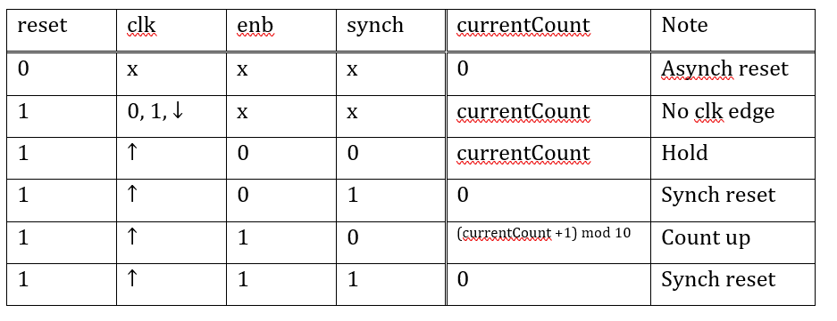
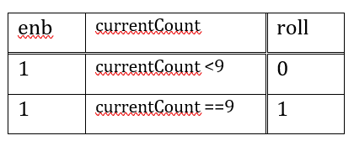
Mod 10 Counter
When enabled, counts up from 0 to 9 and then back to 0.
When it counts up from 9 to 0, we say that it rolls over.
A roll over is accompanied by assertion of an output called roll.
Notes:
Replace <System> with the name of the

Slide 4
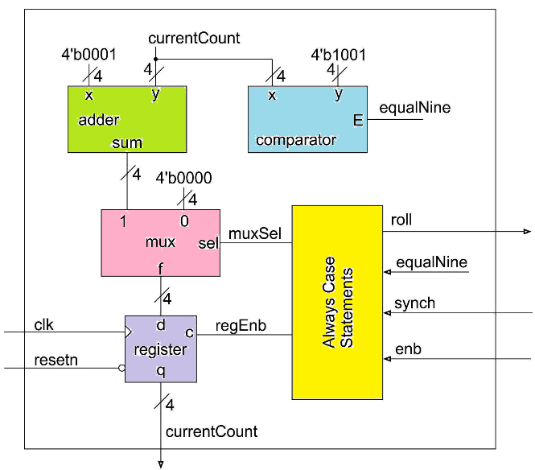
System architecture
You have been provided with the building blocks shown here.
You will wire them and need to define the logic inside the always/case.
Roll logic is combinational
Notes:
Talk about the input is transformed into the output using the system architecture

Slide 5
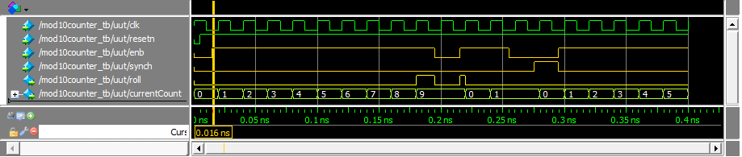
Simulation
Work simulation by hand:
Use Do file to setup traces of your simulation
Run simulation, should equal worked values

Slide 6
Synthesis
No synthesis this week.

Slide 7
Deliverables
Mod10 Counter Verilog
Complete Table 3 and Table 4.
Verilog code for the body of the datapath module.
Timing diagram of the mod10counter in Simulink using the testbench with do file.
Do file.

